Slide 1
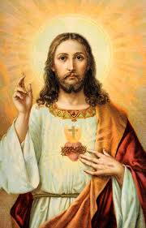
RE
The Gospel

Slide 2
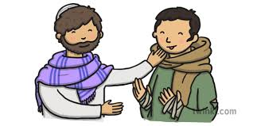
Christian’s thank God for good gifts.
We also thank people for their gifts too. Think of a present you have been given and how you said Thank You
for that gift.

Slide 3
Watch the following video
https://www.youtube.com/watch?v=LzZUDRrKgI8

Slide 4
Look at the following emoticons. Which of the characters from the story had these emotions?

Slide 5
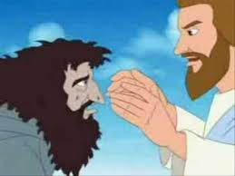
How do you think Jesus would have felt about the leper who came back and the 9 who didn’t?

Slide 6
Think about what you are thankful for and how you can show your thanks.
Draw a picture and perhaps you could write a prayer to say thank you to God .

Slide 7
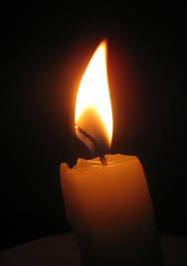
Quiet Reflection time!
Reflect on your day.
What and who are you thankful for today?

