Slide 1
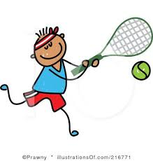
PE at Home
12.1.21
Hi Year 4,
How did you get on with the tennis lesson yesterday?
I hope you enjoyed it and improved your skills. The children in school definitely enjoyed it.
Have you filled in the daily activity form?
There is another video for you to watch today and try the activities yourselves.
Have fun!!

Slide 2
Exercise every day and record what you do
 | Exercise | How long? | How did you feel?
Monday
Tuesday
Wednesday
Thursday
Friday

Slide 3
Here is a challenge for you to try…
https://www.youtube.com/watch?v=D_KaDUryDes&list=PLYGRaluWWTojV3An2WEgsQ4qGFy_91jDL&index=20&t=0s
This video helps you develop co-ordination skills.
Give it a go and have fun.
Don’t forget to fill in the daily activity form.

