Slide 2
Monday 4th January 2021
Happy New Year to you all and welcome back!!!

Slide 3
Busy books – What can you remember?
Write down the factors of 20
Double it
6502
Make a Bar Model for it
Divide it by 2
Write down the prime numbers to 50
Multiply it by 10 and 100

Slide 4
Assembly

Slide 5
Rockstars

Slide 6
Maths – Area and Perimeter
I can use a ruler to measure the perimeter of rectilinear shapes.

Slide 9
1) 1 cm = _____ mm
2) 75 mm = _____ cm
3) How many sides does a quadrilateral have?
4) How many pairs of equal sides does a rectangle have?

Slide 10
10
1) 1 cm = _____ mm
2) 75 mm = _____ cm
3) How many sides does a quadrilateral have?
4) How many pairs of equal sides does a rectangle have?
7.5
4
2 pairs

Slide 12
32 mm
or 3.2 cm
3 cm
2 mm
30 mm
1 cm = 10 mm

Slide 13
Have a think
Is this line 6 cm long?
How long is the line? Give your answer in millimetres.
45 mm

Slide 14
Have a think
6 cm or 60 mm
Is the line equal to, greater than or less than 30 mm?
Greater than

Slide 15
Have a go at questions 1 - 3 on the worksheet

Slide 16
Perimeter $=$ the length around a closed 2D shape
5 cm
9 cm
9 cm
5 cm
5 cm $+$ 9 cm $+$ 5 cm $+$ 9 cm $=$ 28 cm
9 cm + 5 cm =
14 cm
14 cm × 2 =
28 cm

Slide 17
Perimeter $=$ the length around a closed 2D shape
Have a think
Do we need to measure all the sides to find the perimeter?

Slide 18
Perimeter $=$ the length around a closed 2D shape
4.5 cm
5 cm
Complete the shape so its perimeter is 21 cm
3 cm
3.9 cm
0.6 cm
Have a think
What would you do first to complete the task?
5 cm + 4.5 cm + 3.9 cm + 3 cm + 0.6 cm =
5 cm + 4.5 cm + 3.9 cm + 0.6 cm + 3 cm =
17 cm
21 cm $−$ 17 cm =
4 cm
4.5 cm

Slide 19
Have a go at questions 4 - 8 on the worksheet

Slide 20
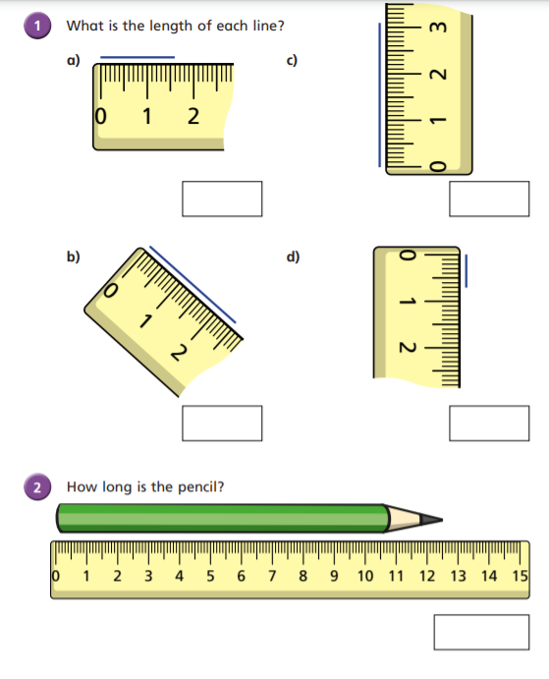
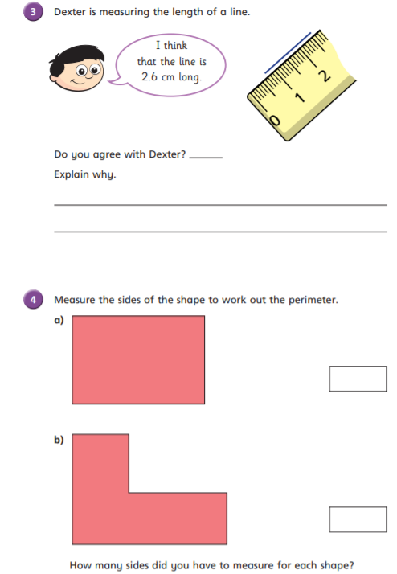

Slide 21
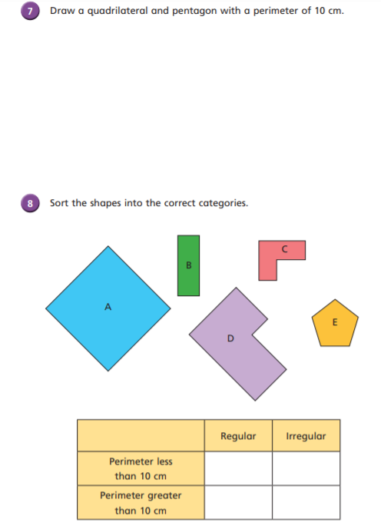
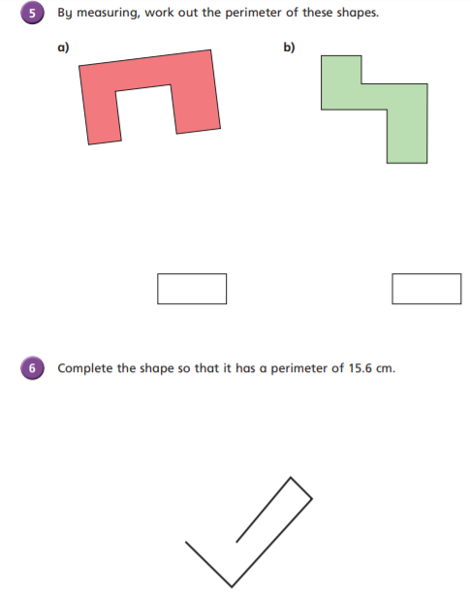

Slide 22
Plenary

Slide 23
Break

Slide 24
English – Initiation I can use evidence from the text to make predictions and inferences.

Slide 25
I predict that…
I predict that this story is about… because it says…
I think that the genre of this book is… because…
I predict that the main characters are… because…
I predict I will like/dislike this book because…
It says “…” so I infer that…

Slide 26
Important Information/ thoughts and feelings…
I think I will like/dislike this because…
Main characters
Setting(s)
Events
Era
Genre
Thoughts and feelings
I think that the main characters will do … and then …

Slide 27
Our new text
What do you see?
What have you read?
Who has been mentioned - Characters?
Where is it set?
When is it set?
Always provide evidence for your predictions

Slide 28
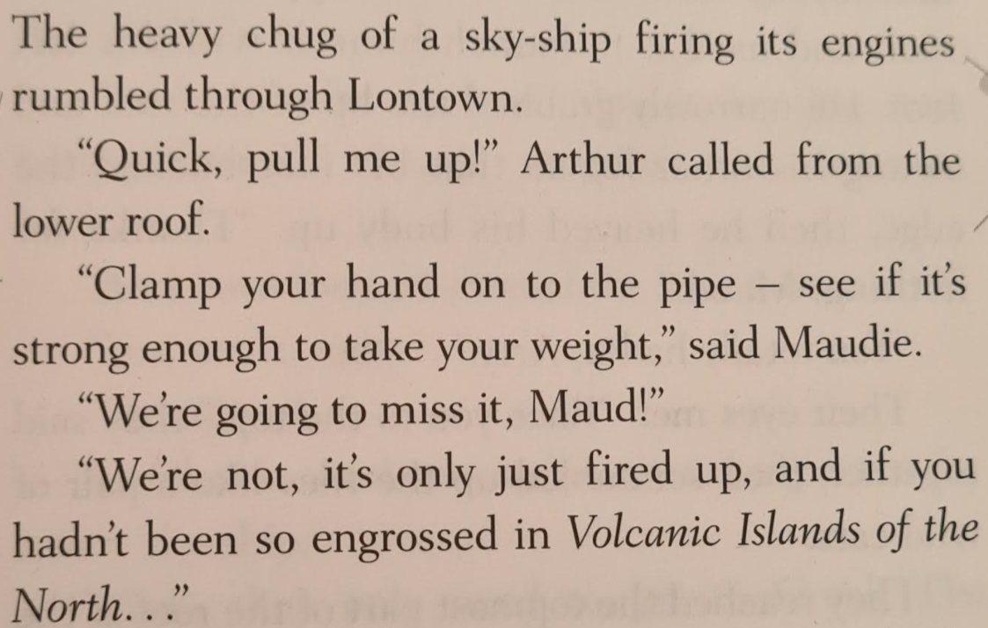
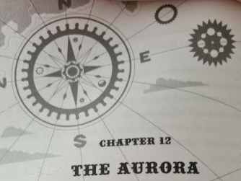
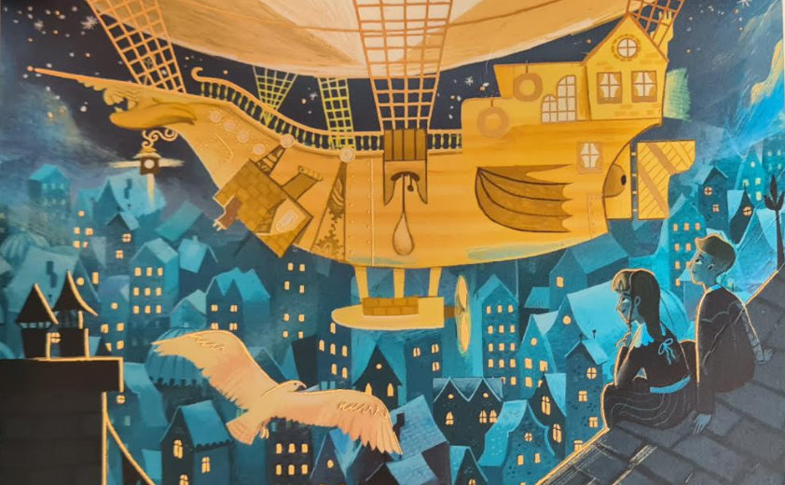
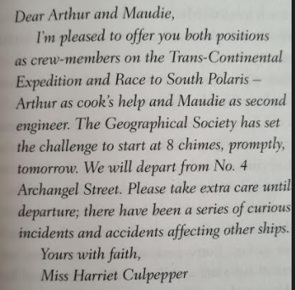
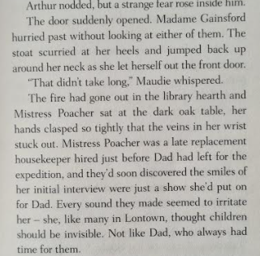
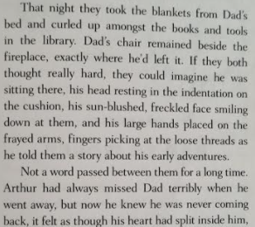
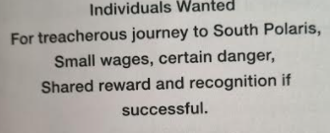
Extracts

Slide 29
What are your thoughts?

Slide 30
In your books… use evidence from the text to record the following:
Predictions
Likes and Dislikes
Questions
Important Information
Genre

Slide 31
Lunch

Slide 32
R.E

Slide 33
R.E

Slide 34
Hometime

