Slide 1
Good Morning Year 2 children who are isolating! I hope you have had a wonderful Christmas break!

Slide 2
04.1.21
2021
How many tens are in my number?
How many ones are in my number?
3) Write the number in words.
4) What will the year be in 30 years time?
5) What was the year 10 years ago?
6) What will the year be in 100 years time?
7) What number would double the year be?
8) What number would half the year be?
9) Arthur was born 3 years ago. How old will he be in 2022?
If I was 16 in the year 2000, how old will I be in 2021?
Can you write a word problem for your friend to solve using 2021?

Slide 3
New talk partners
Can you write a list of rules which are important to work well with your talk partner?
Remind yourself of how you can show respect to yourself and others in school.

Slide 4
Happy New Year!
Did you do anything to celebrate New Year with your family? It was a little different this year!

Slide 6
To understand when, why and how New Year is celebrated.

Slide 7
New Year’s Eve
New Year’s Eve is celebrated on December 31st, the last day of the calendar year.
People enjoy getting together with family or friends and counting down the hours, minutes and seconds to the start of a brand
new year. You might even be allowed to stay up extra late!
In London, Big Ben chimes to tell us when the new year has arrived, then a huge firework display takes place on the banks of the River Thames.

Slide 8
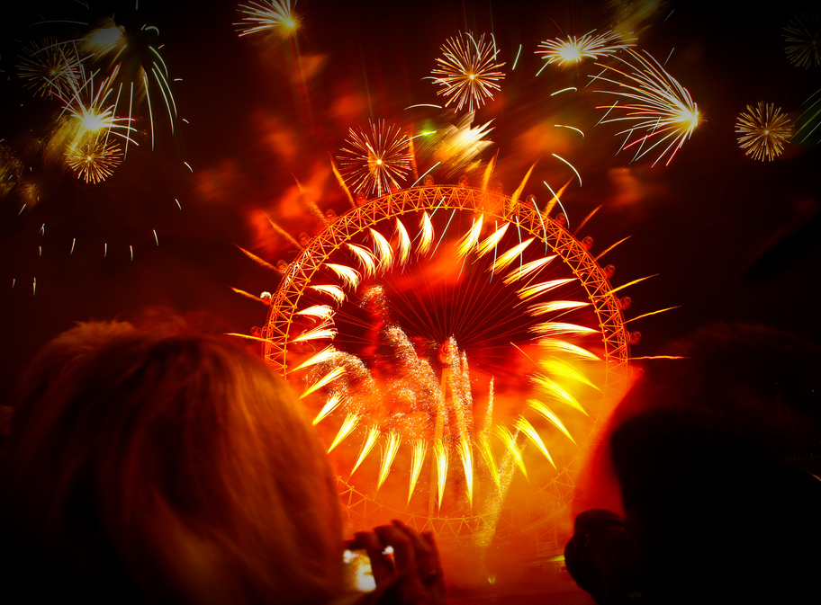
Photos courtesy of Natesh Ramasamy (@ flickr.com) - granted under creative commons licence - attribution

Slide 9
Welcoming a New Year
You might hear people singing ‘Auld Lang Syne’ to welcome in the new year. This is a very old poem written by a famous Scottish poet called Robert Burns. What do you think it is about?
Should auld acquaintance be forgot,
And never brought to mind?
Should auld acquaintance be forgot,
And auld lang syne.
Chorus
For auld lang syne, my jo,
For auld lang syne,
We'll tak a cup o' kindness yet,
For auld lang syne.

Slide 10
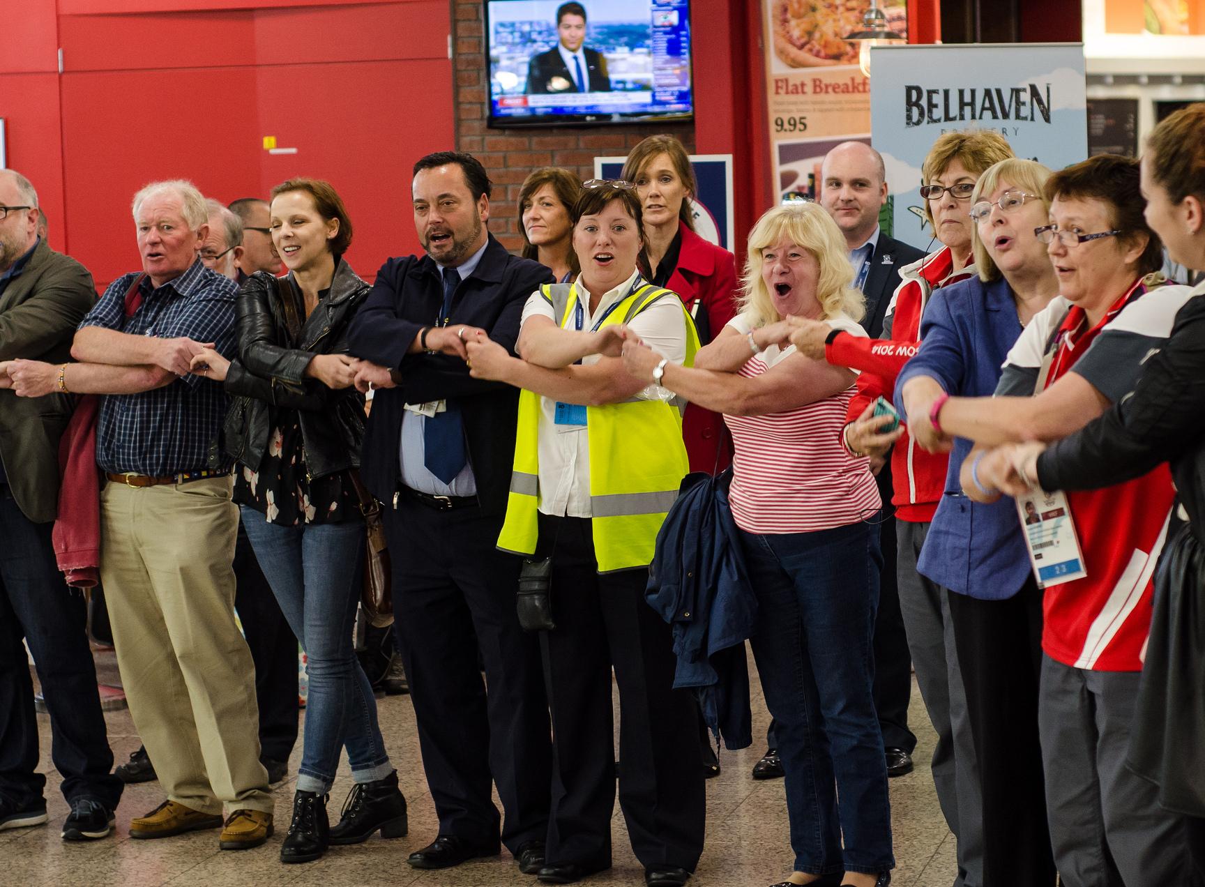
Photos courtesy of Alex Slaven Photography (@ flickr.com) - granted under creative commons licence - attribution

Slide 11
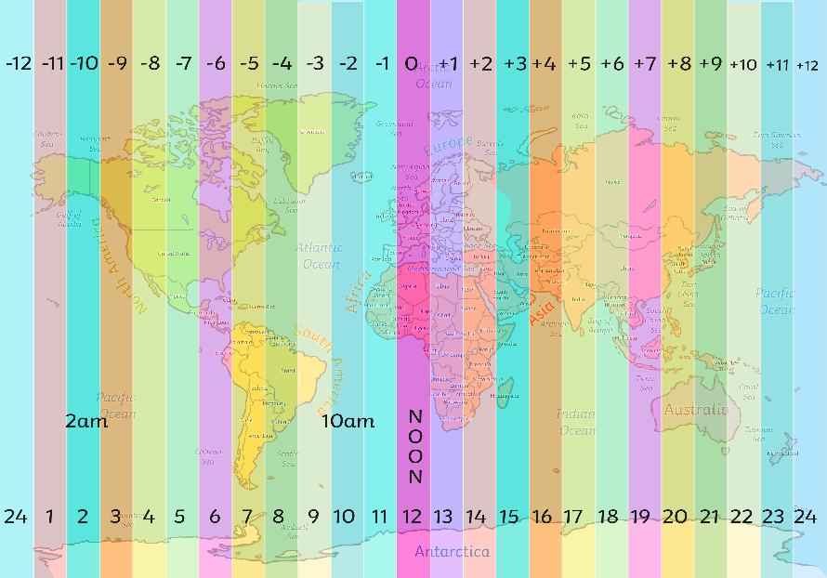
Different Times to Celebrate
Not every place in the world welcomes in the new year at exactly the same time because different places are in different time zones.
Kiritimati, Christmas Island and Kiribati are some of the first places to celebrate with Honolulu, Hawaii being one of the last.

Slide 12
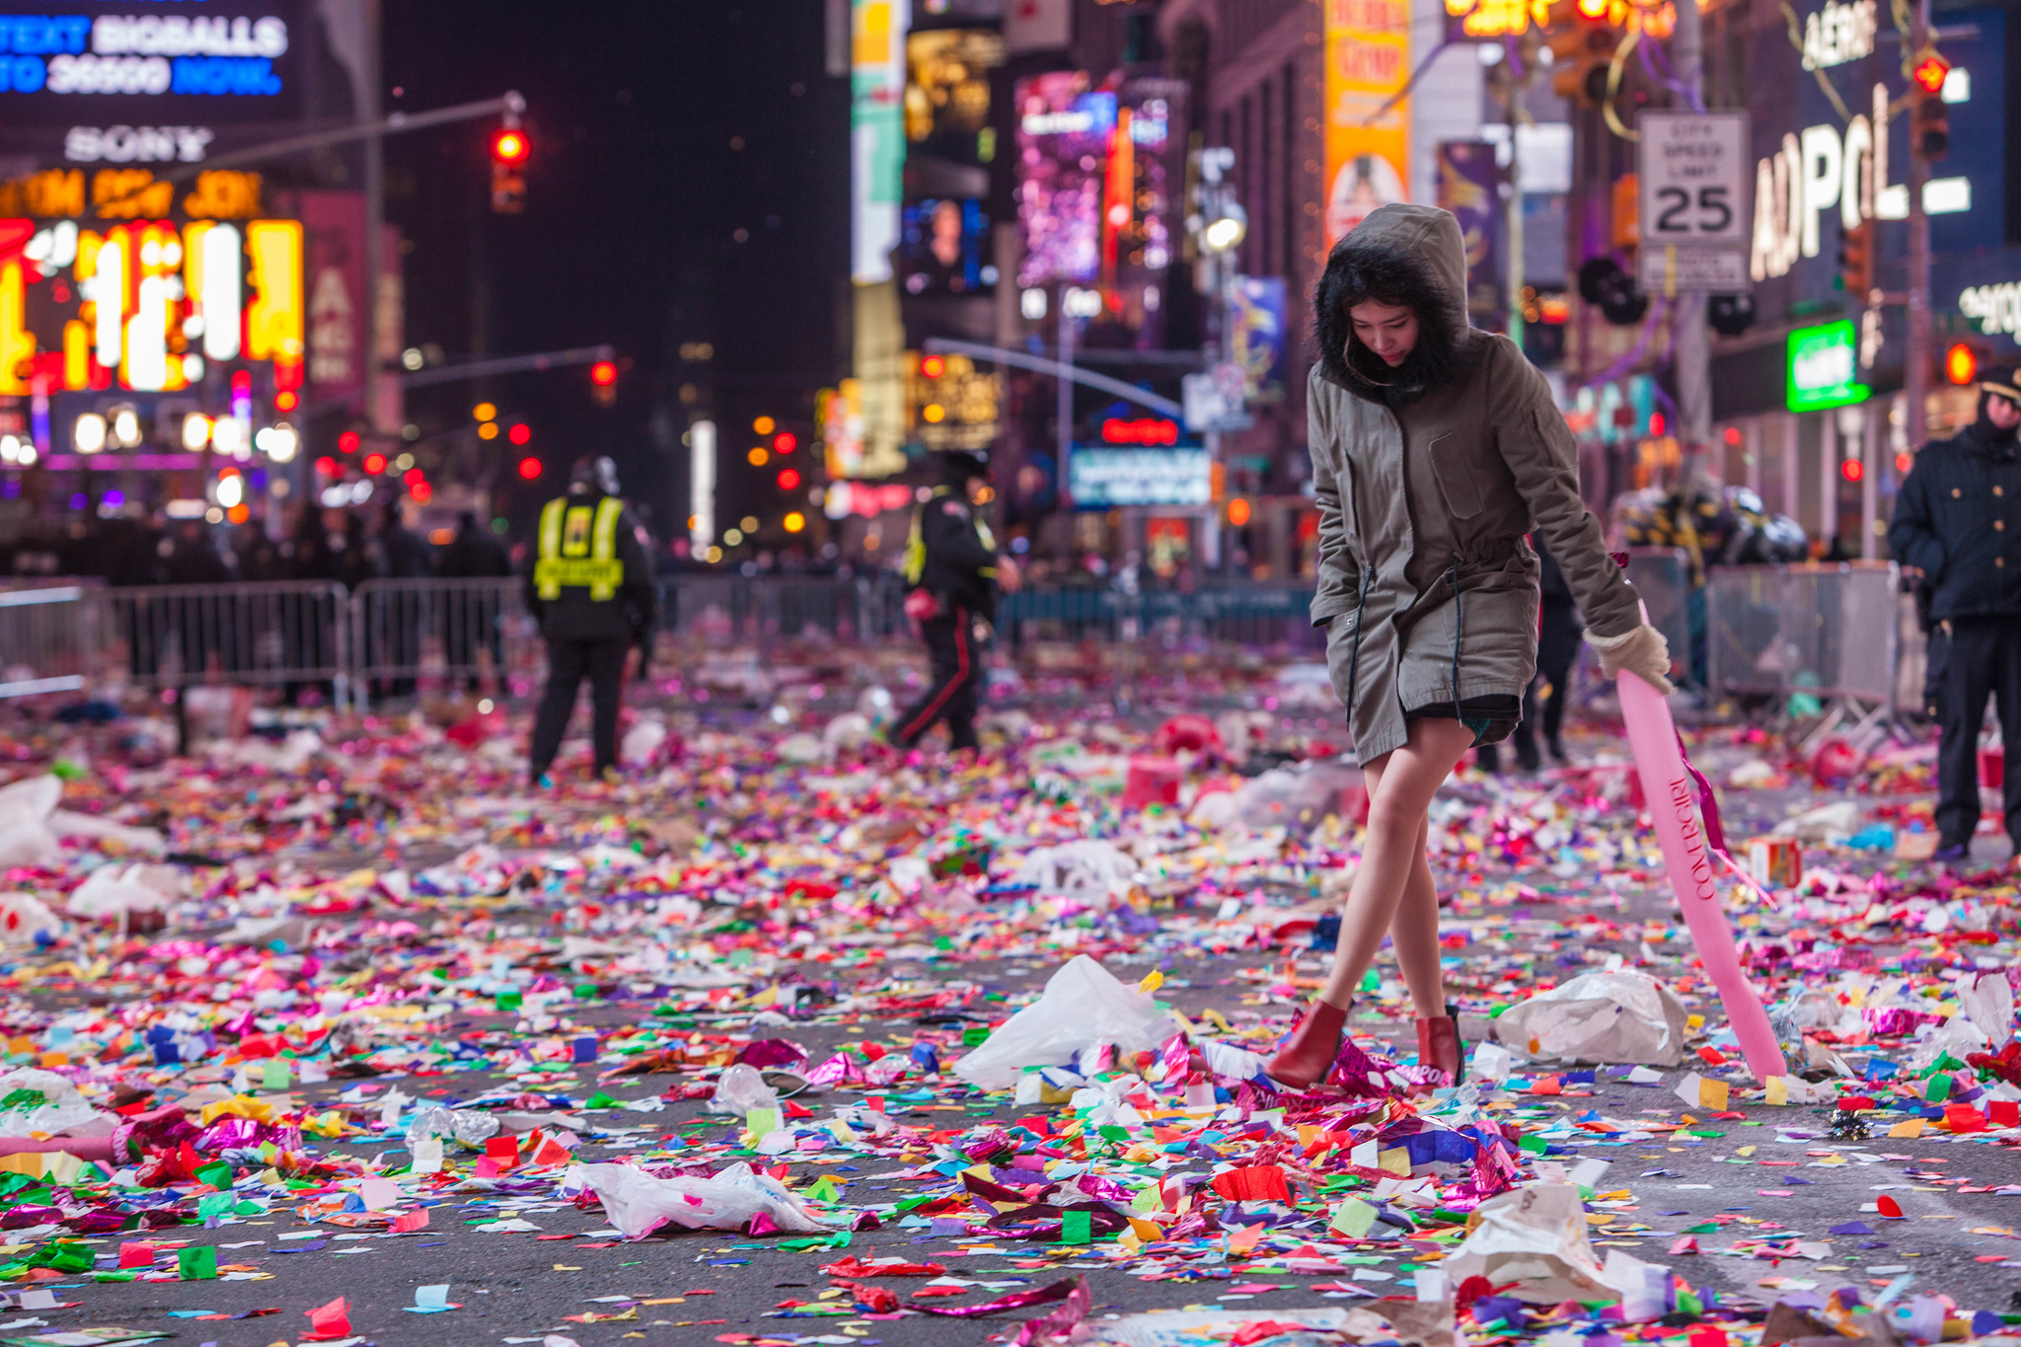
New York
Photos courtesy of Anthony Quintano (@ flickr.com) - granted under creative commons licence - attribution

Slide 13
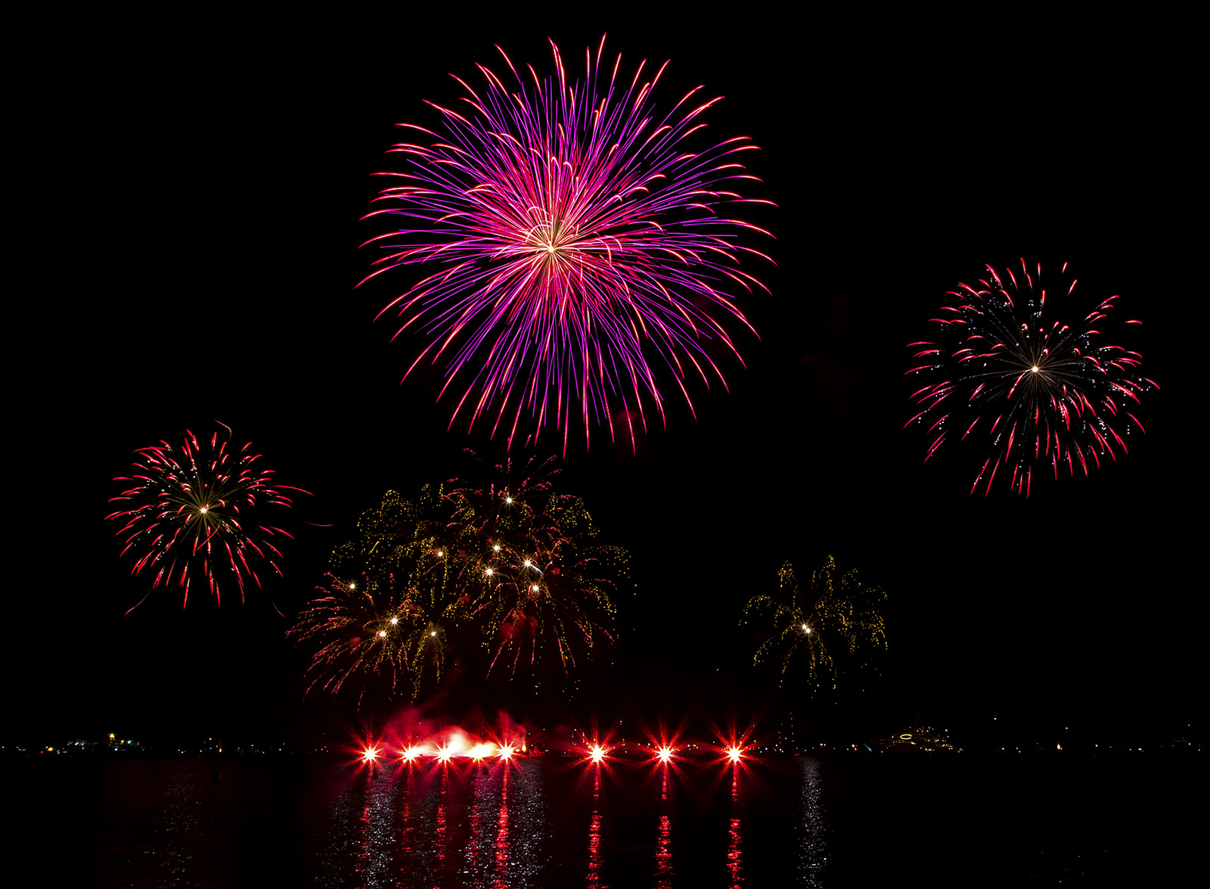
China
Photos courtesy of liquidphotosymail.com (@ flickr.com) - granted under creative commons licence - attribution

Slide 14
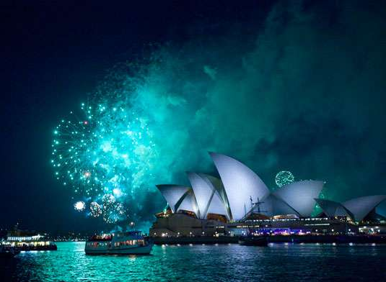
Australia
Photos courtesy of l MandyHallMedia (@ flickr.com) - granted under creative commons licence - attribution

Slide 15
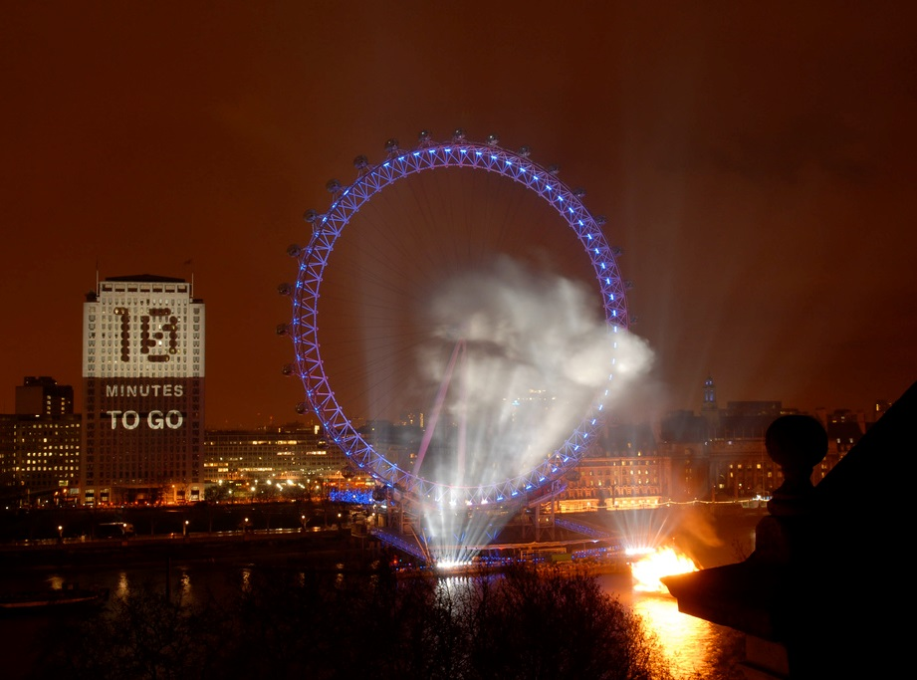
London
Photos courtesy of jtlondon (@ flickr.com) - granted under creative commons licence - attribution

Slide 16
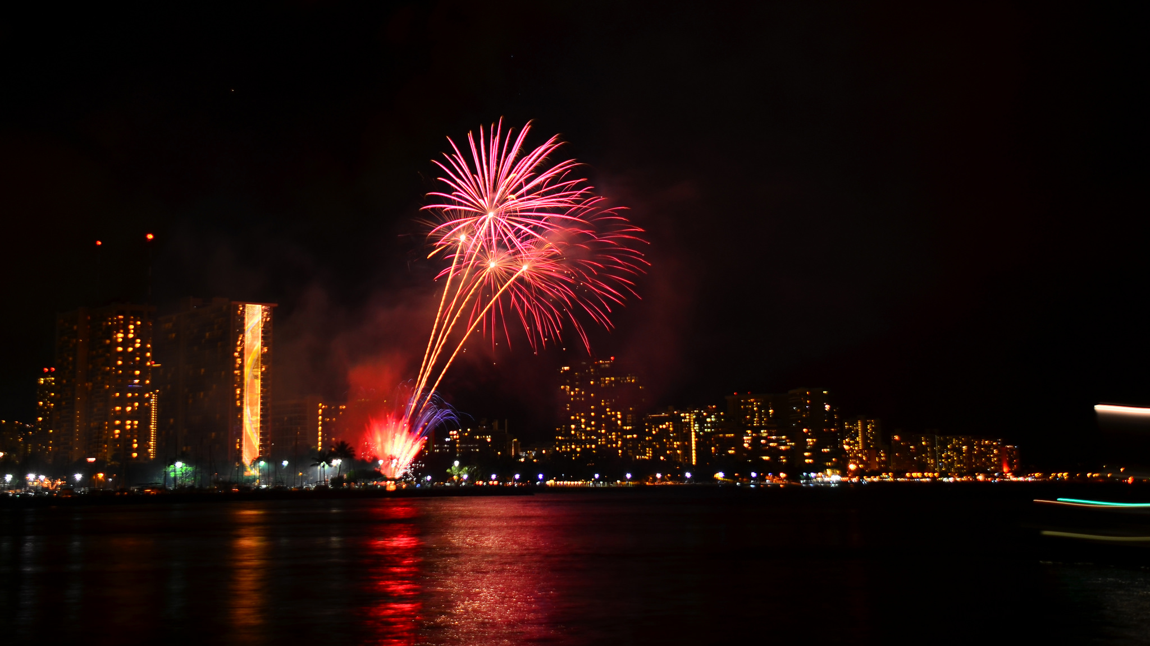
Hawaii
Photos courtesy of Edmund Garman (@ flickr.com) - granted under creative commons licence - attribution

Slide 17
Making a New Year Resolution
New Year’s Day is on January 1st and is often seen as a fresh start.
Many people like to make new year resolutions which are personal goals that they aim to work on throughout the year.
Anyone can make a new year resolution and some make more than one!
Some examples: Getting homework in on time, keeping your bedroom tidy, doing more exercise or eating more healthily.
Have you made any? What are they?

Slide 18
There is a New Years worksheet to record your thoughts on the website.

Slide 19
Maths
The focus of today’s maths lesson is to deepen our understanding of arrays and what they represent for multiplication.
This will help when solving problems involving multiplication and division.

Slide 20
Stem sentences with pictures
There are ____equal groups of________.
For example this picture shows:
There are 4 equal groups of 3 tennis balls.

Slide 21
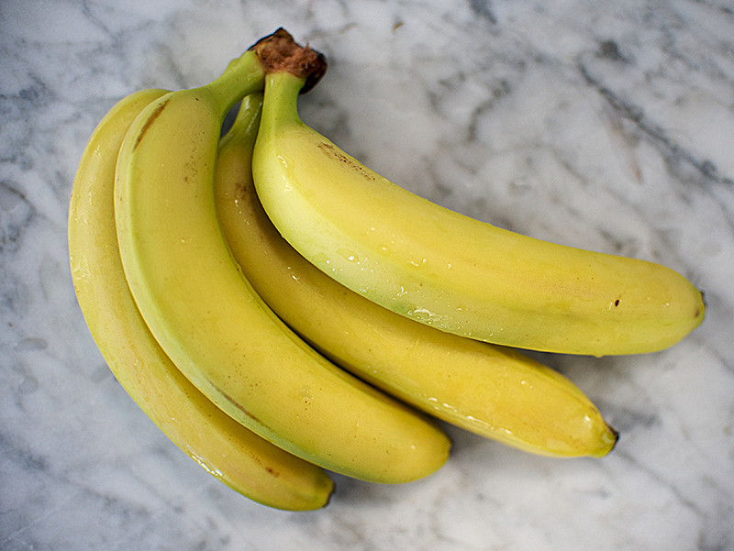
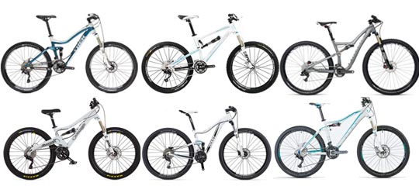
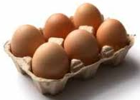
Write sentences for the following pictures.
1.
2.
3.
4.
Can you write 2 more sentences about groups of objects you can find around the classroom or house?

Slide 22
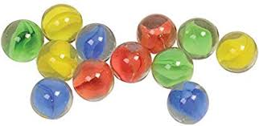
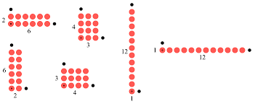
Making arrays and writing calculations
Look at the picture of marbles. How can we arrange these so that they’re easier to count?
We can make any of these arrays. Do you agree?
Think about what is the same and what is different about all these picture?
We can write sentences about each of these ie:
There are 6 equal groups of 2 marbles.
2+2+2+2+2+2
Six groups of two marbles is the same as 6 x 2.

Slide 23
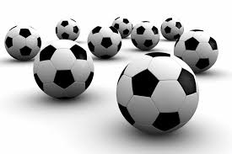
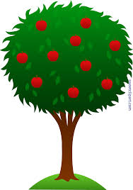
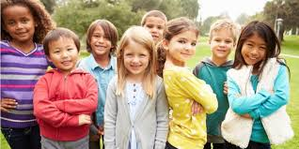
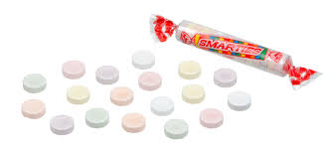
With each of the following pictures, arrange them into arrays (is there more than 1 possible way?) Write the sentence along with the corresponding addition and multiplication sentences (as on previous slide)
3.
4.
1.
2.

Slide 24
Now try these reasoning and problem solving questions…

Slide 27
Handwriting
The handwriting sheets for this week are on the website. There are 6 sheets on one document and you can choose one to do each day. Remember to clearly show your tall letters and low letters and ensure all the other letters are the same size.

Slide 28
Kings and Queens!
I am very excited about our new topic Kings and Queens.
I wonder what you already know about the British Monarchy or Kings and Queens from the past. Can you name any?
Is there anything you would like to find out about during our topic?
Create a spider diagram to record some of your ideas for the topic ahead. It could include things you would like to make or do as well as find out about.

Slide 29
Kings and Queens!
You could not be a King or Queen without a royal crown.
Use some bits from home to make a crown fit for you to wear as King or Queen! I would love to see a picture of you wearing your crown!

Slide 30
Reading - Don’t forget to read daily and record in your yellow reading diary.
Spellings – an email was sent with this half term’s spellings, before Christmas.
I look forward to seeing the work you have achieved today. Send any work, photos, comments or questions to:
year2home@heddon-school.co.uk

