Slide 1
Monday 1st February 2021

Slide 2
Morning Job – Spellings and Mental Maths
Multiply by 10
Multiply by 14
Divide by 5
85
Multiply by 85
Add 4580
Take away 78

Slide 3
Rockstars

Slide 4
Maths
I can divide 2 digits by 1 digit.

Slide 5
Watch…
https://vimeo.com/488870720

Slide 8
1) 40 ÷ 4 =
2) 12 ÷ 4 =
3) 52 ÷ 4 =
4) 84 ÷ 7 =

Slide 9
1) 40 ÷ 4 =
2) 12 ÷ 4 =
3) 52 ÷ 4 =
4) 84 ÷ 7 =
10
3
13
12

Slide 11
39 ÷ 3 =

Slide 12
39 ÷ 3 =
13
Tens | Ones

Slide 13
45 ÷ 3 =
15
Tens | Ones
45
30
15

Slide 14
Have a go at questions 1 - 4 on the worksheet

Slide 15
51 ÷ 3 =
17
51
50
30
1
21
÷ 3
÷ 3
10
7
10 + 7 =
17

Slide 16
Have a think
1) 64 ÷ 4 =
16
2) 75 ÷ 5 =
15
64
75
40
24
50
25
÷ 4
÷ 4
÷ 5
÷ 5
10
6
10
5

Slide 17
There are 60 doughnuts. A box holds 4 doughnuts.
How many full boxes of doughnuts will there be?
15 full boxes
Tens | Ones
60 ÷ 4 =
15
60
40
20

Slide 18
Have a go at questions 5 - 9 on the worksheet

Slide 19
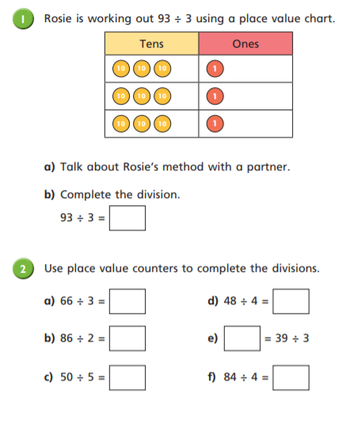
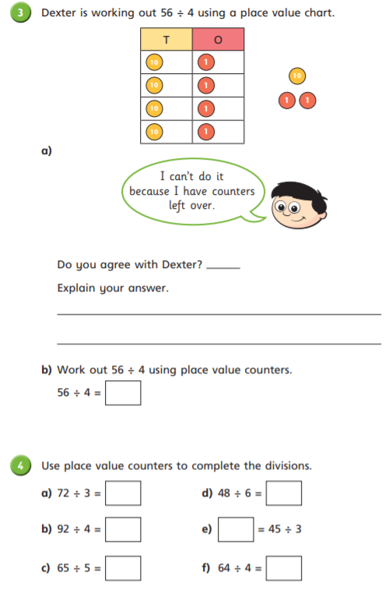

Slide 20
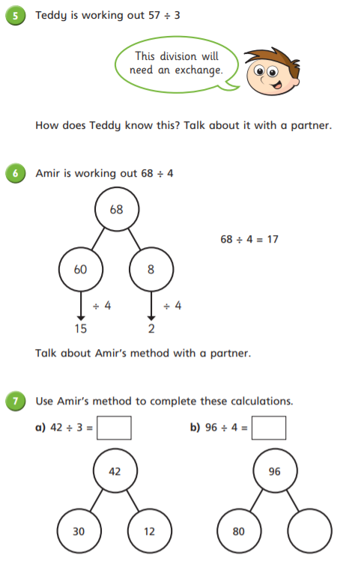
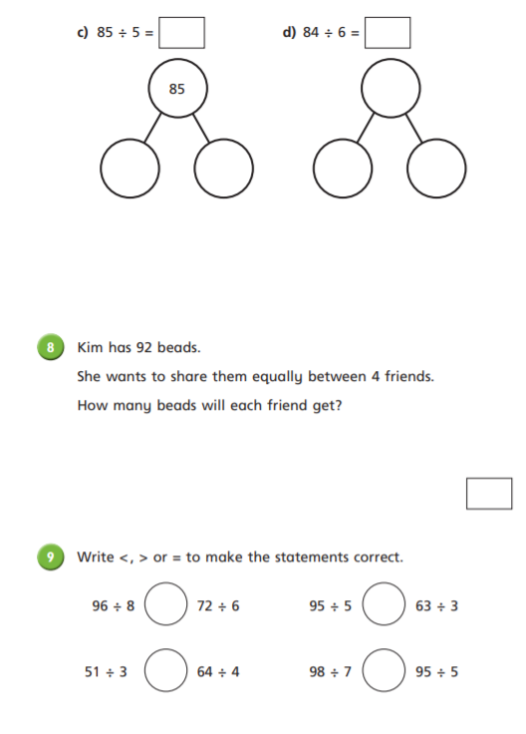

Slide 21
Break

Slide 22
English
I can identify the features of a Newspaper Article.

Slide 23
Brightstorm Chapter 21 – Grave News

Slide 24
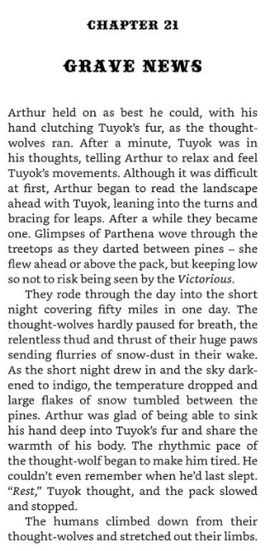

Slide 25
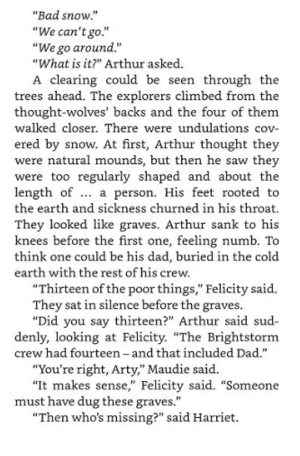

Slide 26
Activity
This week you are going to be creating a Newspaper Article. This will be based on Brightstorm, over the next few days and chapters, write down some key events and happenings that you could include.
When you are at home with an adult, have a look at the front page of a Newspaper, write down what you see and anything that stands out!

Slide 28
A newspaper report needs to…
Be about an interesting event;
Capture the reader’s attention;
Present factual information;
Be succinct and to the point;

Slide 29
The Essentials First
When the reader reads a newspaper report, they should be given the essential information first, so that they can decide if they wish to read more.
It is important that newspaper reports have the most important information coming first. This is called front-loading.

Slide 30
Structure of a newspaper report
Headline and byline
Lead
Body
Tail

Slide 31
Headline
Headline and byline
For a good headline, you need to:
Catch the reader’s attention so they want to read the rest of the report;
Sum up the story in a few words;
Use powerful and interesting language;
Write in the present tense – even if the report is about an event that has already happened;
Include alliteration or wit at times.
Lead
Body
Tail

Slide 32
Byline
Headline and byline
Lead
For a good byline, you need:
The writer’s name;
The writer’s speciality (for example, Sports reporter, Food correspondent, Crime editor, Deputy politic editor, Senior fashion reporter);
A link to the writer’s Twitter account (for example, @dgoodman).
Body
Tail

Slide 33
Lead
Headline and byline
For a good lead paragraph, you need to;
Make the paragraph short and snappy so that it briefly explains what has happened;
Ensure that, even if the reader stopped reading at this point, they would still know roughly what happened;
Use past tense in most cases;
Make sure the first paragraph answers as many of these six questions as you can –
Who? What? Where? Why? When? How?
Lead
Body
Tail

Slide 34
Body
For a good body section, you need to:
Add more information and detail to your lead paragraph;
Include background information, evidence, facts and quotes from people involved in or connected to the event/story;
Continue to write in order of importance, putting the most important information in the first few paragraphs of the body section.
Headline and byline
Lead
Body
Having quotes from witnesses or experts
will make your report more credible and interesting.
Tail
Be sure to use correct punctuation for quotes!

Slide 35
Tail
For a good tail section:
Give the reader the opportunity to gain additional information if they are particularly interested in the topic of the news report;
Include links to previous news reports or useful websites;
Include a final quote from a witness or expert that helps to sum up the story or that could hint at what might happen next.
Headline and byline
Lead
This ‘Tail’ information can be useful but is not always needed. It tends to be the least important information in the report.
Body
Tail

Slide 36
Example
headline
School Children Raise Funds for Local Charity
Frances Trackall, Education reporter
byline
A small group of Year 5 students from Arkwood Primary School have created a brilliant plan to raise money for a local charity that assists people in the community. Following a visit to the school from a charity representative, the students set out to create a way of raising much needed funds.
The students presented the fundraising idea to school principal Mrs Justine Knight, who saw great potential in the plan to sell produce from the school’s vegetable garden to local restaurants and, in turn, raise money for the local charity. She stated that ‘the children have displayed a true sense of community in their fundraising plan.’ Following a meeting with teachers, it is hoped that the students can begin to implement the four phase plan. ‘The school would support students wholly in the fund raising venture,’ Mrs Knight added.
The school plans to sell the garden produce to two local restaurants, beginning in early September. For more information on this fundraising plan, visit the Arkwood Primary School website (www.arkwood.sch.com).
lead
body
tail

Slide 37
Get It Right!
For a GREAT newspaper report you need to:
Keep your most important information near the top of the report;
Cut out the less important sections from the bottom of the report if it ends up being too long;
Keep your sentences short and punchy, so that the report is interesting to your reader;
Check your spelling and your facts…and check them again!

Slide 38
Today’s Activity -
Highlight the key features
Headline
Byline
Lead
Body
Tail
Pictures
Captions
What makes this a Newspaper? What particular features does it have?

Slide 39
Lunch

Slide 40
R.E

Slide 41
Can I explain how Christians today help bring justice and freedom?
I am successful if:
I know what Jesus said was the most important commandment;
I can explain how charities like Christian Aid bring justice and freedom;
I have looked at the life of a child to see how they are helped by Christian Aid.

Slide 42
How well do you know the big story of the Bible?
Click and explain what each picture means.

Slide 43
Jesus was asked which commandment was most important?
He said:
Love the Lord your God with all your heart, mind, soul and strength
Love your neighbour as you love yourself.
These are the most important.

Slide 44
This is a challenge to everyone.
Jesus wanted people to love others, to treat them well with fairness - even people that they didn’t know or people who were their enemies!
Christians today try to do what Jesus asked them to do. Some set up charities like Christian Aid.

Slide 45
Christian Aid is a charity which is set up to help people all around the world.
Watch the video (by clicking the picture below) and try and complete the quiz on the sheet.
Notes:
https://youtu.be/I1D-EaItZkw

Slide 46
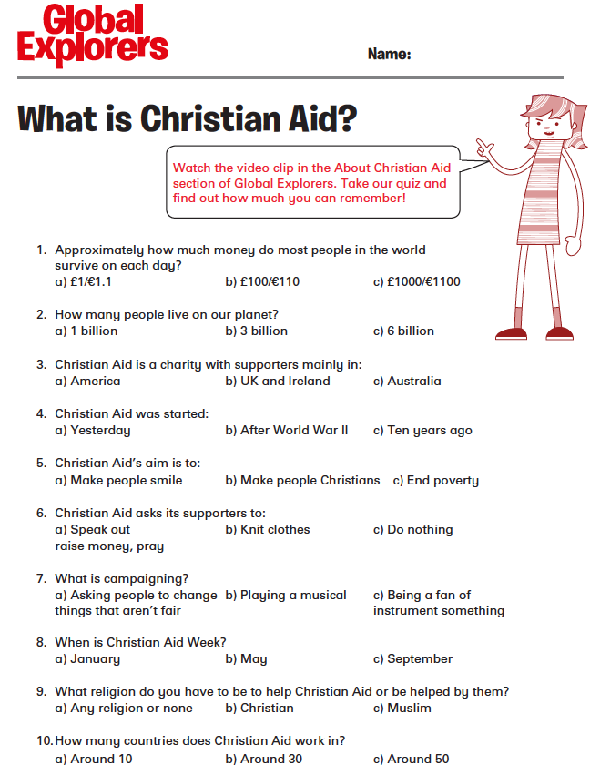
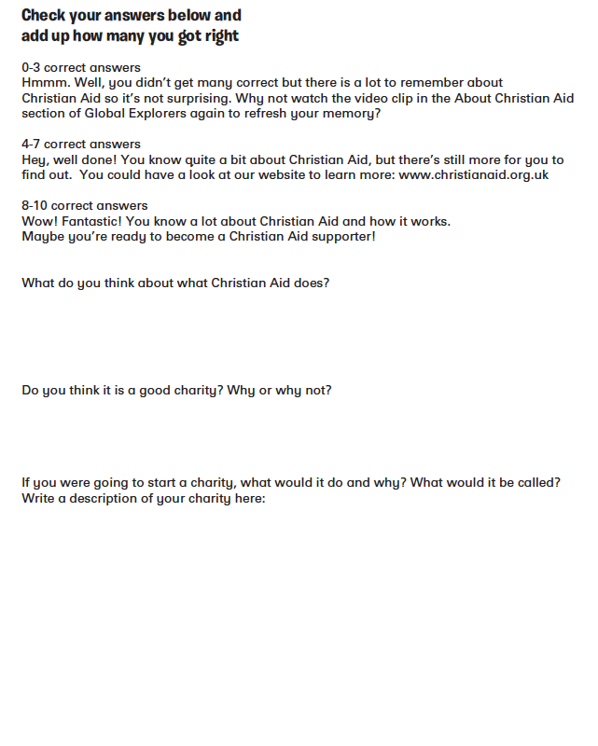

Slide 47
You can must choose ONE story to look at -either Ivana from Bolivia or Edile from Colombia.
Read their story carefully and think about how their lives have been changed through the help of Christian Aid and other charities.
Their stories are on the next slides:

Slide 48
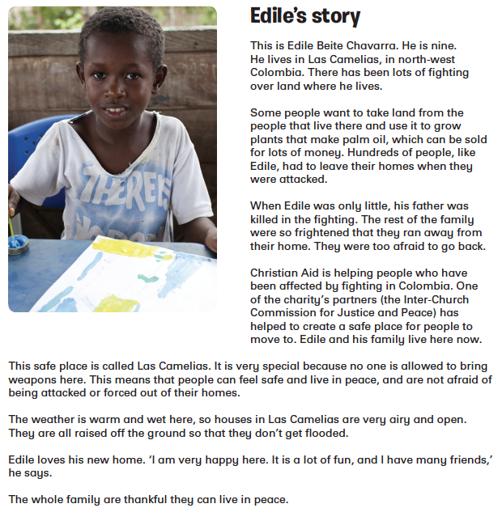
Can you find out some facts about Colombia?
Check out the Global Explorers website: HERE
Check out Edile’s story on video HERE

Slide 49
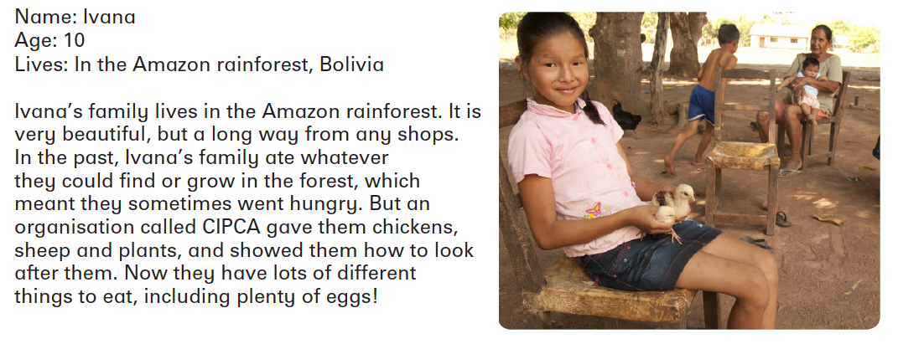
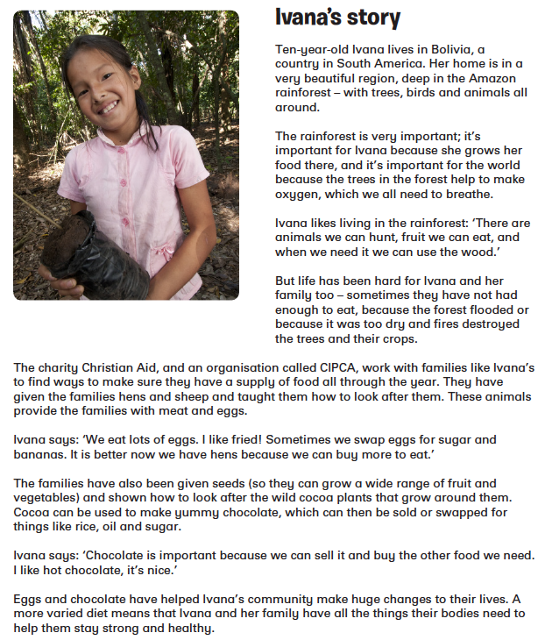
Can you find out some facts about Bolivia?
Check out the Global Explorers website: HERE
Check out Ivana’s story on video - HERE

Slide 50
Once you have read your case study write a letter to persuade Christians to support Christian Aid particularly to support either Edile or Ivana’s community.
You must include:
Information from your case study - what problems did the children have and what was done to solve them;
How the help given fits with the 10 Commandments given to Moses;
How the help given fits with what Jesus said was the most important Commandment.

Slide 51
Can I explain how Christians today help bring justice and freedom?
I am successful if:
I know what Jesus said was the most important commandment;
I can explain how charities like Christian Aid bring justice and freedom;
I have looked at the life of a child to see how they are helped by Christian Aid.

Slide 52
Hometime

