Slide 1
Monday 4th January
04.01.21

Slide 2
What are we learning?
Consolidation of 2, 4 and 8 times tables.

Slide 3
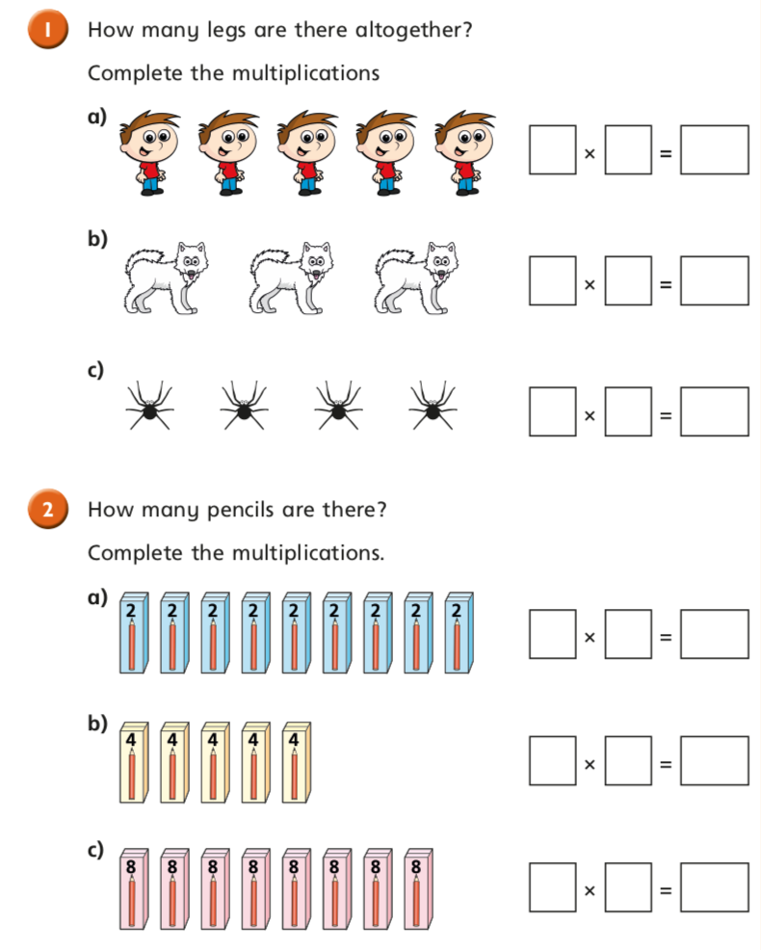

Slide 4
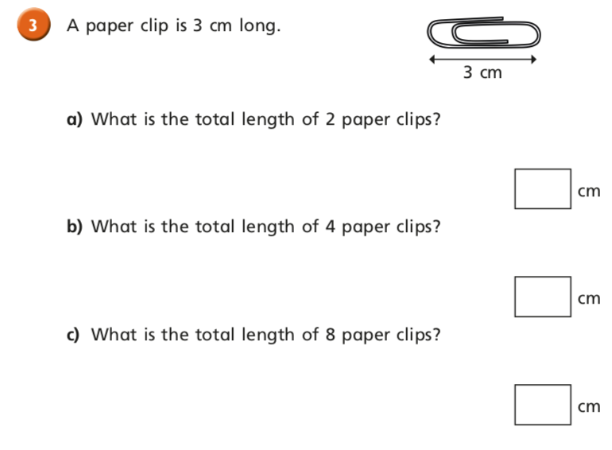

Slide 5
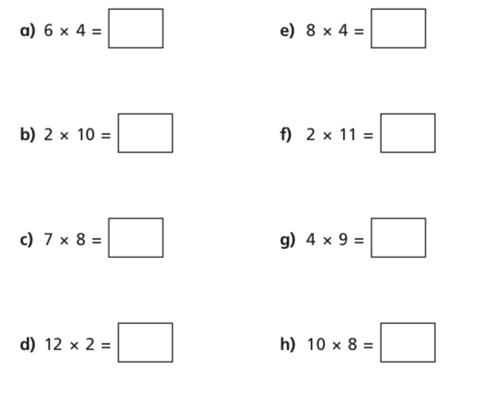

Slide 6
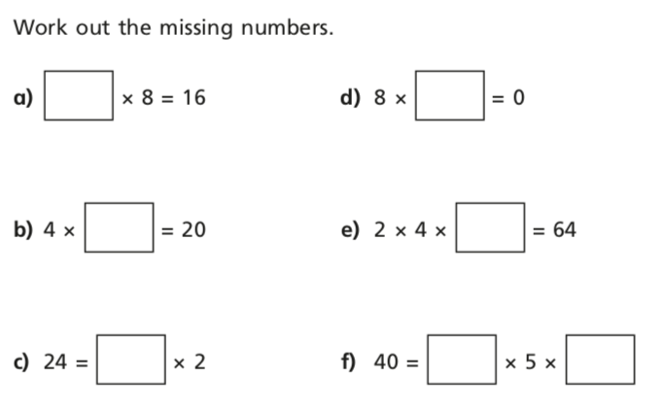

Slide 7
Tuesday 5th January
05.01.21

Slide 10
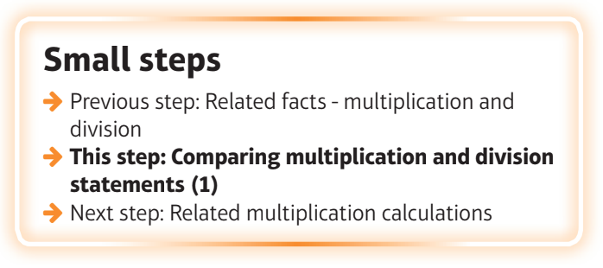
What are we learning?
I can compare multiplication and division statements.

Slide 13
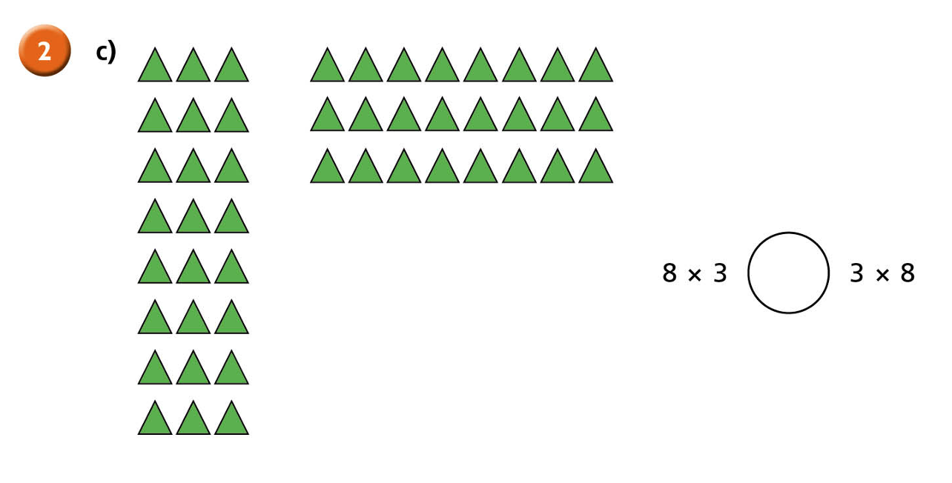

Slide 14
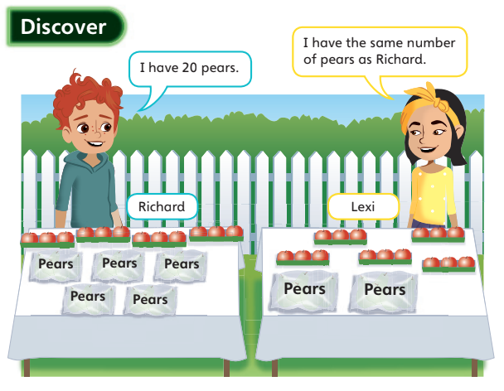
Who has more apples, Richard or Lexi?
If richard gave Lexi 2 apples, who would have more and by how many?
Richard’s bags each have the same number of pears in them.
Each of Lexi’s bags have the same number of pears in them.
Whose bags contain the least number of pears?

Slide 15
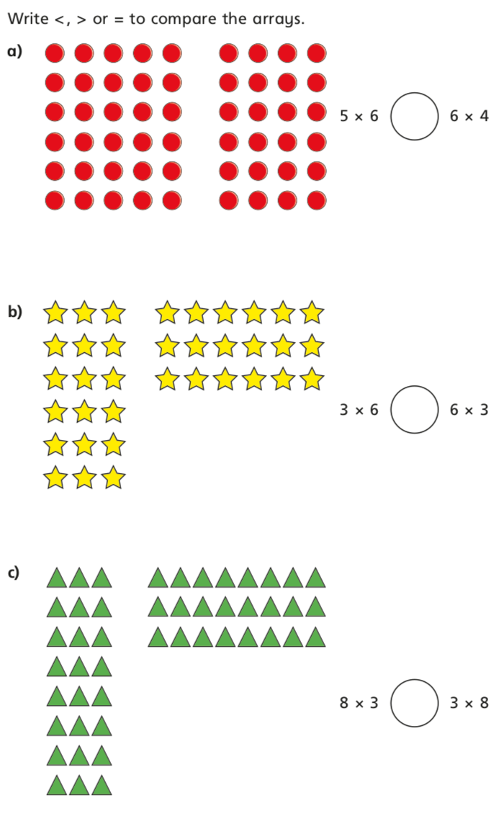

Slide 18
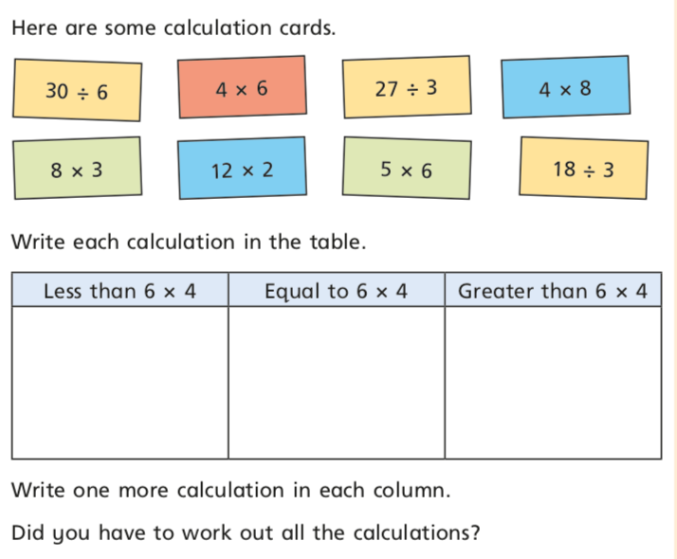

Slide 19
