Slide 1
Monday 25th January
25.01.21

Slide 2
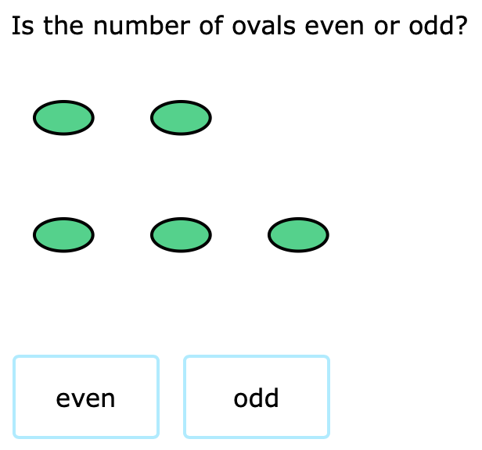
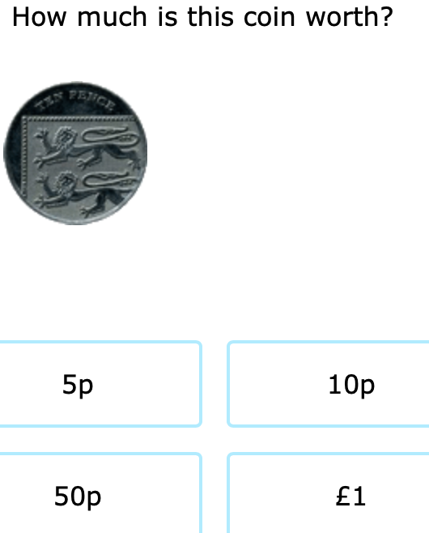
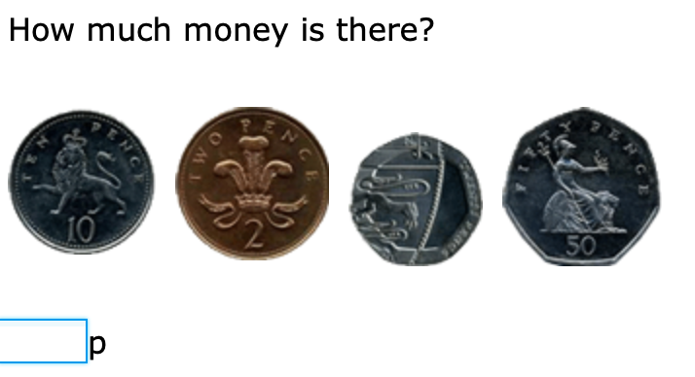
DMM

Slide 4
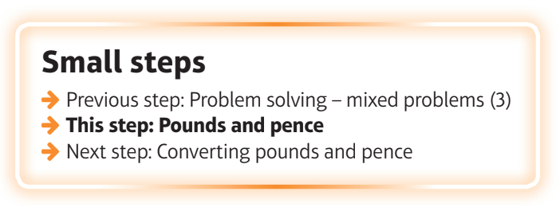
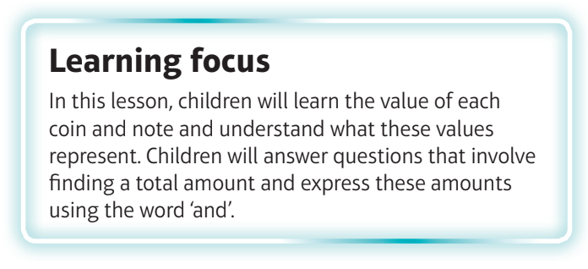
What are we learning?
I can identify the value of each coin and note.

Slide 5
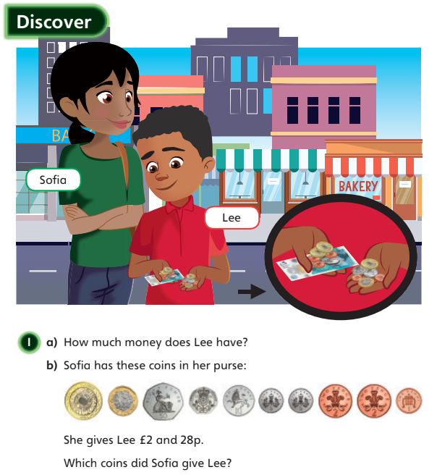

Slide 6
Watch the video
https://vimeo.com/497345587

Slide 8
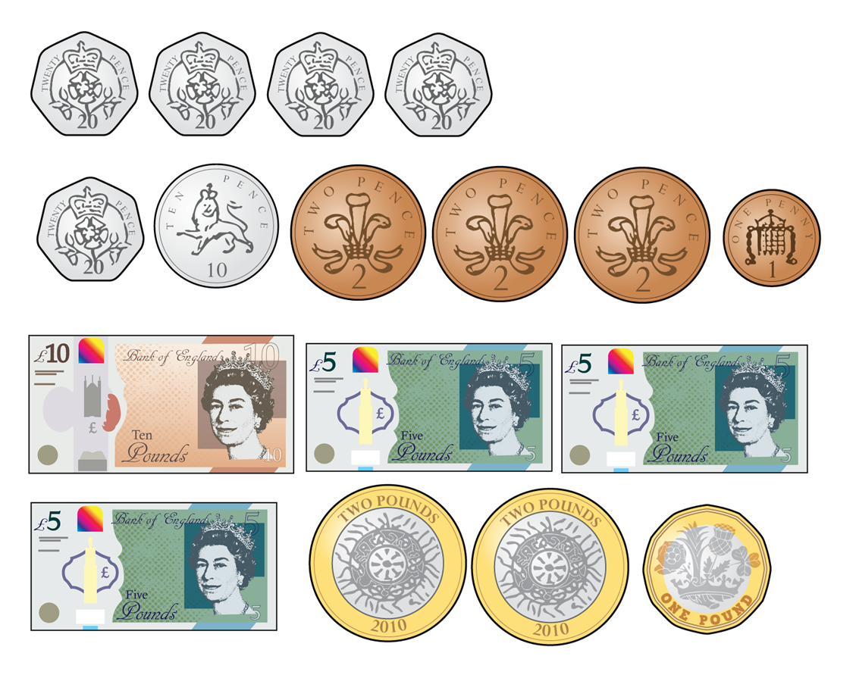
Count the money.
1)
2)
3)
4)

Slide 9
Count the money.
1)
2)
3)
4)
80p
37p
£20
£10

Slide 11
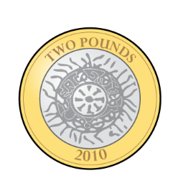
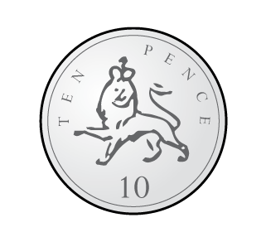
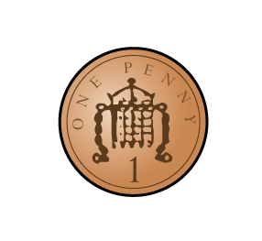
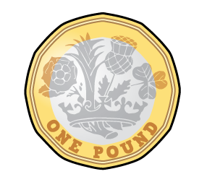
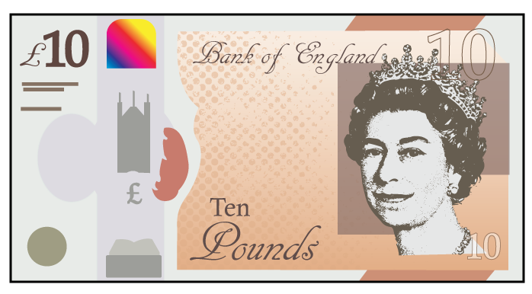
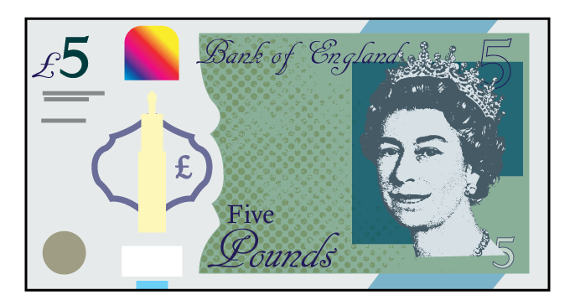
Which of these represent £14?
Have a think

Slide 12
Which of these represent £14?

Slide 13
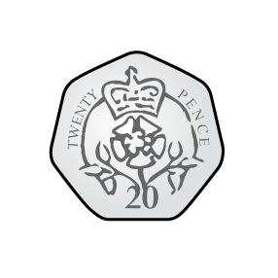
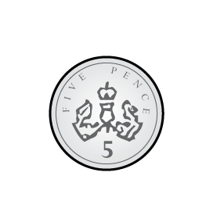
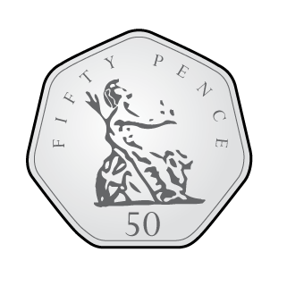
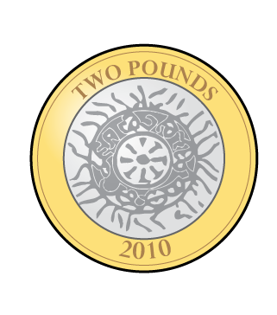
Who has the most money?
Who has the least?
50p
Jack
73p
Amir
£5
Mo
Have a think
Mo has the most money. Jack has the least.

Slide 14
Whitney is making 50p using only silver coins.
There are lots of different ways to do this.
Have a think

Slide 15
Have a go at questions 1 - 4 on the worksheet

Slide 17
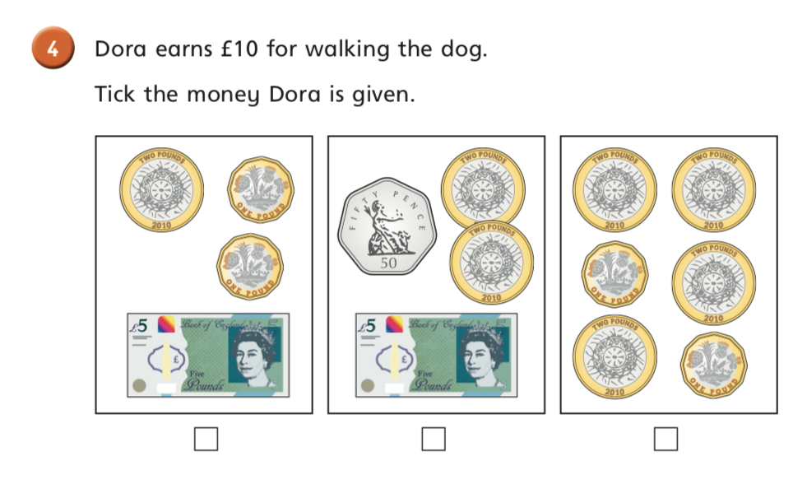

Slide 18
How much does Whitney have?
£2
66p
Whitney has £2 and 66p

Slide 19
How much does Rosie have?
£7
34p
Rosie has £7 and 34p
Have a think

Slide 20
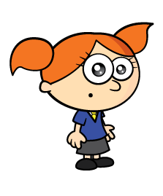
Alex has these coins.
Have a think
50p
$+$ 10p
$+$ 2p
$+$ 1p
$=$ 63p
She drops one of her coins.
How much could she have left?

Slide 21
Alex has these coins.
£1
$+$ 50p
$+$ 10p
$+$ 1p
$=$ £1 and 61p
She drops one of her coins.
How much could she have left?

Slide 22
Alex has these coins.
£1
$+$ 50p
$+$ 2p
$+$ 1p
$=$ £1 and 53p
She drops one of her coins.
How much could she have left?

Slide 23
Alex has these coins.
£1
$+$ 10p
$+$ 2p
$+$ 1p
$=$ £1 and 13p
She drops one of her coins.
How much could she have left?

Slide 24
Alex has these coins.
£1
$+$ 50p
$+$ 10p
$+$ 2p
$=$ £1 and 62p
She drops one of her coins.
How much could she have left?

Slide 25
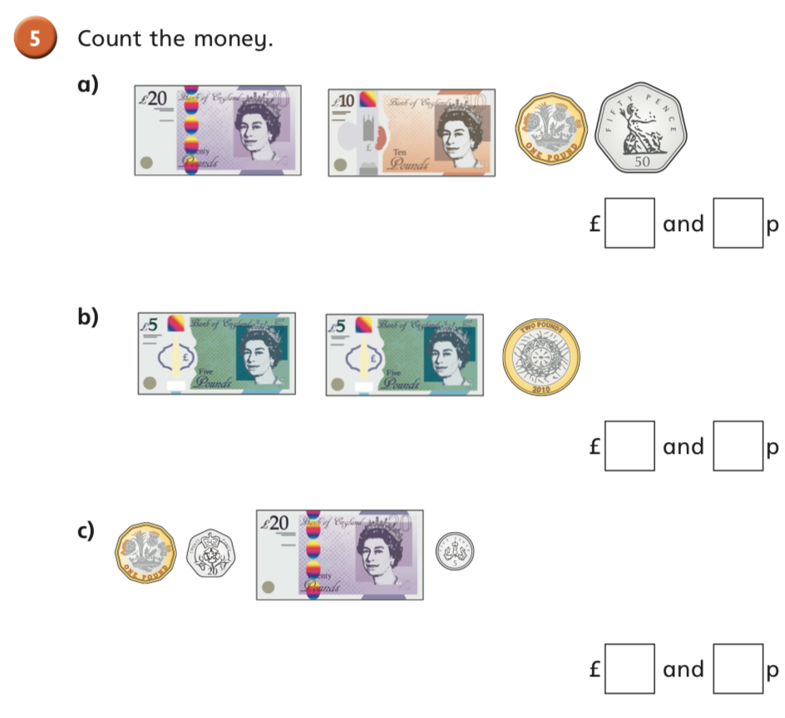
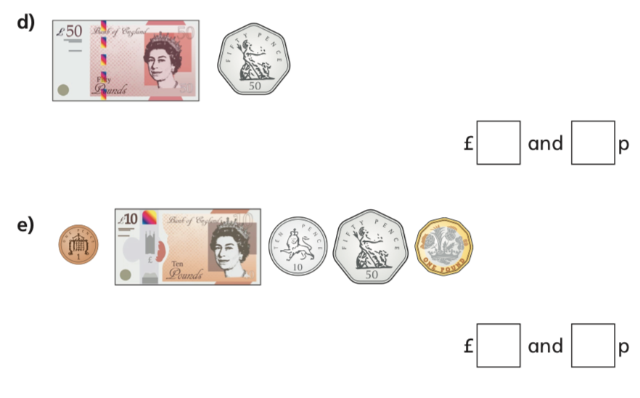

Slide 27
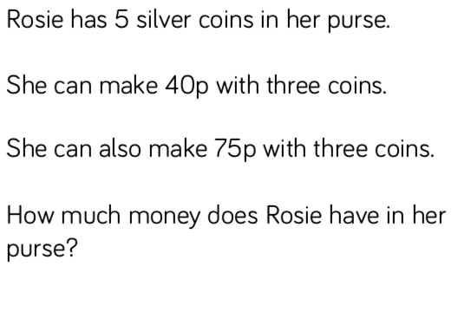
Challenges

