Slide 1
1) 2 × 2 =
2) 40 × 2 =
3) 2 × 300 =
4) 342 × 2 =

Slide 2
1) 2 × 2 =
2) 40 × 2 =
3) 2 × 300 =
4) 342 × 2 =
4
80
600
684

Slide 4
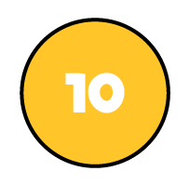
Hundreds | Tens | Ones
243
4 times
243 × 4 =
9
7
2

Slide 5
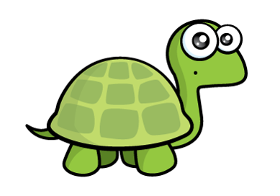
Have a think
Hundreds | Tens | Ones
150 × 3 =
450
I think the answer is 45

Slide 6
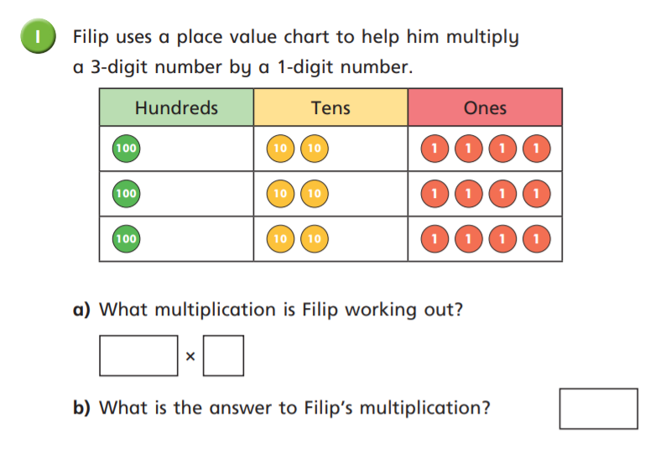
Try this on your own. Write your answers on some paper.

Slide 7
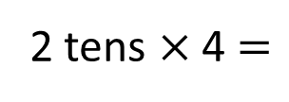
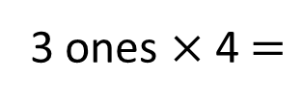
123 × 4 =
492
H | T | O
1 | 2 | 3
 |  | 4
Hundreds | Tens | Ones
$$×$$
4
9
2
1
3 ones × 4 $=$
12 ones
2 tens × 4 $=$
8 tens
8 tens + 1 ten $=$
9 tens
1 hundred × 4 $=$
4 hundreds

Slide 8
103 × 4 =
412
H | T | O
1 | 0 | 3
 |  | 4
3 × 4 =
12
0 × 4 =
0
100 × 4 =
400
$$×$$
Hundreds | Tens | Ones
4
1
2
1
103
100
3
0

Slide 9
153 × 7 =
1,071
 | H | T | O
 | 1 | 5 | 3
 |  |  | 7
Th
3 × 7 = 21
50 × 7 = 350
$$×$$
100 × 7 = 700
1
0
7
1
153
3
2
5 tens × 7 = 35 tens
100
3
50
35 tens + 2 tens = 37 tens
1 hundred × 7 = 7 hundreds
7 hundreds + 3 hundreds = 10 hundreds

Slide 10
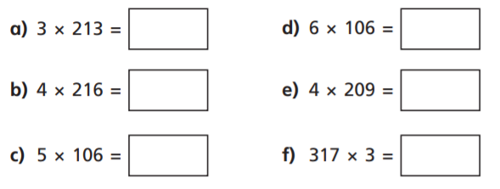
Try these on your own. Write the calculations and your answers on some paper.

Slide 11
Try these on your own. Write the calculations and your answers on some paper.

Slide 12
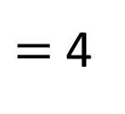
7
× 6
$=$ 4
2
147 × 6 $=$
?
The answer will have 2 ones.
3
× 2
= 6
383 × 2 =
?
The answer will have 6 ones.

Slide 13
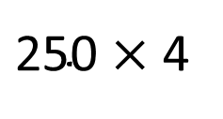
$\text{250}$ × 4
= 1,000
247 × 4 =
1,088
The answer must be less than 1,000

Slide 14
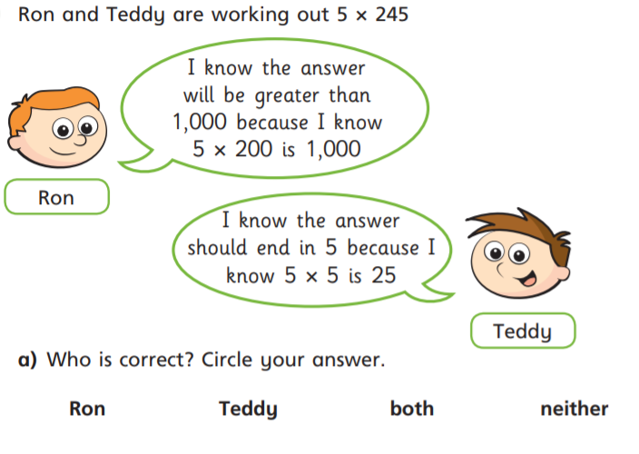
Try these on your own. Write the calculations and your answers on some paper.

Slide 15
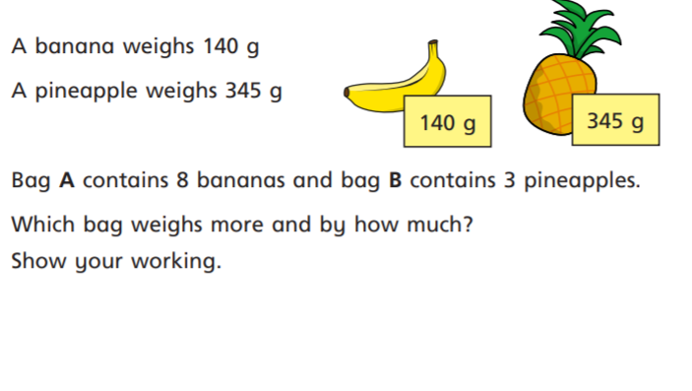
Challenge

