Slide 1
5.1.21
Today we will revisit multiplying 3 numbers and factors.
I can multiply 3 numbers and find factors.

Slide 2

2 $+$ 3 $+$ 4 $=$
3 $+$ 2 $+$ 4 $=$
4 $+$ 3 $+$ 2 $=$
4 $+$ 2 $+$ 3 $=$
5 $×$ 6 $=$
10 $×$ 3 $=$
15 $×$ 2 $=$
3) 1 $×$ 24 $=$ 24 2 $×$ 12 $=$ 24
3 $×$ 8 $=$ 24 4 $×$ 6 $=$ 24
5.1.21
DMM
4) Use the number 2, 12 and 24 to complete
a fact family.

Slide 3
9
2 $+$ 3 $+$ 4 $=$
3 $+$ 2 $+$ 4 $=$
4 $+$ 3 $+$ 2 $=$
4 $+$ 2 $+$ 3 $=$
5 $×$ 6 $=$
10 $×$ 3 $=$
15 $×$ 2 $=$
3) 1 $×$ 24 $=$ 24 2 $×$ 12 $=$ 24
3 $×$ 8 $=$ 24 4 $×$ 6 $=$ 24
9
Commutative
9
9
30
30
30
24
12
8
6
4) 2 x 12 = 24 12 x 2 = 24
24 ÷ 2 = 12 24 ÷ 12 = 2

Slide 4
How many ways can you use all three digit cards to fill in the multiplication sentence?
2
5
3
$× ×$
Have a think
2 $×$5 $×$ 3
3 $×$2 $×$ 5
5 $×$2 $×$ 3
2 $×$3 $×$ 5
3 $×$5 $×$ 2
5 $×$3 $×$ 2

Slide 5
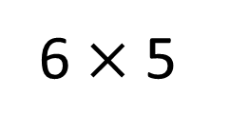


How many ways can you use all three digit cards to fill in the multiplication sentence?
10 $×$ 3
2
6 $×$ 5
15 $×$ 2
5
3
30
30
30
$× ×$
Which method do you prefer?
2 $×$5 $×$ 3
3 $×$2 $×$ 5
5 $×$2 $×$ 3
2 $×$3 $×$ 5
3 $×$5 $×$ 2
5 $×$3 $×$ 2

Slide 6
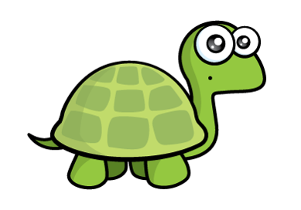
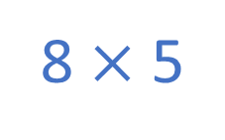
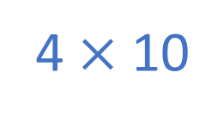

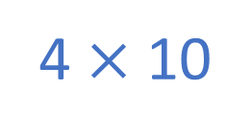
4 $×$ 2 $×$ 5 $=$ 4 $×$ 7
4 $×$ 5 $×$ 2 $>$ 4 $×$ 9
8 $×$ 5
4 $×$ 10
4 $×$ 10
Can you work out if Tiny is correct without calculating?
Have a think
8 and 5 are greater than 4 and 7
so 8 $×$ 5 $>$ 4 $×$ 7
4 $×$ 10 $>$ 4 $×$ 7
4 $×$ 10 $>$ 4 $×$ 9

Slide 7
4 $×$ 2 $×$ 5 $=$ 4 $×$ 7
4 $×$ 5 $×$ 2 $>$ 4 $×$ 9
4 $×$ 10
4 $×$ 10
8 $×$ 6 $>$ 2 $×$ $×$ 4
Have a think
6 $>$
4
3
2
1
0
8
5

Slide 8
What is a factor?
factor
2 rows of 3 are equal to 6
2 × 3 = 6
factor
product
3 columns of 2 are equal to 6
3 × 2 = 6
2 and 3 are factors of 6
Have a think
Are there any other factors of 6?

Slide 9
factor
1 row of 6 is equal to 6
1 × 6 = 6
factor
product
6 columns of 1 are equal to 6
6 × 1 = 6
1 and 6 are factors of 6
The factors of 6 are: 1, 2, 3 and 6

Slide 10
18 × 1
9 × 2
Factor pair
18
3 × 6
6 × 3
The factors of 18 are: 1, 2, 3, 6, 9 and 18

Slide 11
Now let’s complete the activities.
Choose your own level of challenge.
Choose which of the sheets would like to do. There are sheets about multiplying three numbers and about factors attached with this powerpoint.

Slide 12
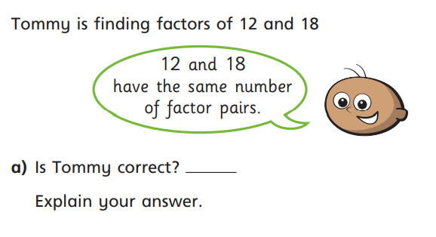
Reflect
Did you remember the work we did on this before the holiday?

