Slide 1
Friday 15th January
Good morning,
It’s Friday so that can only mean one thing… spelling test!!
Take a moment to practise, maybe try bubble or rainbow writing and then ask someone in your family to test you. Your spellings are on the next slide if you don’t already have them.
I would love to hear how you get on so please email me your result.
Good luck!!

Slide 2
This week your spellings are...

Slide 3
Daily Reading
Remember you should be reading every day.
To help you do this, we have set you a reading 2do on Purple Mash.
Every day a new chapter will arrive for you to read. Then there will be a quiz for you to complete.
I hope you enjoy the first book. It is called ‘Time Freeze’.
After you have finished your online lessons, head over to Purple Mash and enjoy!
Now for… Macavity...

Slide 4
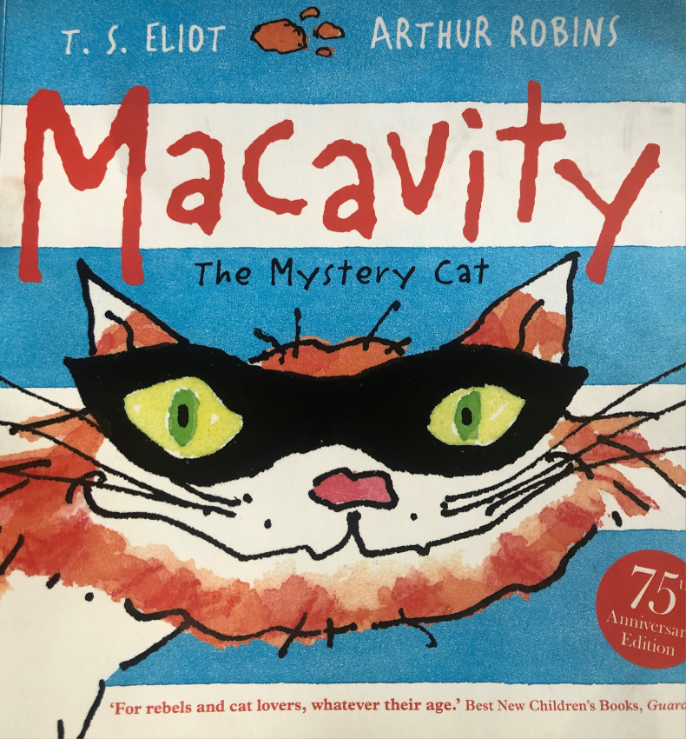
Friday 15th January
Macavity
I can answer questions about the text
I am reading.

Slide 5
Today is our final lesson on Macavity, we do hope
you’ve enjoyed it.
As you click through the next slides I would like you to answer the questions about the text. Either print out the poem (you might have already done this so you can use it again today) or use these slides.
Remember to read the question carefully before you try and answer.

Slide 6
Question 1.

Slide 7
Question 2

Slide 8
Question 3
Explain your choice using evidence from the text.

Slide 9
Question 4

Slide 10
Question 5

Slide 11
Question 6

Slide 12
Read: on this powerpoint or print out the sheet if you can.

Slide 13
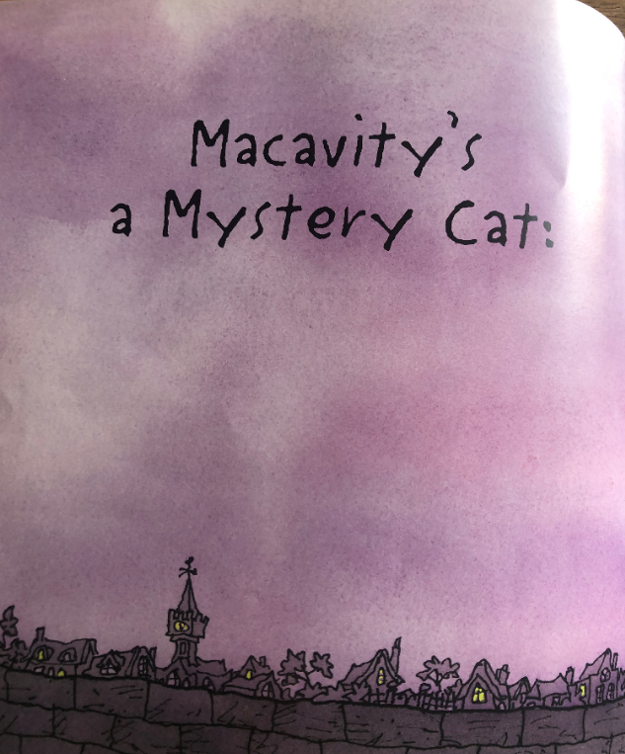
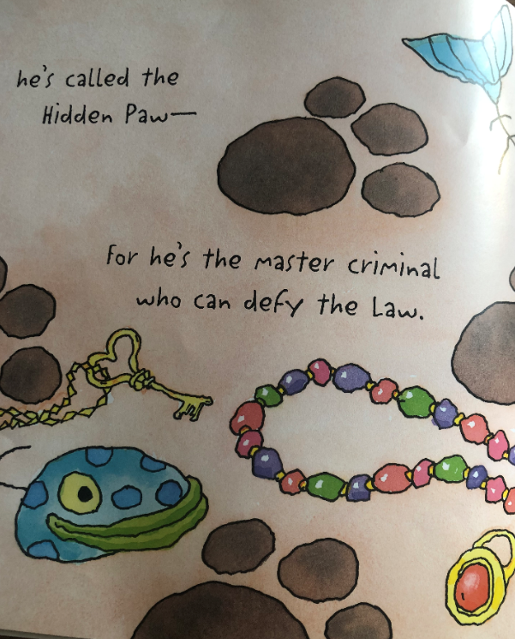

Slide 14
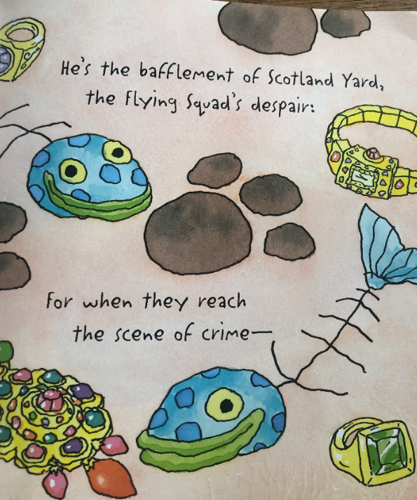
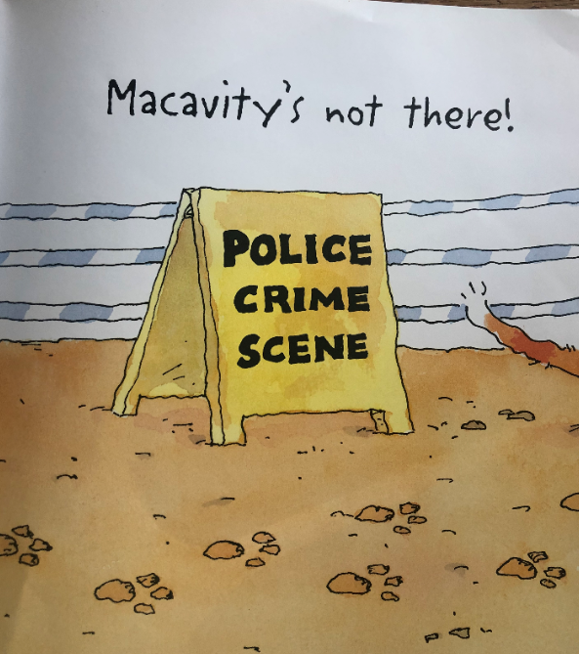

Slide 15
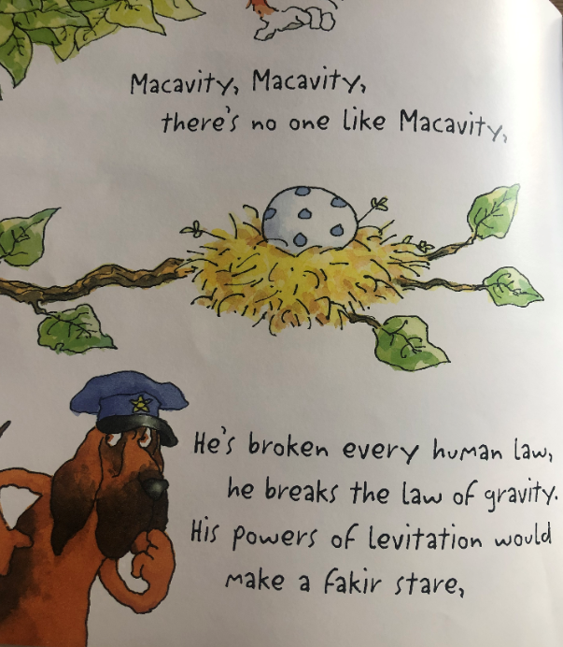
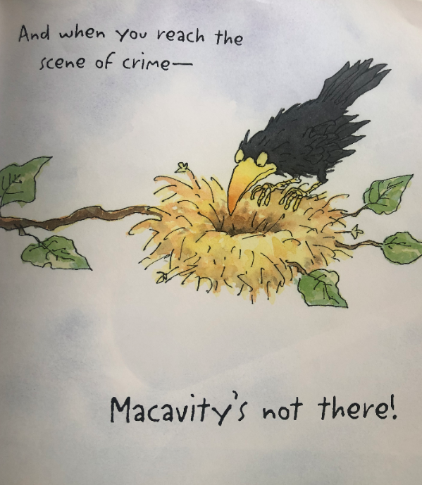

Slide 16
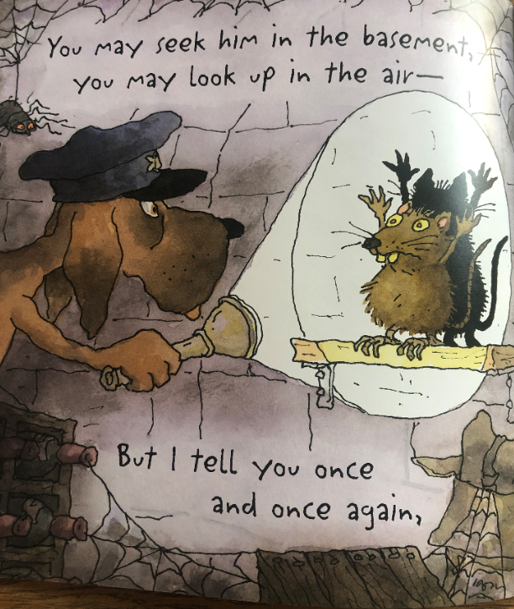
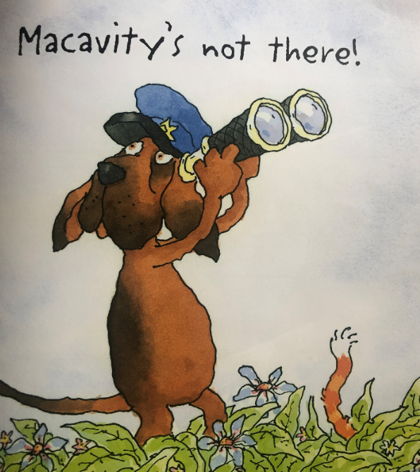

Slide 17
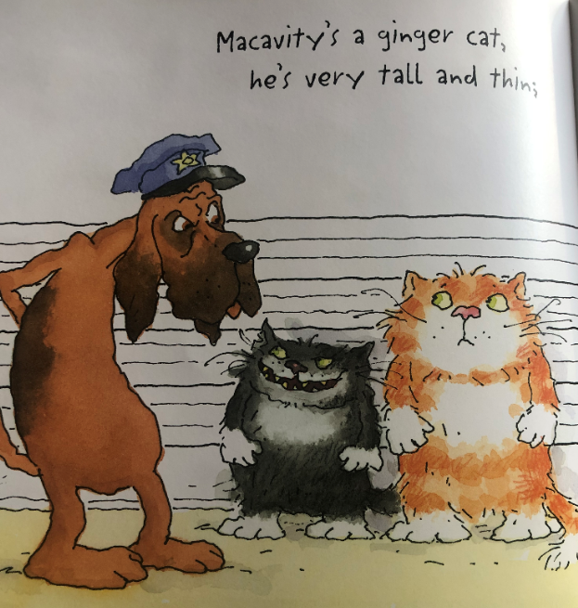
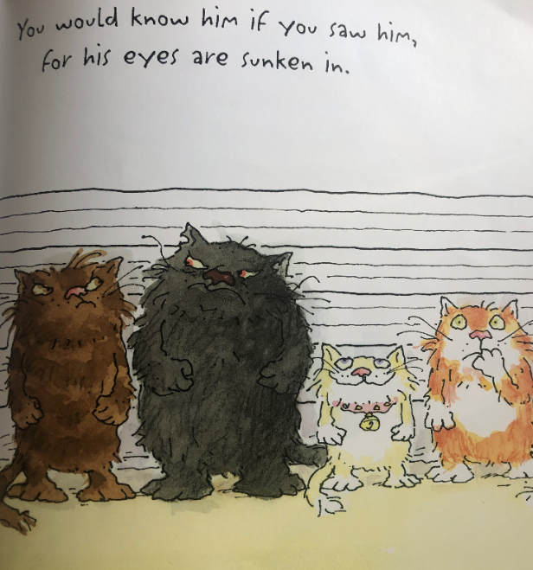

Slide 18
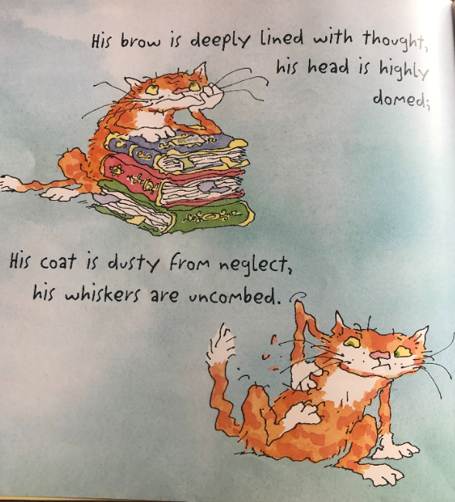
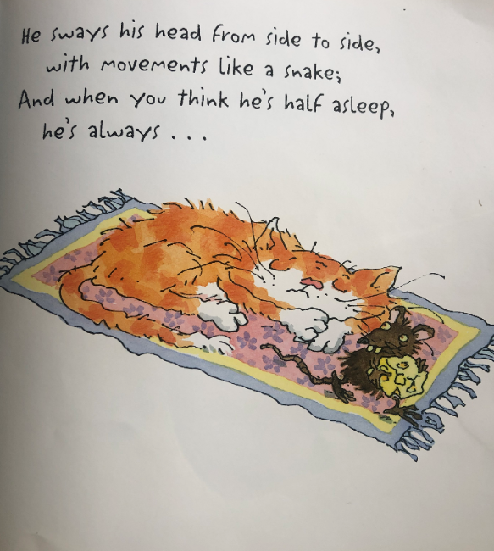

Slide 19
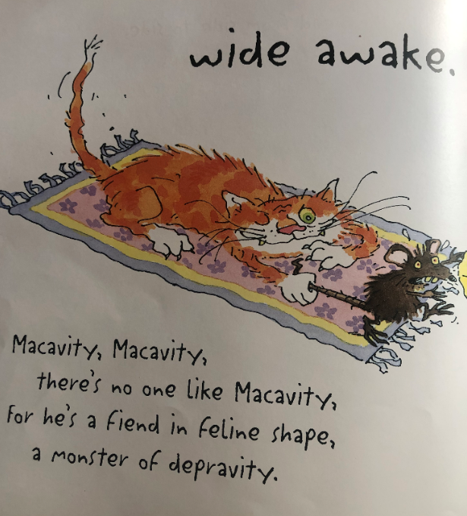
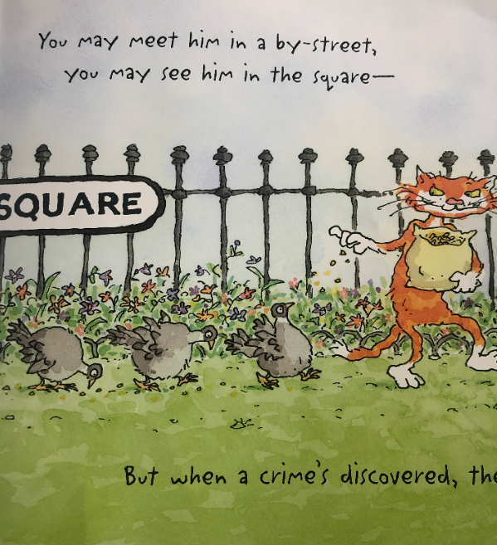

Slide 20
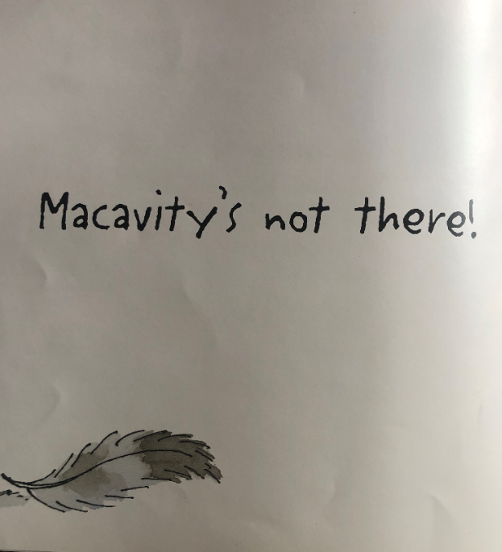
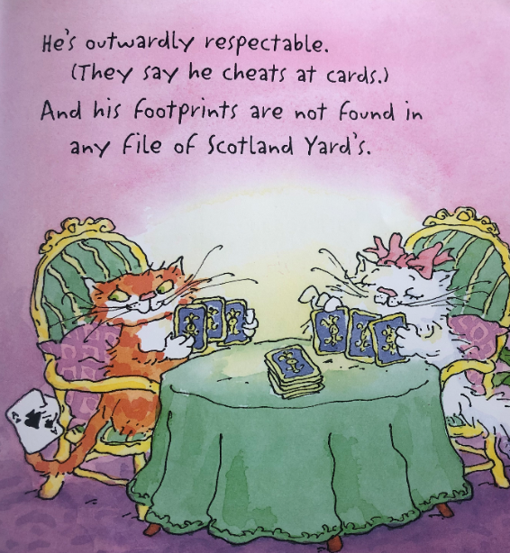

Slide 21
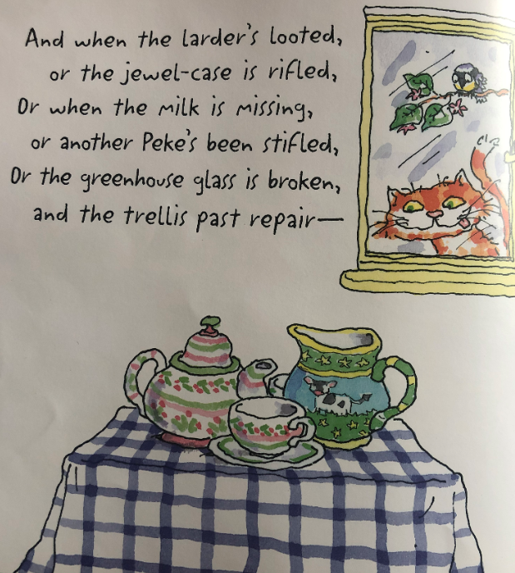
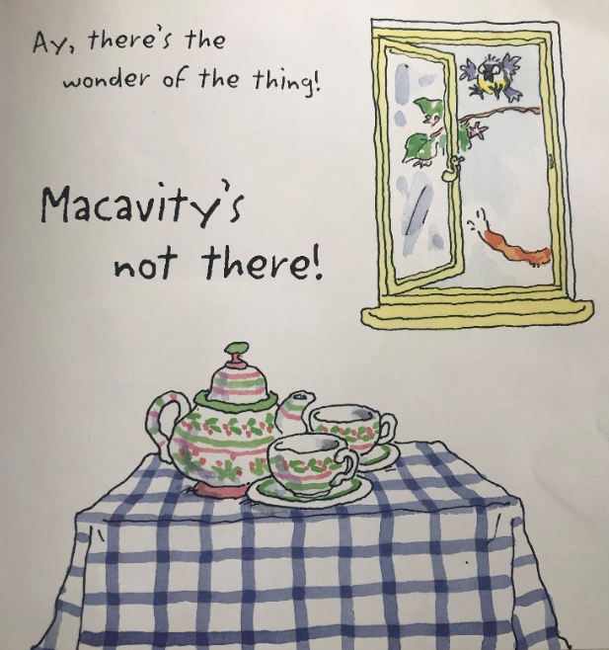

Slide 22
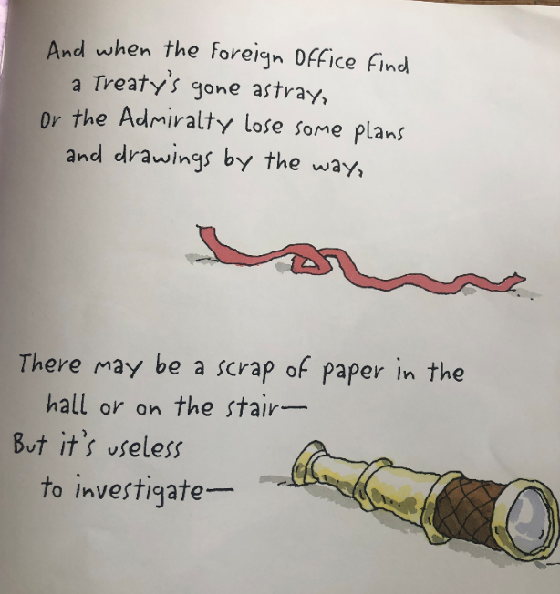

Slide 23
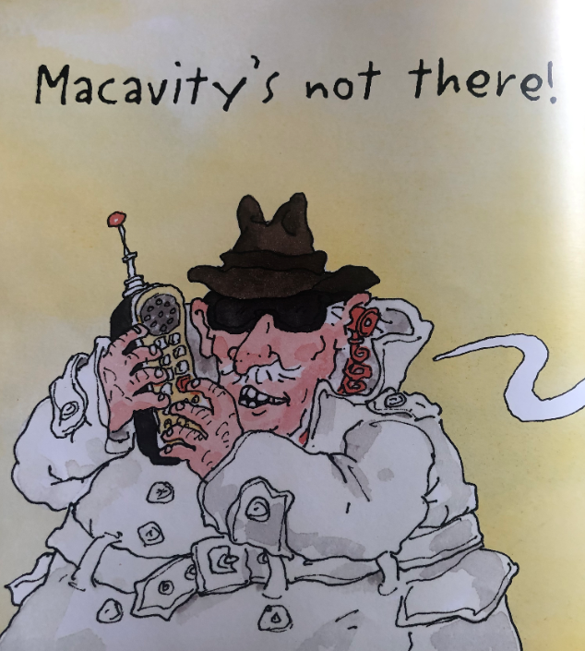
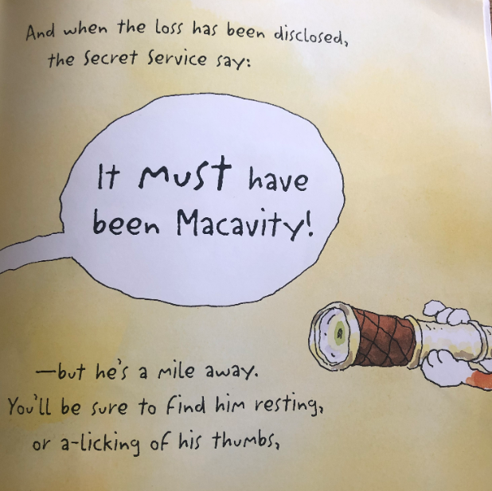

Slide 24
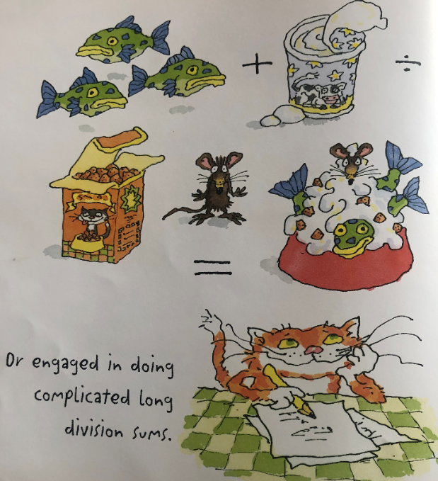
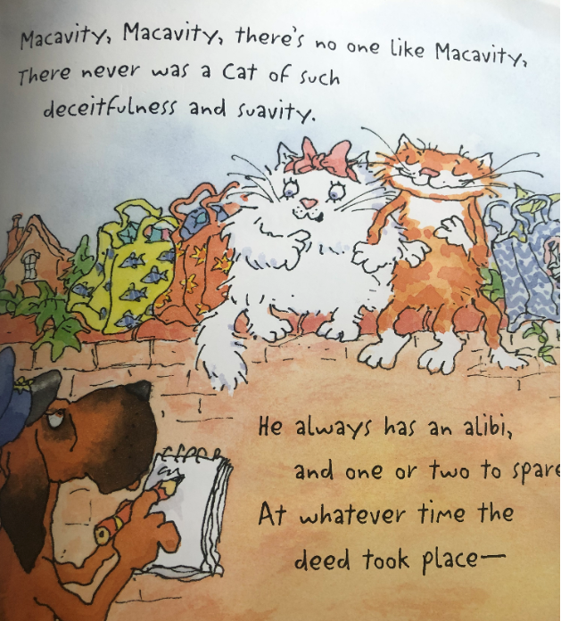

Slide 25
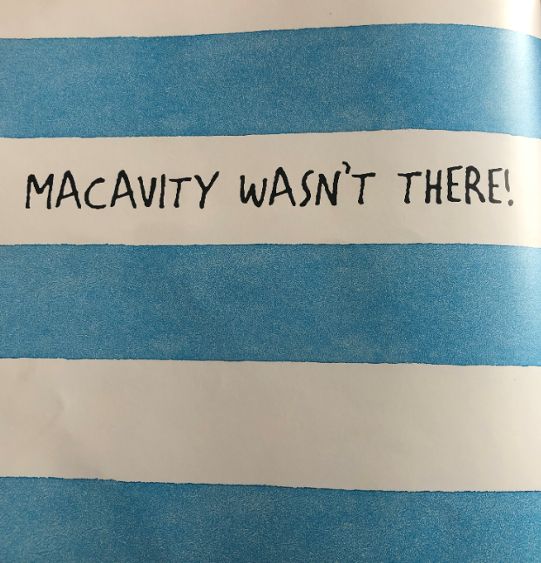
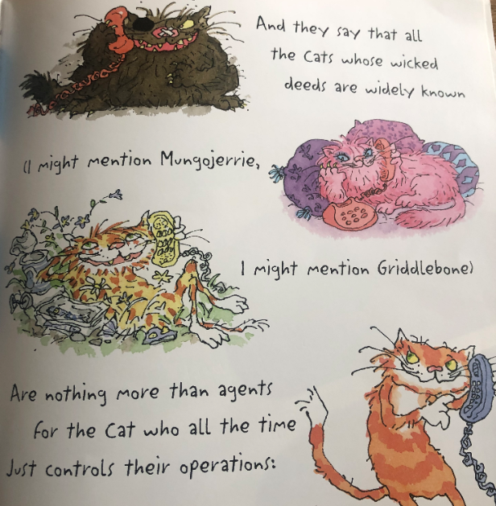

Slide 26
