Slide 1
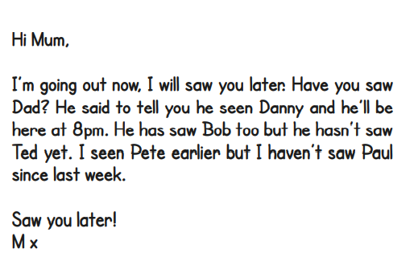
Tuesday 12th January
SPaG Morning Job
See, saw or seen?
Copy out this message for Mum. Correct see, saw or seen in each sentence.
Sometimes you may need to add has or have.

Slide 2
Tuesday 12th January
Macavity
I can write a description of Macavity based on what I have read.

Slide 3
I can write a description of Macavity based on what I have read.
A synonym is a word that means exactly or almost the same, eg scared and frightened.
Today you are going to write your own description of Macavity.
You can use some words from the poem but put them into your own sentences.
You can also use synonyms to make your writing more interesting.
First gather your ideas by writing any helpful words or phrases. The next slide can help you do this.

Slide 4
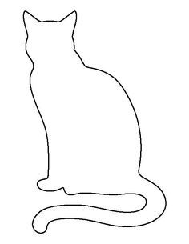
Inside the cat, write
words to describe his
personality.
Macavity
Outside the cat, write words to describe his appearance.
Mischievous
Tall
Lanky

Slide 5
Description of Macavity
You can read the poem again on the following slides if you want to.
Now write 2 paragraphs: one about what Macavity looks like;
and a paragraph about his personality.
To be successful:
I can turn my notes into interesting sentences.
I can use expanded noun phrases to describe Macavity.
I can start sentences with fronted adverbials.

Slide 6
Now read or listen to the poem.
Listen: https://www.youtube.com/watch?v=rBhnrEi8qpg
Read: on this powerpoint or print out the sheet.
If you have the sheet, you could highlight words or phrases.

Slide 7
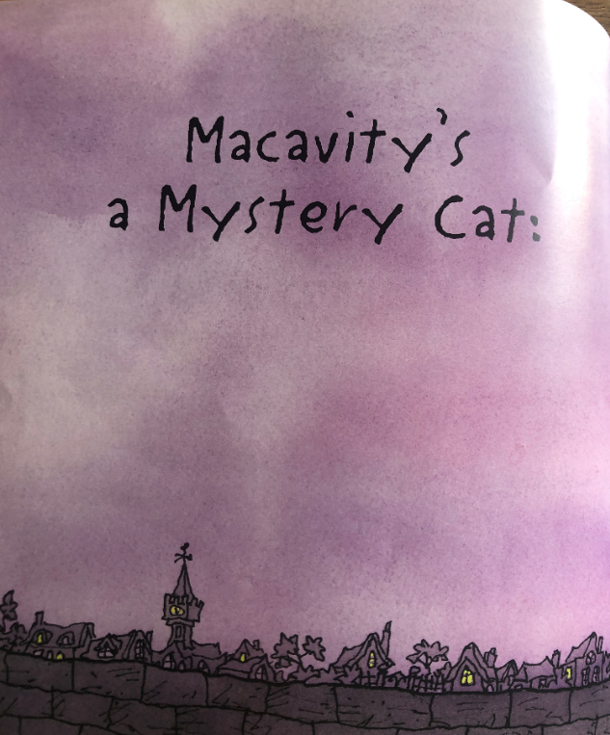
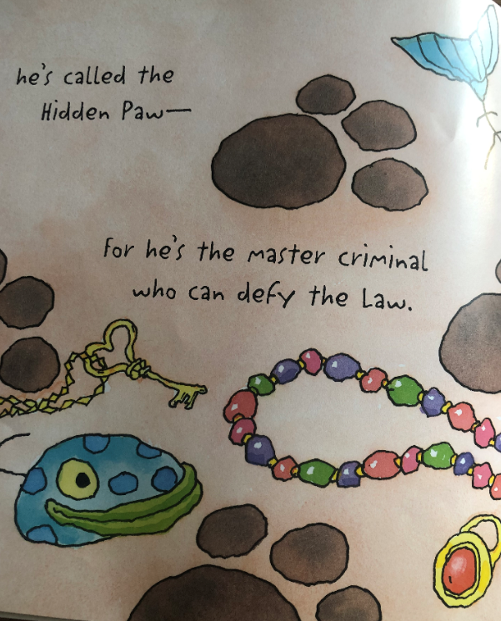

Slide 8
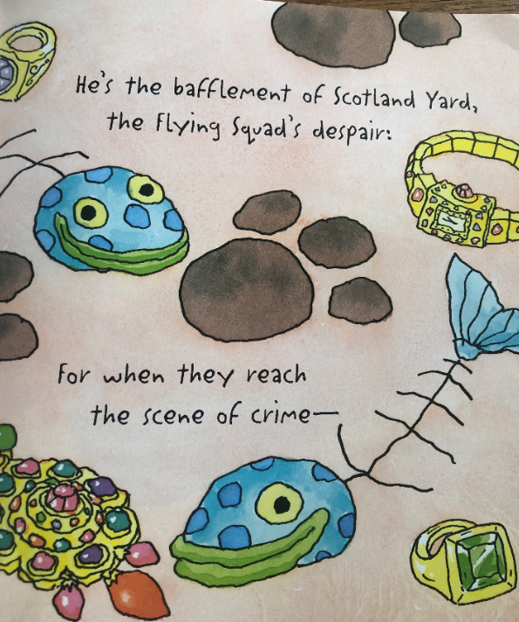
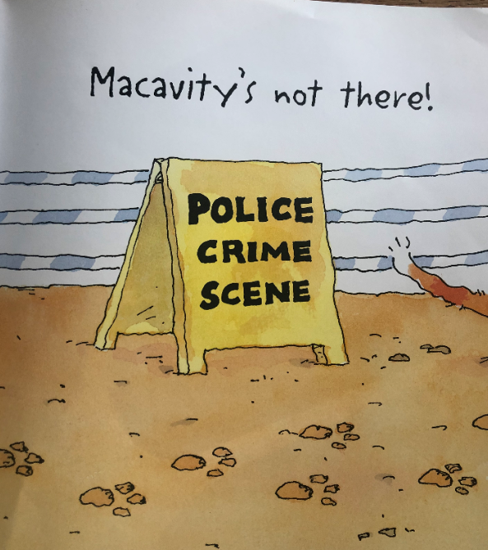

Slide 9
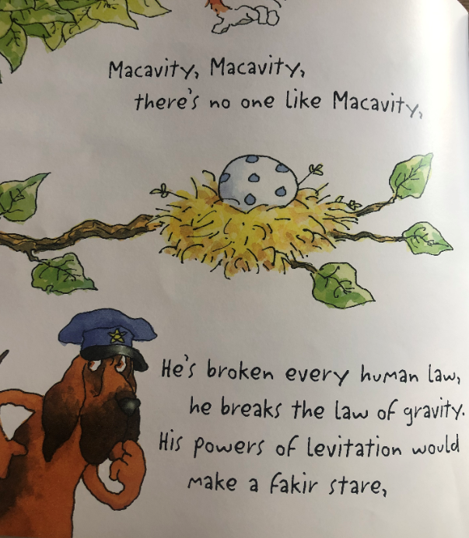
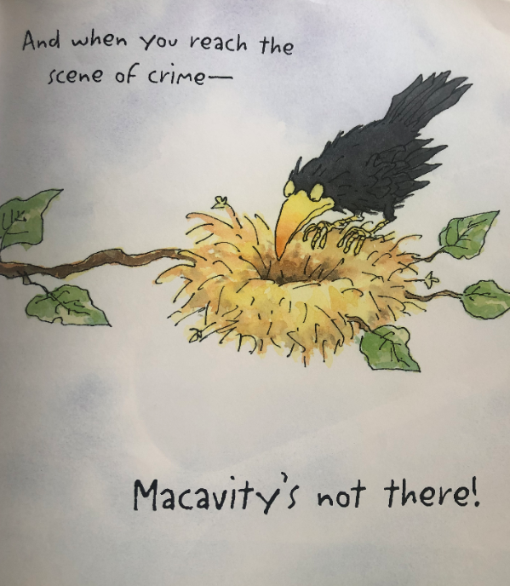

Slide 10
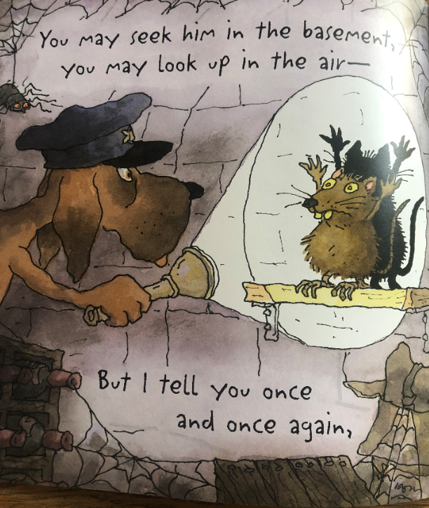
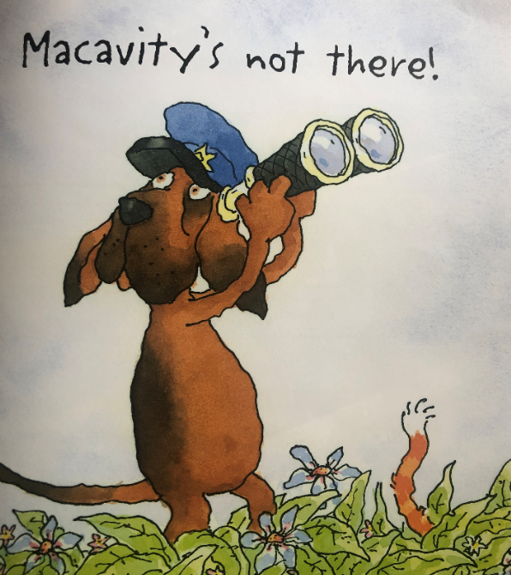

Slide 11
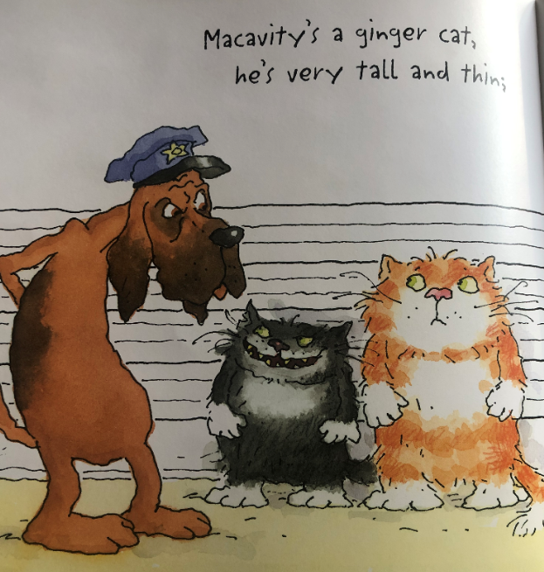
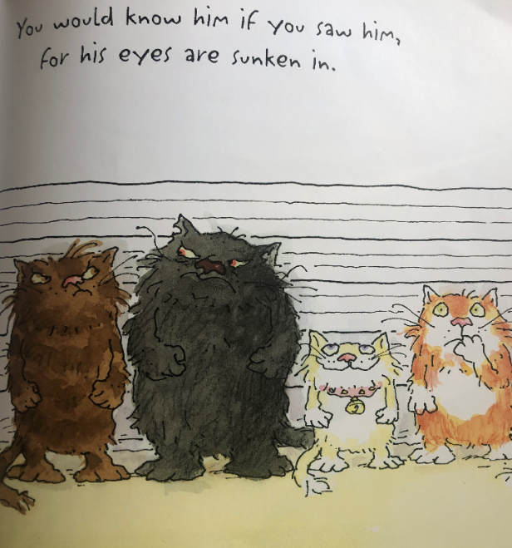

Slide 12
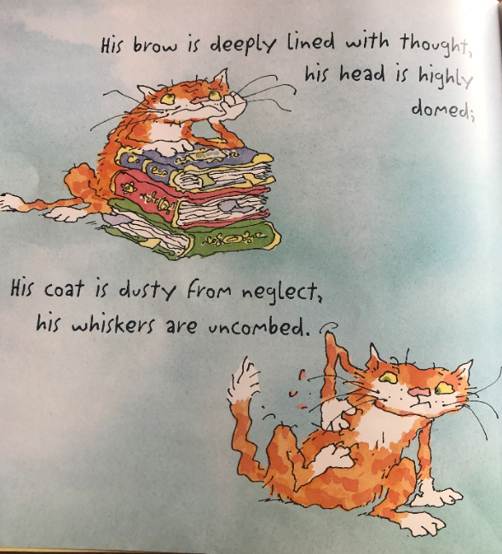
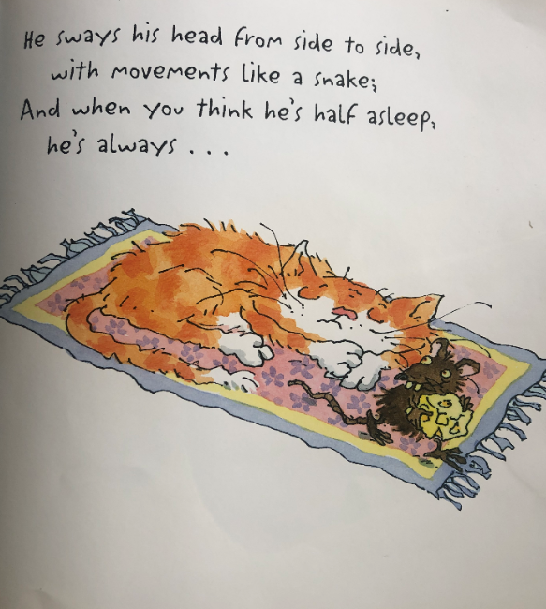

Slide 13
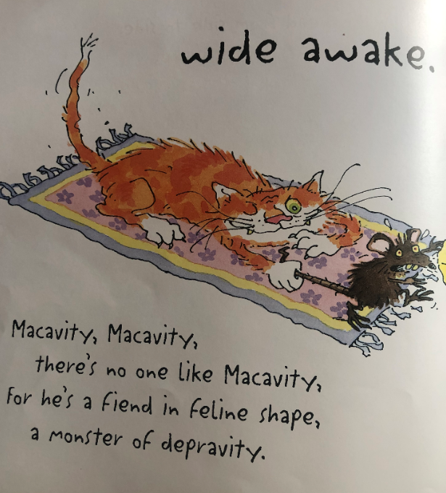
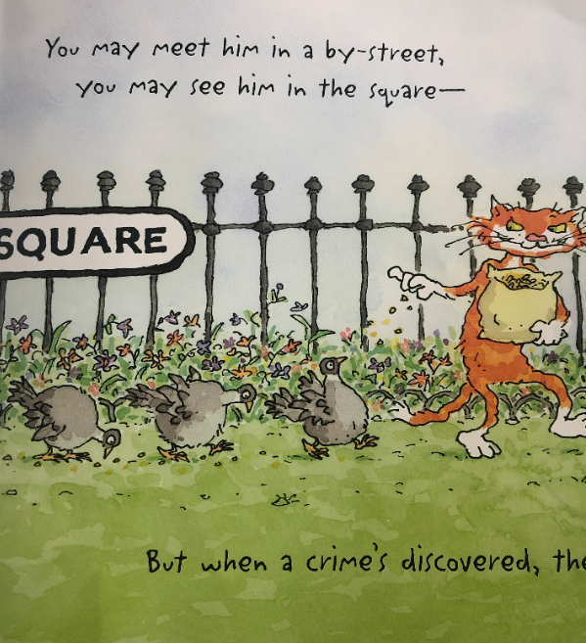

Slide 14
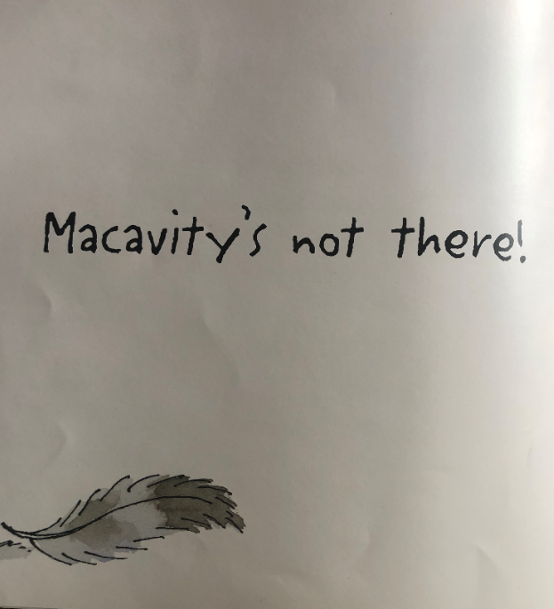
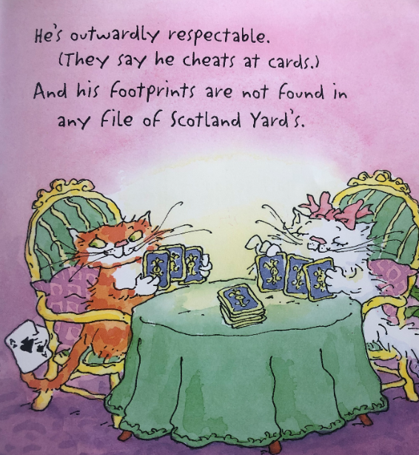

Slide 15
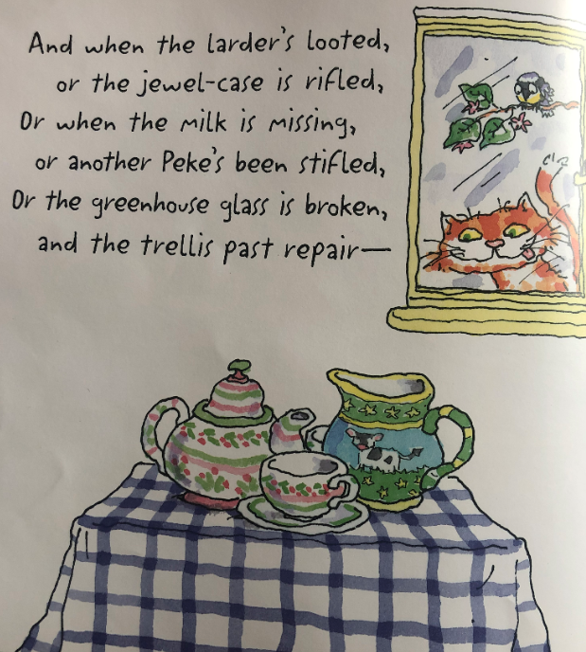
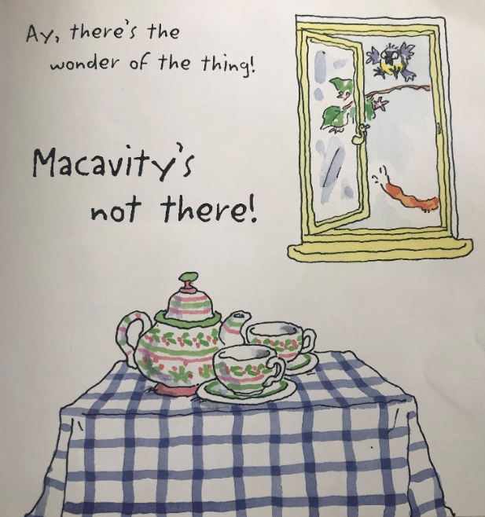

Slide 16
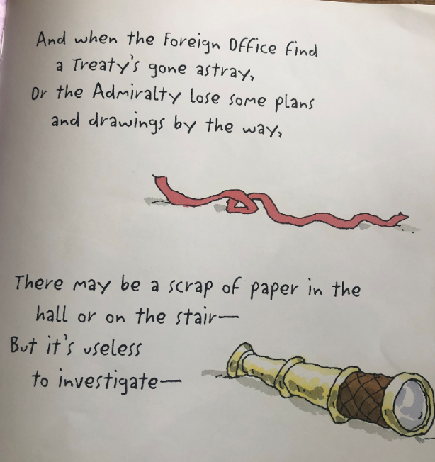

Slide 17
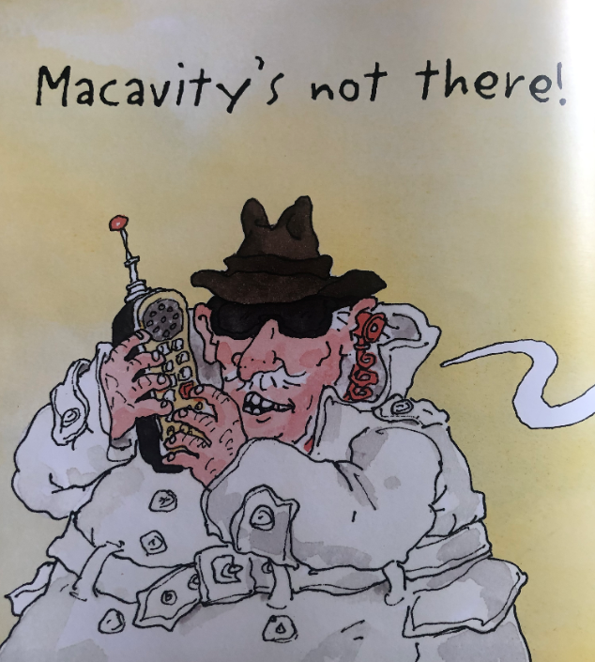
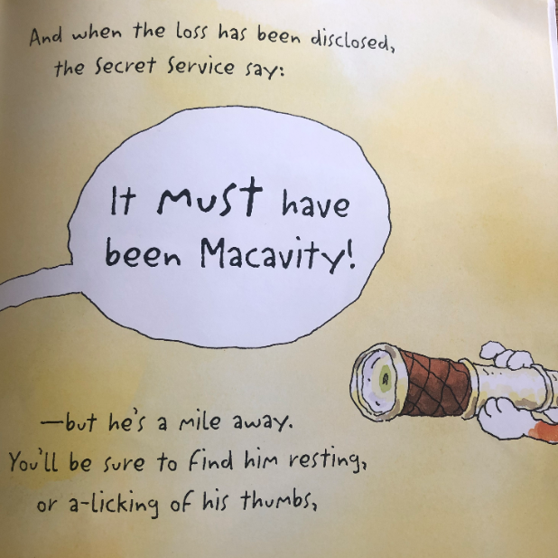

Slide 18
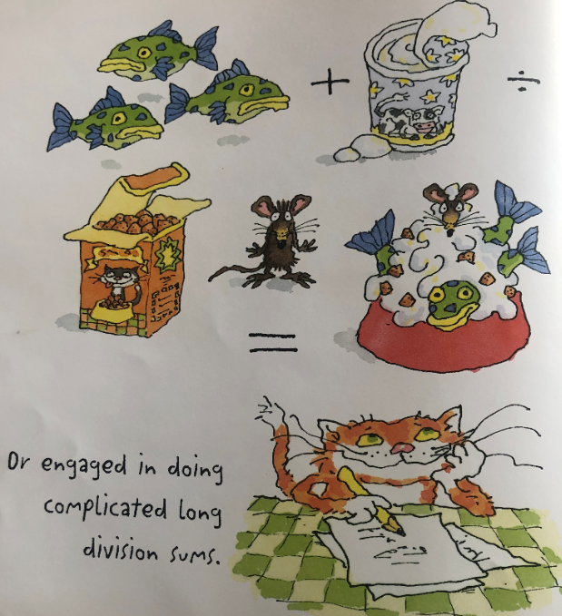
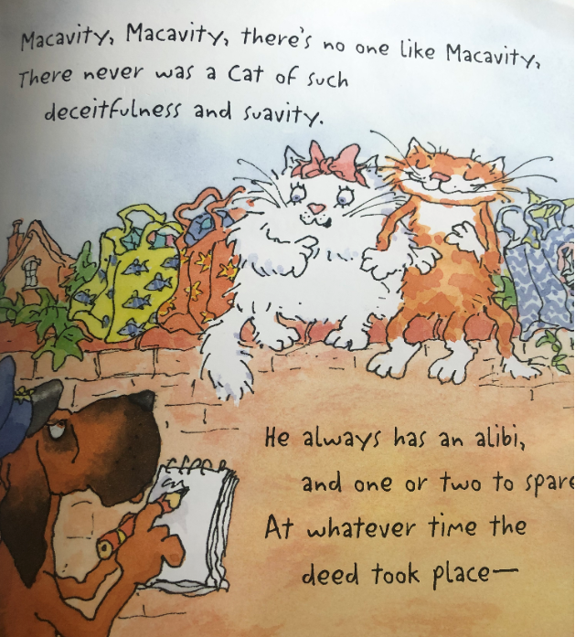

Slide 19
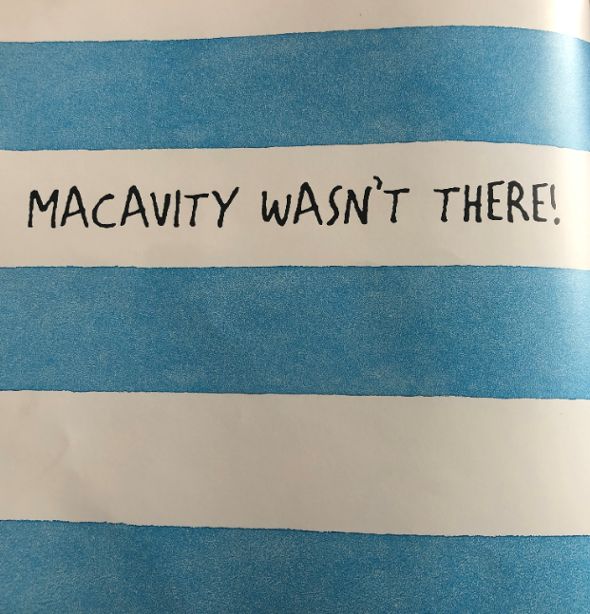
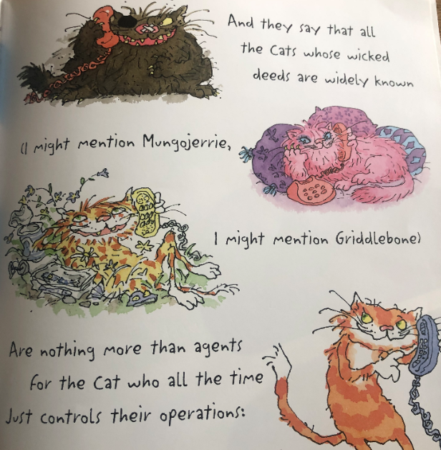

Slide 20
