Slide 1
Monday 11th January
SPaG Morning Job
I can use see or seen correctly.
Can you remember what you learned last week about this?
Remember: if the word ‘have’ or ‘has’ is used, then the word seen is correct.
Copy and complete the sentences on the next slide.
Remember your best, joined handwriting!

Slide 2
1. That is the fluffiest kitten I have ever __________.
2. Last night I ___________ two witches flying on their brooms.
3. Have you __________ my slippers?
4. I ___________ Dave at the cinema the other day.
5. No one has ___________ the scissors for days.
6. I ____________ a shooting star.
7. I have _____________ a solar eclipse.
8. I wish I could have ____________ Santa when he was in my house.
9. I have never _______________ the tooth fairy.

Slide 3
Daily Reading
Remember you should be reading every day.
To help you do this, we have set you a reading 2do on Purple Mash.
Every day a new chapter will arrive for you to read. Then there will be a quiz for you to complete.
I hope you enjoy the first book. It is called ‘Time Freeze’.
After you have finished your online lessons, head over to Purple Mash and enjoy!
Now for… Macavity...

Slide 4
Monday 11th January
Macavity
I understand the meaning of words and phrases.

Slide 5
I understand the meaning of words and phrases.
Today we will reread Macavity carefully and find our some information about this mystery cat.
When you read and listen to it, think about:
What he looks like
How he moves
What others think of him.
Then complete the worksheet or write out your answers on some paper.
Remember the information is in the text. This is not an imagination job today!

Slide 6
Now read or listen to the poem.
Listen: https://www.youtube.com/watch?v=rBhnrEi8qpg
Read: on this powerpoint or print out the sheet.
If you have the sheet, you could highlight words or phrases.

Slide 7
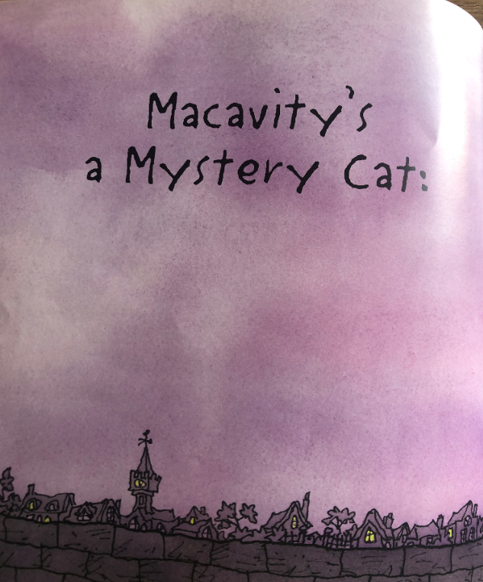
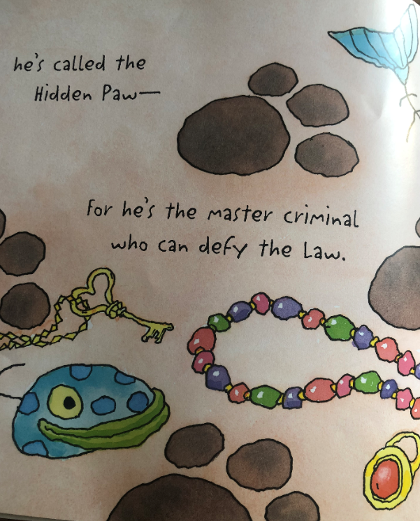

Slide 8
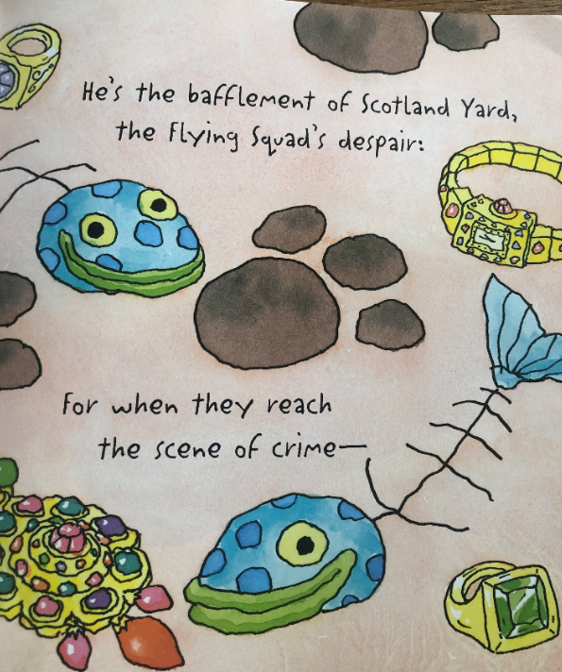
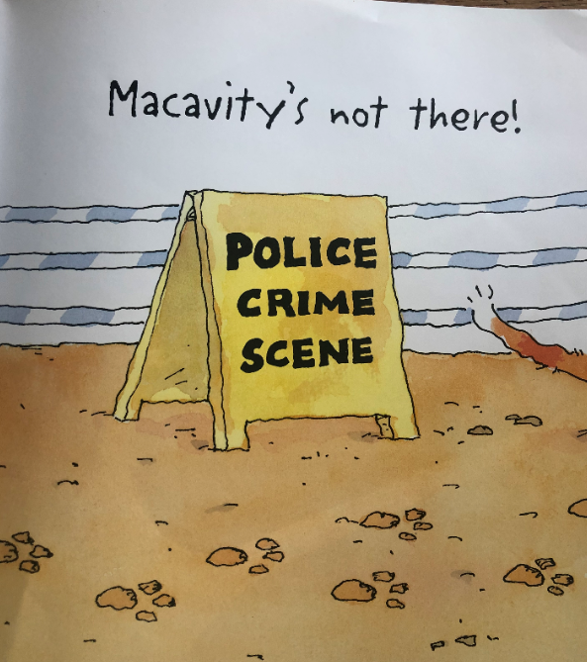

Slide 9
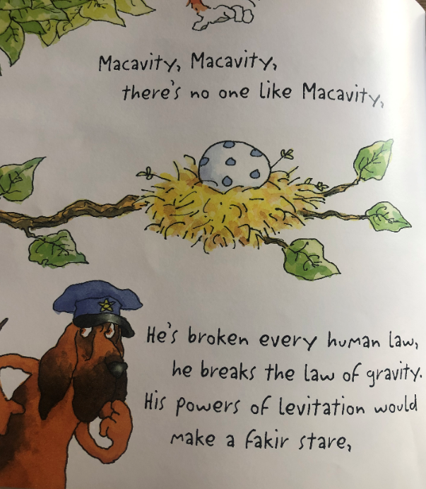
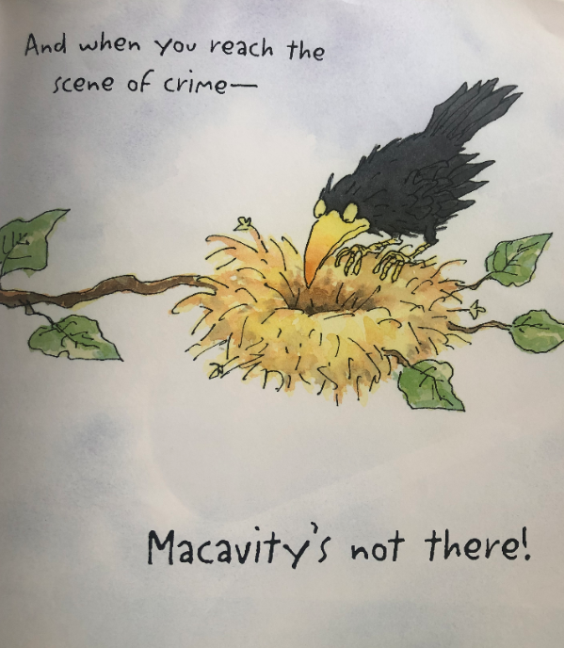

Slide 10
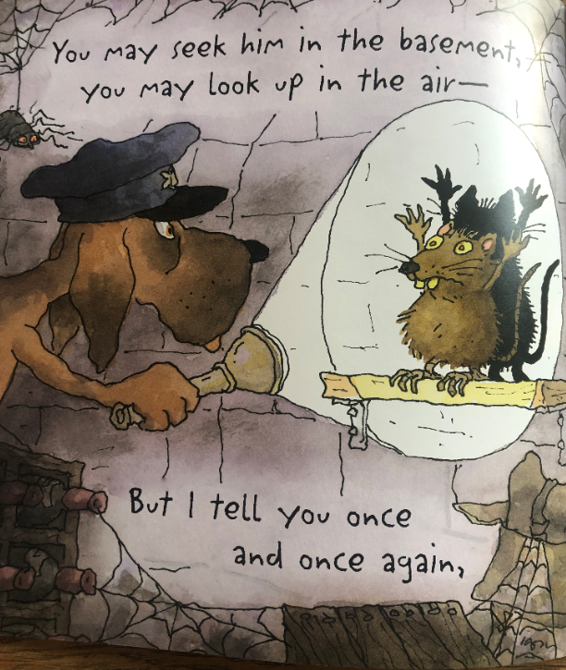
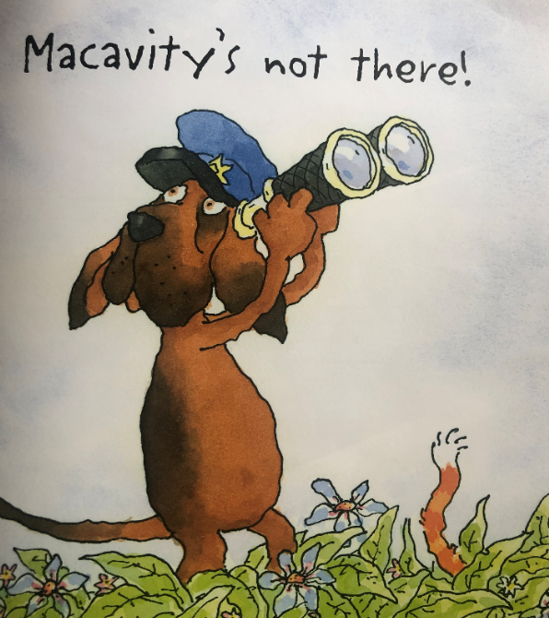

Slide 11
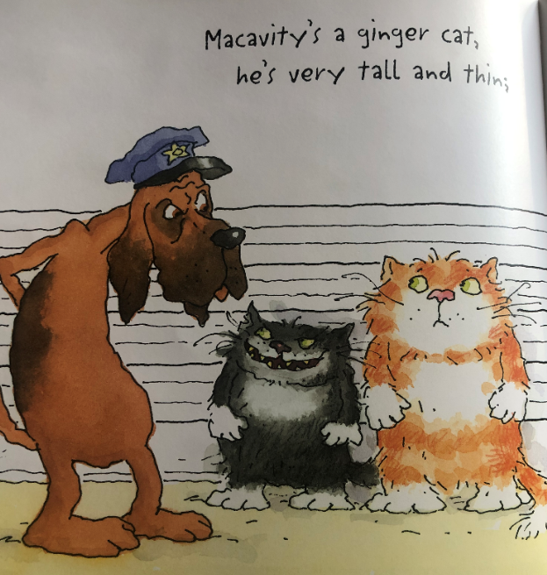
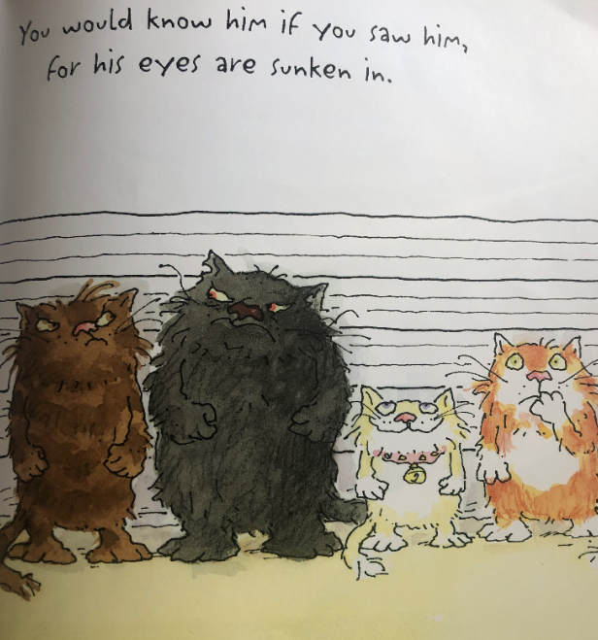

Slide 12
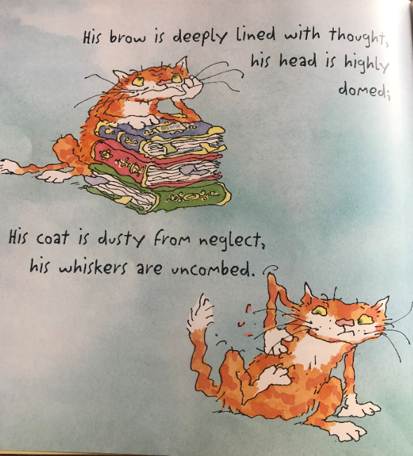
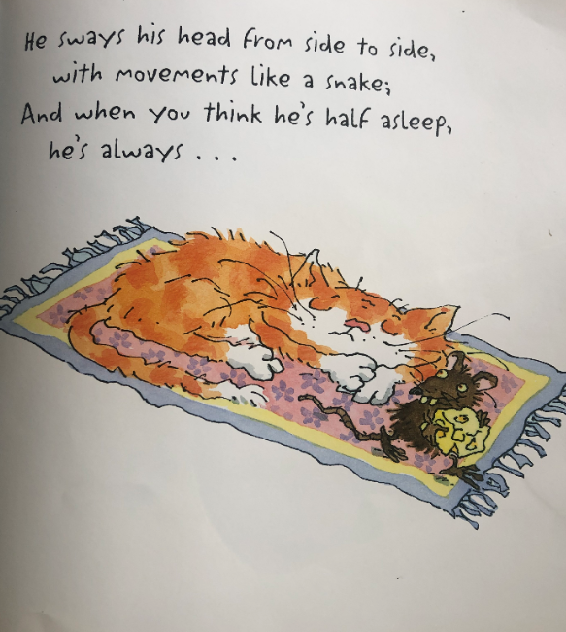

Slide 13
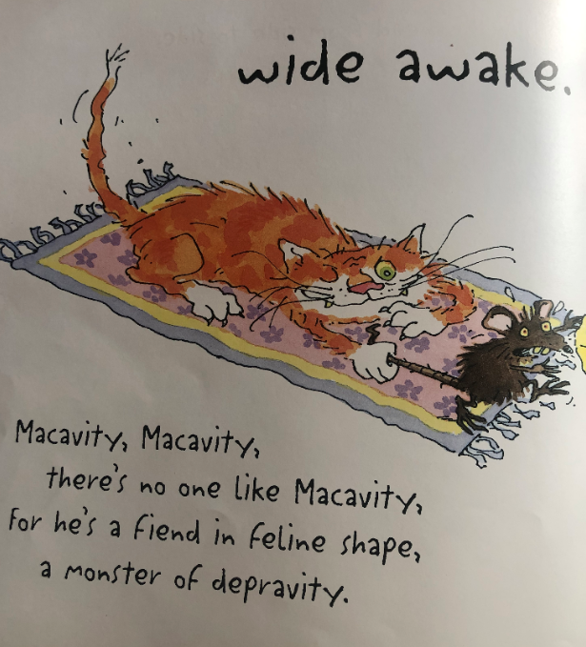
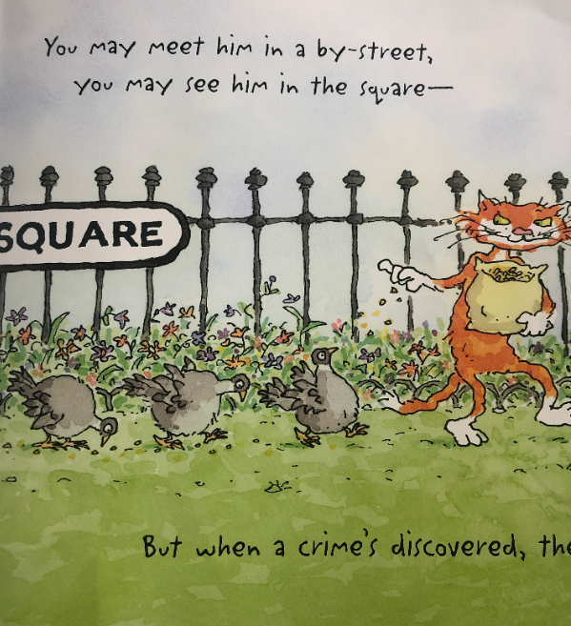

Slide 14
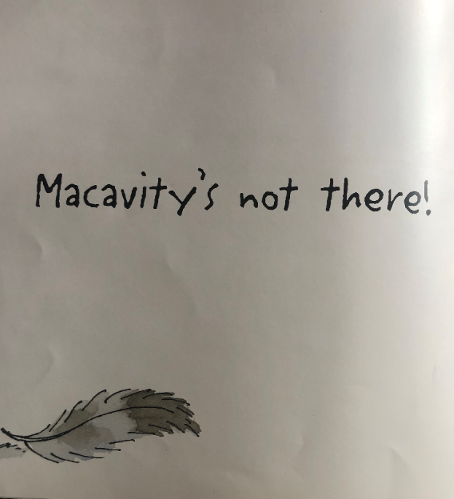
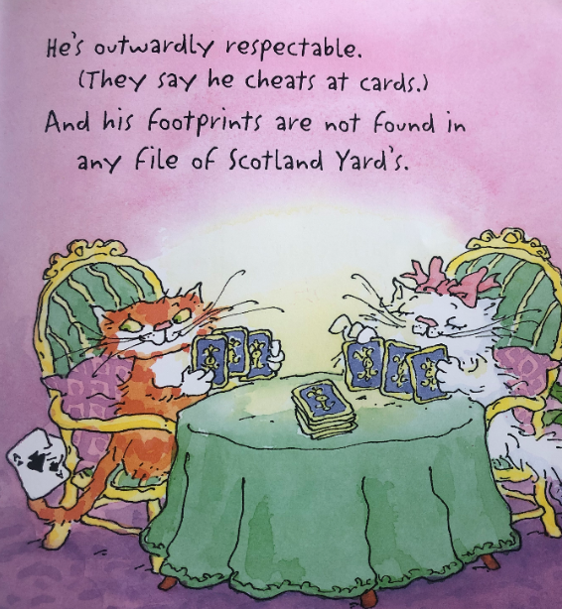

Slide 15
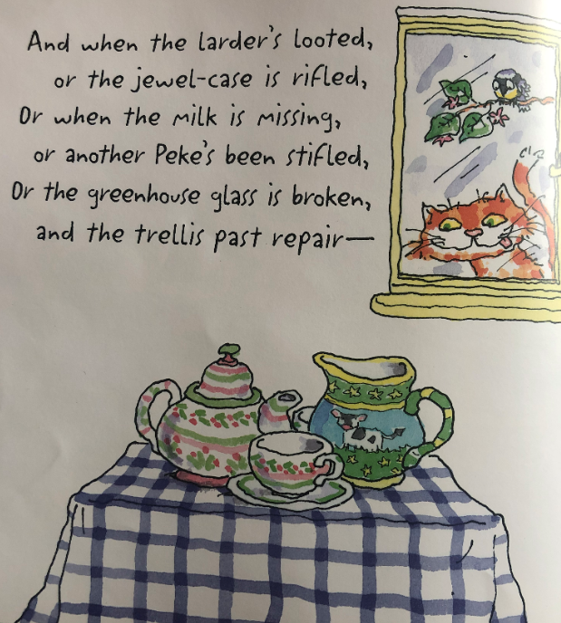
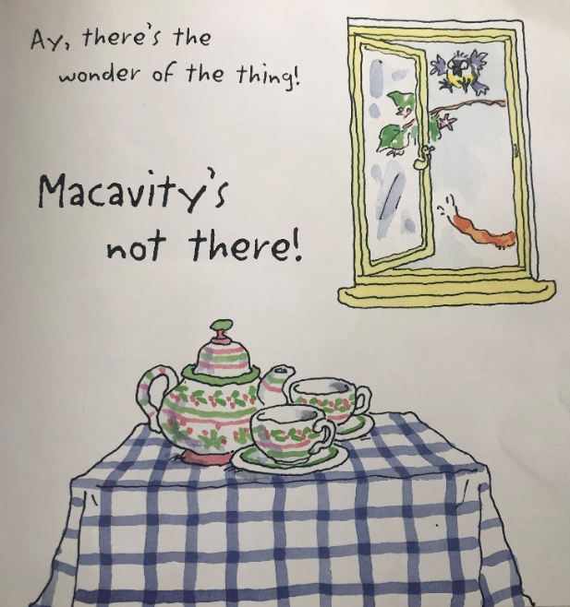

Slide 16
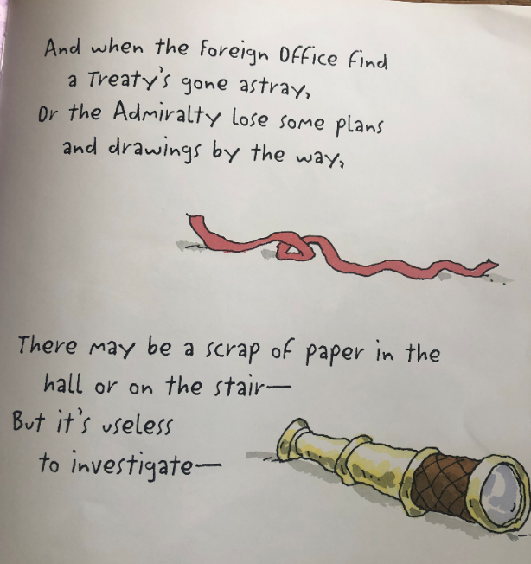

Slide 17
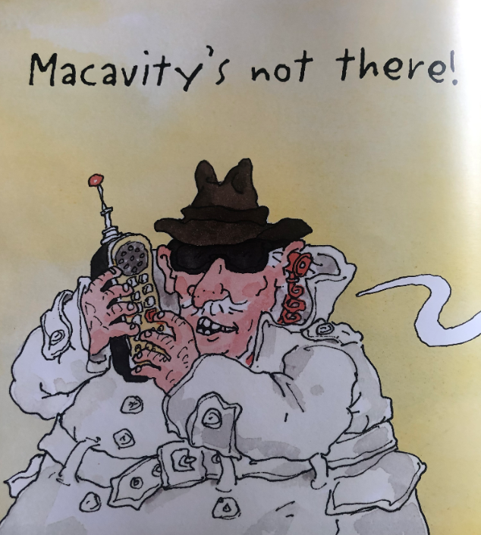
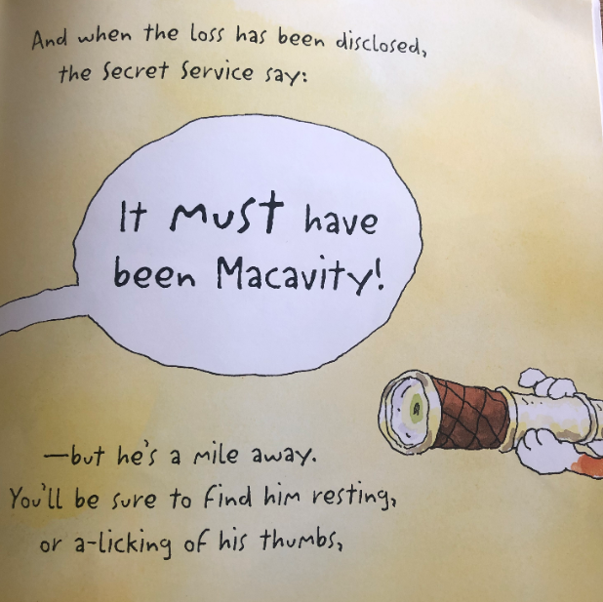

Slide 18
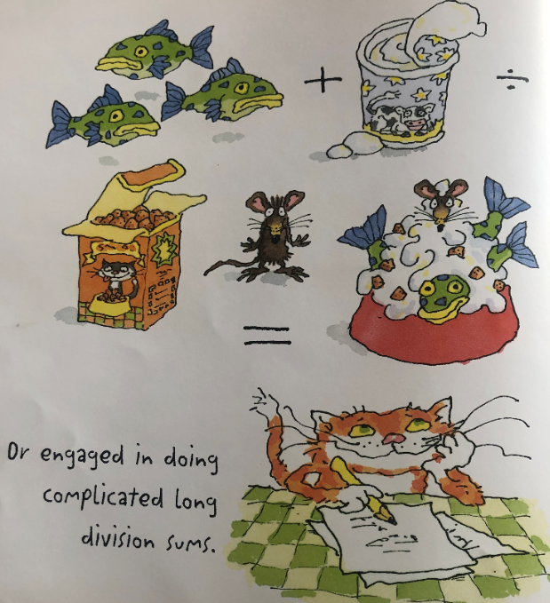
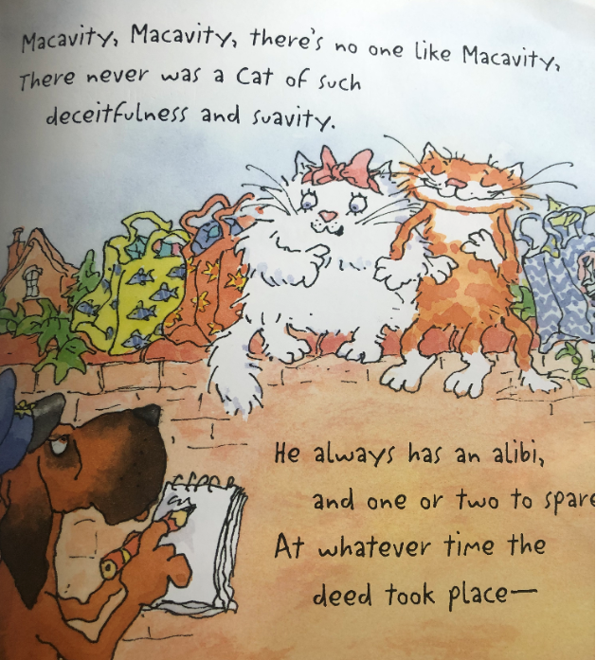

Slide 19
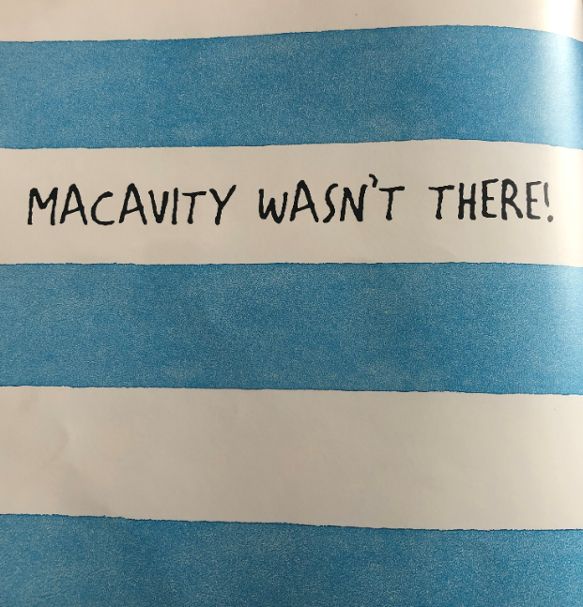
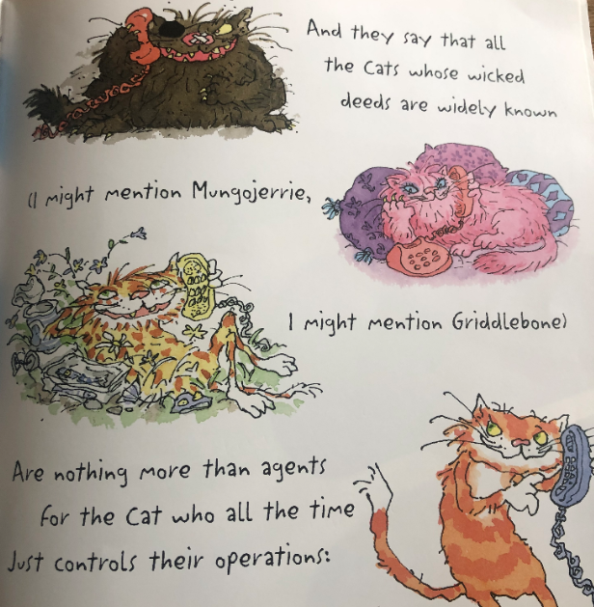

Slide 20
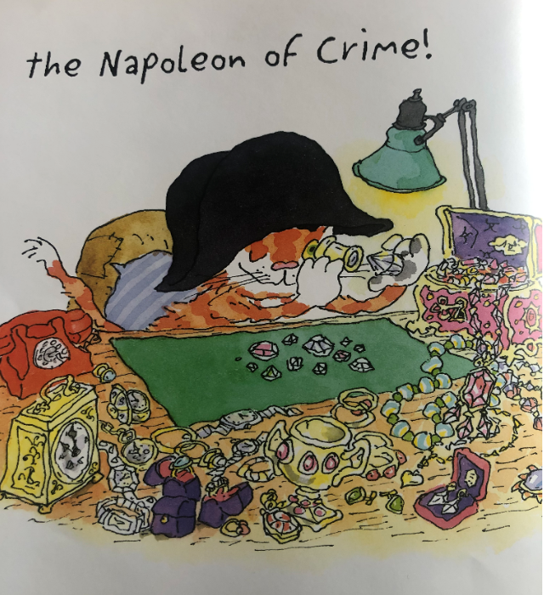

Slide 21
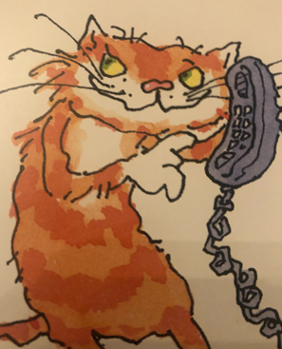
I understand the meaning of words and phrases.
Did you find some words and phrases to describe Macavity?
Now write them out on the worksheet or on some paper.
Keep your work until tomorrow because it will help you with your next task.
What do you think it will be?

