Slide 1
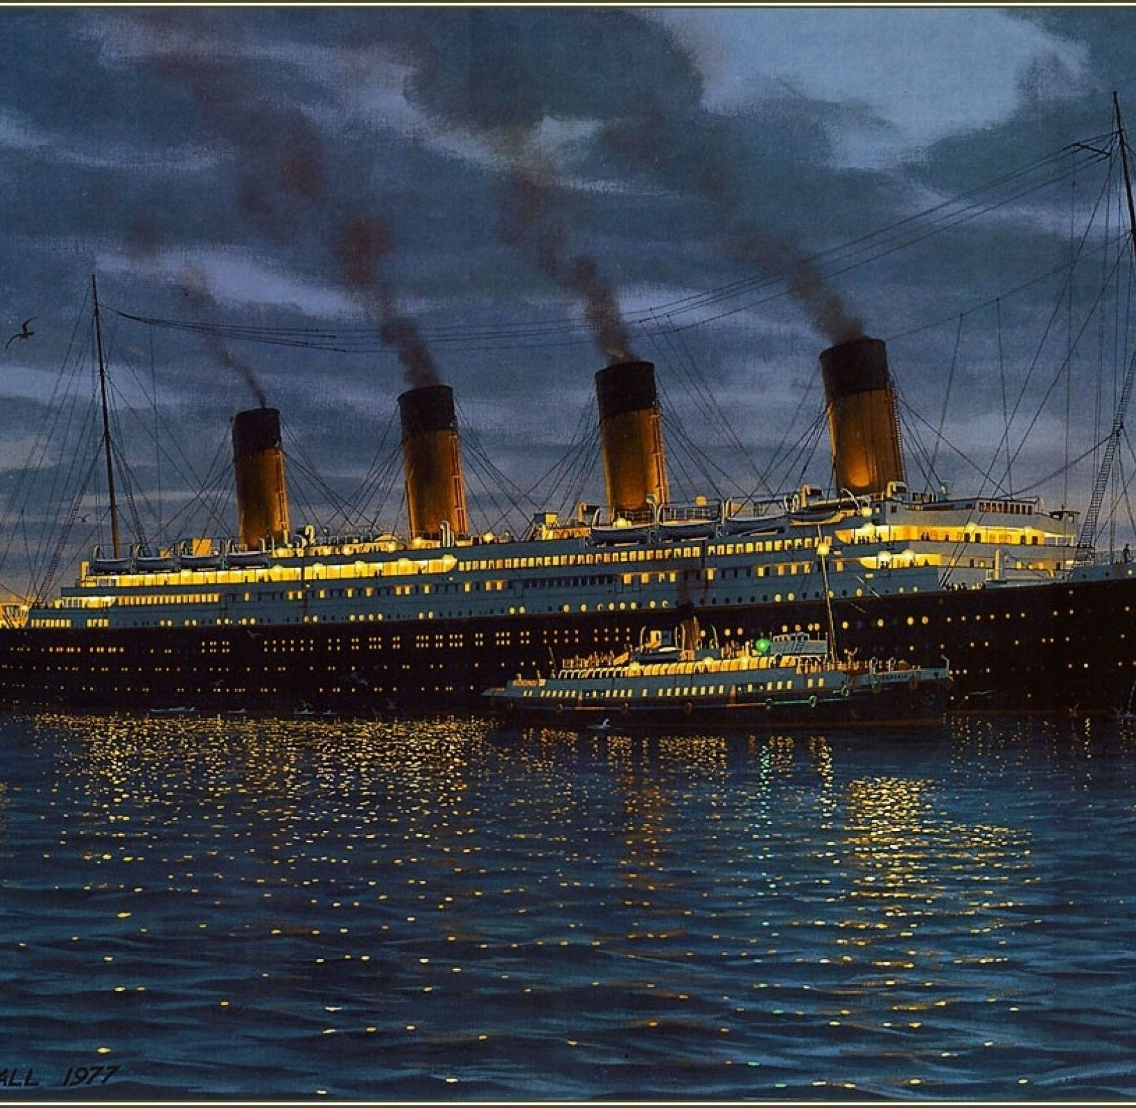
LO: visualise using details both stated and implied
Wednesday 6th January 2021

Slide 2
What do we know so far about the Countess?
Discuss…

Slide 3
Scan through Chapter One and highlight any words or phrases that describe or tell us more about the character of the Countess…

Slide 4
Using all the evidence you have gathered from the text, sketch the Countess.

Slide 5
Quotes in pen, inferences in pencil
“…she didn’t just walk to the lift, she sailed there magnificently.”
This quote suggests that the Countess has confidence and moves elegantly.

Slide 6
Examples …

