Slide 1
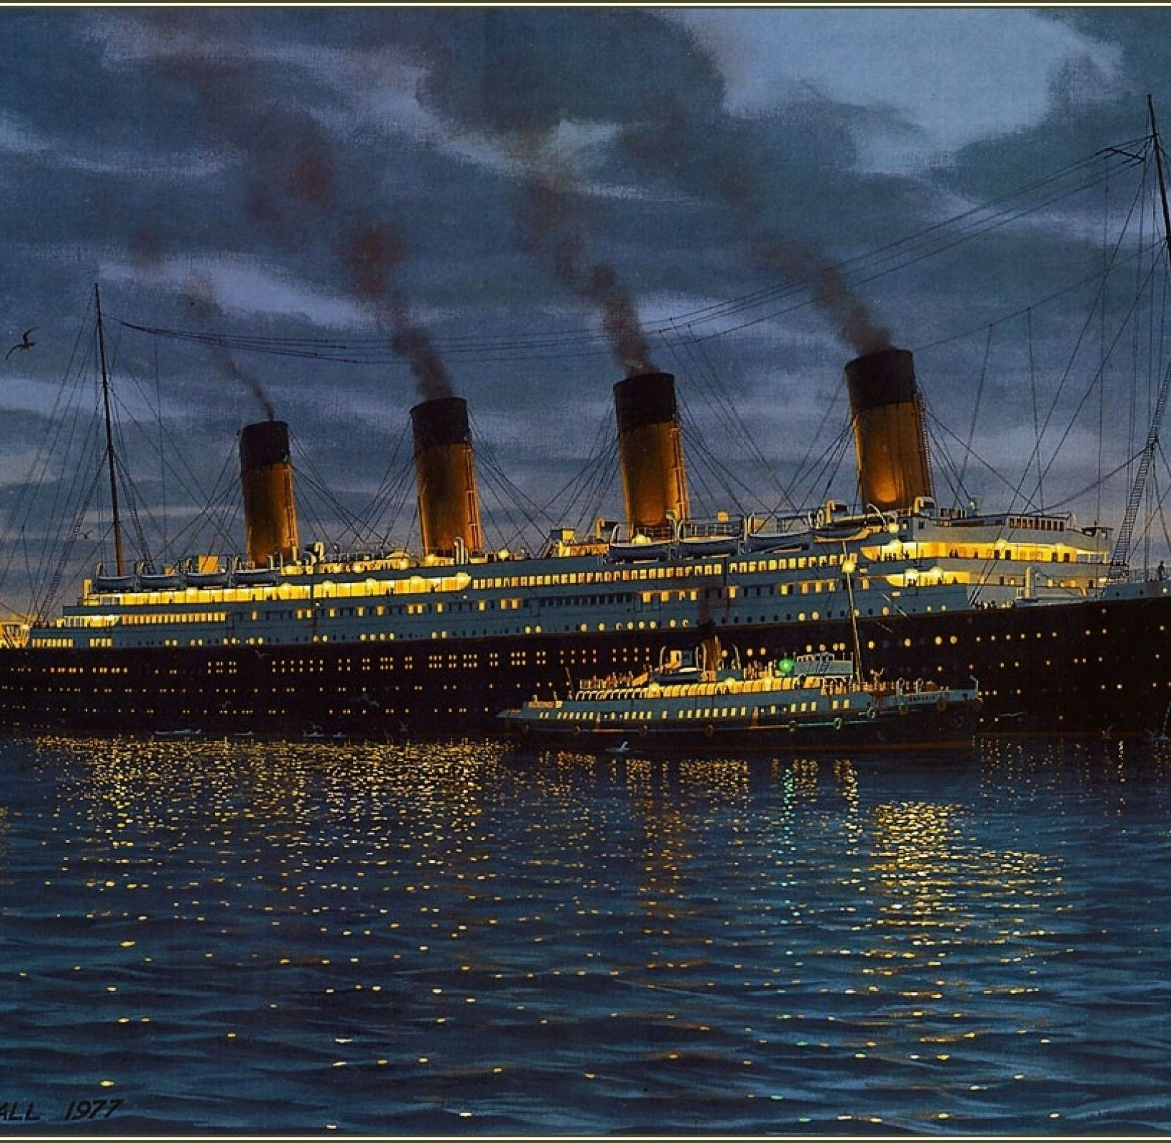
LO: predictions
Monday 4th January 2021

Slide 2
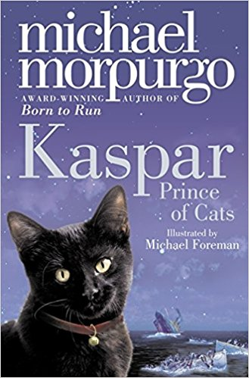
Don’t forget to add WHY you think this- EVIDENCE!
Predictions about the cover...
I wonder if
Perhaps the ship
‘Prince’ makes me think of…
Maybe the cat represents
I think that
In my opinion…
The colour scheme suggests...
I already know … therefore …

Slide 4
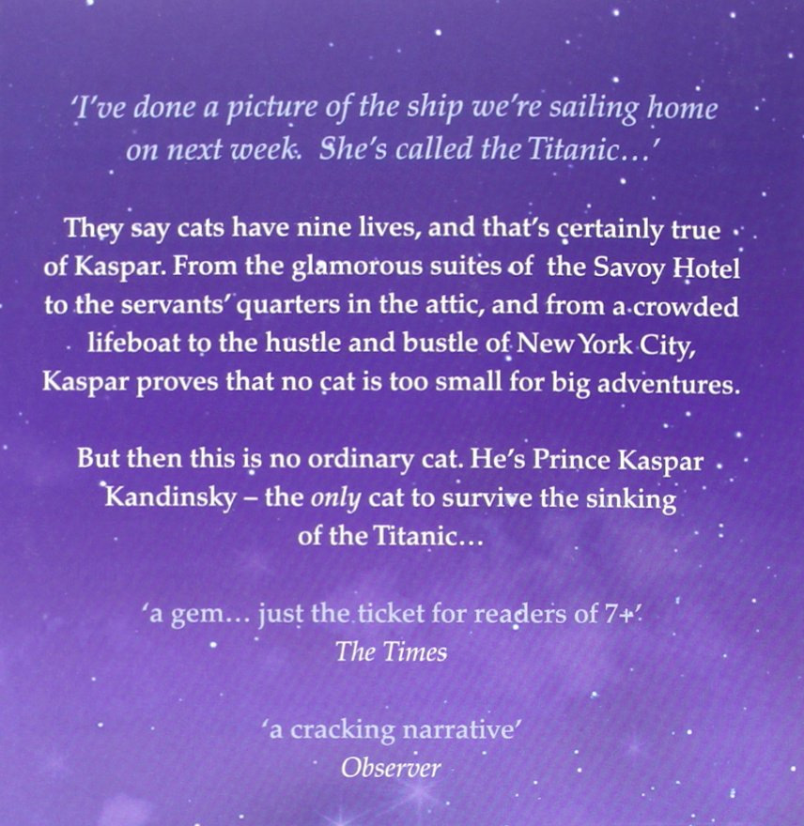
-> Have your predictions changed now that you’ve read the blurb?

