Slide 1
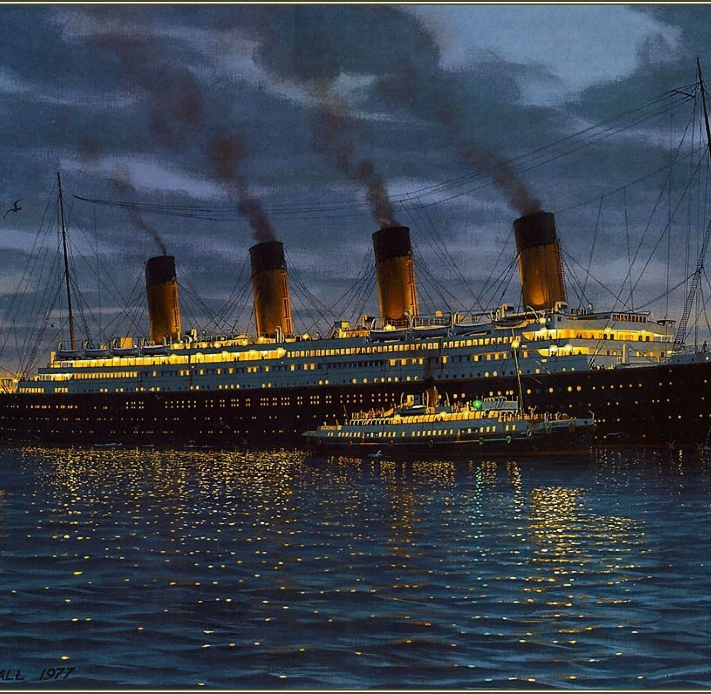
Reading Comprehension
Monday 1st February 2021

Slide 2
Enjoy reading Chapter 8: Women and Children First

Slide 13
Now answer the comprehension questions carefully, using textual evidence to support your answers.

