Slide 1
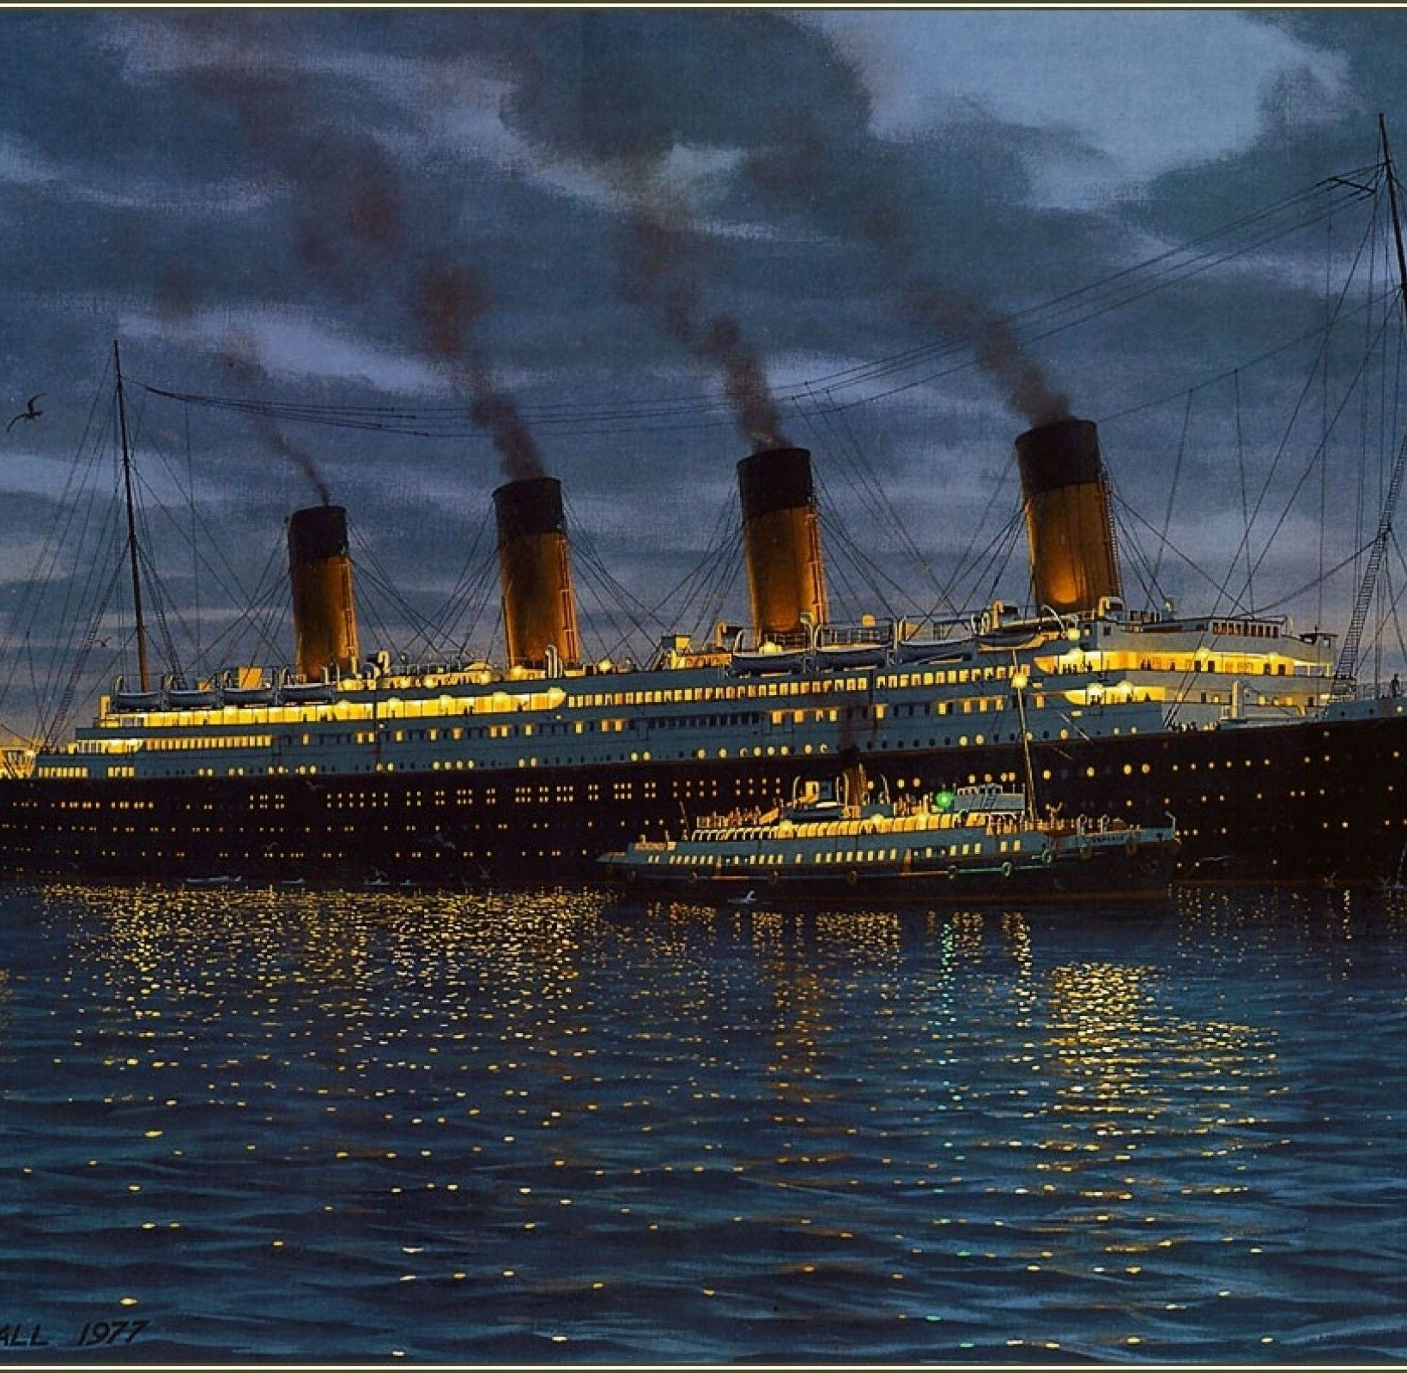
I can research and take notes
Monday 25th January 2021

Slide 2
Enjoy reading Chapter 7: We’ve only gone and hit a flaming iceberg!

Slide 11
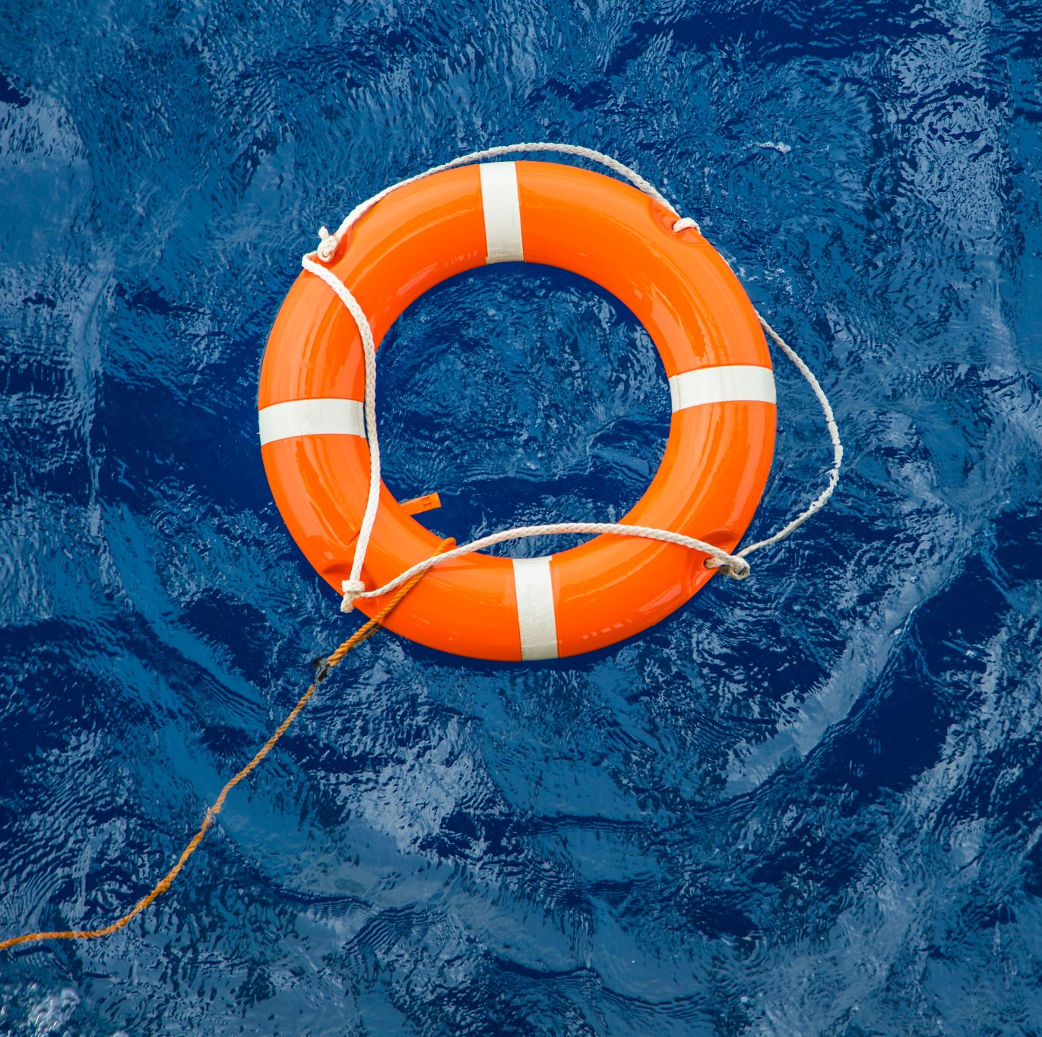
Whose fault was the sinking of the Titanic?

Slide 12
Today you are going to research some key people involved in the Titanic disaster and begin to think about who was to blame for the sinking…
Who were they?
What did they do when the disaster struck?
What was their job?
Were they solely to blame?
How might it have been their fault?
Was there anything that might have justified their actions?
How might it NOT have been their fault?

Slide 14
Present your research as a bullet pointed list or create a mini fact-file for each suspect.
When you’re reading, keep this question in mind: who was responsible for the sinking of the Titanic?
Here’s an example to get you started!

