Slide 1
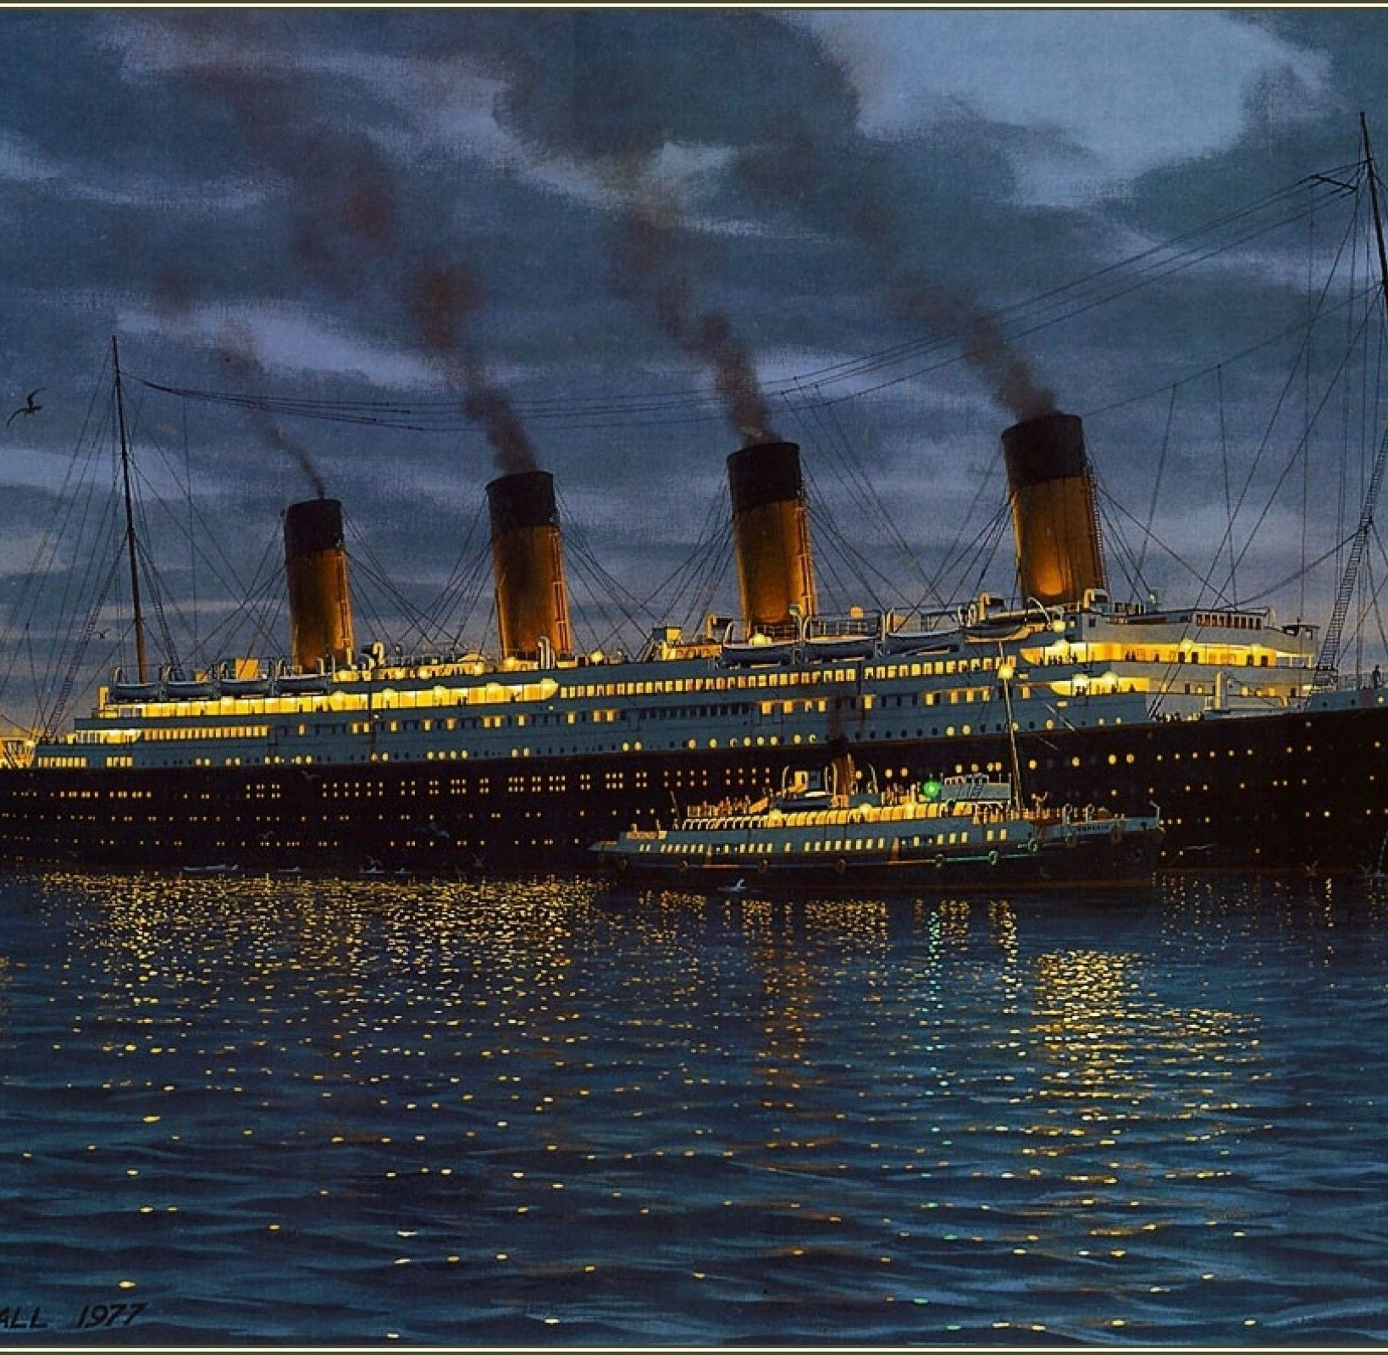
Chapter 4: Who gives a fig, anyway?
Reading Comprehension
Monday 18th January 2021

Slide 6
