Slide 1


Crime and Punishment
There is audio on this PowerPoint. Make sure you have the volume on your computer. You could wear headphones if you have them. When you ready to start, click here or the down arrow.
Monday 25th January

Slide 2

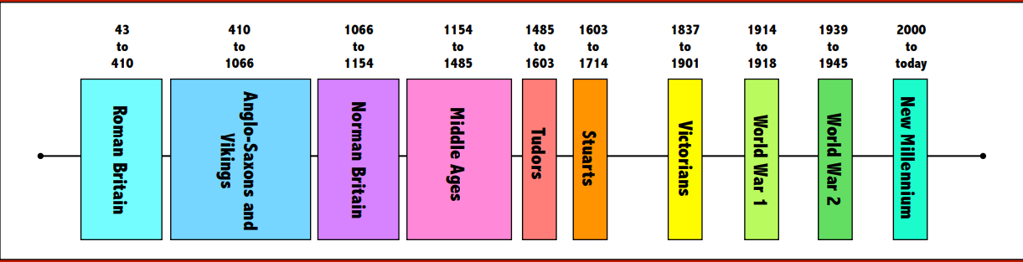
So far in our topic, we have learned about crime and punishment in Roman Britain and in Anglo-Saxon times.
Look on the timeline. Can you work out which era we will study next?

Slide 3
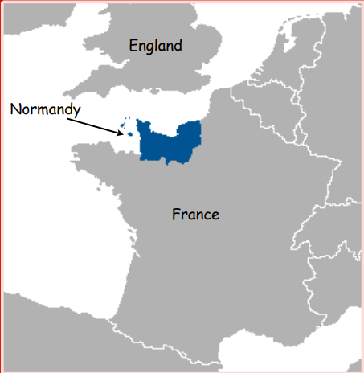
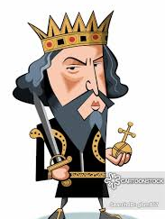
The Normans!
The Normans came from Normandy in North West France.
In 1066, William the Conqueror won the Battle of Hastings and became the King of England.

Slide 4
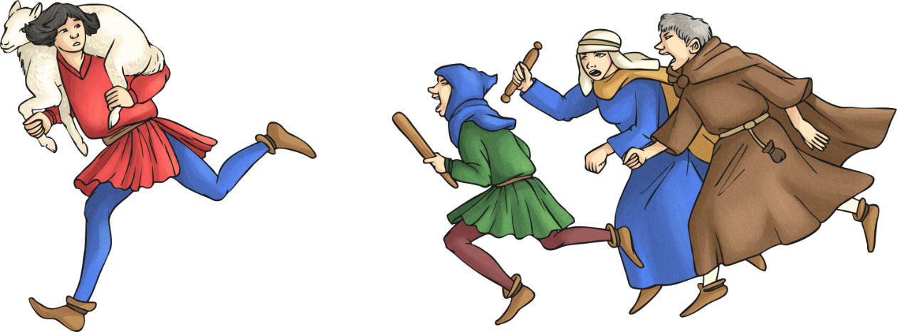
What can you remember about Anglo-Saxon crime and punishment?
What is wergild?
What is trial by ordeal?
Whose job was it to catch the criminals?

Slide 5
Did you remember?
What is wergild?
What is trial by ordeal?
Whose job was it to catch the criminals?

Slide 6
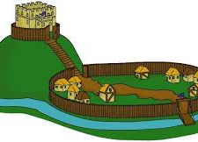
Norman England
William the Conqueror changed the way England was organised.
Motte and Bailey castles were built in villages and towns.
The lord was now in charge of law and order.
The lord of the manor would be a judge at courts and many trials would have juries too.

Slide 7
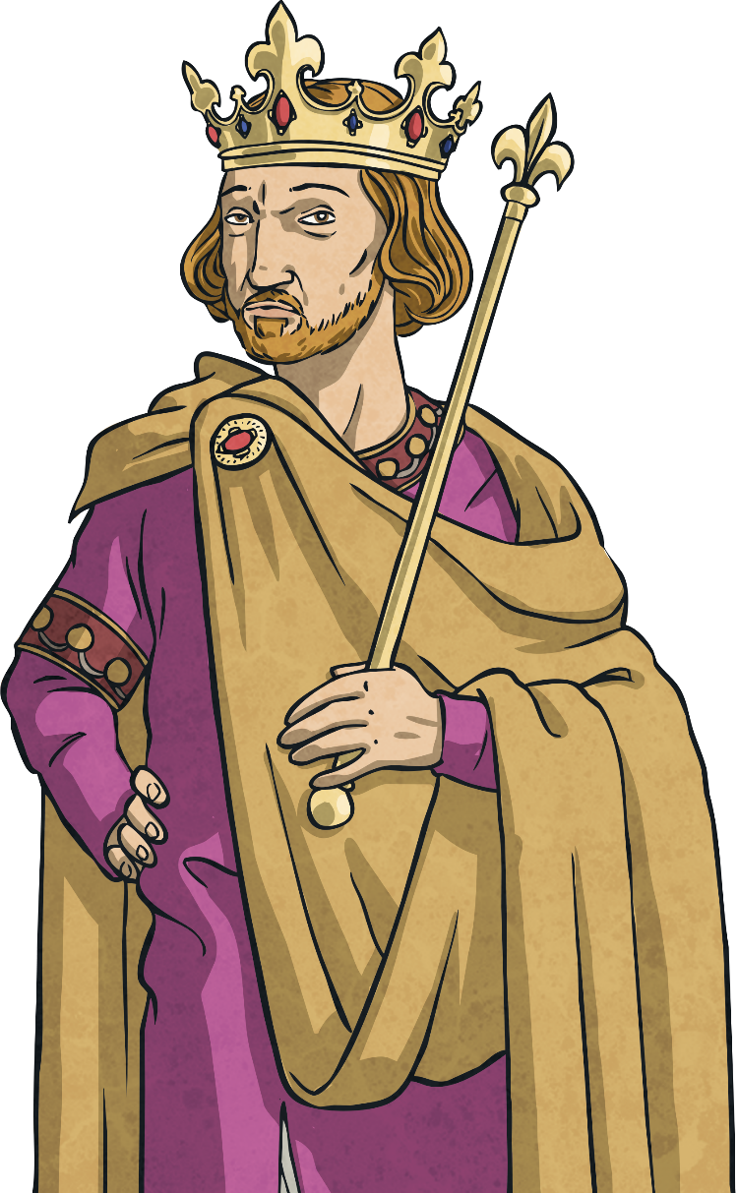
Norman England
Instead of wergild, people were mutilated (for example, by having their ears slit or their hands cut off), executed or fined for their crimes.
However, instead of the money going back to the victim or the victim’s family, it would go to the king.

Slide 8
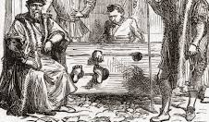
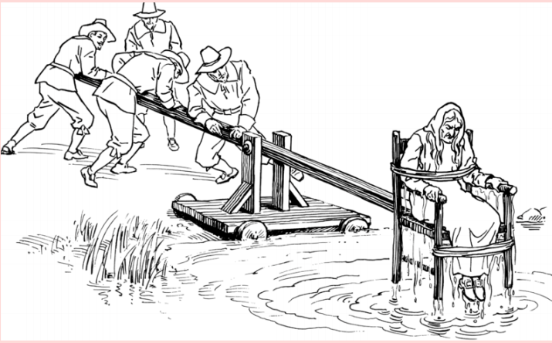
Shaming Punishments
Trial by ordeal was abolished about 100 years after Norman rule began.
Some criminals were put in the stocks if you were a man or on the ducking stool if you were a woman.
This was called a ‘shaming punishment’ as it humiliated the criminal in front of his or her neighbours.

Slide 9
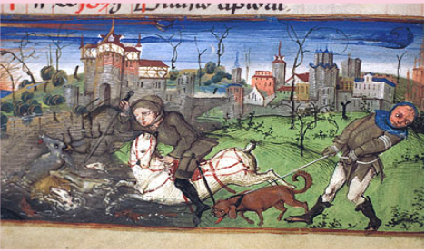
Forest Law
The Norman kings set up large forests where they could hunt for deer.
Anyone living in the forests now had to have a licence to hunt animals or even gather firewood.
25 royal forests had been set up by 1087 and in the end there would be around 80.

Slide 10
What do you think of Forest Law?
Most people lived on small farms and grew their own food. They gave some food to the lord.
They were poor so added to their diet by hunting.
Hunting was a very popular hobby for rich Norman lords.
The Norman lords believed they owned all the land so could do what they wanted.

Slide 11
Forest Law Task
Today you are going to pretend you are a Norman.
You can choose to be a Norman Lord or a Norman peasant.
After you have read about your character on the following slides, you will write a letter to William the Conqueror telling him your side of the story.

Slide 12
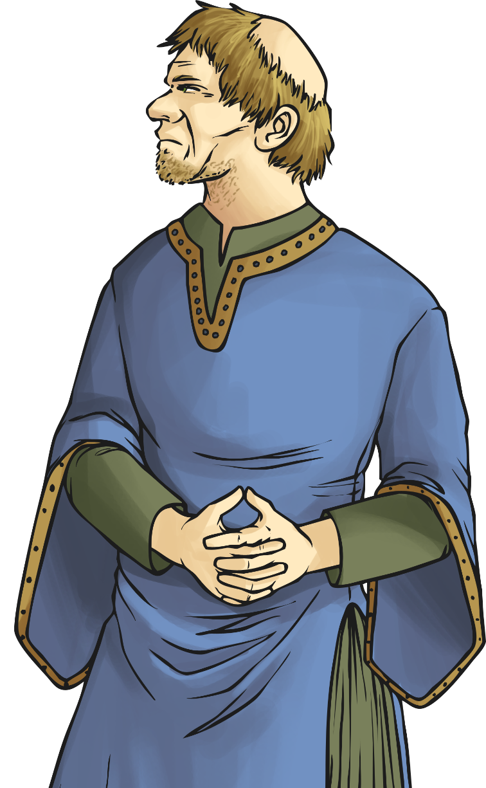
Forest Law Task
What is Gerald’s job?
Why does he think he should chop off Wulfric’s hand?
Lord Gerald
Gerald lives in a castle near the New Forest and holds courts to punish people who poach from the forest.
Gerald has to answer to the king if people are stealing from the forest.
Gerald has a wife and family and a large household of servants.
He gets food from the local peasants, like Wulfric, who grow food on their farms rented from Gerald.
Hello, my name is Gerald and I am a lord. I hunt with the king in his forest, and I am very annoyed when I find out a villager has been stealing the king's deer.

Slide 13
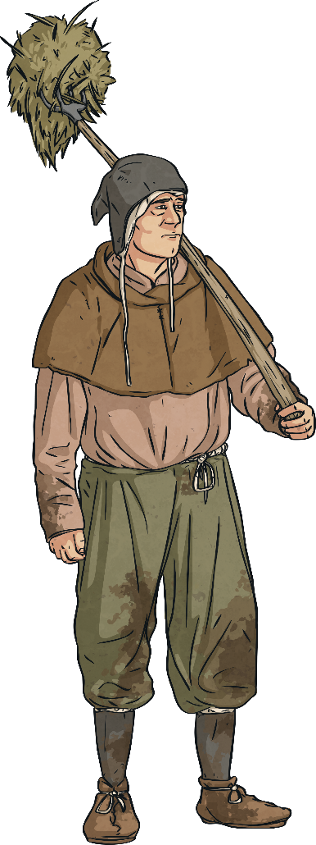
Forest Law Task
Why will they cut his hand off?
What will happen to Wulfric if his hand is cut off?
Wulfric the peasant
Deer were specifically meant for the king and no one else was allowed to eat them.
It was a crime to hunt any animal in the forest, but Wulfric decided to hunt deer.
Wulfric has a wife and family.
He has a little bit of land that he farms, but he has to give some of his food to the lord.
Without his hand he won't be able to farm as well and his family will be even hungrier.
Hello, my name is Wulfric. The Lord will cut off my hand for poaching the king's deer in the New Forest.

