Slide 1
Geography
Wednesday 20th January

Slide 9
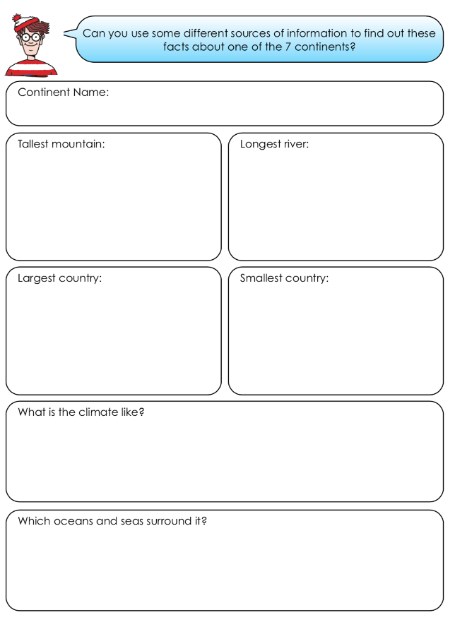
Now have a go at the worksheet. Use different sources of information to find out facts about a continent of your choice.

