Slide 1
English
Friday 8th January

Slide 2
I am successful if...
I can retrieve and infer information from a text.

Slide 3
Re-read Chapter 2

Slide 6
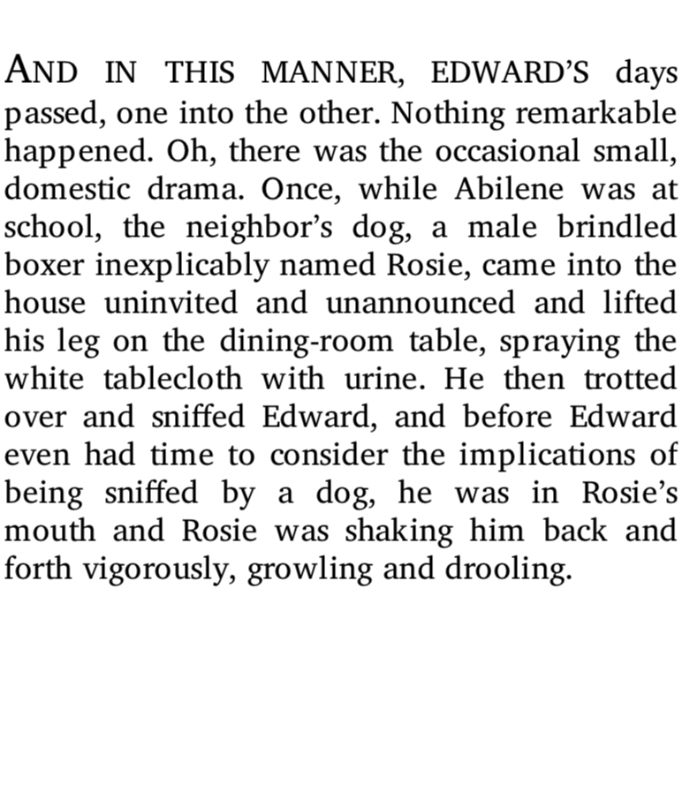

Slide 7
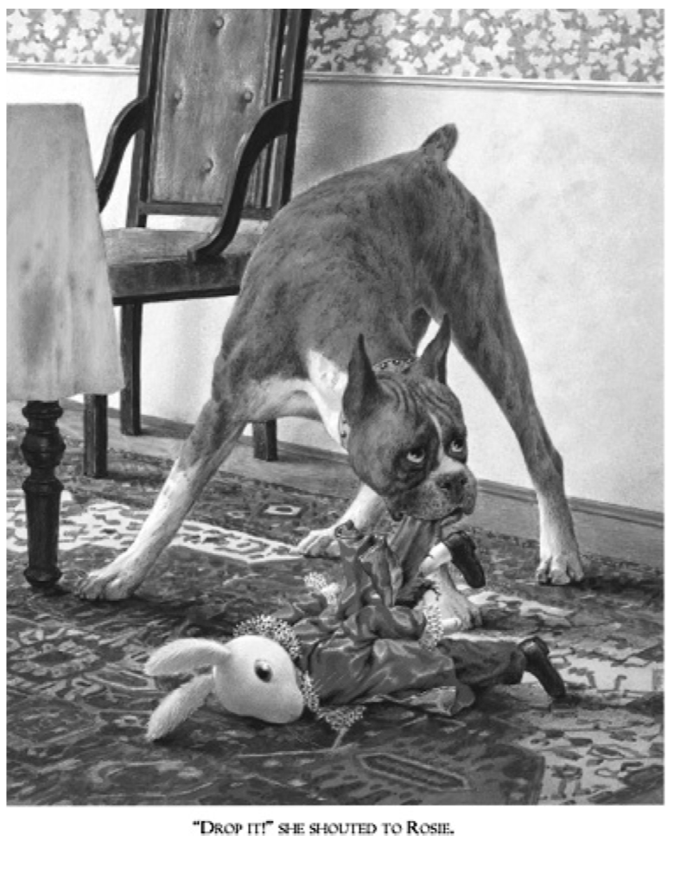

Slide 8
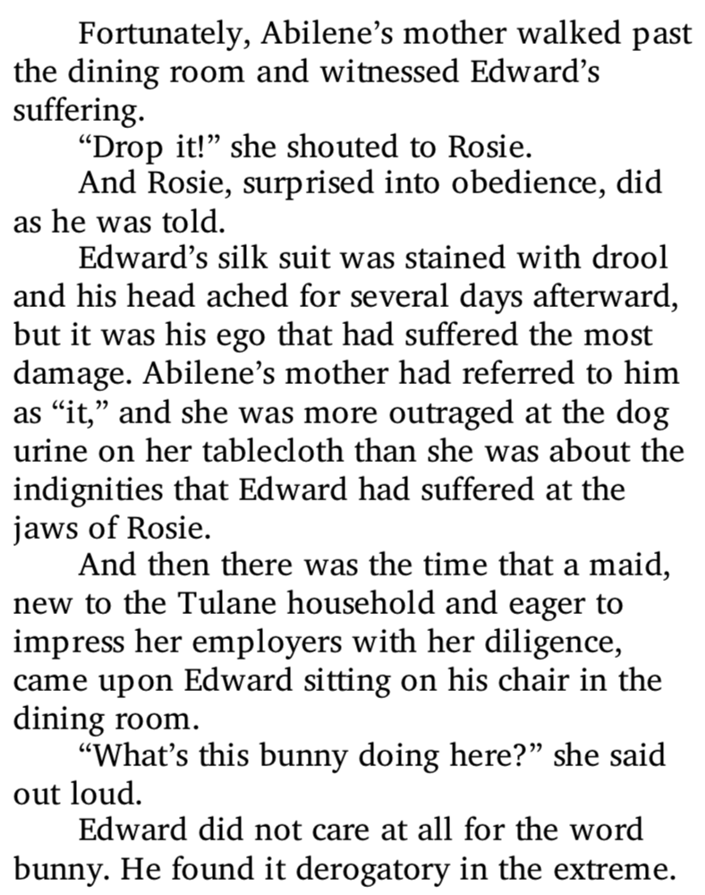

Slide 9
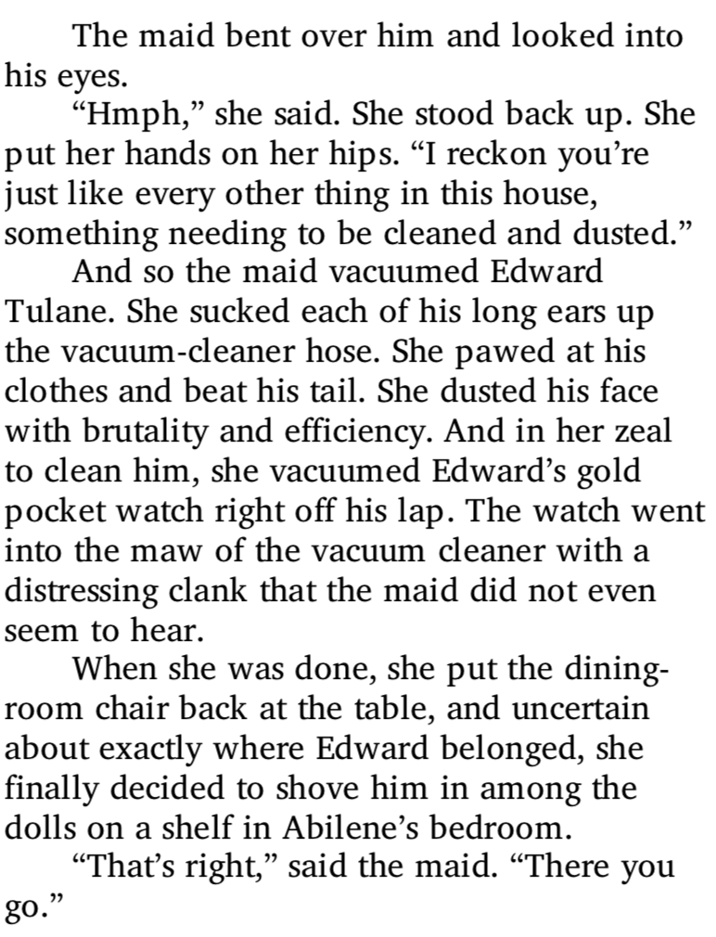

Slide 10
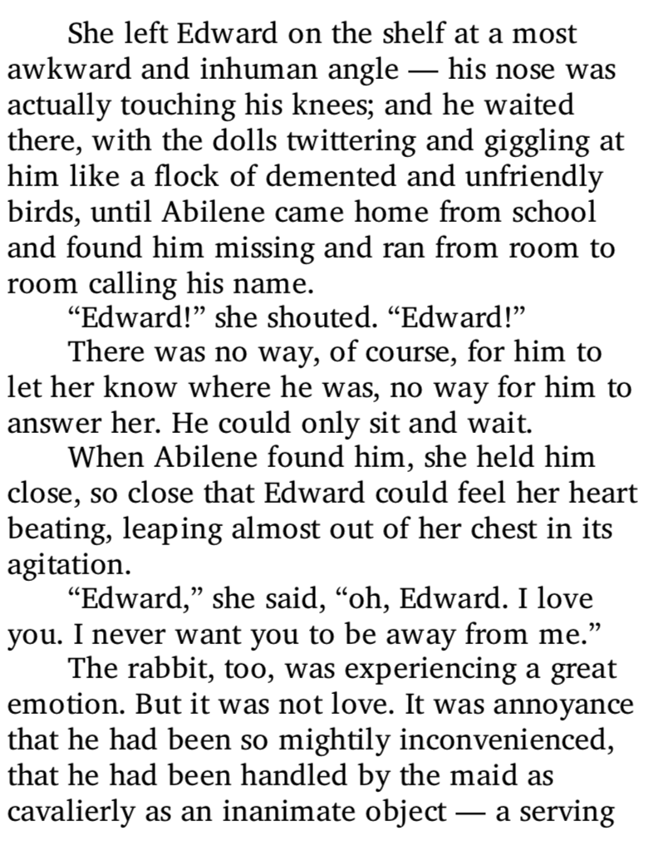

Slide 11
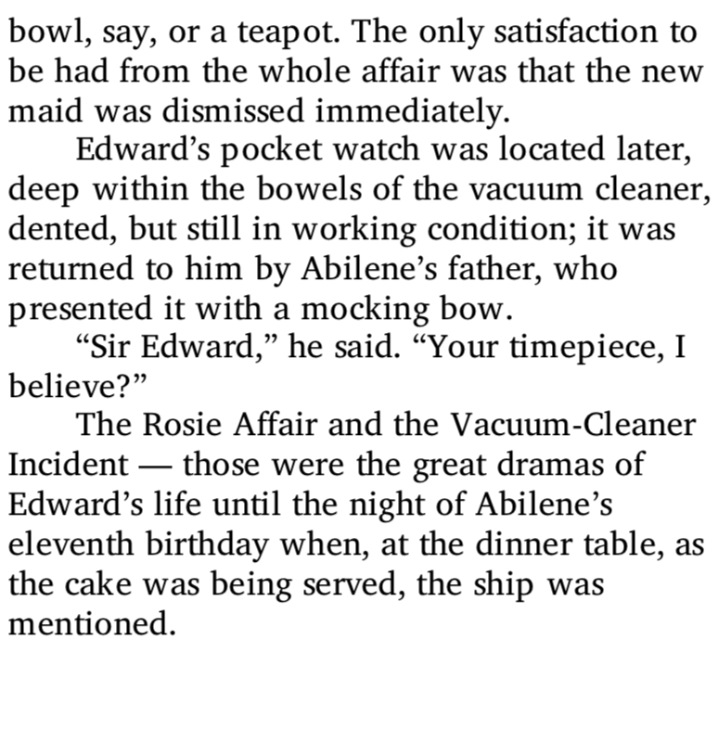

Slide 12
Your task
Use the worksheet to answer questions about Chapter 2.

Slide 13
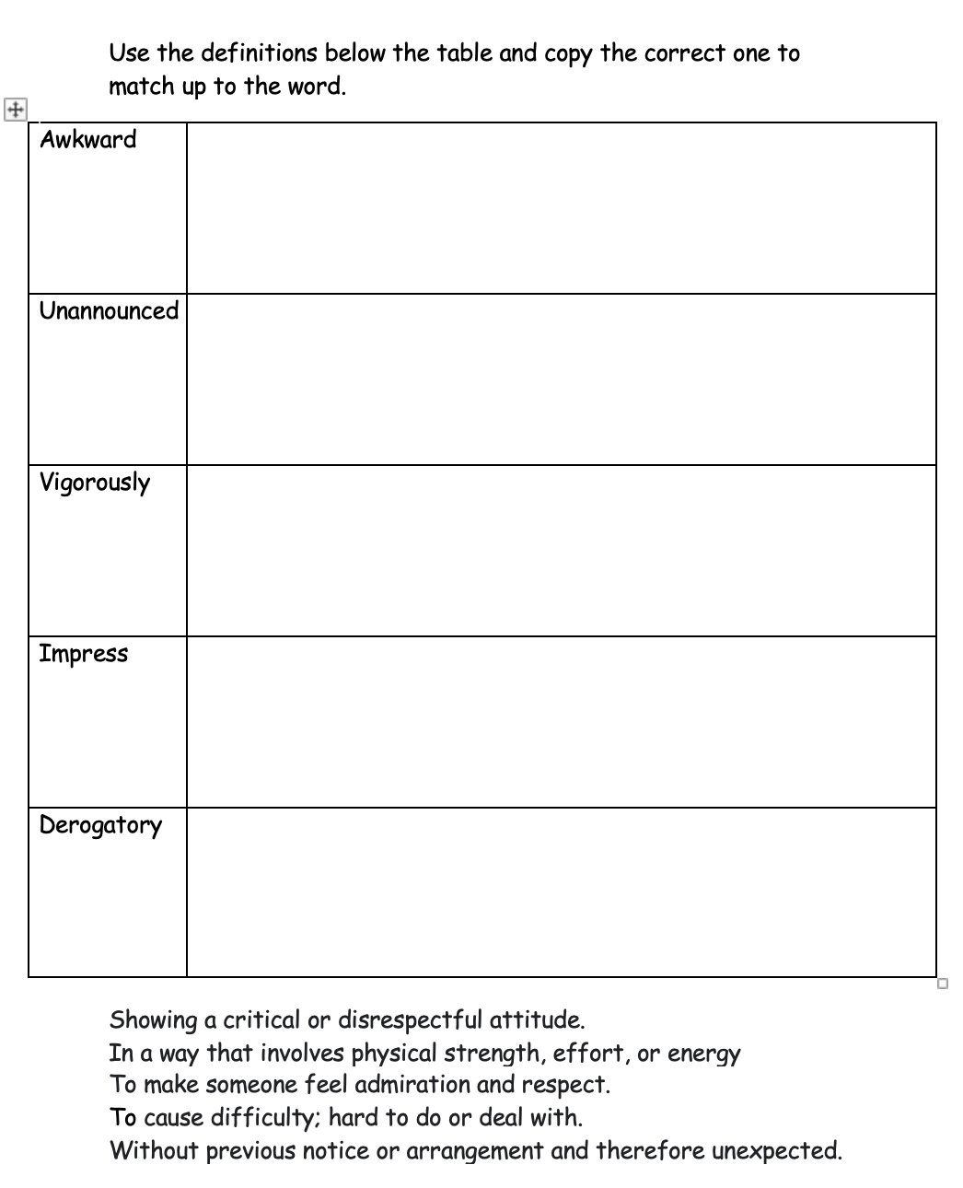
Extension - Matching up the definitions

