Slide 1
8.1.21
Are these numbers odd or even? How do you know?
23
27
46
52
12
98
67
46
35
10) 98
11) 146
12) 132
13) 245
14) 689
368
13,256,895
15,577,782
4, 678, 004
73, 689, 497
These look tricky but they are not!
Don’t forget you just need to look at the last digit in the number to find out if it is odd or even.

Slide 2
Spellings
Ask your grown up to test you on your spellings. Have a go at 5 surprise words too (from the common exception word list attached to your spellings)… these are important.
Wordearch
There is a common exception wordsearch on the website for you.

Slide 3
English
Today we are going to read some more pages of the text. I would like you to read the pages first and then listen to me reading them.
When you read them the second time, I would really like you to use lots of expression! It is a funny book and gives a good opportunity to read with some funny voices!
Enjoy!

Slide 4
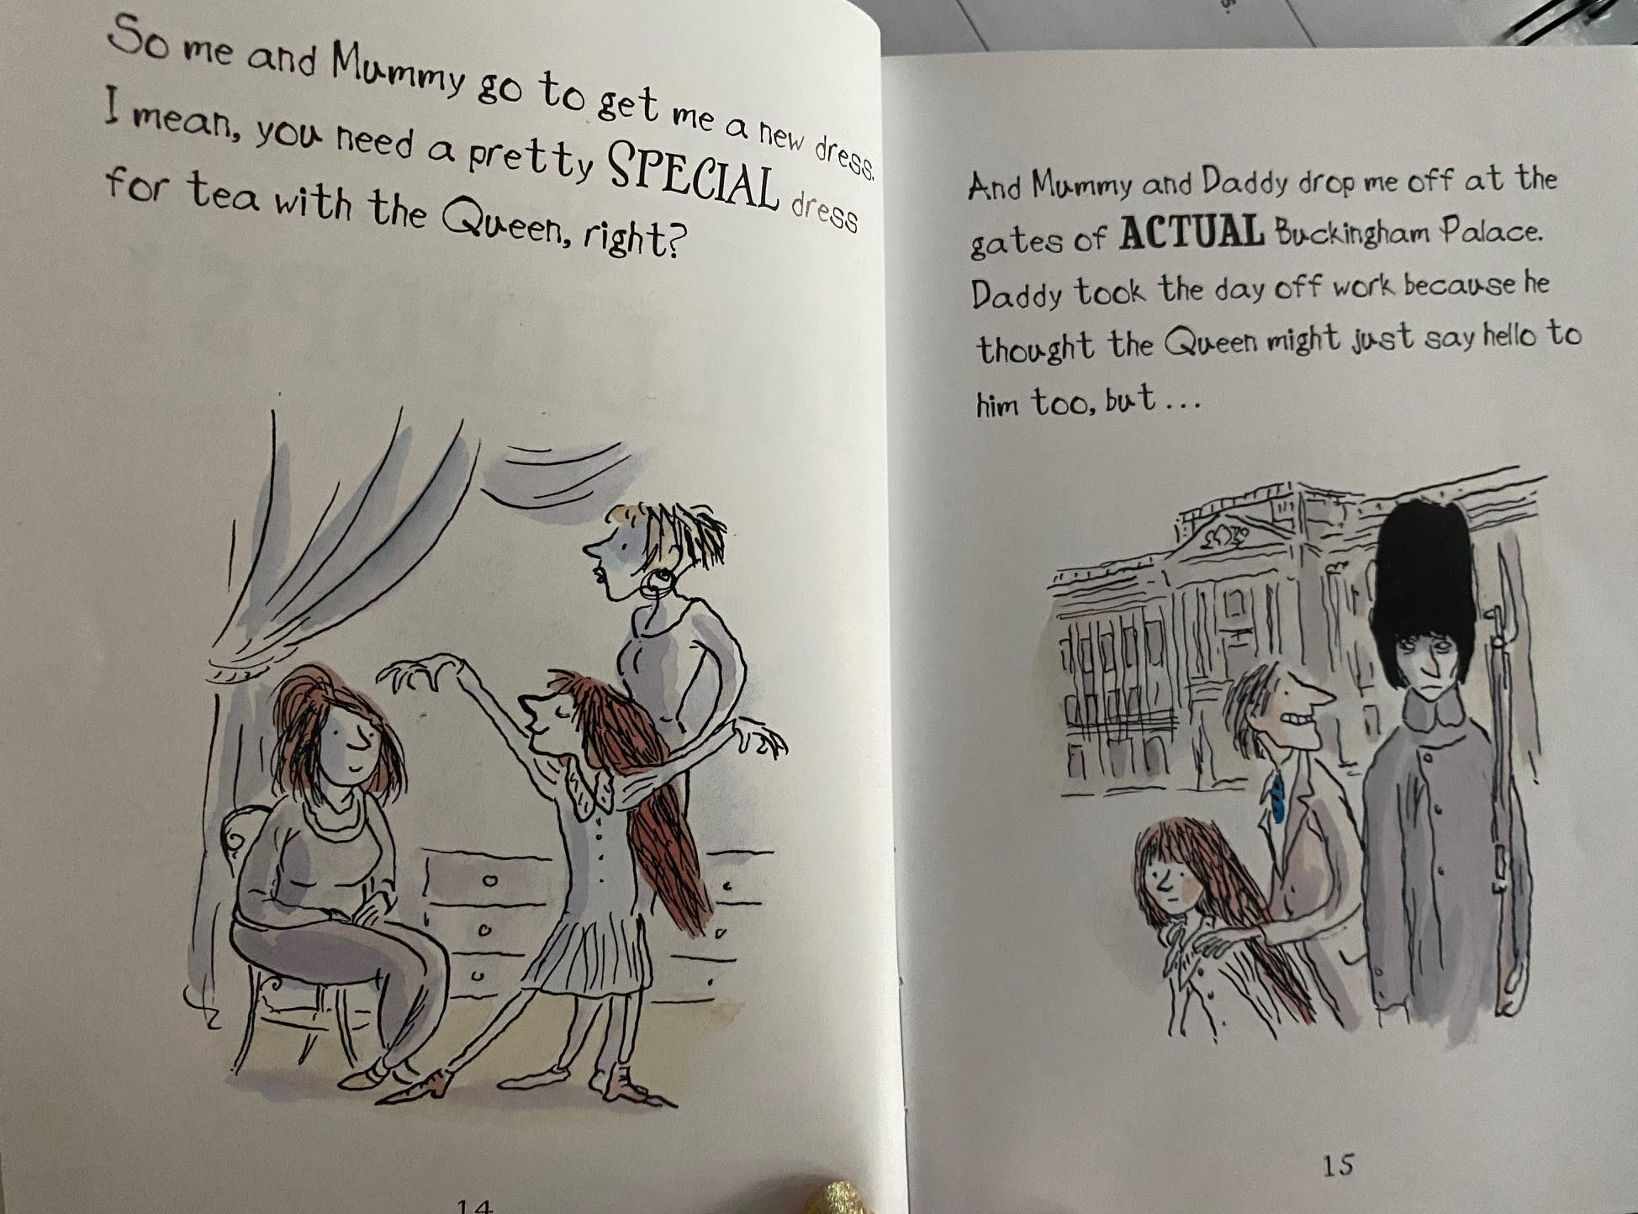

Slide 5
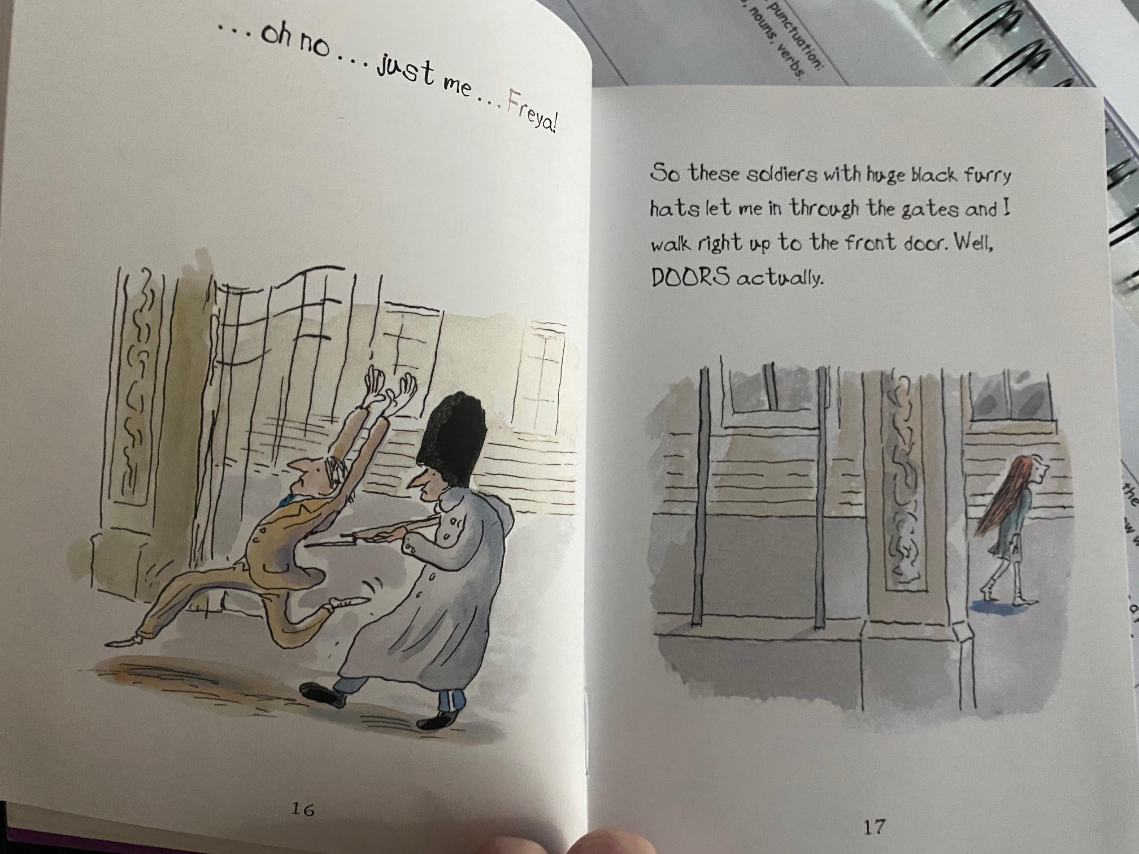

Slide 6
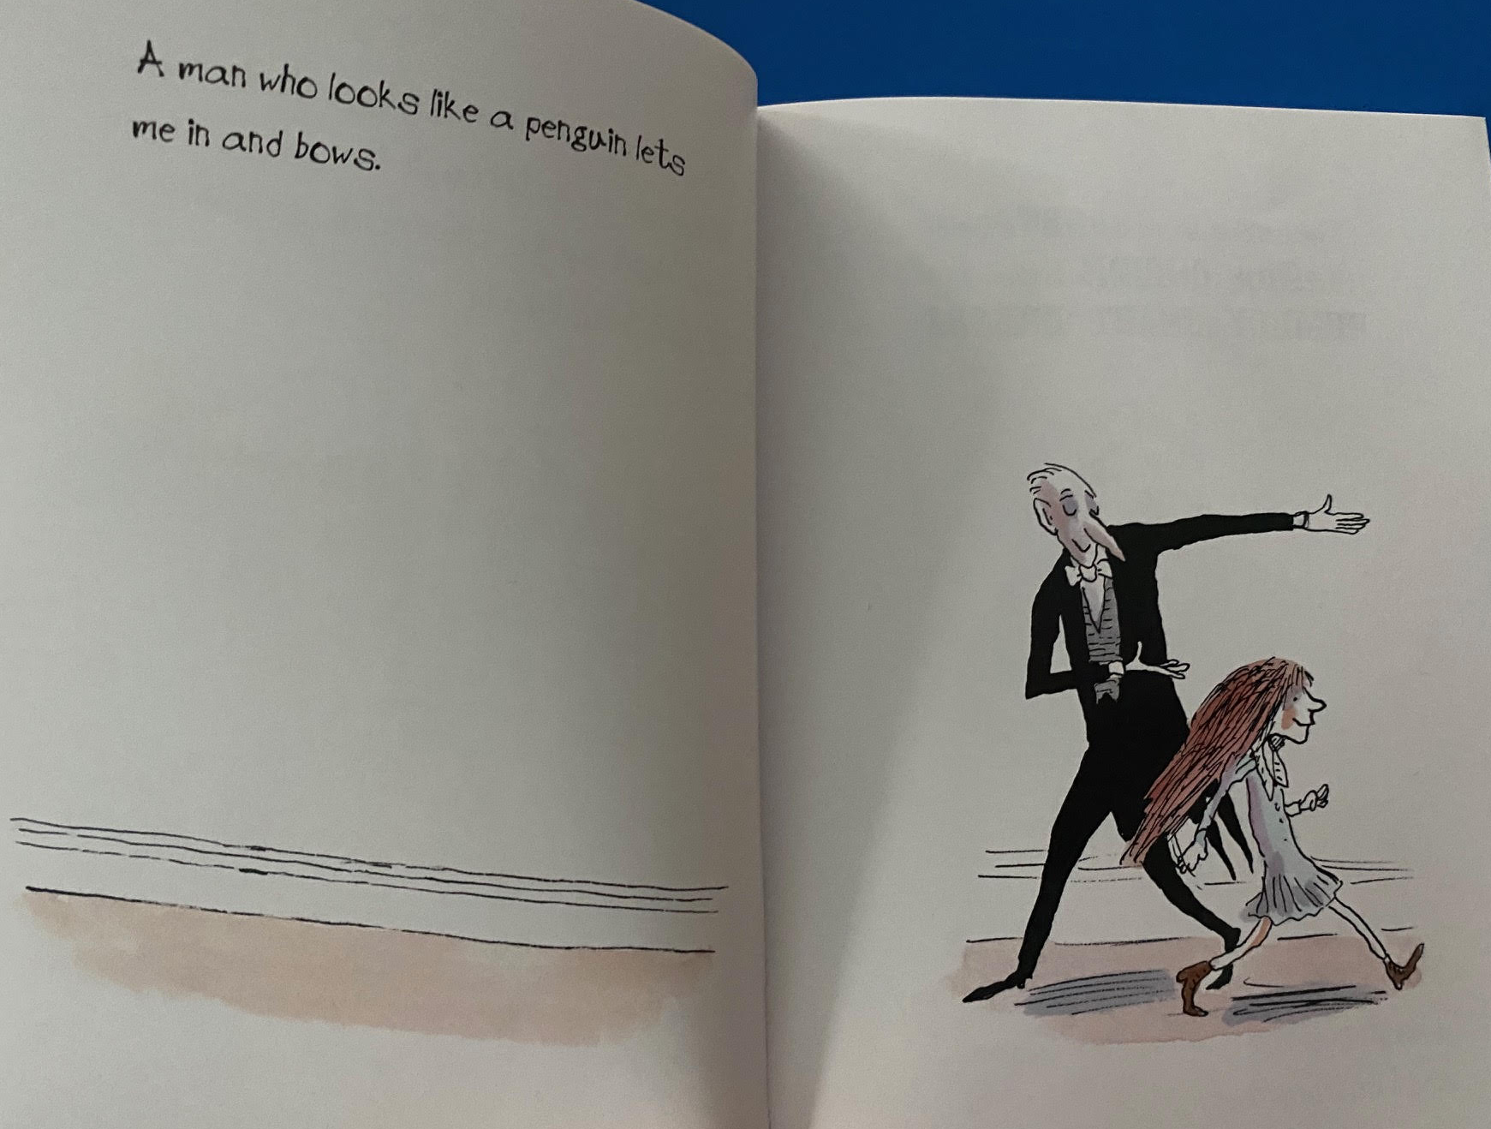

Slide 7
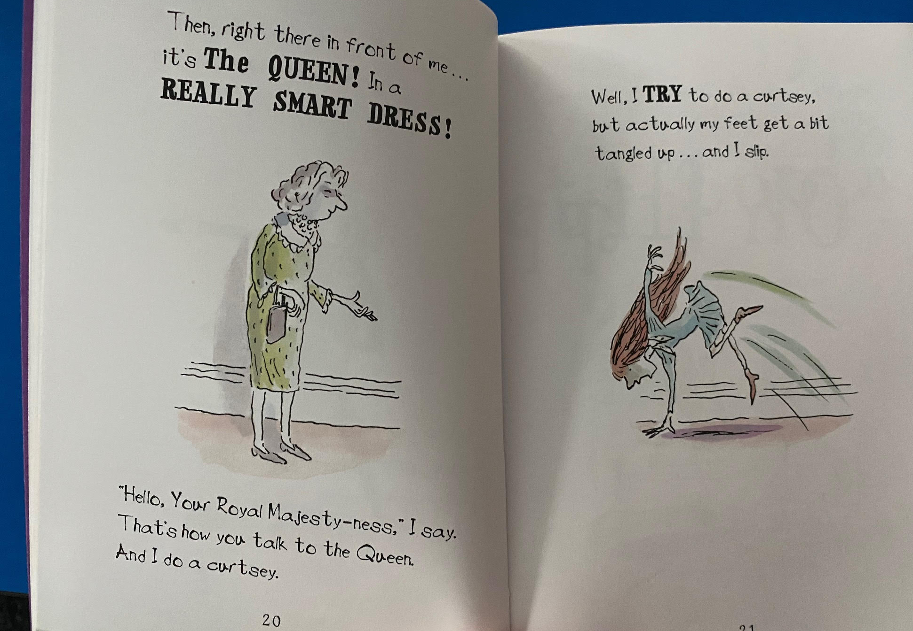

Slide 8
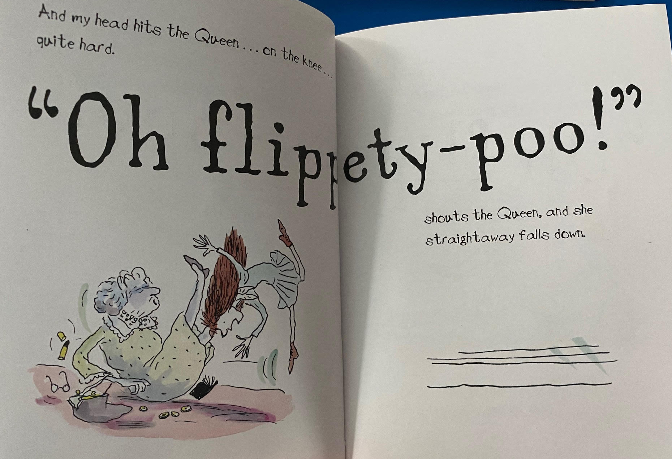

Slide 9
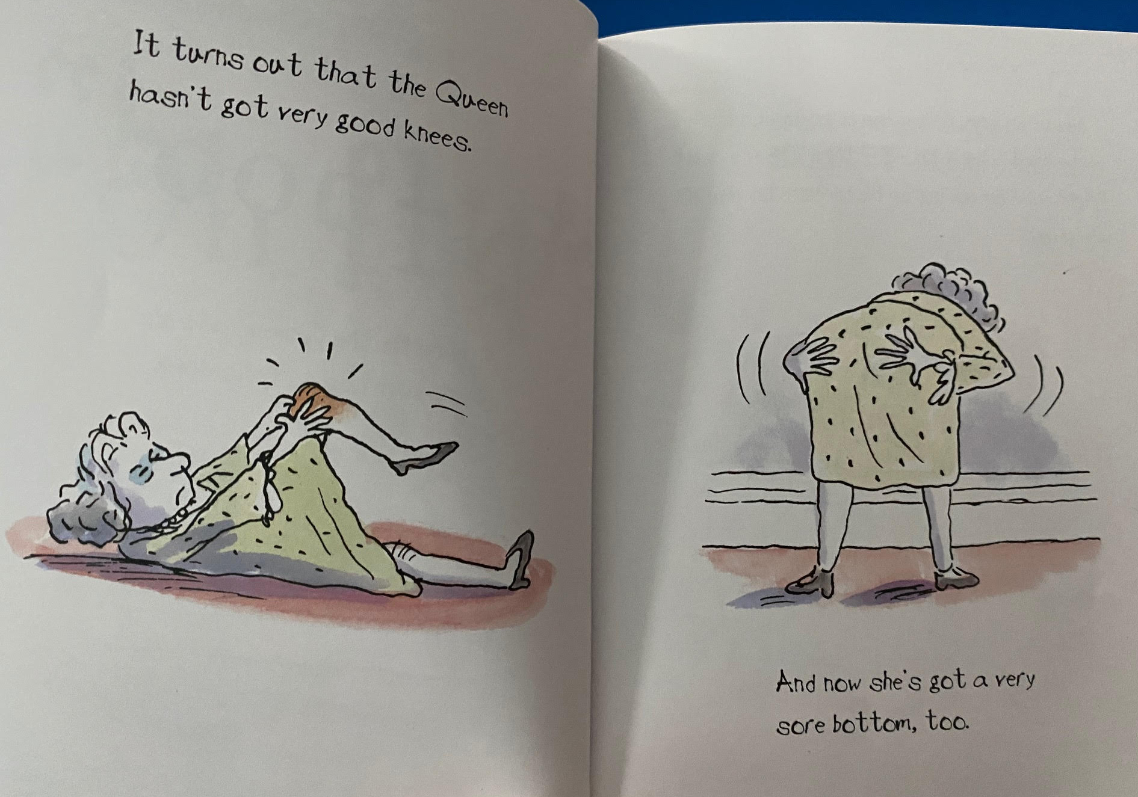

Slide 10
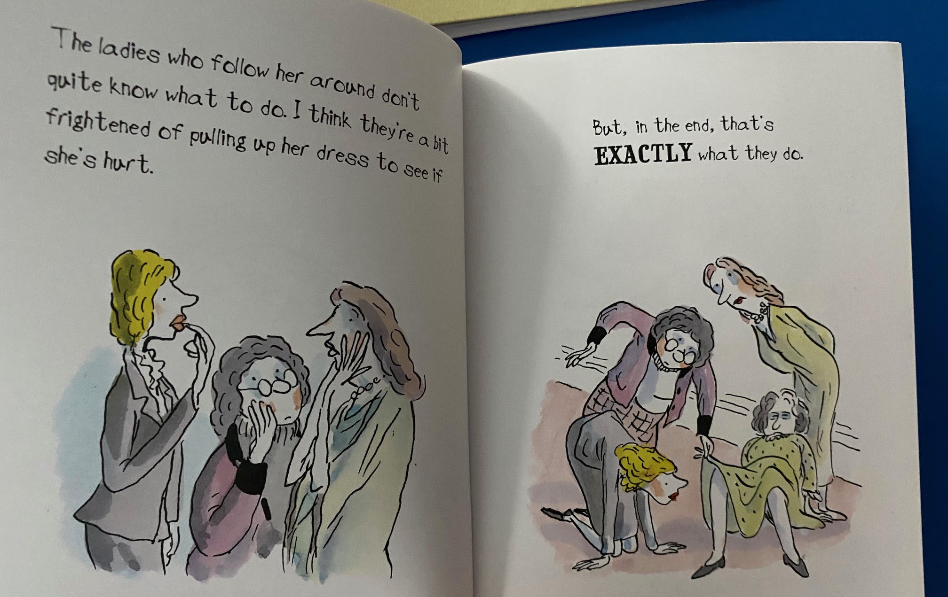

Slide 11
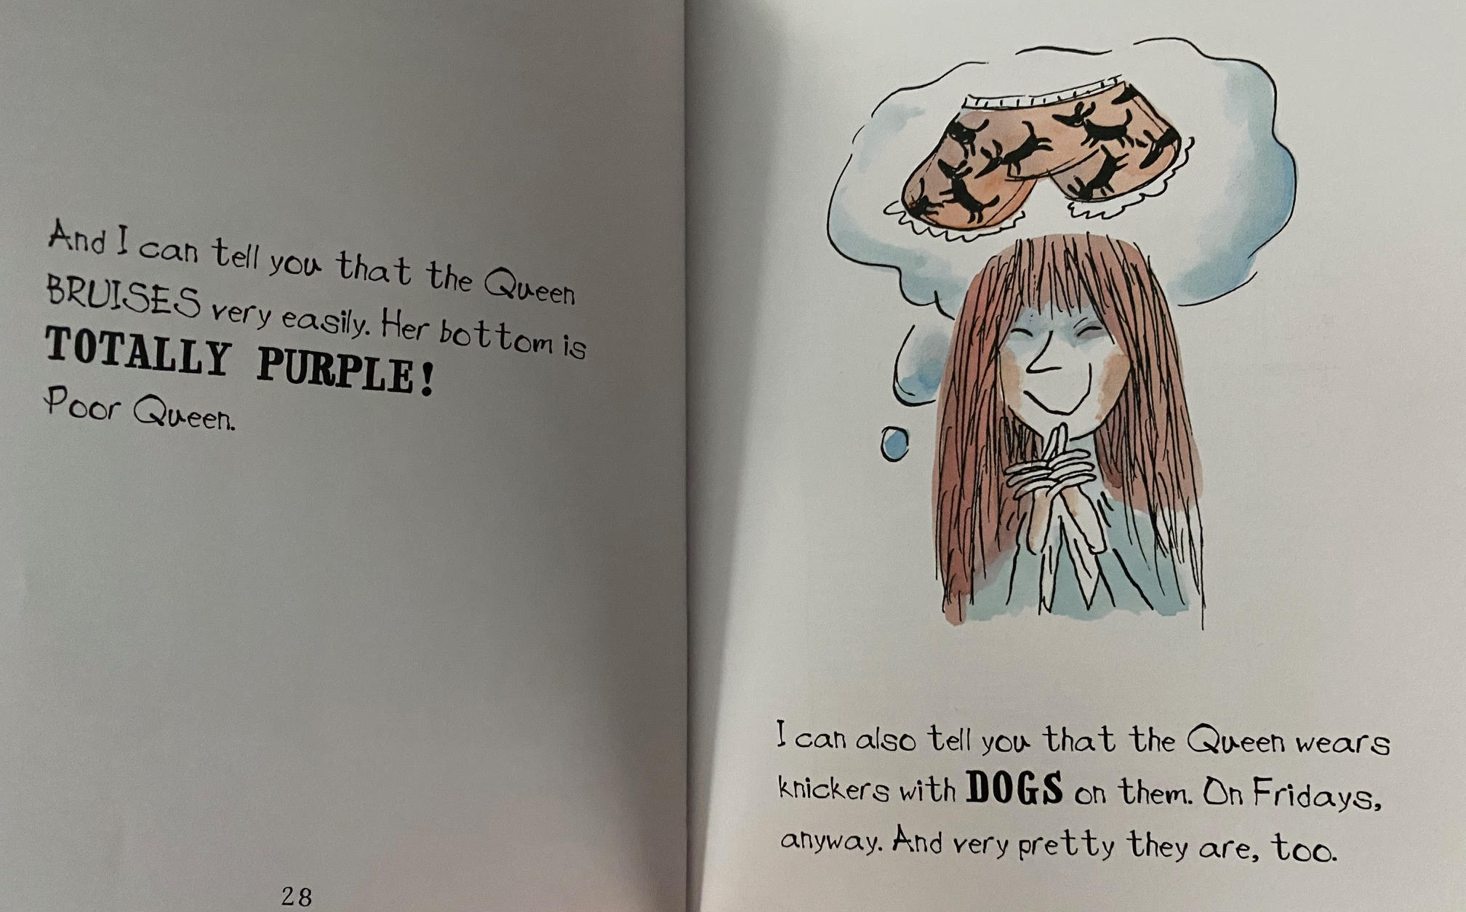

Slide 12
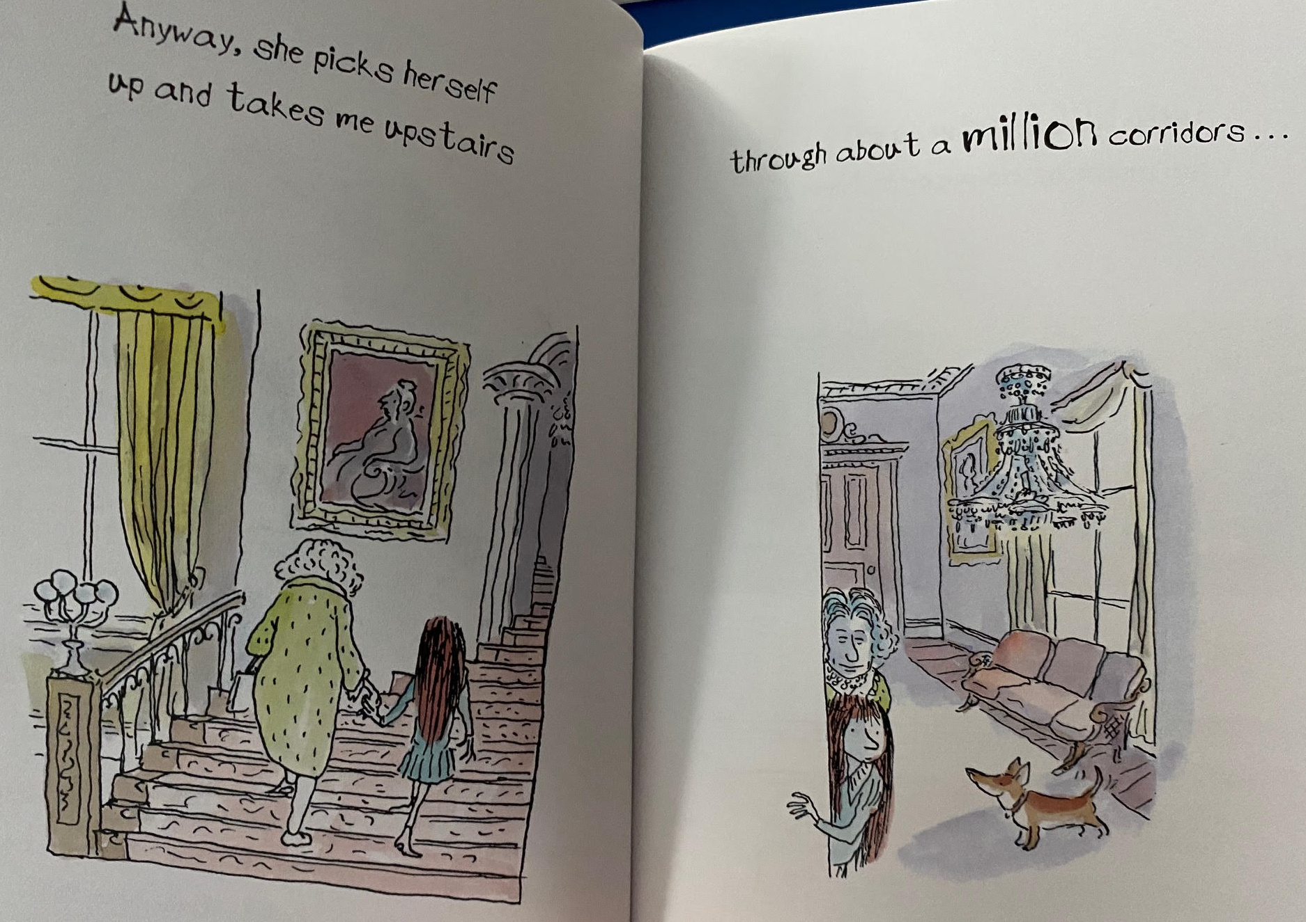

Slide 13
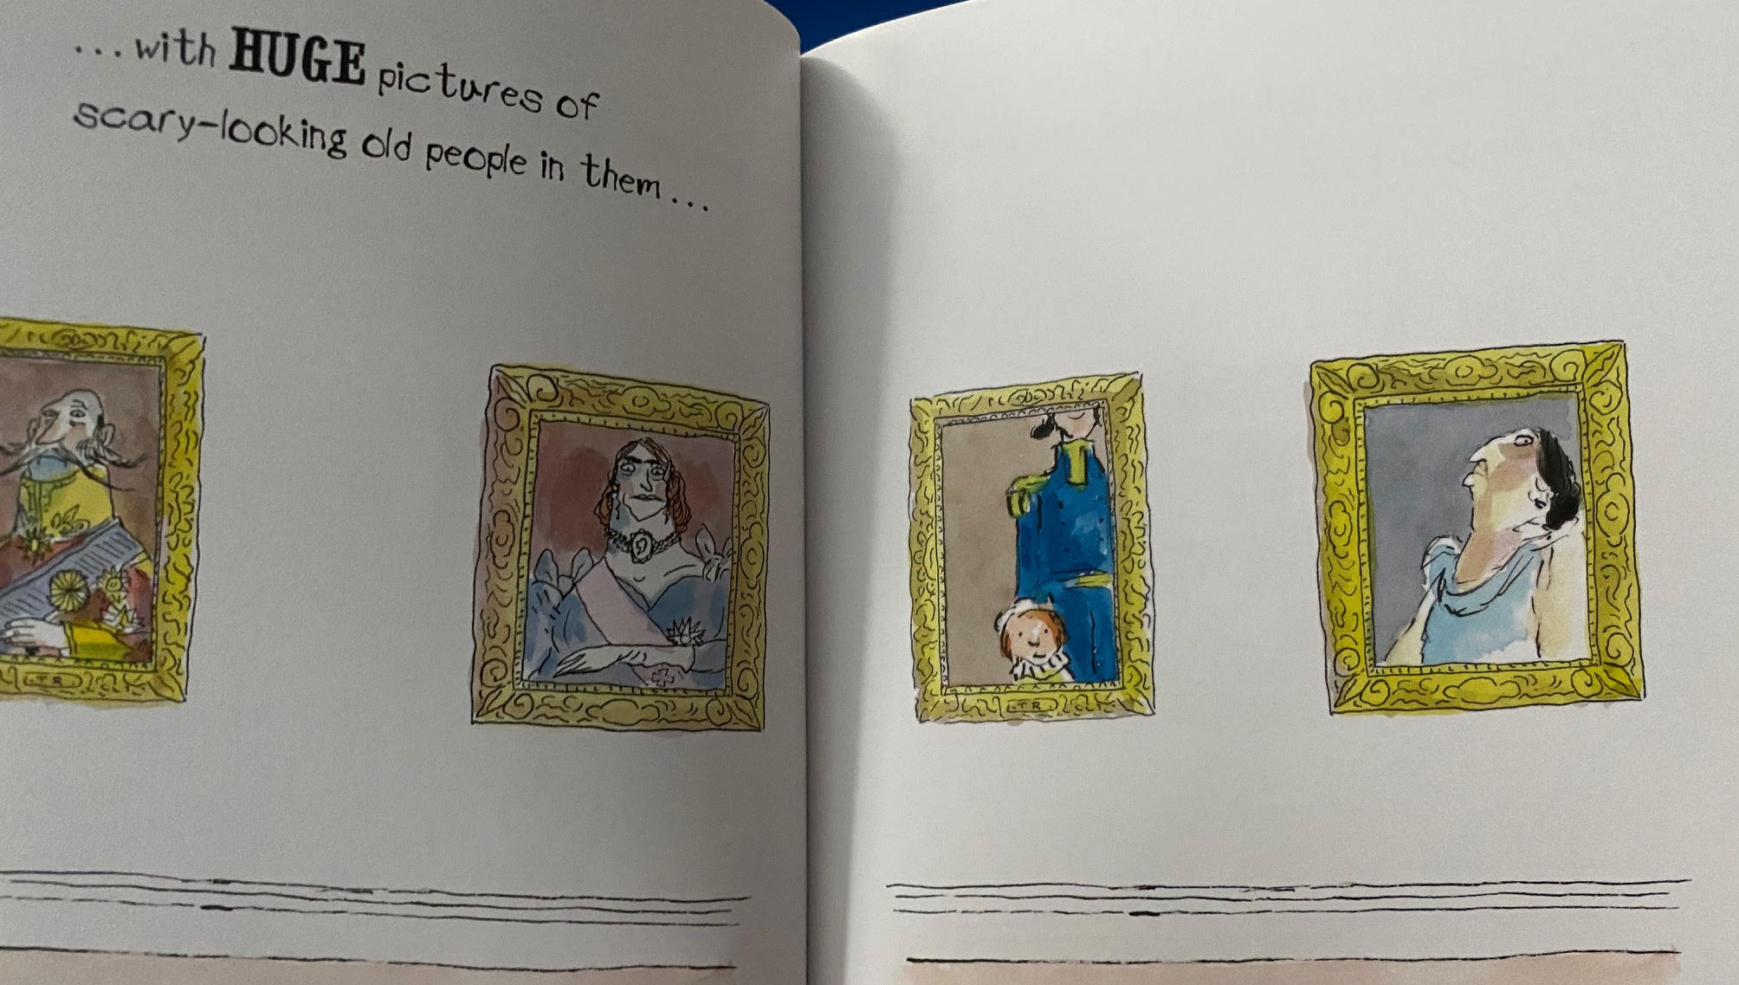

Slide 14
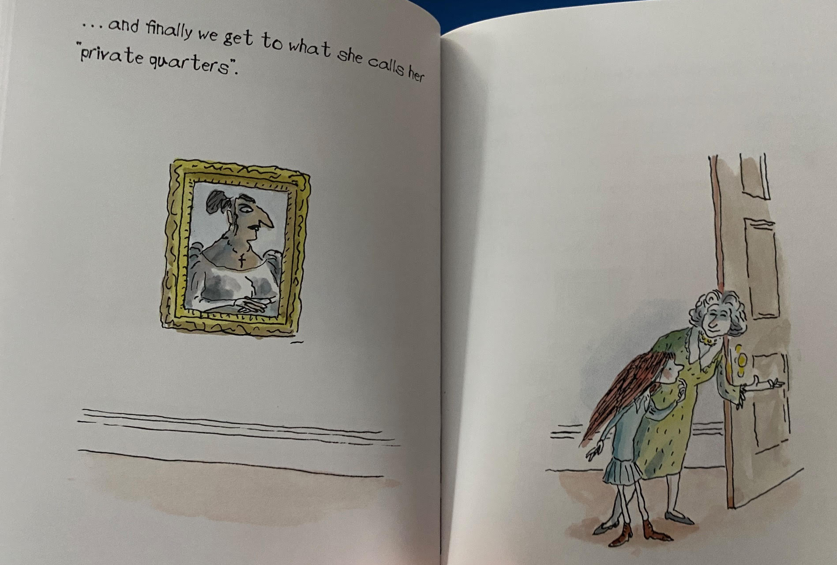

Slide 15
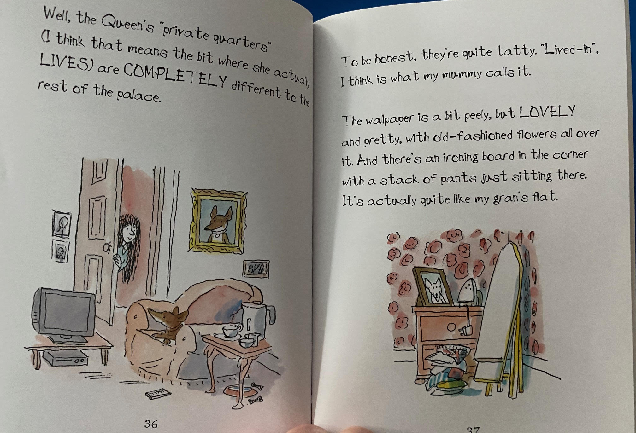

Slide 16
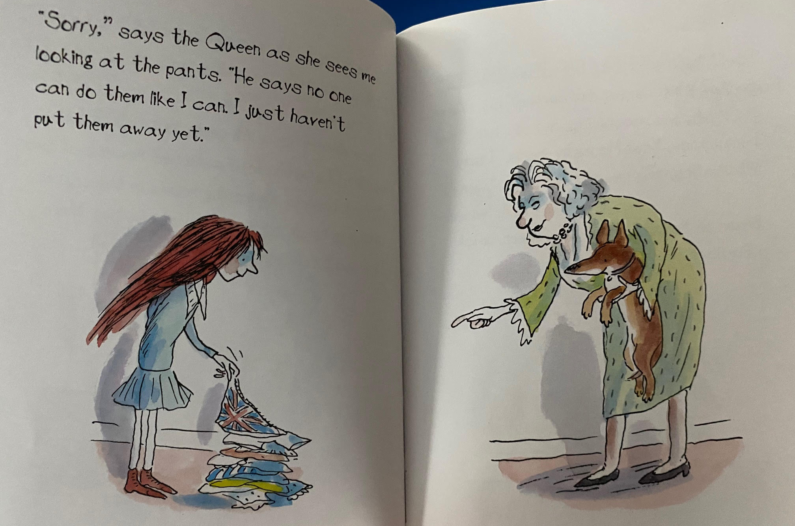

Slide 17
Now, I would like you to go on an adjective hunt. Look through the pages of the text so far and find the adjectives that are used to describe things that Freya can see.

Slide 18
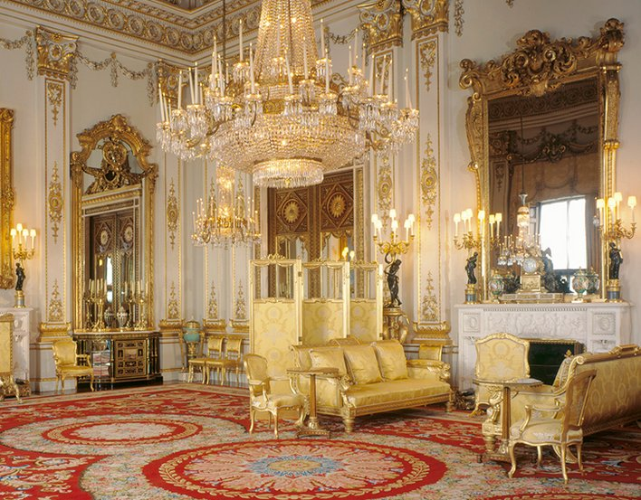
Look at the picture below at one of the state rooms in Buckingham Palace. Can you write a list of adjectives that you could use to describe this room.

Slide 19
Maths
Follow this link below for the online learning video for today’s lesson.
https://vimeo.com/490420115
The worksheet is attached on the website.

Slide 20
Handwriting
The handwriting sheets for this week are on the website. There are 6 sheets on one document and you can choose one to do each day. Remember to clearly show your tall letters and low letters and ensure all the other letters are the same size.

Slide 21
Art
This half term we are going to be looking at portraits. Kings and Queens often have their portrait painted. Have a look at the portraits of some famous Kings and Queens on the next slide.
What do you notice about the portraits?
Portraits often tell a story but no King or Queen wanted to look bad or ugly on a portrait.

Slide 22
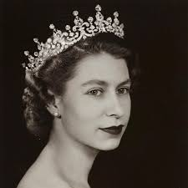
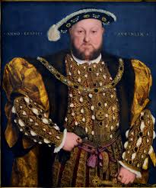
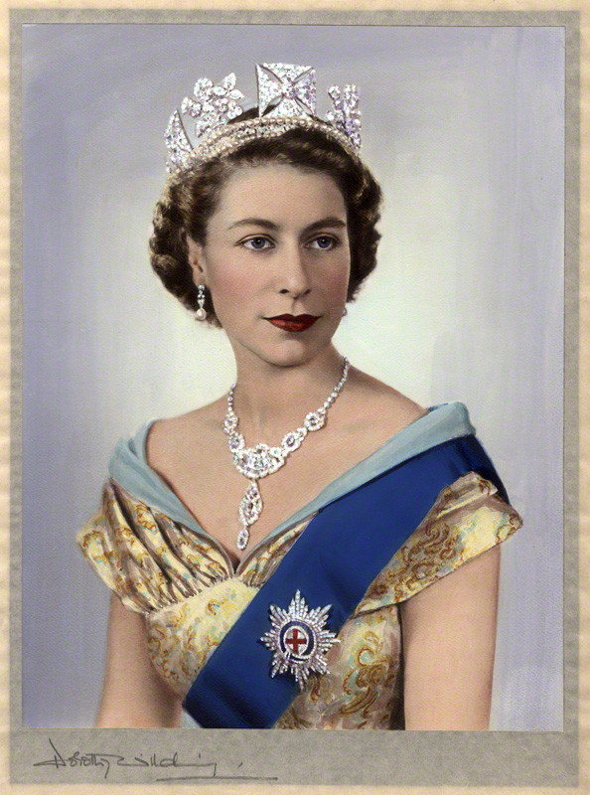
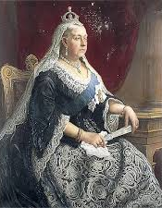
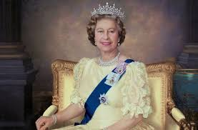
Portraits

Slide 23
Now have a go yourself!
We are going to start by looking at drawing eyes.
Look at your eyes in the mirror. What colour are they? You will notice that your eyes are not round, which is how most of us normally draw eyes. Look at their shape.
Follow this link to watch a simple youtube video about drawing eyes.
https://www.youtube.com/watch?v=mQ36ABaDMO4
This video, shows how eyes can be drawn in different ways. You can watch this aswell if you would like.
https://www.youtube.com/watch?app=desktop&v=DrmTBxfQbdA
Only draw eyes today. We will look at different parts of the face each week to build up to drawing a portrait.

