Slide 1
Friday 29th January 2021

Slide 2
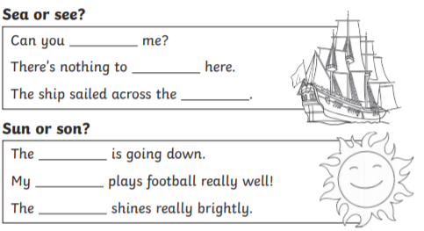
Morning Job
HOMOPHONES
Create 2 sentences of your own that require the correct use of a homophone!

Slide 3
Spellings

Slide 4
Rockstars

Slide 5
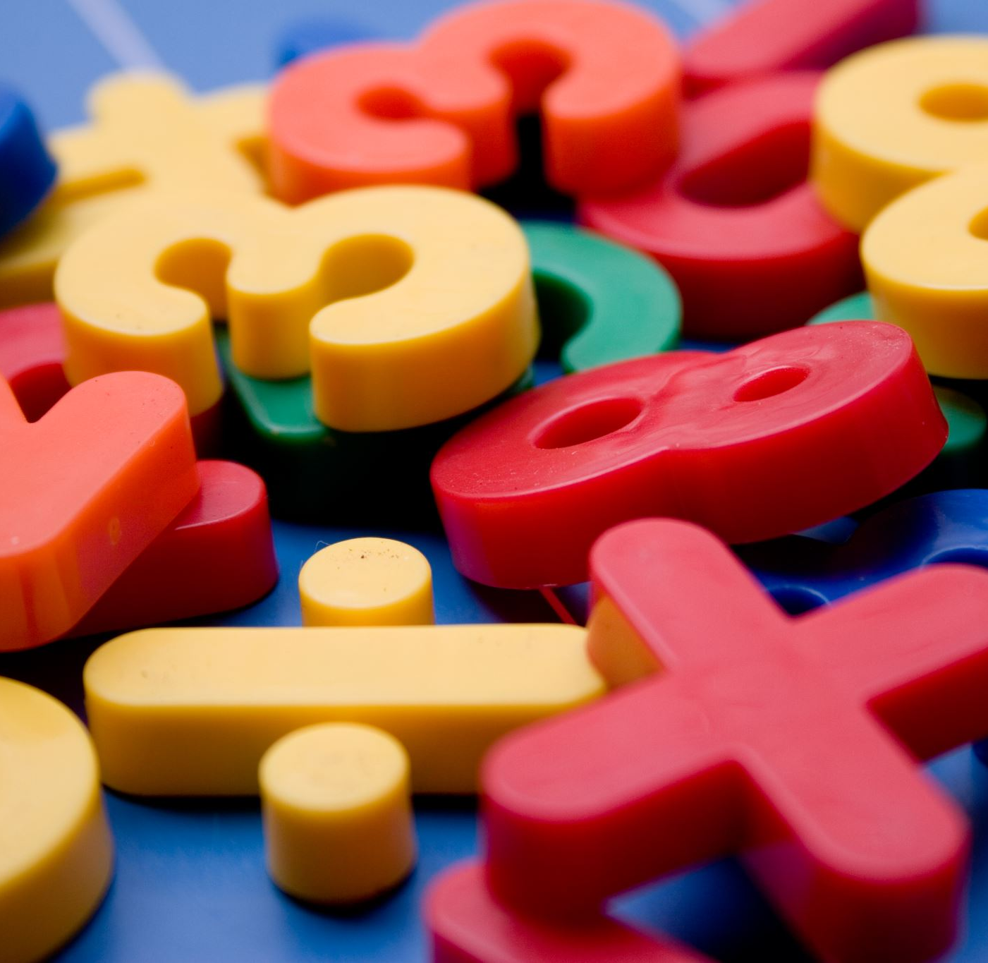
Maths
I can divide 2 digits by 1 digit.

Slide 6
Video Clip
https://vimeo.com/492054019

Slide 9
1) 21 ÷ 7 =
2) 22 ÷ 7 =
3) 34 ÷ 7 =
4) 35 ÷ 7 =

Slide 10
3
1) 21 ÷ 7 =
2) 22 ÷ 7 =
3) 34 ÷ 7 =
4) 35 ÷ 7 =
3 r 1
4 r 6
5

Slide 12
75 ÷ 6 =
Tens | Ones
75
60
15
÷ 6
÷ 6
10
2
r 3
10 + 2 r 3 =
12 r 3

Slide 13
1) 53 ÷ 3 =
17 r 2
Have a think
2) 64 ÷ 5 =
12 r 4
Tens | Ones
64
53
Tens | Ones
50
14
30
23

Slide 14
3
r 2
17 ÷ 5 =
Tens | Ones

Slide 15
25 ÷ 3 =
8
r 1
Have a think
Tens | Ones

Slide 16
55 ÷ 5 = 11
Tens | Ones
56 ÷ 5 = 11 r 1
57 ÷ 5 = 11 r 2
58 ÷ 5 = 11 r 3
59 ÷ 5 = 11 r 4
60 ÷ 5 =
12
?
11 r 5
The remainder must be smaller than the divisor.

Slide 17
The remainder must be smaller than the divisor.
Have a think
1) When we divide by 7 the largest remainder we can have is ___
2) When we divide by 4 the largest remainder we can have is ___
3) When we divide by 36 the largest remainder we can have is ___
6
3
35

Slide 18
Have a go at questions 1 - 4 on the worksheet

Slide 19
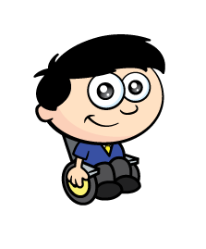
Apples are packed in bags of 8
Dexter has 91 apples.
How many bags does Dexter need so that every apple is in a bag?
Have a think
91
8
___ ÷ ___ =

Slide 20
How many bags does Dexter need so that every apple is in a bag?
Tens | Ones
91
8
___ ÷ ___ =
11 r 3
12 bags
11 bags
91
80
11

Slide 21
Have a go at questions 5 - 6 on the worksheet

Slide 22
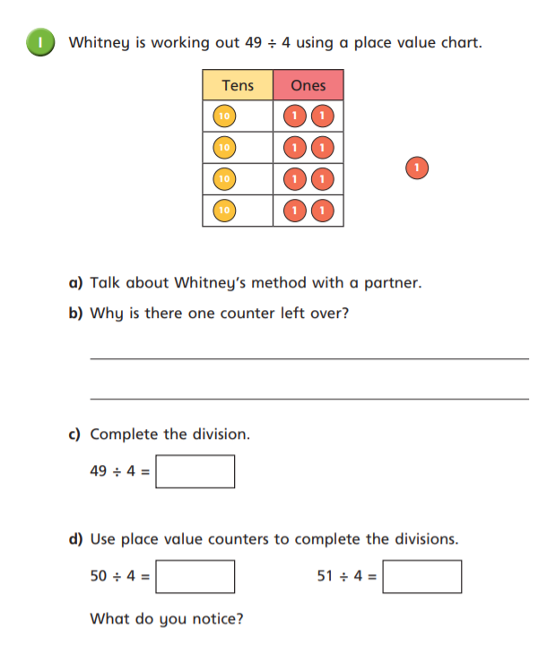
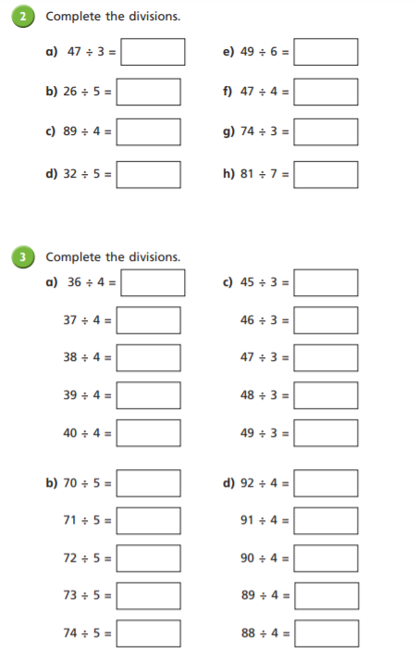

Slide 23
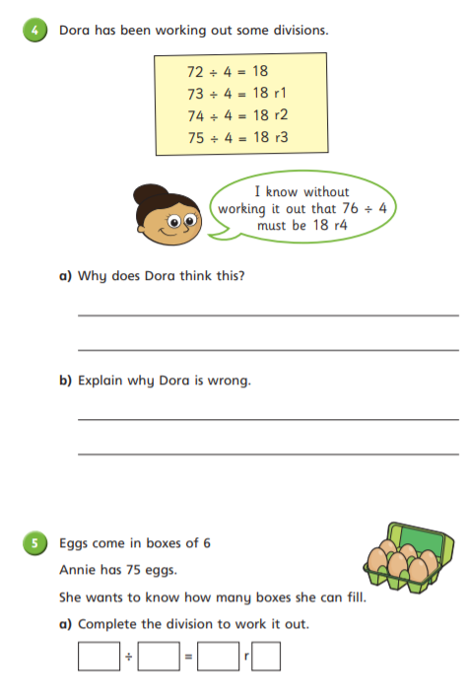
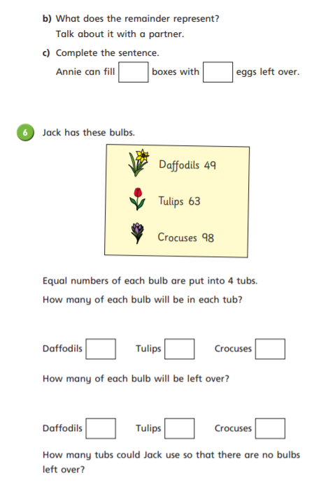

Slide 24
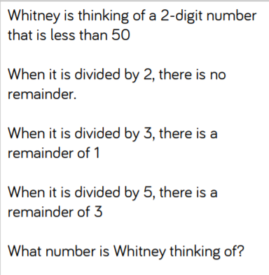
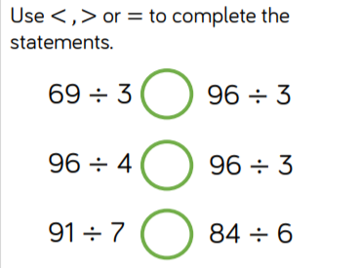
Optional Challenges:

Slide 25
Break

Slide 26
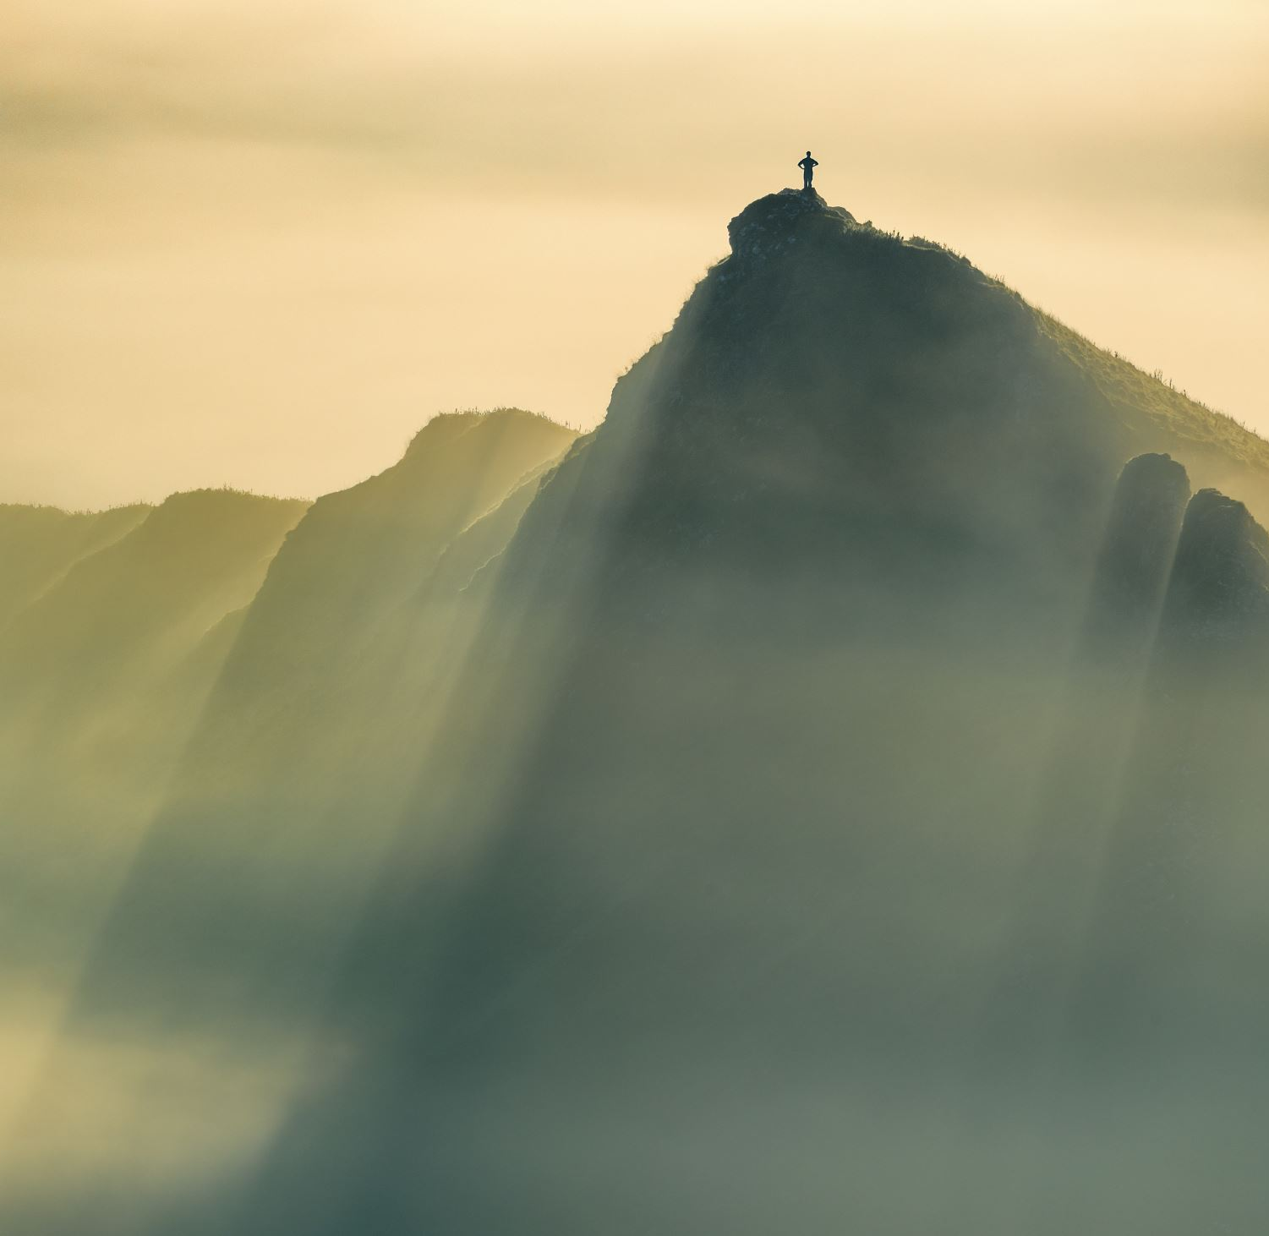
English
I can use evidence from the text to infer and discuss characters feelings.

Slide 27
Brightstorm Chapter 20 – “Thought-Wolves”

Slide 28
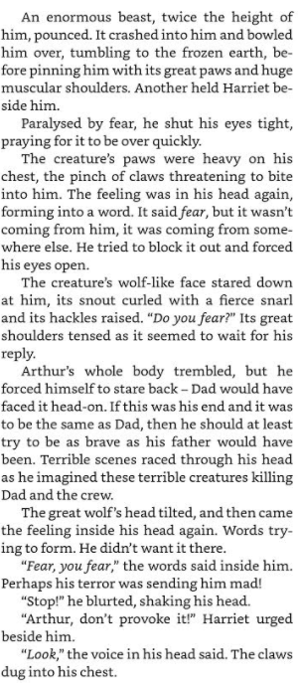
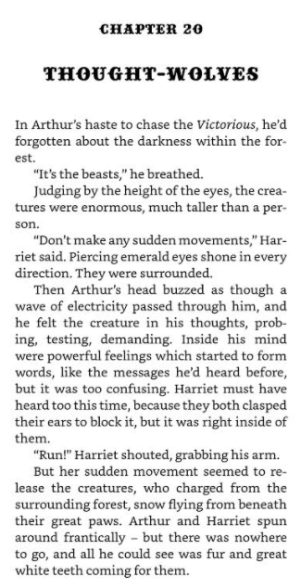

Slide 29
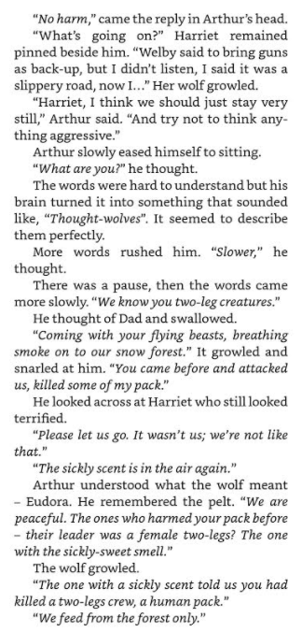
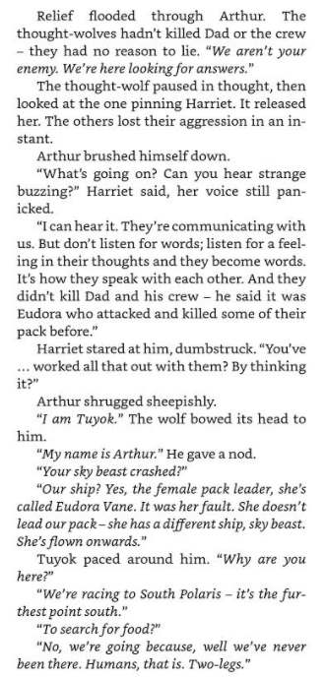

Slide 30
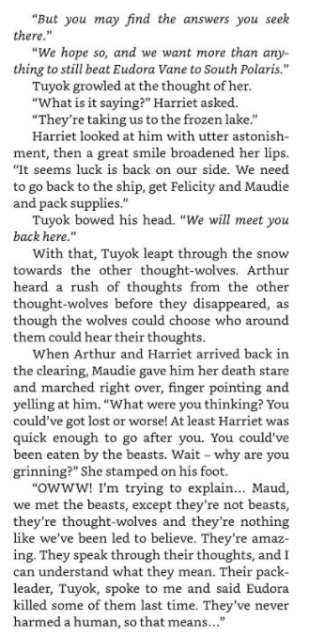
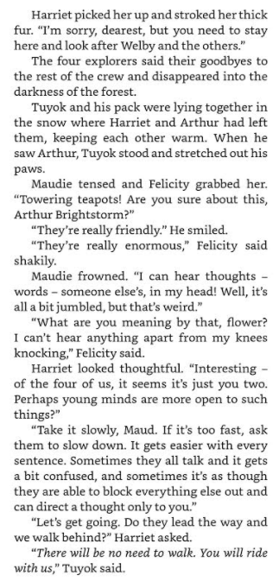

Slide 31
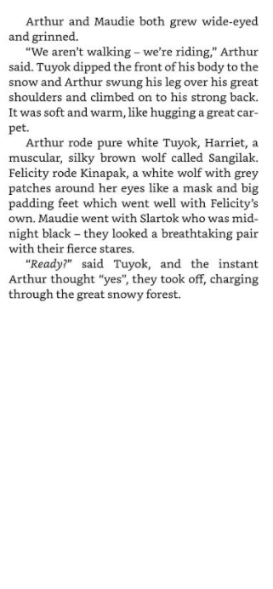

Slide 32
Activity: Inference
What is inference? – Making an inference involves using what you know to make a guess about what you don't know or reading between the lines.
Readers who make inferences use the clues in the text along with their own experiences to help them figure out what is not directly said.

Slide 33
Create 5 inferences that are related to Chapter 20.
Things to focus on:
Characters feelings
What might happen next from what is stated
Does it tell us anything new about that character?
Example:
When I read the words “It’s the beasts” it shows that Arthur knows or has read what could be lurking in the dark forest. I can infer that Arthur is brave character and willing to take on such monsters like the Wolves.

Slide 35
Lunch

Slide 36
Science

Slide 42
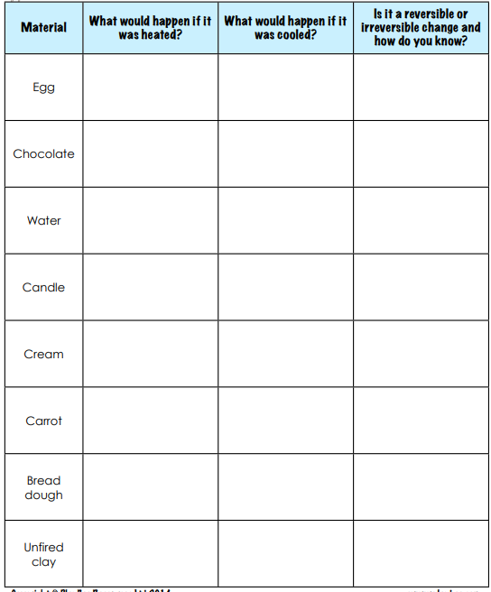
Activity:
OR

