Slide 1
Friday 22nd January 2021

Slide 2
Morning Job
85 x 2
978 x 3
75 x 5
33 x 3
486 x 4
110 x 10
95 x 6
44 x 7
Extra – Please do 15 minutes of reading from your library book or reading book.
Any extra spelling practice if you need it!

Slide 3
Rockstars

Slide 4
Spellings

Slide 5
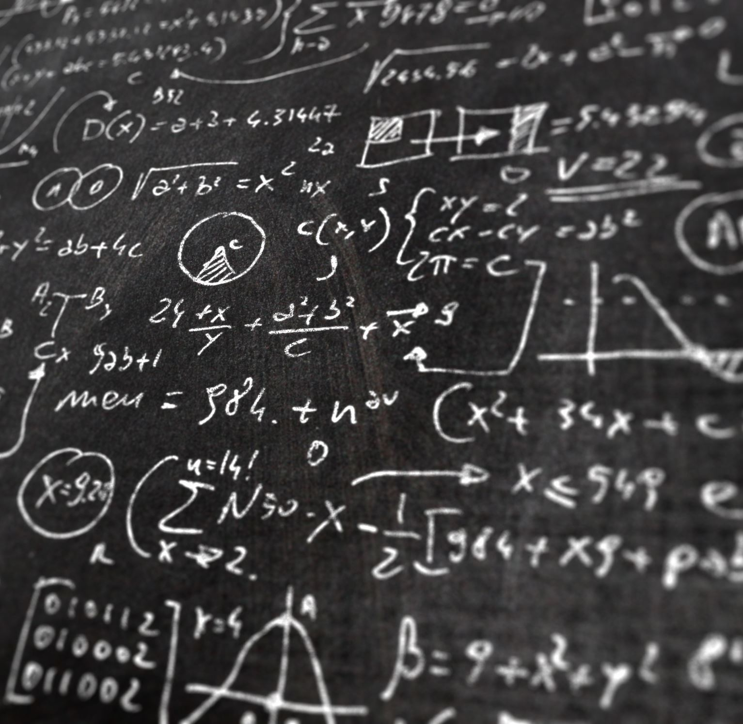
Maths I can multiply 2-digits by 2-digits

Slide 6
Video Clip
https://vimeo.com/488553863

Slide 9
1) 3 $×$ 8 $=$ 30 $×$ 8 $=$
2) 6 $×$ 7 $=$ 6 $×$ $=$ 420
3) 22 $×$ 13 $=$
4) 22 $×$ 14 $=$
$$×$$

Slide 10
1) 3 $×$ 8 $=$ 30 $×$ 8 $=$
2) 6 $×$ 7 $=$ 6 $×$ $=$ 420
3) 22 $×$ 13 $=$
4) 22 $×$ 14 $=$
24
240
42
70
286
308
$$×$$
20
2
10
200
20
3
60
6

Slide 12
23 $×$ 31
H | T | O
 | 2 | 3
 | 3 | 1
$$×$$
20
3
30
600
90
$$×$$
3
1
20
3
600 $+$ 90 $+$ 20 $+$ 3
$=$ 713

Slide 13
23 $×$ 31
H | T | O
 | 2 | 3
 | 3 | 1
$$×$$
20
3
30
600
90
$$×$$
2
3
1
20
3
600 $+$ 90 $+$ 20 $+$ 3
$=$ 713

Slide 14
23 $×$ 31
H | T | O
 | 2 | 3
 | 3 | 1
$$×$$
20
3
30
600
90
$$×$$
2
3
1
20
3
9
0
600 $+$ 90 $+$ 20 $+$ 3
$=$ 713

Slide 15
23 $×$ 31
H | T | O
 | 2 | 3
 | 3 | 1
$$×$$
20
3
30
600
90
$$×$$
2
3
1
20
3
6
9
0
600 $+$ 90 $+$ 20 $+$ 3
$=$ 713

Slide 16
23 $×$ 31
H | T | O
 | 2 | 3
 | 3 | 1
$$×$$
20
3
30
600
90
$$×$$
2
3
1
20
3
6
9
0
$$+$$
600 $+$ 90 $+$ 20 $+$ 3
$=$ 713
7
1
3
1

Slide 17
23 $×$ 31
H | T | O
 | 2 | 3
 | 3 | 1
$$×$$
3
1
2
3
$($23 $×$ 1$)$
6
9
0
$($23 $×$ 30$)$
$$+$$
7
1
3
1
23 $×$ 31 $=$ $($23 $×$ 1$)$ $+$ $($23 $×$ 30$)$

Slide 18
41 $×$ 26
Have a think
H | T | O
 | 4 | 1
 | 2 | 6
$$×$$
6
2
4
6
$($41 $×$ 6$)$
2
$$+$$

Slide 19
41 $×$ 26
H | T | O
 | 4 | 1
 | 2 | 6
$$×$$
2
2
4
6
$($41 $×$ 6$)$
8
2
0
$($41 $×$ 20$)$
$$+$$
1
0
6
6
41 $×$ 26
$=$ 1,066

Slide 20
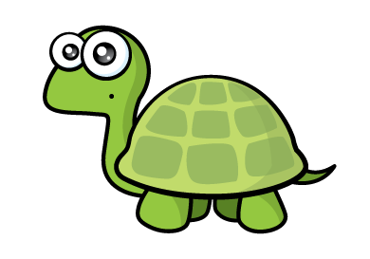
Have a think
32 $×$ 46 $=$ 320
Th | H | T | O
 |  | 3 | 2
 |  | 4 | 6
$$×$$
1
9
2
$$+$$
1
2
8
3
2
0
1
1

Slide 21
32 $×$ 46 $=$ 320
Th | H | T | O
 |  | 3 | 2
 |  | 4 | 6
32 $×$ 46 $=$ 1,472
$$×$$
1
9
2
$($32 $×$ 6$)$
$($32 $×$ 40$)$
1
2
0
$($32 $×$ 4$)$
$$+$$
8
1
3
4
2
7
2
0
1

Slide 22
Have a go at the questions 1 - 4 on the worksheet

Slide 23
Tommy wants to find the area of the blue part of the rectangle.
35 cm
12 cm
12 cm
16 cm
7 cm
7 cm
Have a think

Slide 24
Tommy wants to find the area of the blue part of the rectangle.
35 $×$ 16
35 cm
H | T | O
 | 3 | 5
 | 1 | 6
12 cm
12 cm
16 cm
7 cm
7 cm
$$×$$
2
1
0
$($35 $×$ 6$)$
3
3
5
0
$($35 $×$ 10$)$
$$+$$
5
6
0

Slide 25
Tommy wants to find the area of the blue part of the rectangle.
35 cm
35 $×$ 16 $=$ 560
12 cm
12 cm
16 cm
7 cm
7 cm
12 $×$ 7 $=$ 84
2
560 $−$ 168 $=$ 392 cm
84 $×$ 2 $=$ 168

Slide 26
Have a go at the questions 5 and 6 the worksheet

Slide 27
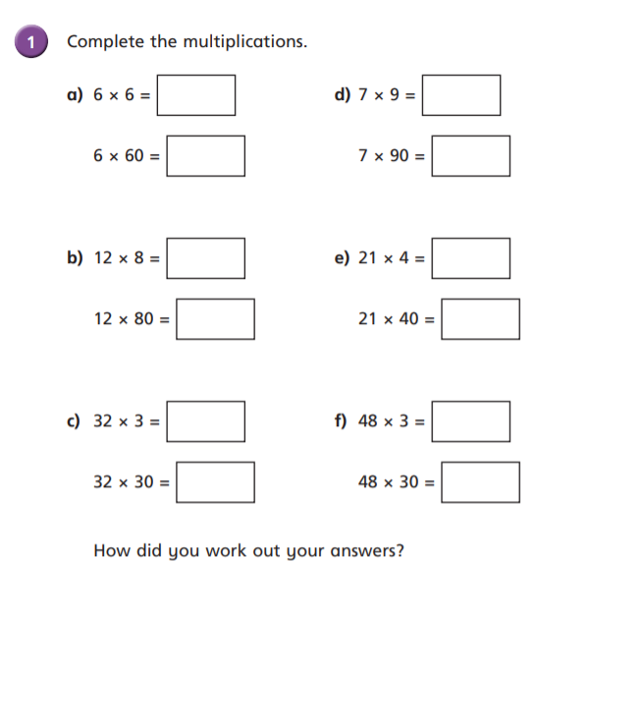
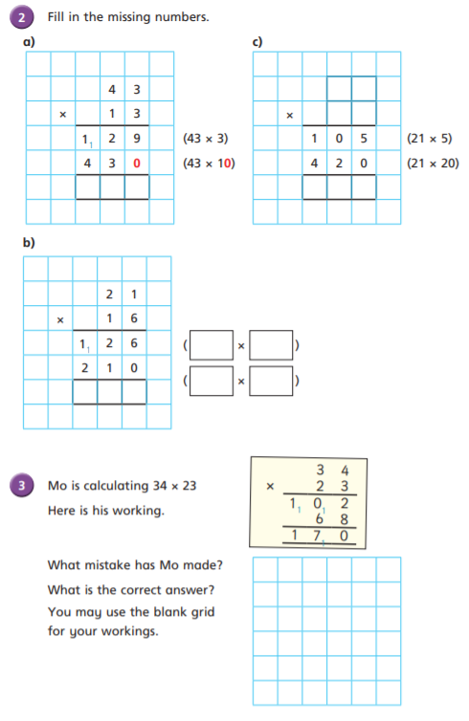

Slide 28
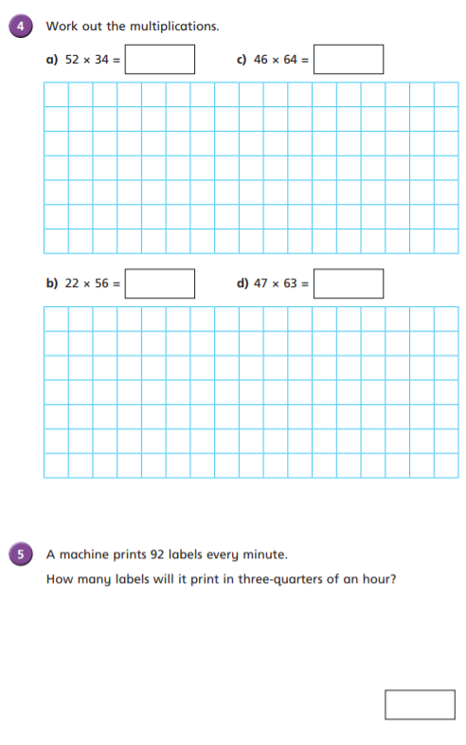
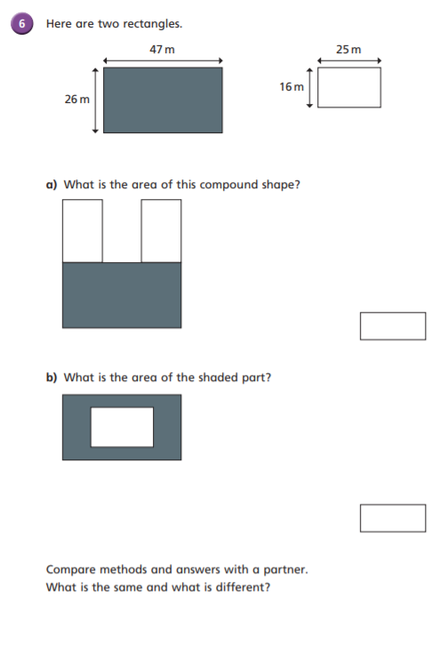

Slide 29
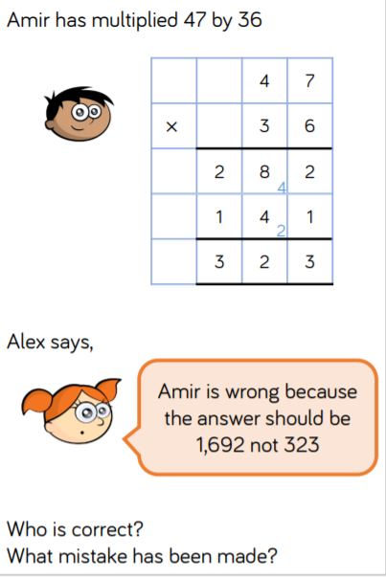
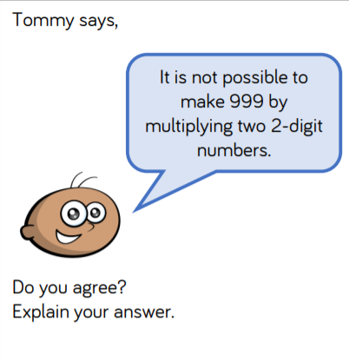
Optional Challenge:

Slide 30
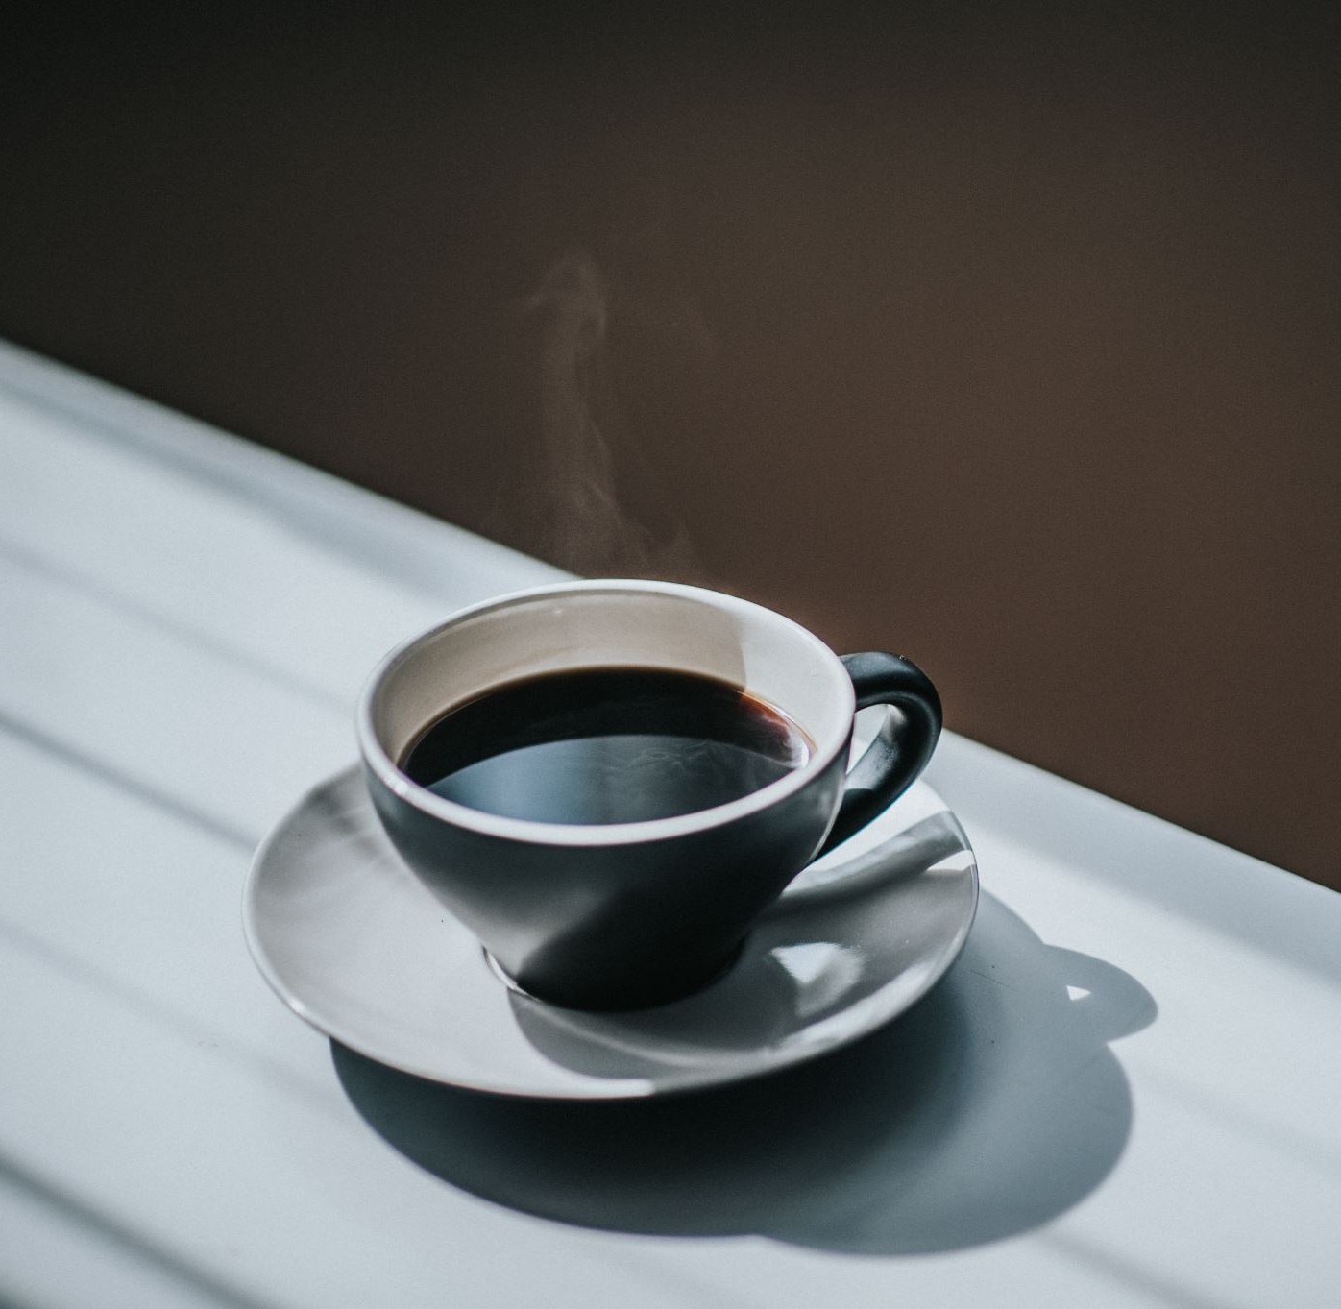
Break

Slide 31
English
I can use evidence from the text to predict what is going to happen next.

Slide 32
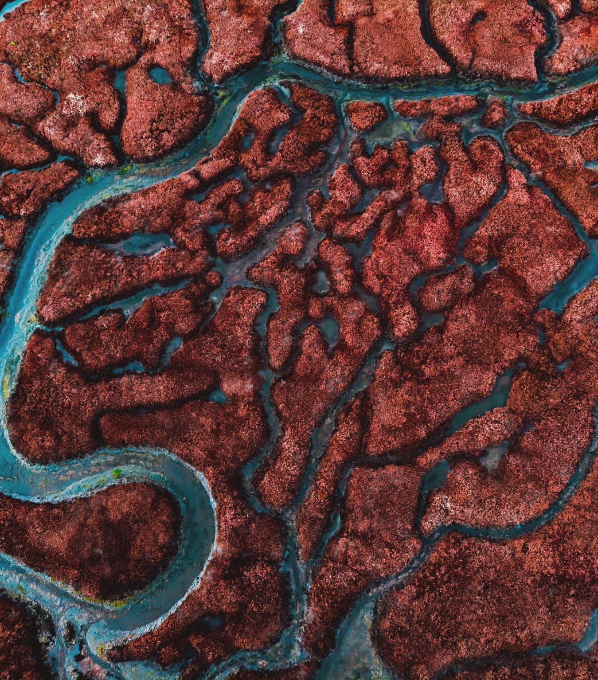
Brightstorm – Chapter 15 – “Desert Sands”

Slide 33
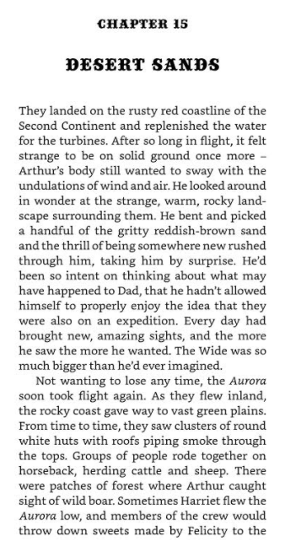
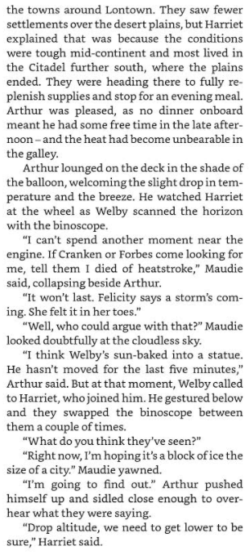

Slide 34
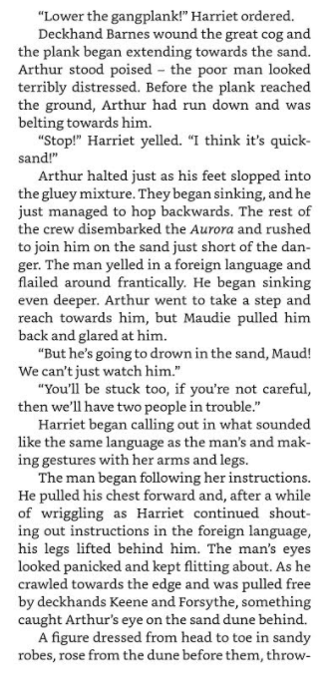
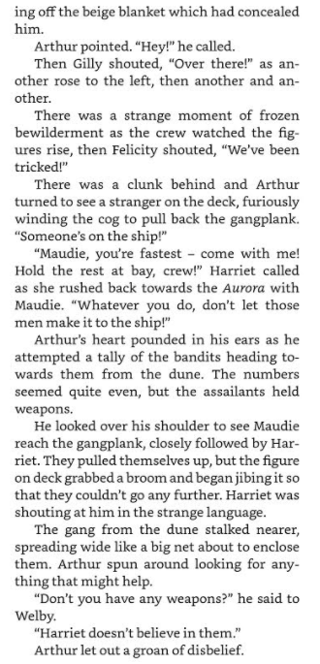

Slide 35
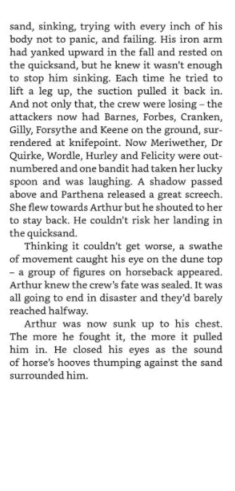

Slide 36
Activity – Predicting using evidence.
Your task is to complete 6 predictions of what you think may happen next in our story!
You will NEED at least one piece of evidence for each prediction that you make and you will also need to justify your answer using “because”.
Tip – When reading through the chapter, highlight key information that will help you make predictions!!!

Slide 37
Sentence Starters:
I predict …. Is going to happen because it says in the text that….
It says … in chapter 15 so I predict that … is going to happen because…
Using the evidence provided I predict that the following statement means… because…

Slide 38
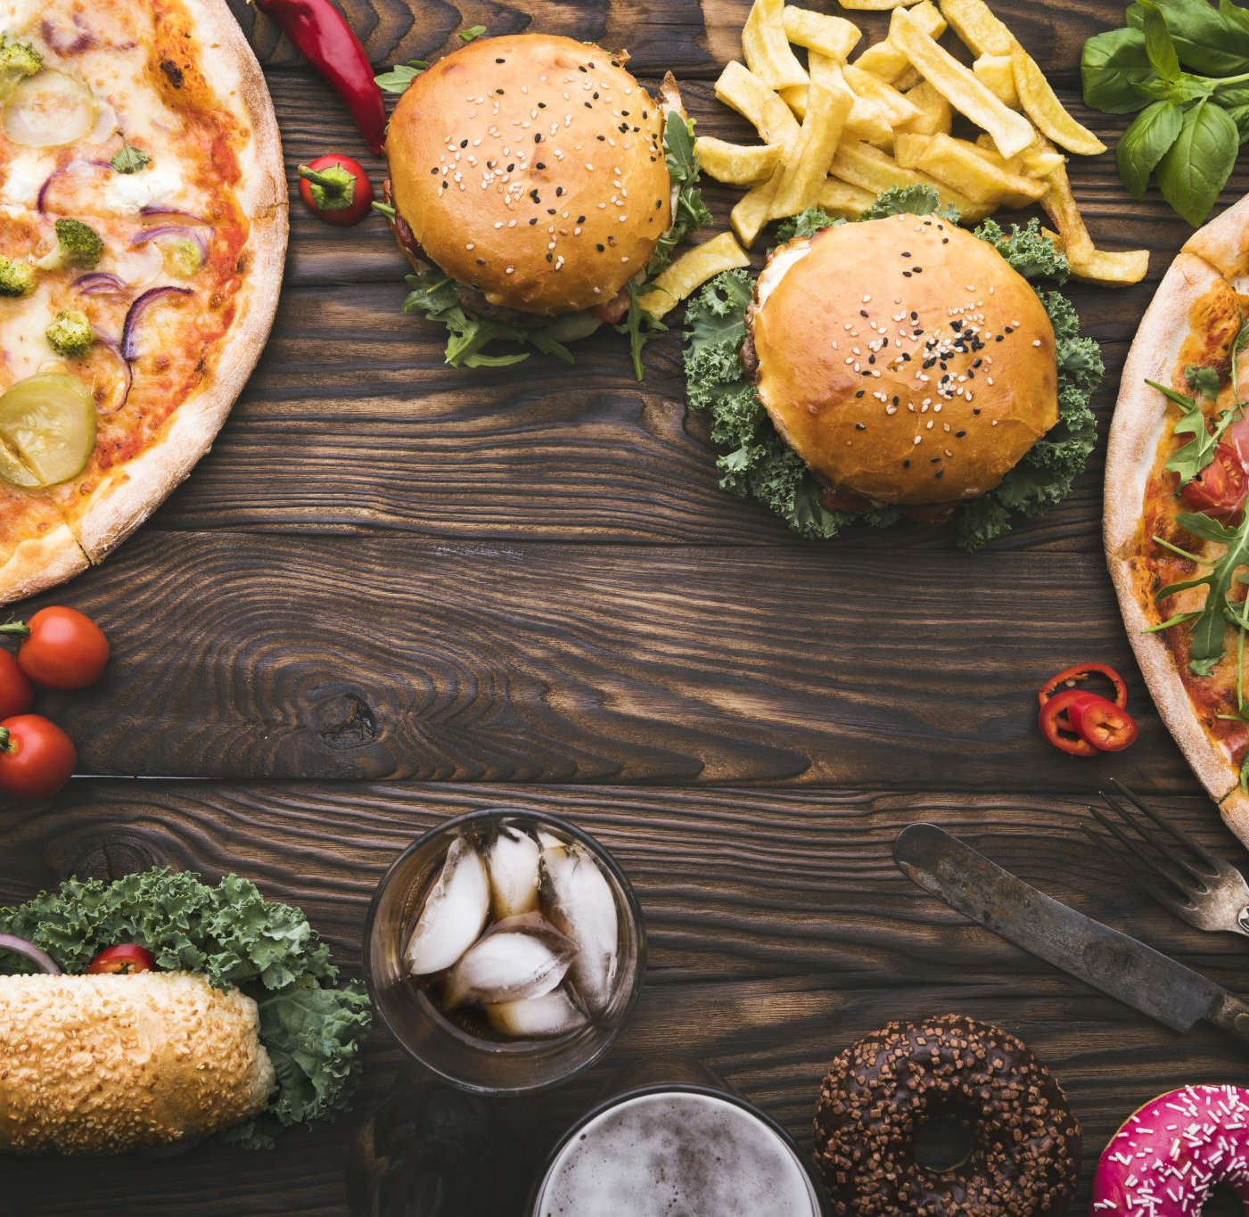
Lunch

Slide 39
Computing

Slide 41
What are variables?

Slide 42
This gives tutorial videos to help you out!!!

Slide 44
Complete the 2Dos then save and then send them

Slide 45
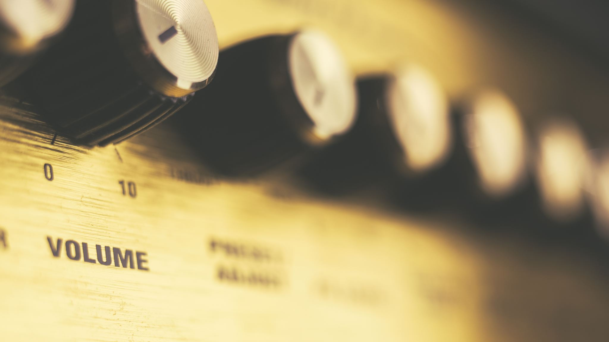
Music

Slide 46
Watch the video of the Oak Academy
https://classroom.thenational.academy/lessons/exploring-4-beats-in-a-bar-cgwk2t

Slide 47
What have you learned?

Slide 48
Hometime

