Slide 1
Good morning Year 6!
Let’s start with a warm-up, and do our Daily Ten mental maths. Level 6-> Ones and Tenths Minus Tenths, today. Set the timer at a speed that’s suitable for you.
https://www.topmarks.co.uk/maths-games/daily10
Here are your maths slides for Friday 22nd January. We will be looking at equivalent fractions, decimals and percentages. Before you begin, watch this short tutorial first:
https://vimeo.com/492474663
Remember that some of these new objectives are challenging, and we would usually discuss them together as a class. Please email us at year6home@heddon-school.co.uk if you need any help or want to ask any questions.
You are all doing an amazing job. Keep up the super work! ☺

Slide 4
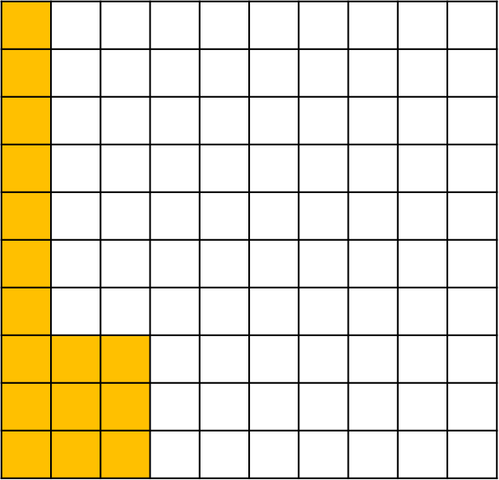
1a) What percentage of the
hundred square is shaded?
b) What fraction on the hundred
square is shaded?
2a) What percentage of the bar model is shaded?
b) What fraction of the bar model is shaded?

Slide 5
1a) What percentage of the
hundred square is shaded?
b) What fraction on the hundred
square is shaded?
2a) What percentage of the bar model is shaded?
b) What fraction of the bar model is shaded?
16 %
10%
85 %

Slide 7
Let’s recap…
1 %
10 %
percentage
‘out of’
‘one hundred’

Slide 8
Have a think
56 %
0 . 56
56
%
c
5 tenths and 6 hundredths
56 hundredths
out of one hundred
0.
0 . 97
97 %
0 . 33
33 %
c

Slide 9
Have a think
0
80 %
0 . 8
c
0 . 75
75 %
0 . 3
30 %
0
c

Slide 10
Convert 9 % and 0.3 into fractions, decimals and percentages.
Have a think
9 %
0.3

Slide 11
Have a go at questions 1 - 4 on the worksheet

Slide 12
Four children were completing some maths work.
Put the children in order of who got the most correct.
Have a think
F D P
0.85
85 %
2nd
84 % correct
0.84
84 %
3rd
0.8 correct
0.8
0
80 %
4th
12 % incorrect
0.88
88 %
88 % correct
1st

Slide 13
I’m thinking of a fraction – can you guess what it is?
- It is less than 73 %
- It is greater than 0.4
- It has a denominator of 5
20%
40%
60%
80%
Have a think
0.2
0
0.4
0.6

Slide 14
Have a go at the rest of the questions on the worksheet

Slide 16
Problem solving

Slide 17
Problem solving

