Slide 1
English
Monday 1st February

Slide 2
I am successful if…
I can use descriptive language to describe characters.

Slide 3
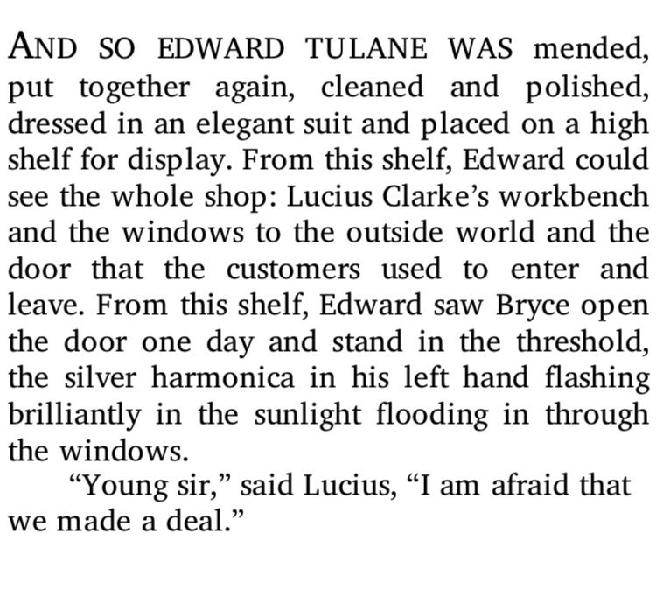

Slide 4
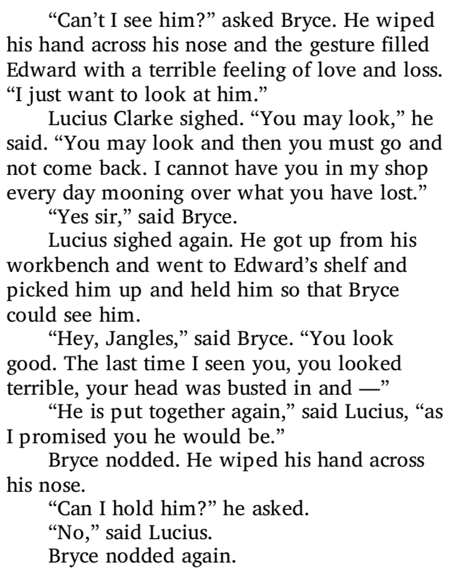
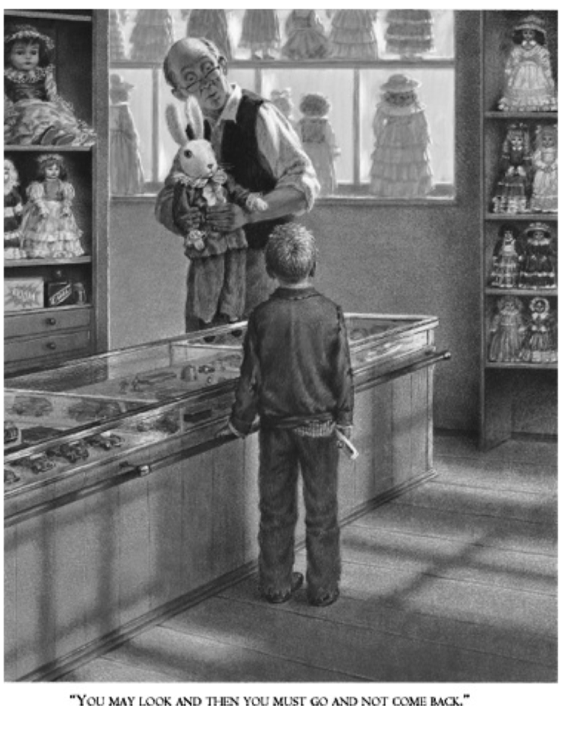

Slide 5
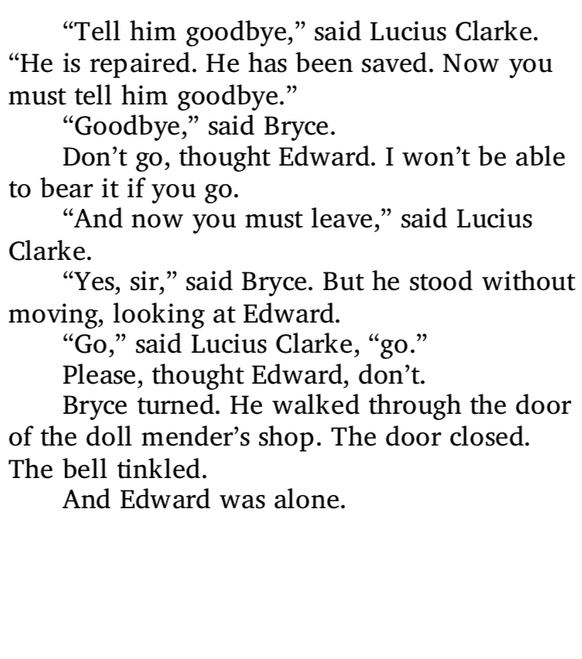
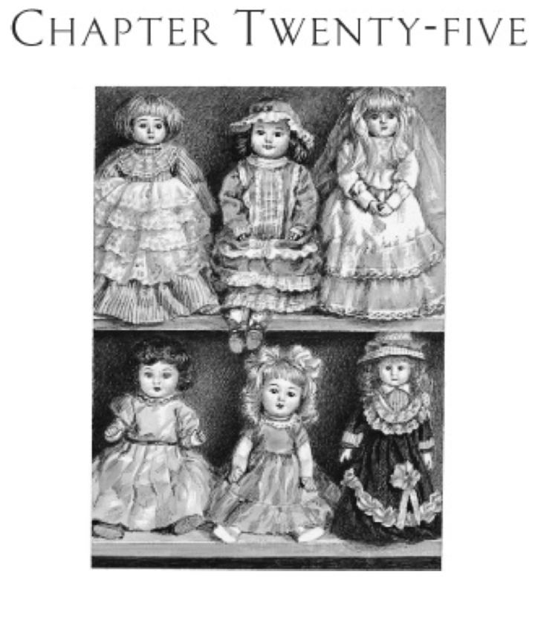

Slide 6
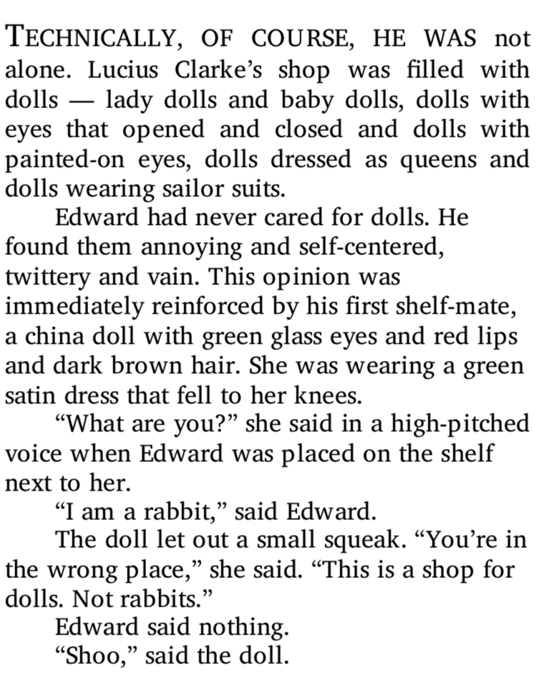
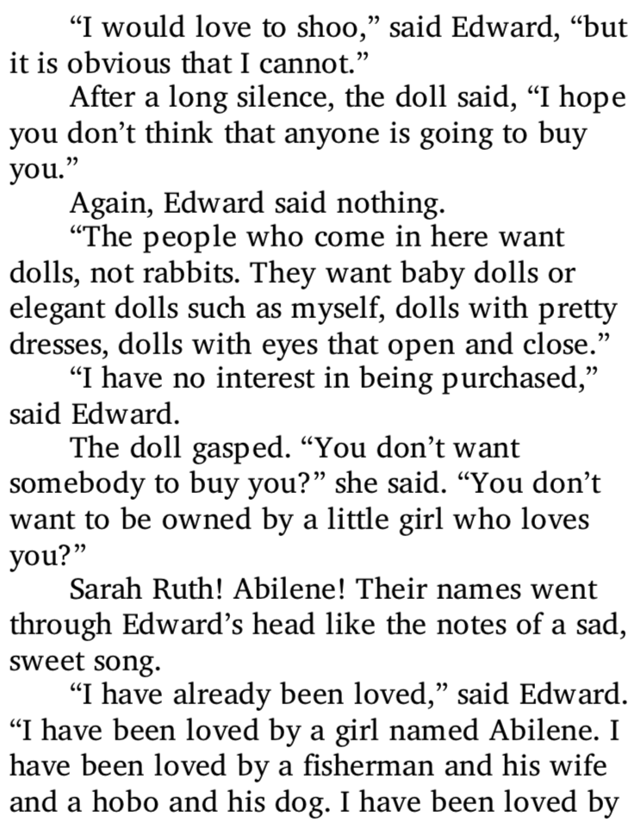

Slide 7
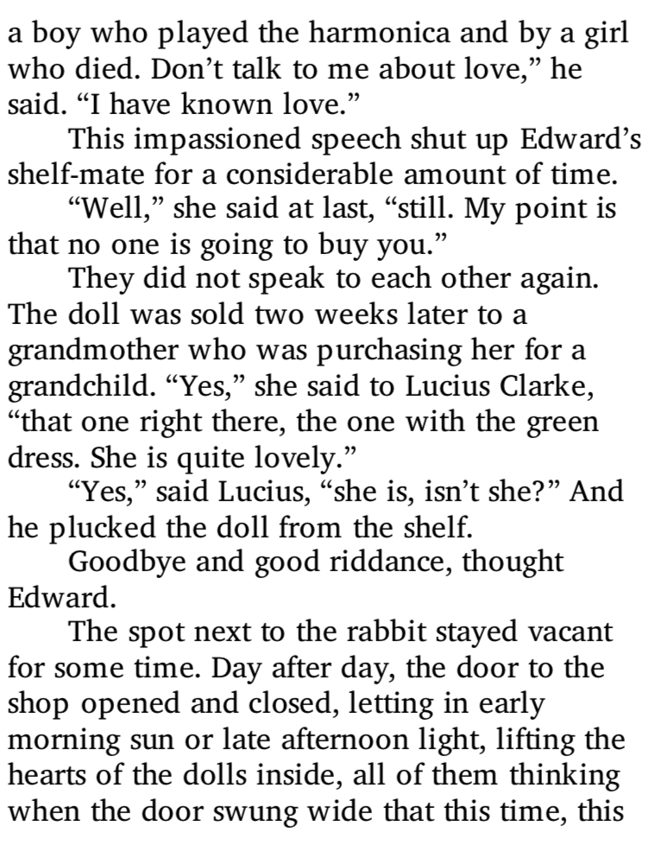
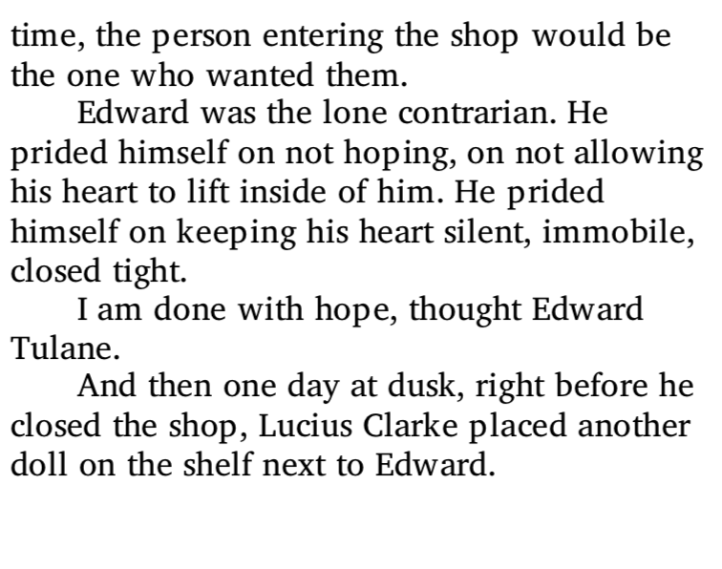

Slide 8
Adjectives and nouns
Adjectives are words that describe nouns (naming words).
i.e. The shiny mirror.
Noun: Nouns are names of people, places and things.
Adjective: Adjectives describe the mirror’s appearance. Without this, the reader wouldn’t know if the mirror was clean or dusty or what it was like at all.

Slide 9
Write 3 sentences describing this picture, using adjectives.

Slide 10
Similes
A simile describes something by comparing it to something else using ‘like’ or ‘as’.
E.g. The lion’s roar was like a trumpet, calling the pride to war.
Or
E.g. The elephant’s skin was as grey as the miserable sky.

Slide 11
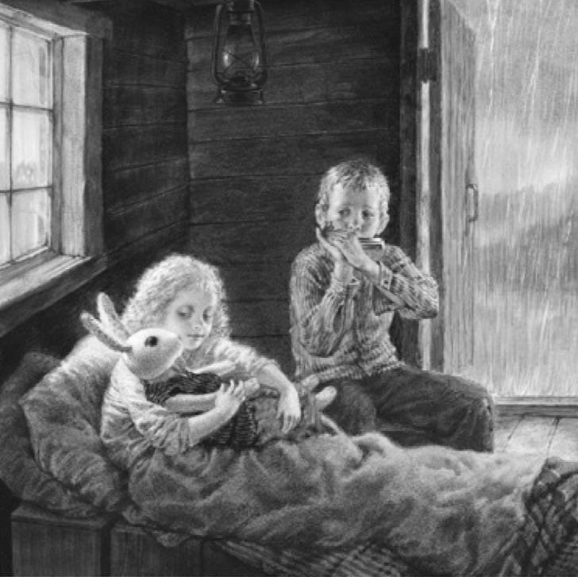
Write 2 sentences about this picture, using similes.
Here are some examples:
The cold rain pattered on the roof, like a persistent knock.
Sarah Ruth’s hair was as white as snow.

Slide 12
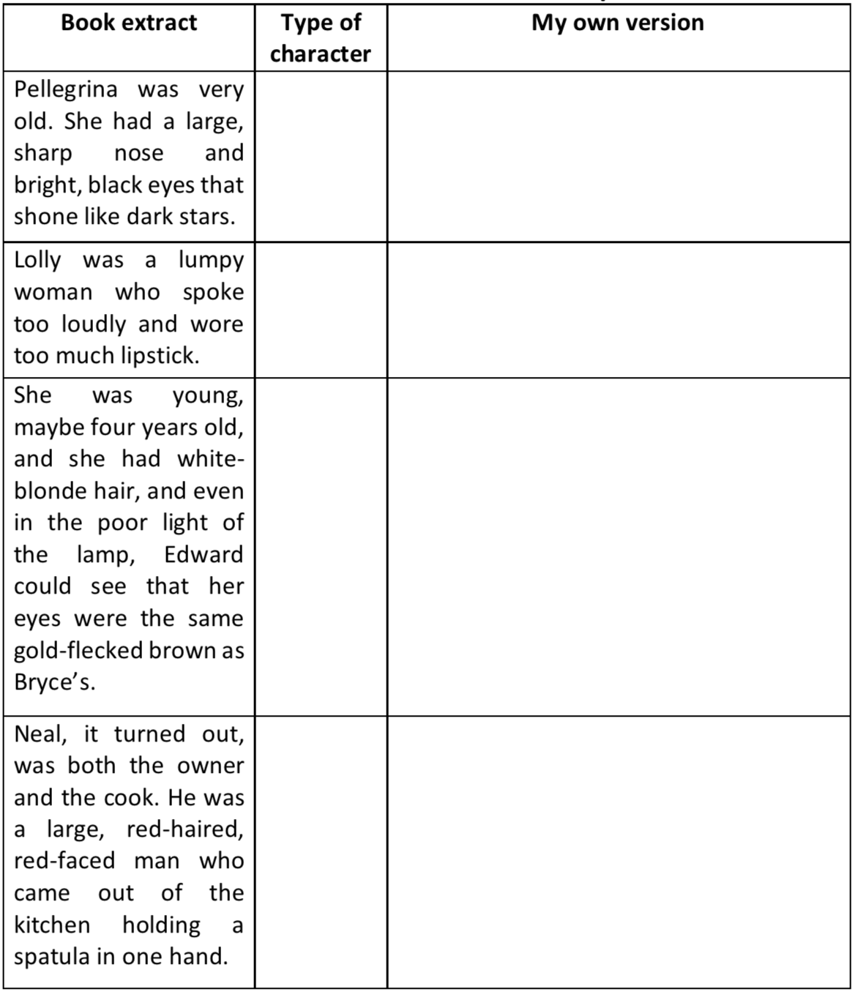
Your job
Kate DiCamillo constructs detailed character descriptions to make her characters come alive in the reader’s mind.
Complete the table. Write what type of character they are, after you have read the description.
Then write descriptions of your own characters, using descriptive language, based upon each character.

Slide 13
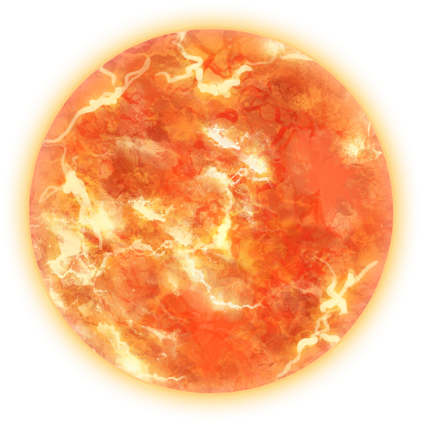
Plenary
Look at this short section of writing: The crimson ball in the sky seemed to stare furiously down at him, angry with him for losing his way. Brown, withered plant tendrils, as dry as paper, tickled him as they slithered their scorched scratchy skins across his forearm.
Try to find the following:
A verb
An adjective
A simile

