Slide 1


Slide 2
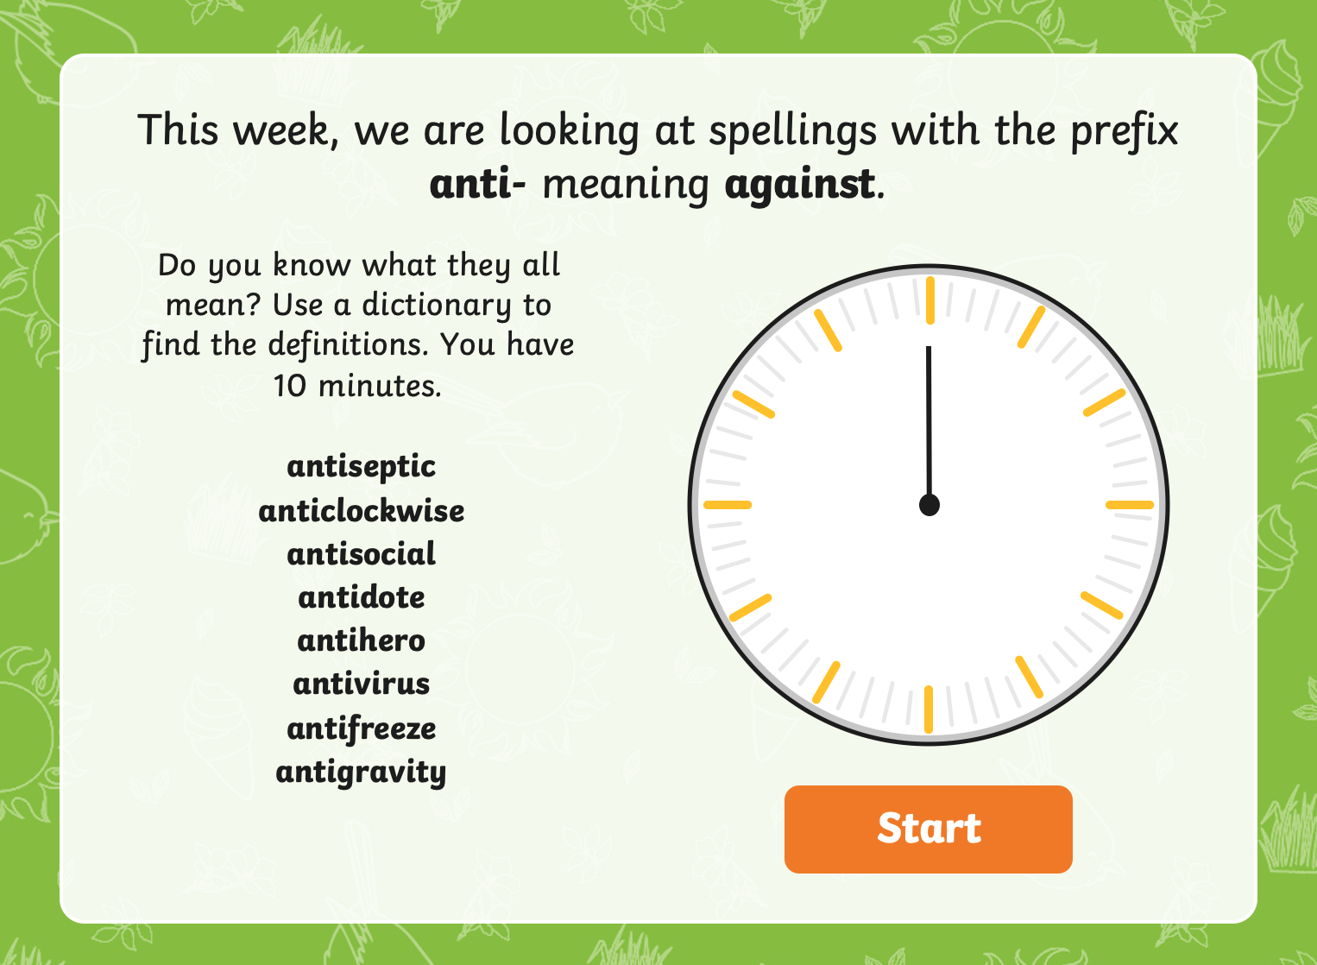

Slide 3
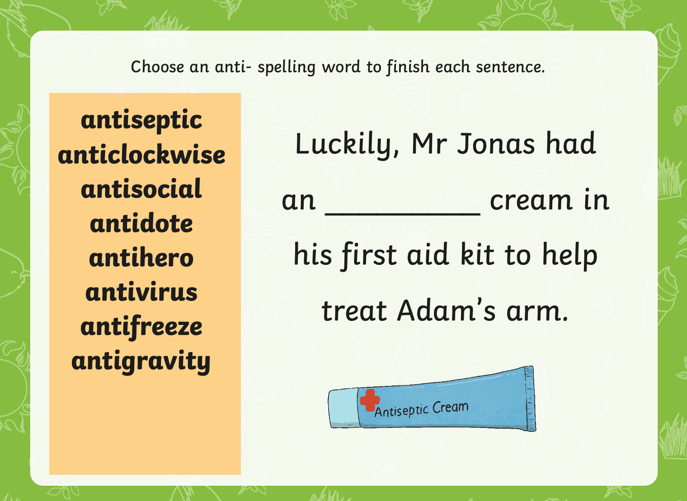

Slide 4
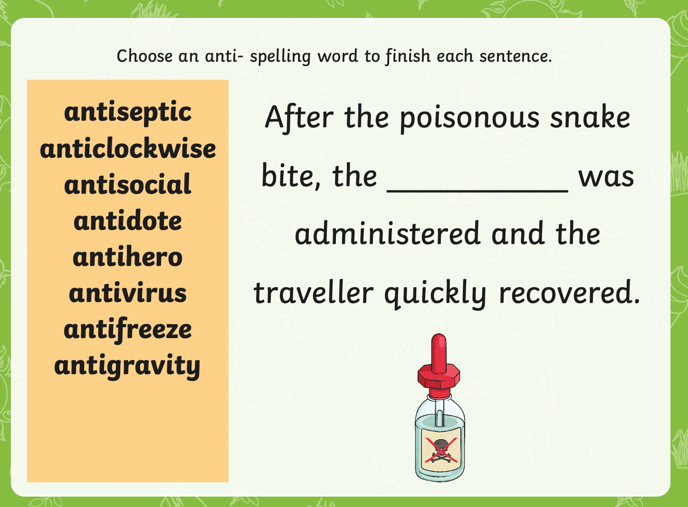

Slide 5
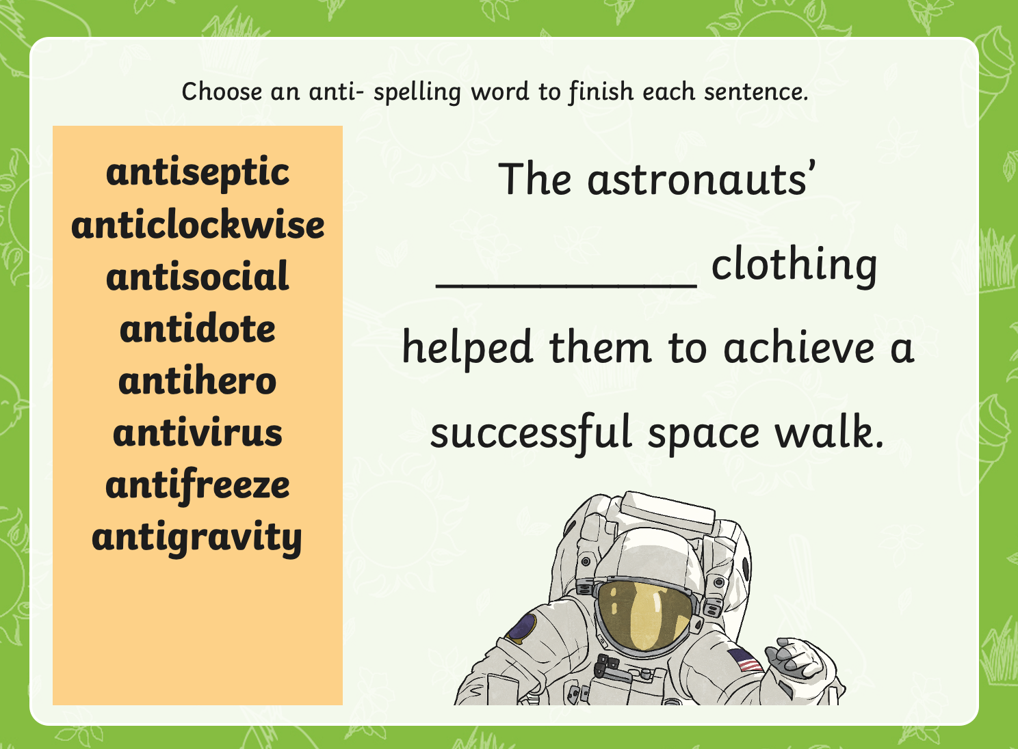

Slide 6
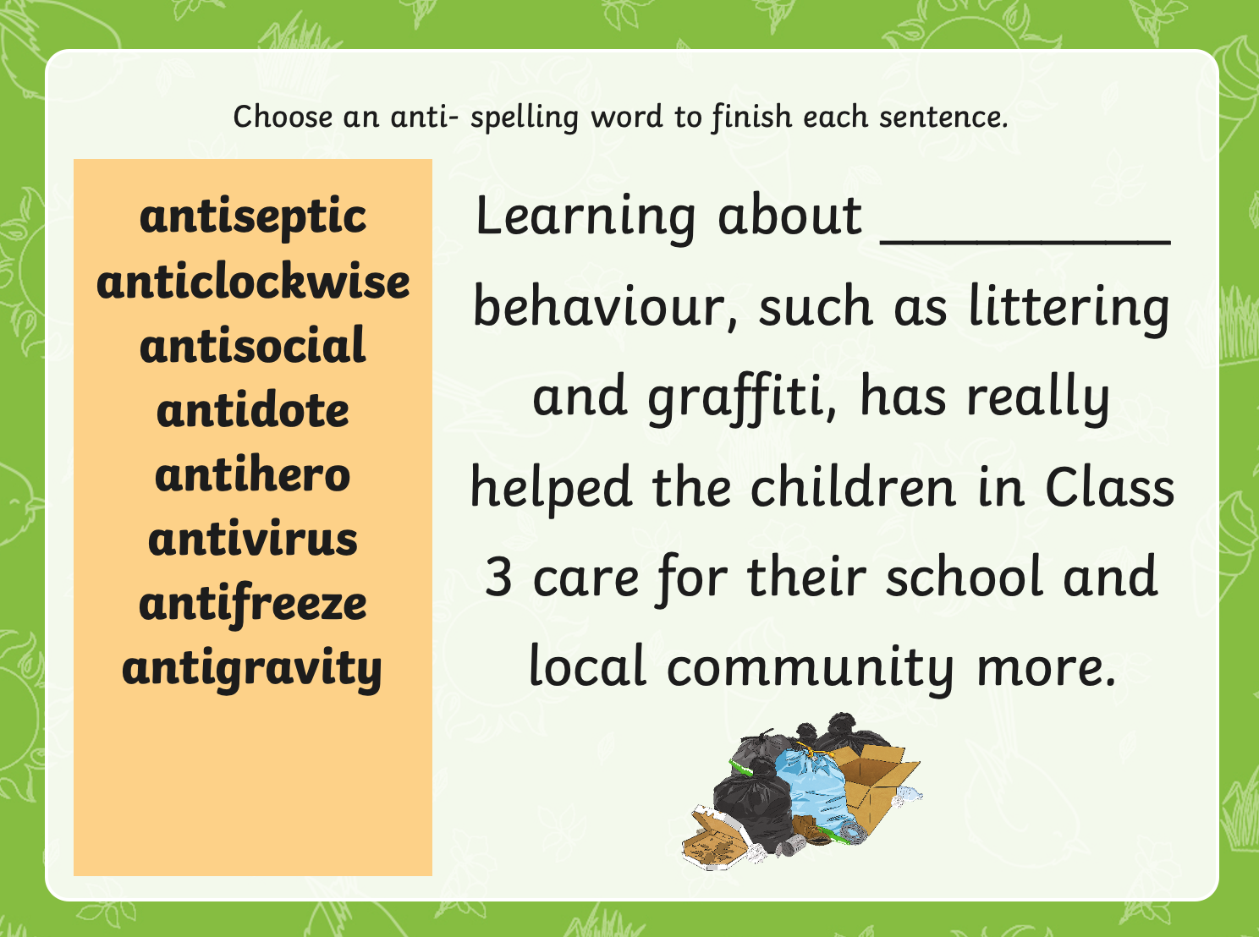

Slide 7
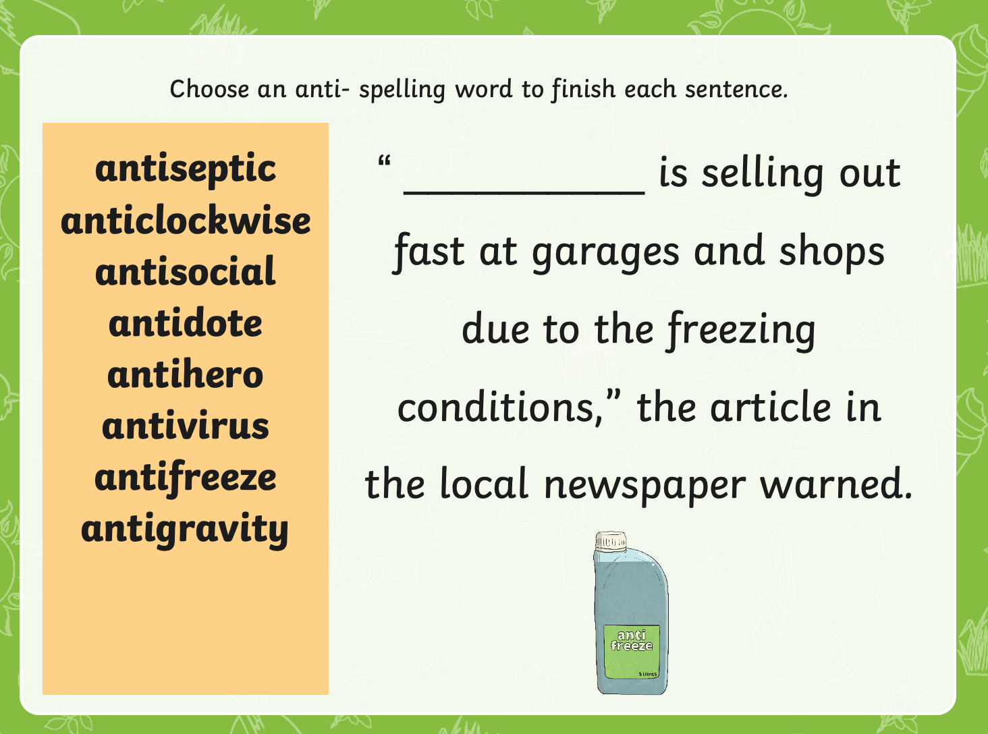

Slide 8

English
Monday 18th January

Slide 9
I am successful if…
I can use evidence from the text to describe a character's experience.

Slide 10


Slide 11
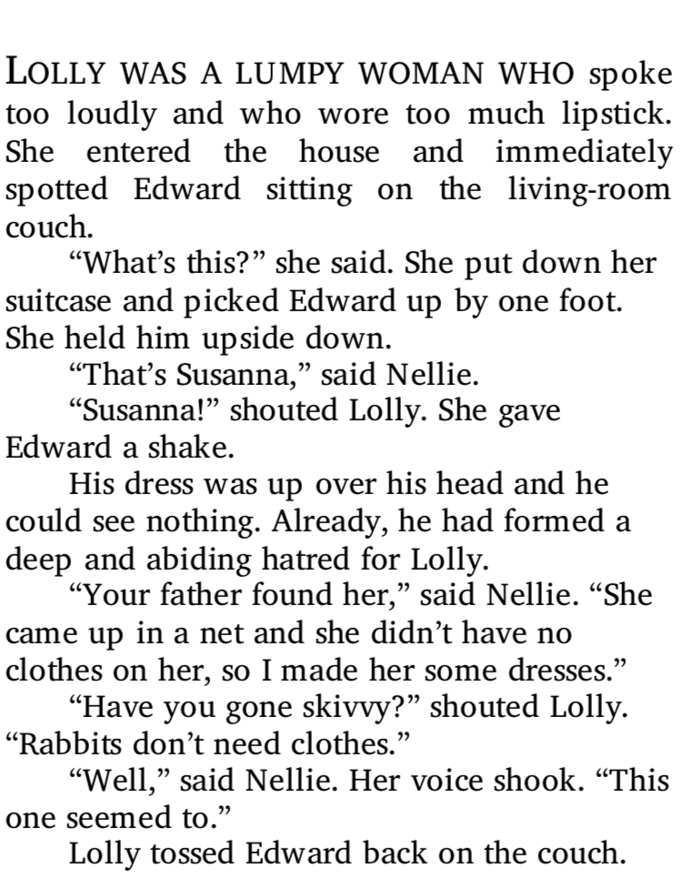

Slide 12
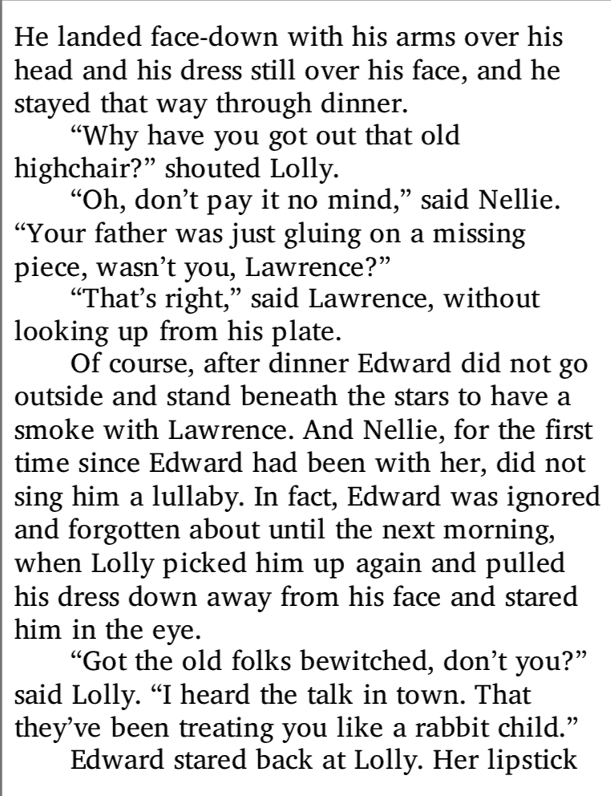

Slide 13
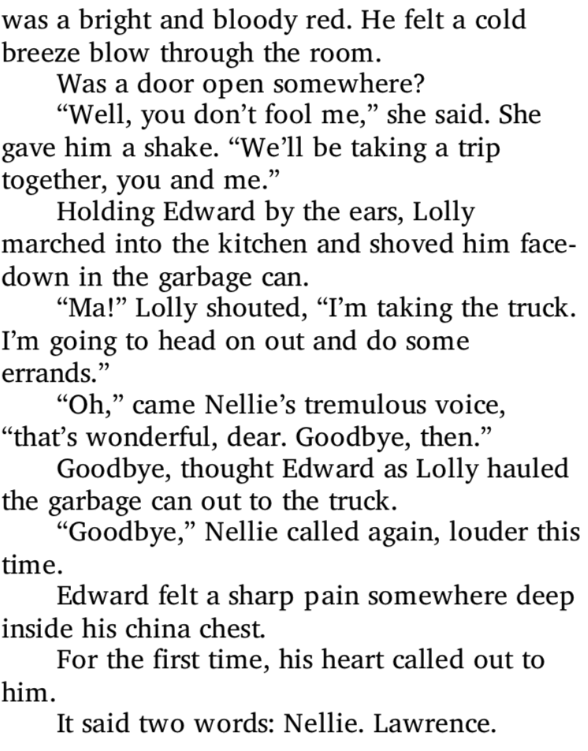

Slide 14
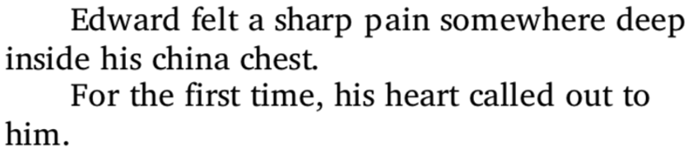
Discuss
What does this part of the text mean?
Do you think Edward is starting to change? Why?

Slide 15
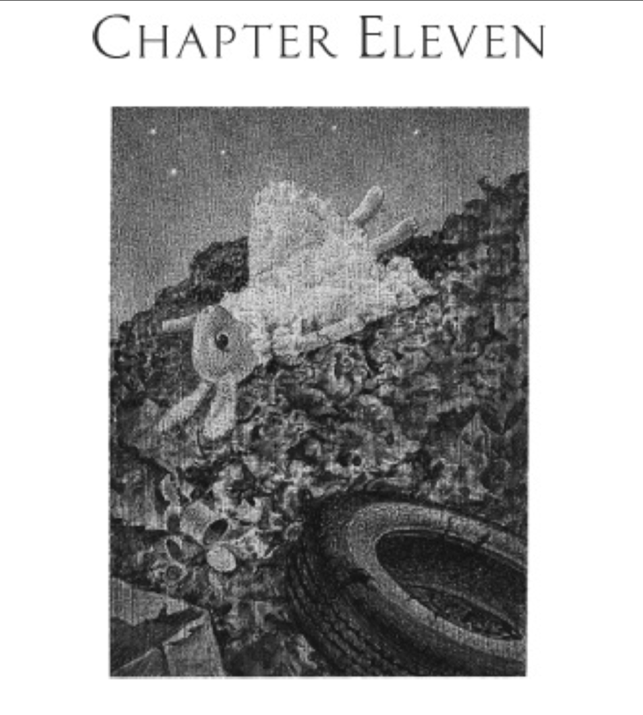

Slide 16
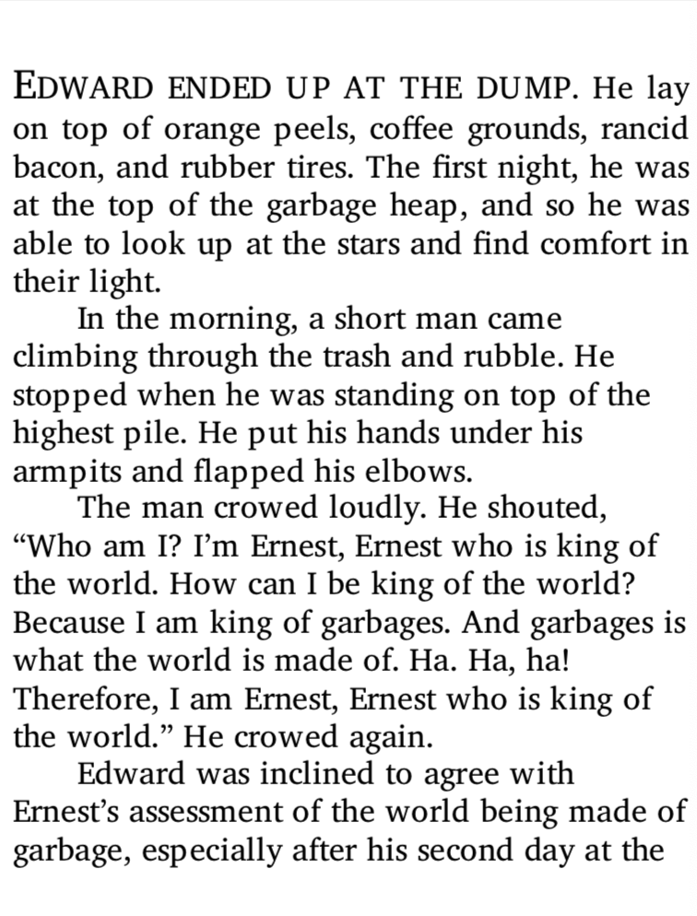

Slide 17
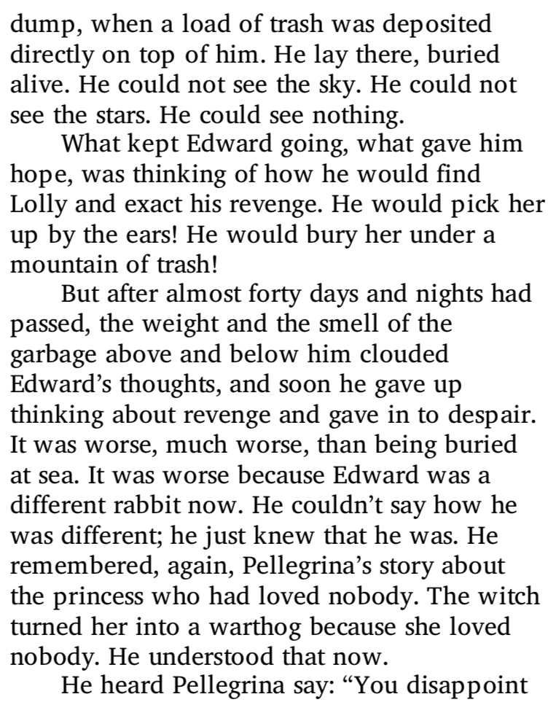

Slide 18
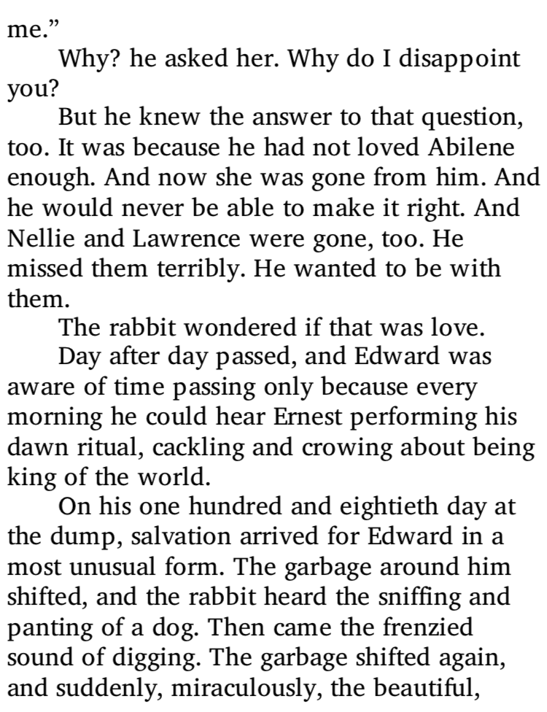
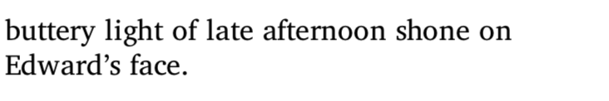

Slide 19
How is Edward feeling?
http://www.youtube.com/watch?v=Td4xbl1D_d8 watch the following video up to 1 minute.
The video shows what it would be like for Edward at ’The Dump’.
Your job is to think about the senses and imagine how Edward would be feeling. What would he be experiencing?

Slide 20
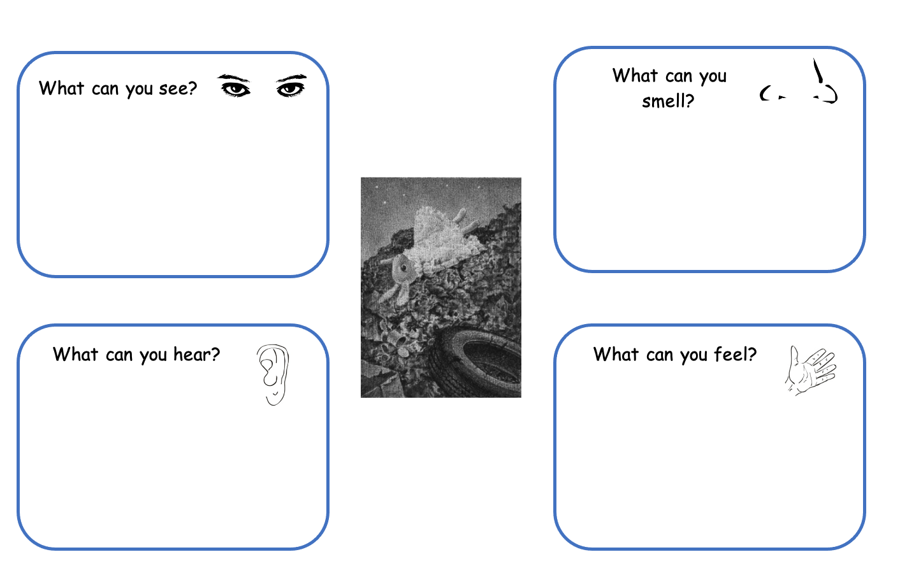

Slide 21
Time for poetry!
Now write an acrostic poem, to describe Edward’s experience. Use the text to help you.
The weight of the garbage clouded his thoughts.
He could not bear to smell the rancid bacon.
Every night he dreamed of Abilene.
Despair filled the air around him.
Underneath the discarded rubbish, Edward waited.
Miraculously, the buttery light of late afternoon shone on Edward’s face.
Perhaps he was to be saved after all, thought Edward.

Slide 22
Share your poems!
Why don’t you share your poem on the blog? We would all love to read them!

