Slide 1
English
Tuesday 5th January

Slide 2
What have we done so far?
Yesterday, we were discussing the word ‘precious’. We talked about what it could mean. We mentioned words such as ‘special’, ‘important’, ‘valuable’, ‘delicate’.
Miss Allsopp then showed us what was precious to her, a teddy, a box and a knitted blanket.
We then thought about what was precious to us and explained why.

Slide 3
I am successful if…
I can predict what a character may be like from the details stated.

Slide 4
Key vocabulary
Yesterday, you were provided with details about the character from our new story. We discussed them and considered what kind of character they could be referring to.

Slide 5
Intelligent
Felt himself to be an exceptional specimen.
Elegant
Extraordinary wardrobe
Handmade silk suits
Finest leather
Edward could see his own reflection in the glass and what a reflection it was!
He never ceased to be amazed at his own fineness.

Slide 6
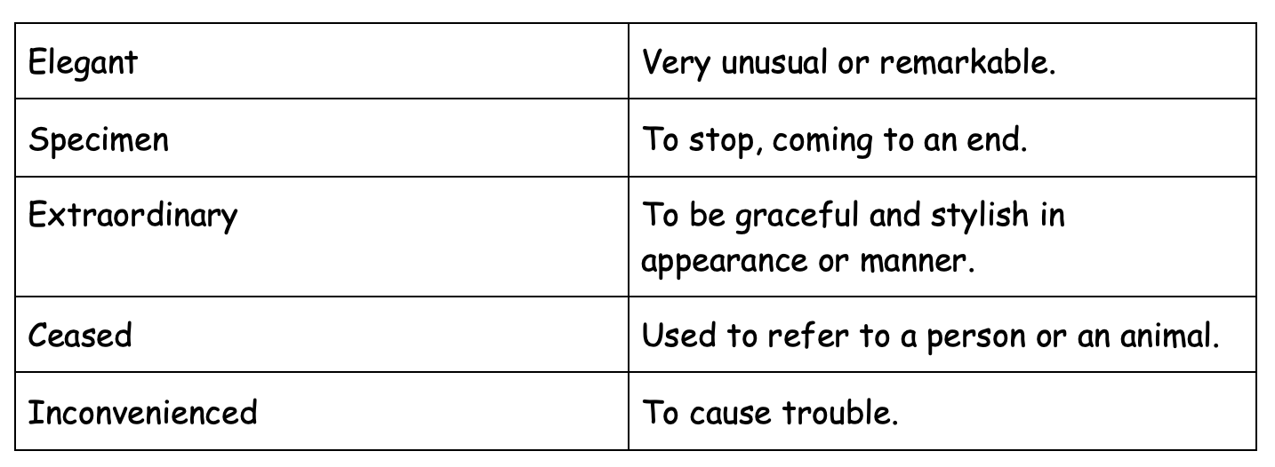
Match up the words to their correct meaning.

Slide 7
What do we now know?
The main character in our story could be called Edward
He wears fancy clothes and could be posh
He thinks he is very attractive and enjoys looking at himself
What does this reveal in terms of his character? Do we think Edward is a good character or a bad character?

Slide 8
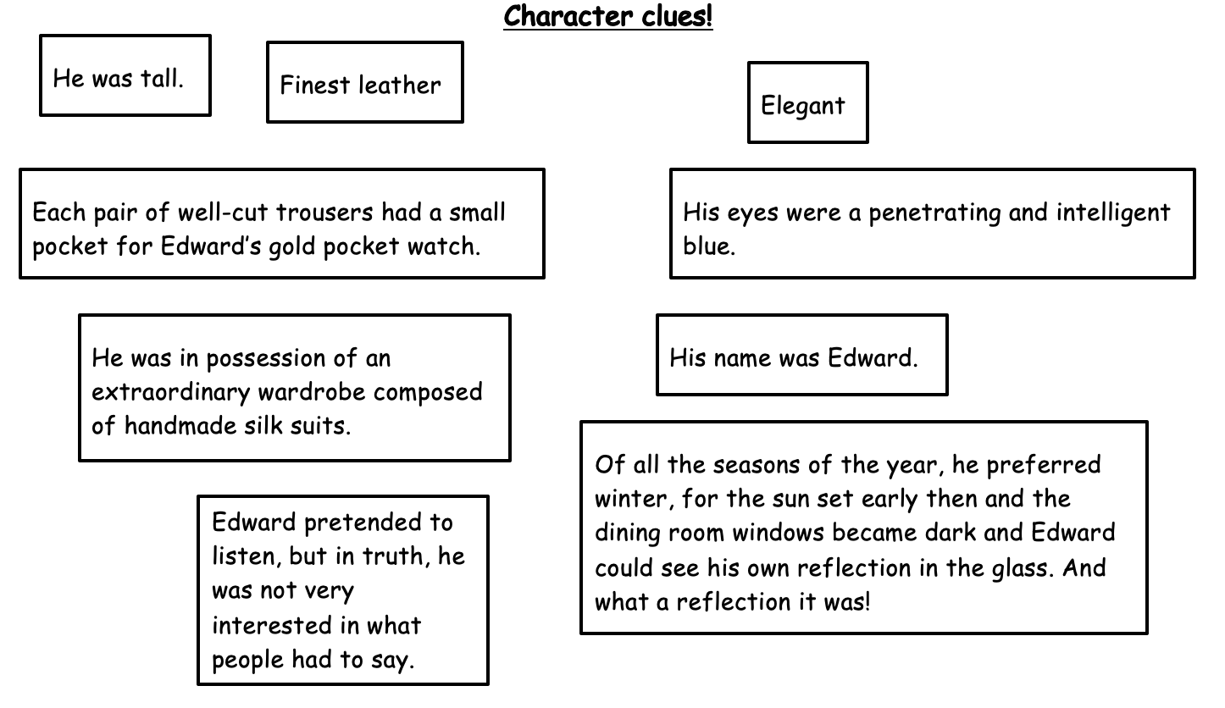
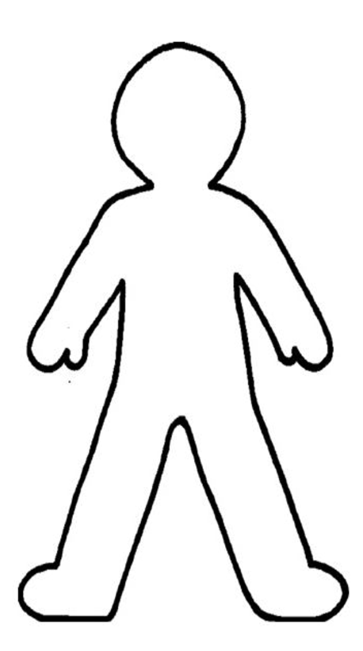
Read the following clues about Edward.
Think about which words or sentences are describing his outward appearance and write them around an outline of a person. Then think about what the clues make you think his personality is like. Write your own words on the inside to show what you think he might be like.

Slide 9
Then write your own prediction.
Thinking about the clues we have read, you must now predict what Edward is like. Is he kind? Does he seem like a good friend? Does he seem caring? Modest?
Write a paragraph explaining what you think Edward is like, using evidence from the clues provided to justify your answers.
For example, I think Edward is not a very nice character as he seems very vain and is not kind to others. An example of this is that ‘he is not interested in what people had to say’, as that makes him appear to be unkind and unthoughtful.

Slide 10
I have been successful if…
I can predict what a character may be like from the details stated.

