Slide 1
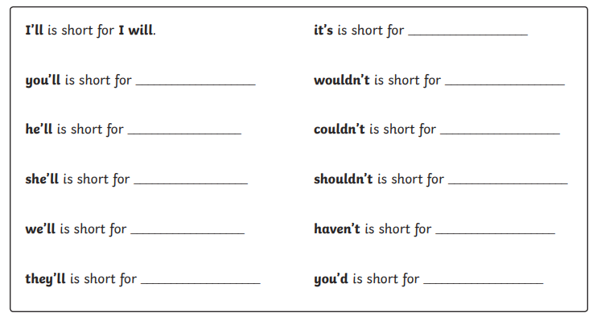
Wednesday 13th January
SPaG Morning Job
I’ve noticed in the work you have been sending me that’s lots of you seem to be forgetting how to spell contractions. Here is a reminder. Finish the sentences.

Slide 2
Wednesday 13th January
Macavity
I can edit and improve my work.
I can create a wanted poster.

Slide 3
I can create a wanted poster for Macavity.
Today you are going to create a WANTED poster for the police to use to try to catch Macavity.
This will be done in our English and Art lessons today.
In English you will complete the writing section and then you must go to the Art PowerPoint to find out about the picture.
The writing section will use the description of Macavity that you wrote yesterday.
Before you can copy it onto the poster, you must make sure it is perfect…

Slide 4
I can edit and improve my work.
Edit
Check your work for incorrect spellings and punctuation. Make sure every sentence makes sense. Read very carefully!
Improve
How can you make your writing better?
Can you add some adjectives? Can you change some for better adjectives? Can you add a fronted adverbial?
Is your work your very best? Yes? Then let’s make a WANTED poster…

Slide 5
WANTED Poster
To make your poster, you can print off the sheet like this one on the website or you can make your own.
Make this your very best work.
If we were in school, we would put them on display.
Maybe you could display it in your house?
Or put it on our Purple Mash blog?
Good luck and have fun!

Slide 6
Now read or listen to the poem.
Listen: https://www.youtube.com/watch?v=rBhnrEi8qpg
Read: on this powerpoint or print out the sheet.
If you have the sheet, you could highlight words or phrases.

Slide 7
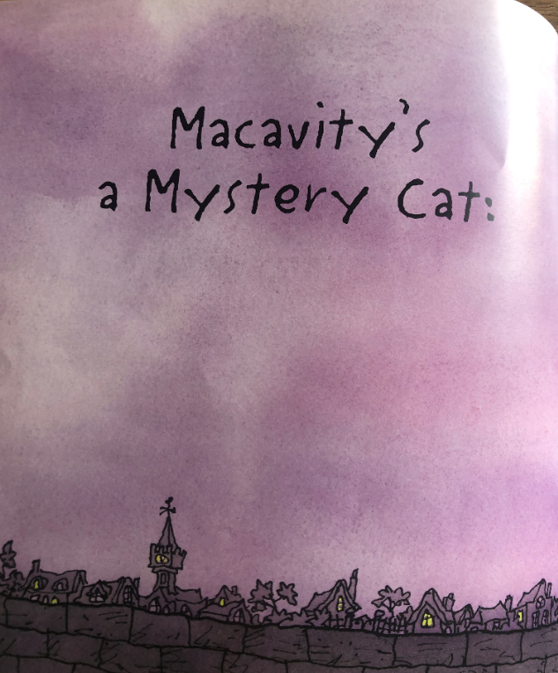
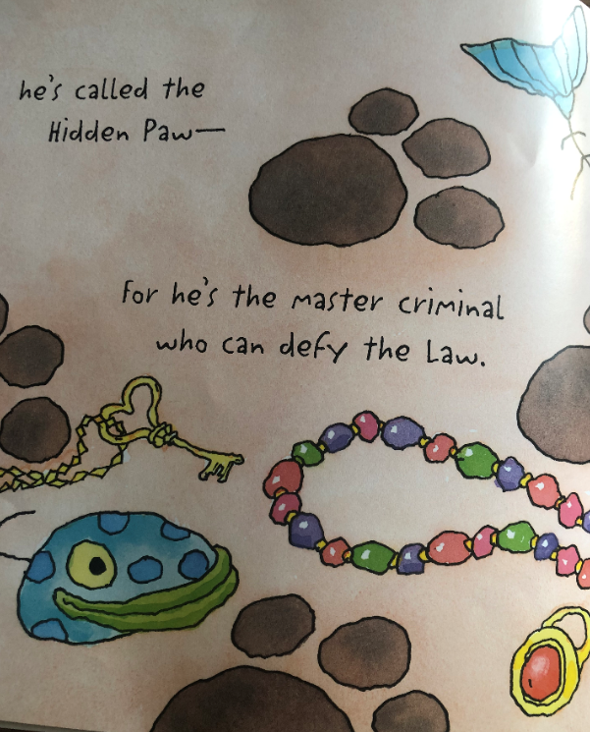

Slide 8
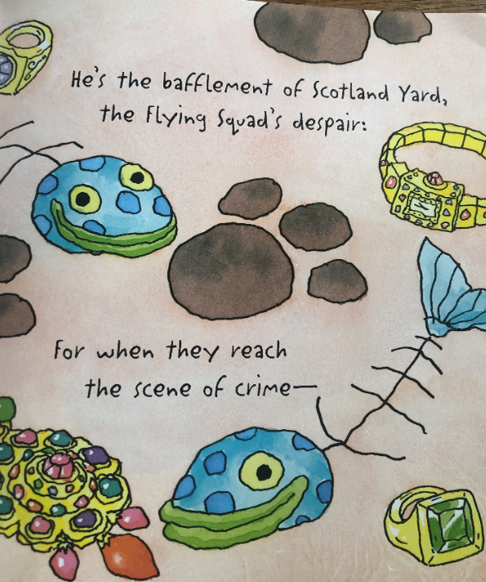
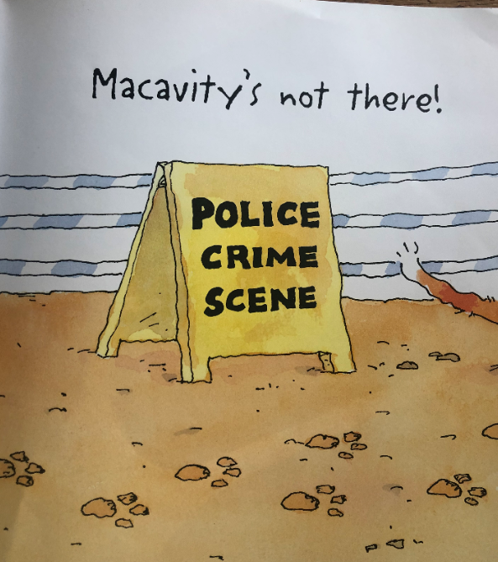

Slide 9
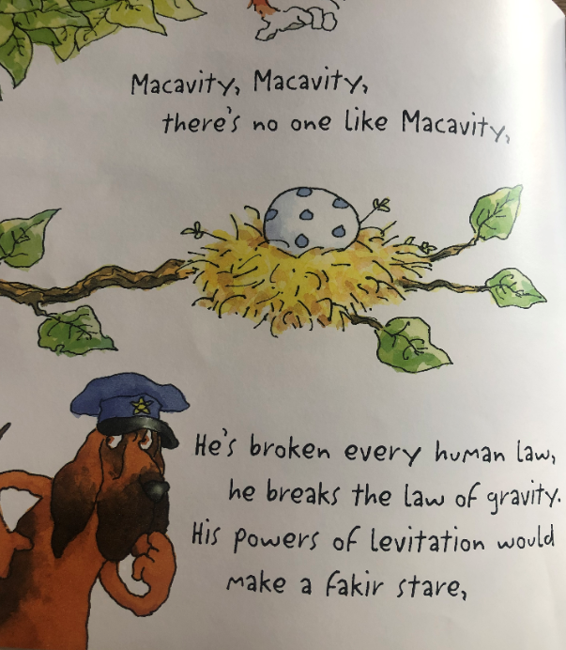
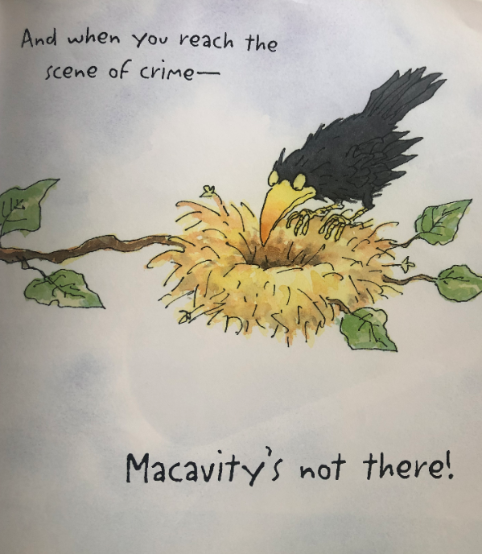

Slide 10
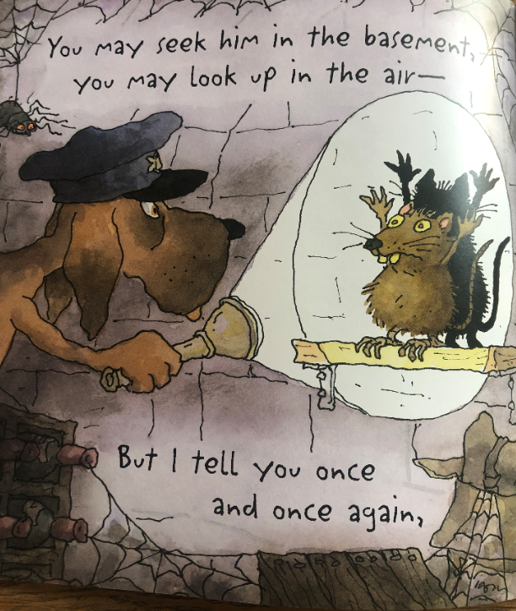
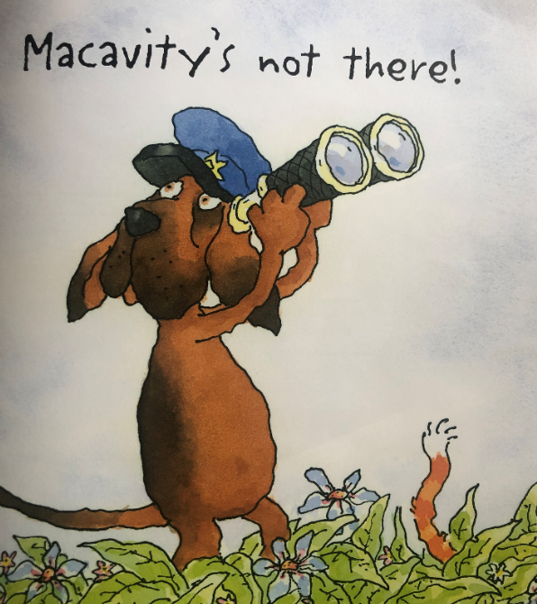

Slide 11
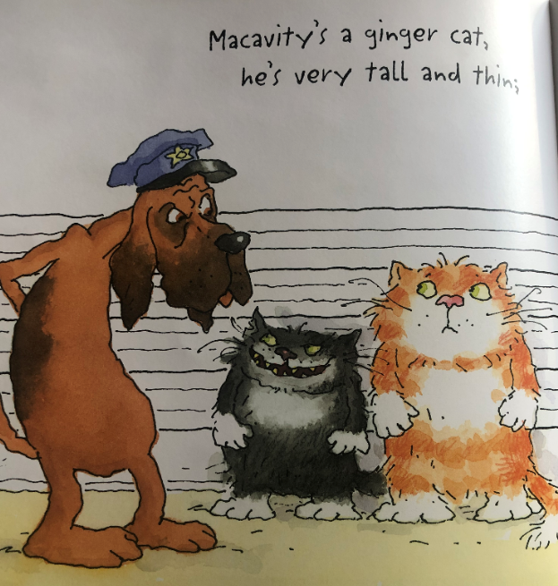
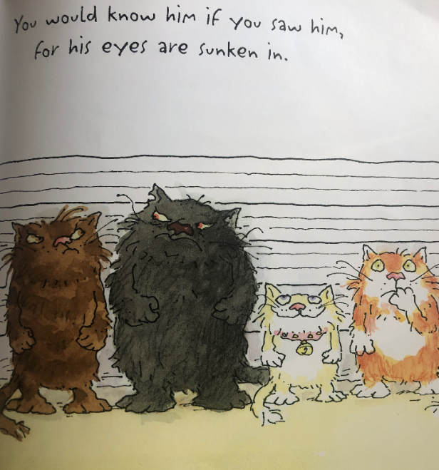

Slide 12
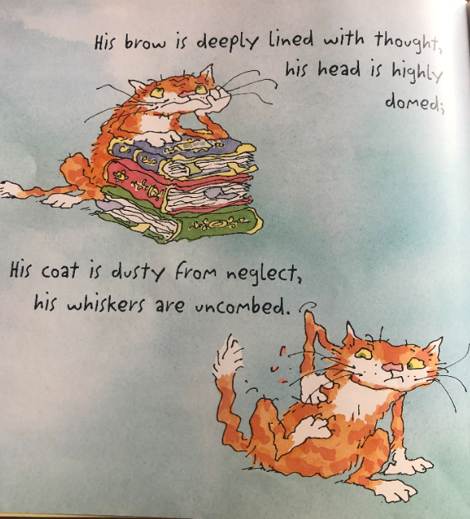
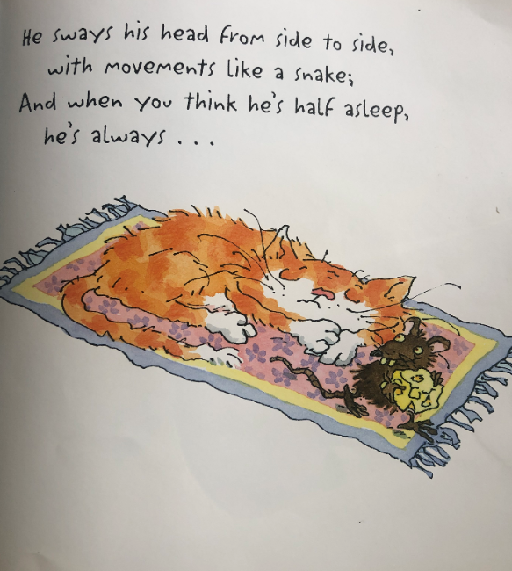

Slide 13
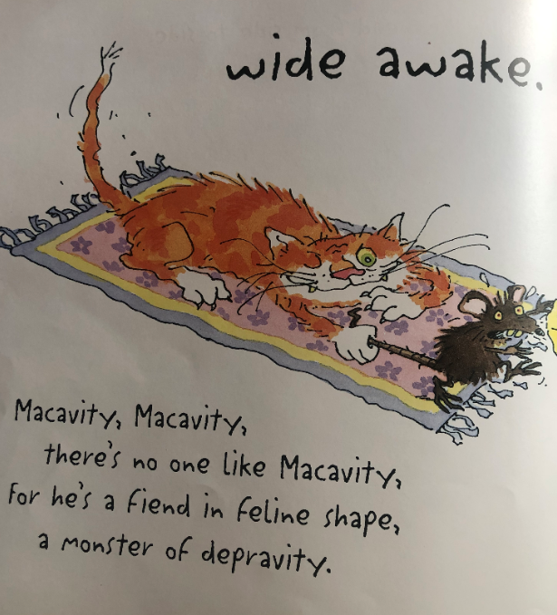
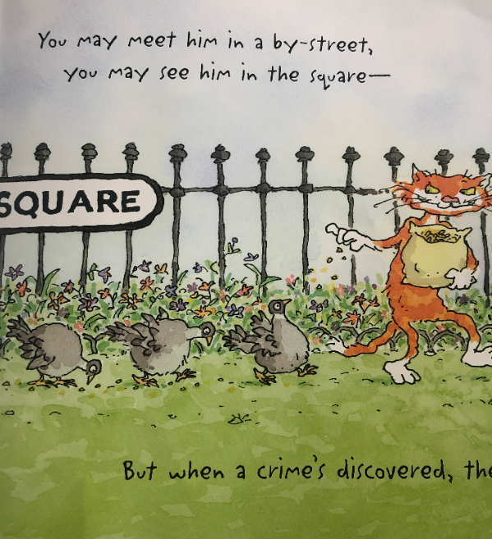

Slide 14
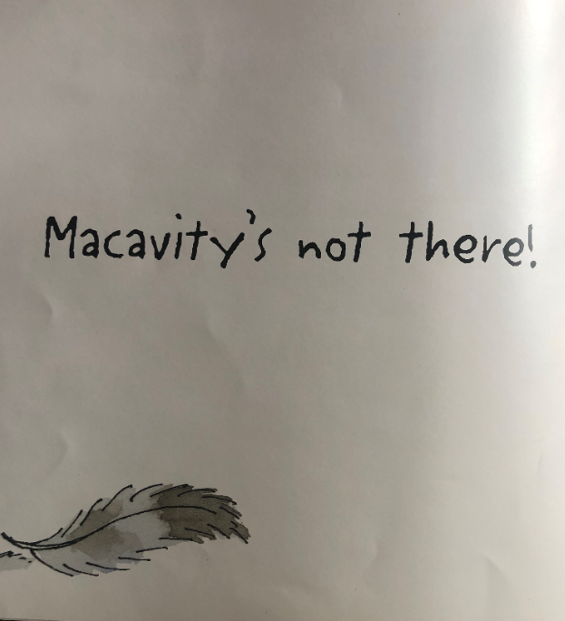
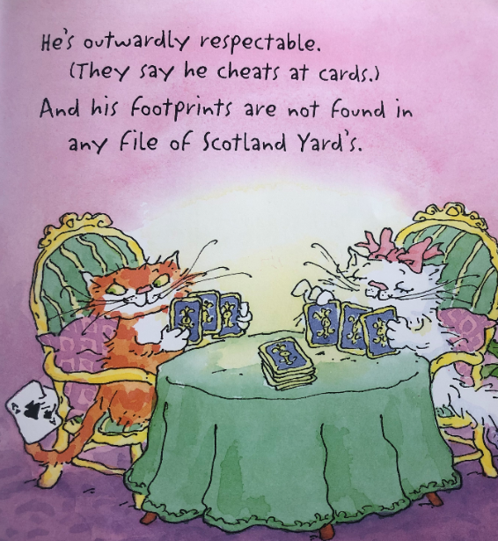

Slide 15
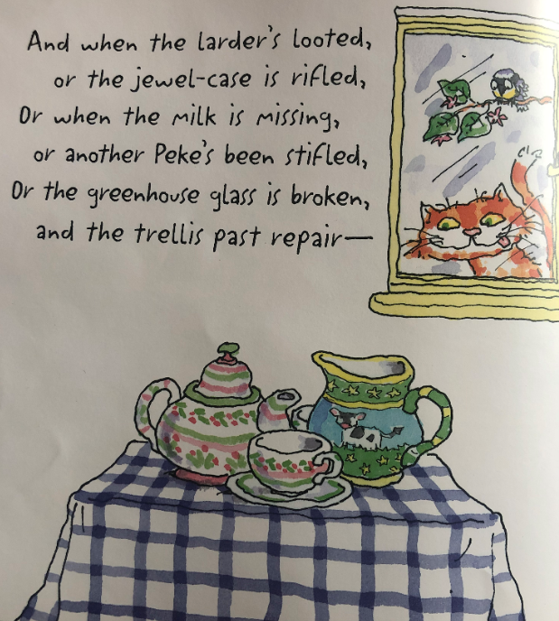
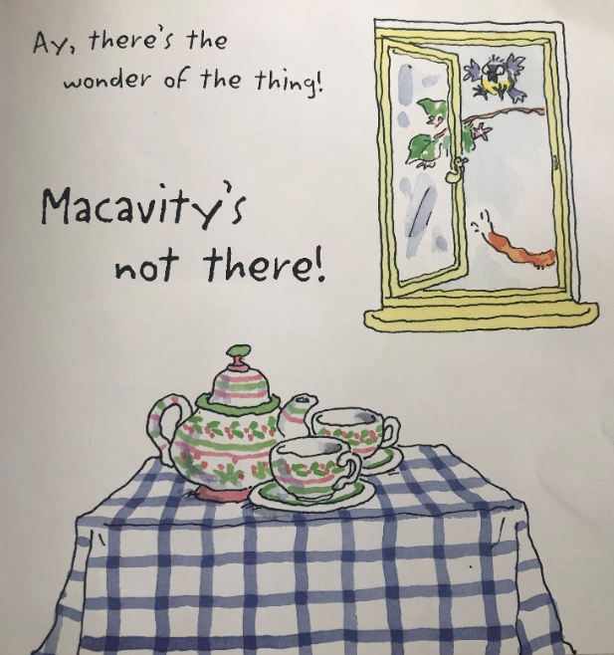

Slide 16
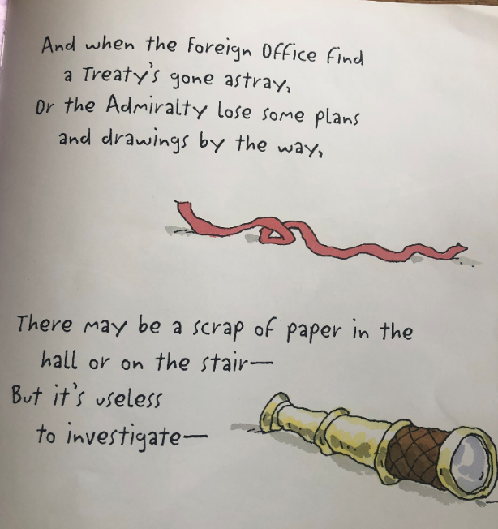

Slide 17
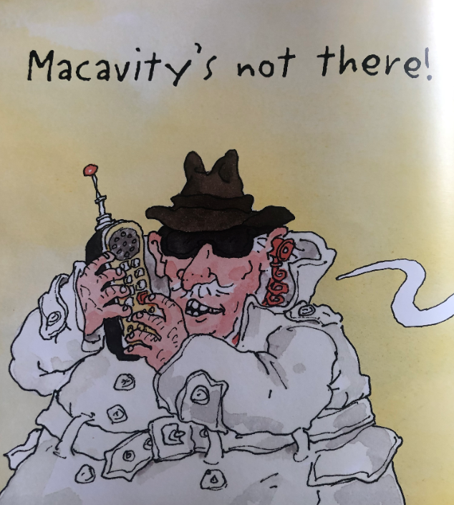
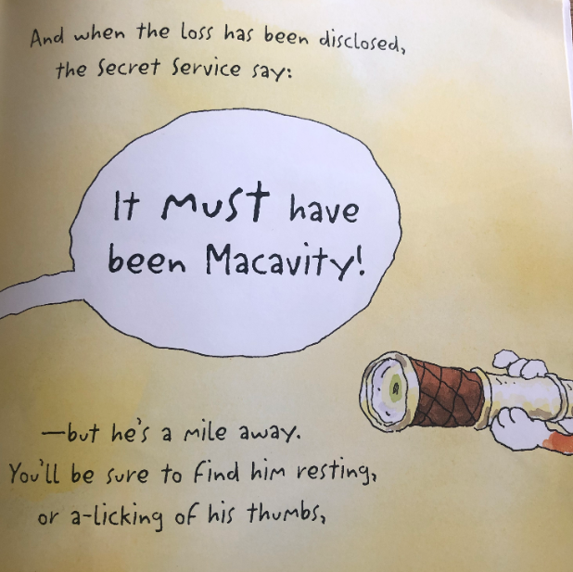

Slide 18
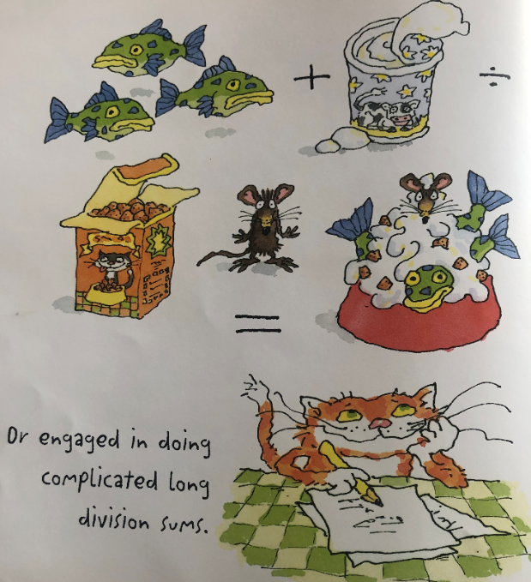
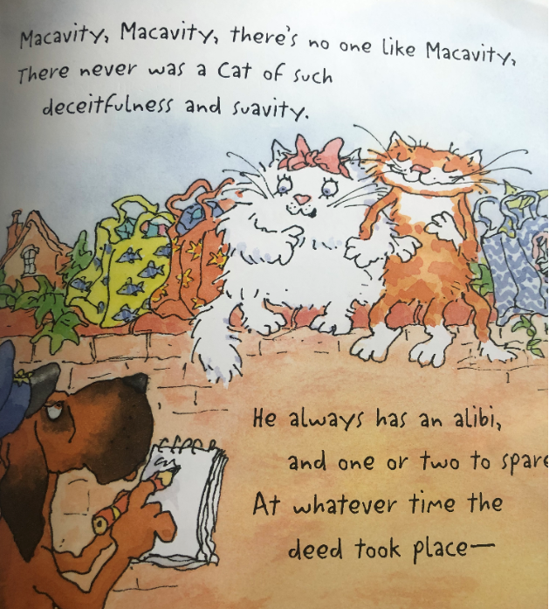

Slide 19
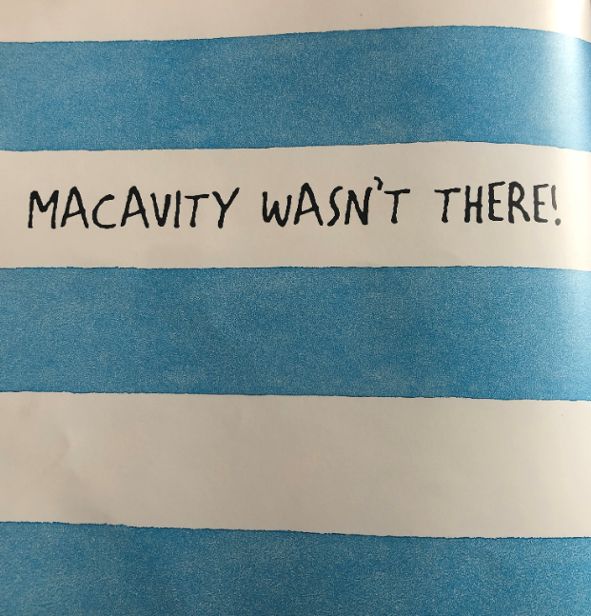
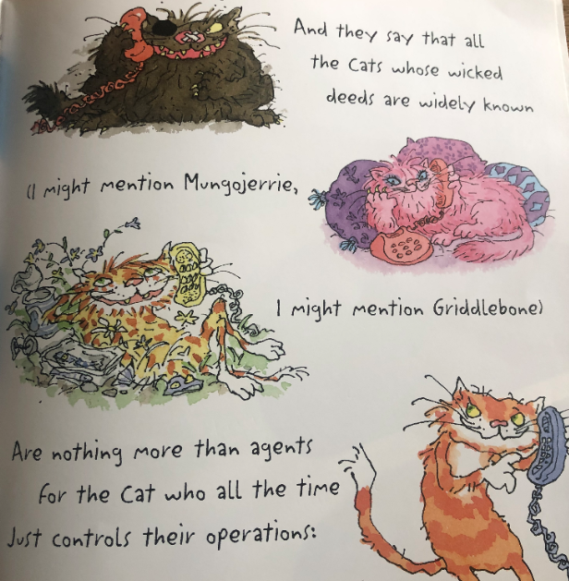

Slide 20
