Slide 1
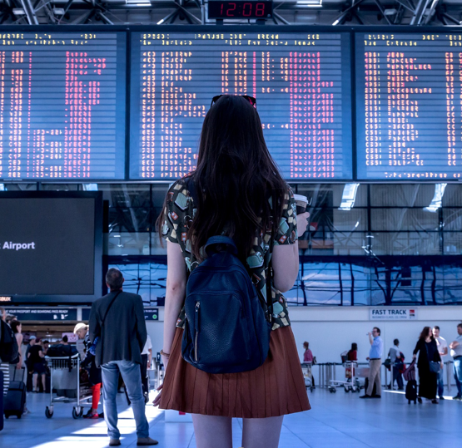
I can use inference to make predictions about a text.
Tuesday 5th January
What is inference?
Inference is like being a detective.
We use clues that we read and see, and also use knowledge we already have about the world, to make decisions about a text.
Last term we looked at photos, like this one, to practise inferring.

Slide 2
I can use inference to make predictions about a text.
Today we are using inference to make predictions about our new class text.
We will read some extracts and look at some pictures from the text.
After looking at each slide, you will write a thought or a question based on the clues you see.
Think carefully about what type of text it might be; the characters; the setting; the plot.
Write the date and ‘I can’ sentence. Now start predicting…

Slide 3
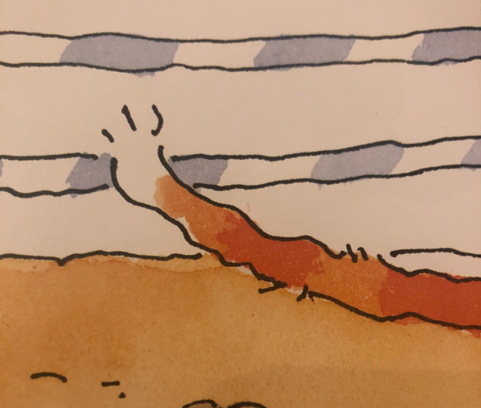
Write a thought or question.
1. ‘The master criminal’

Slide 4
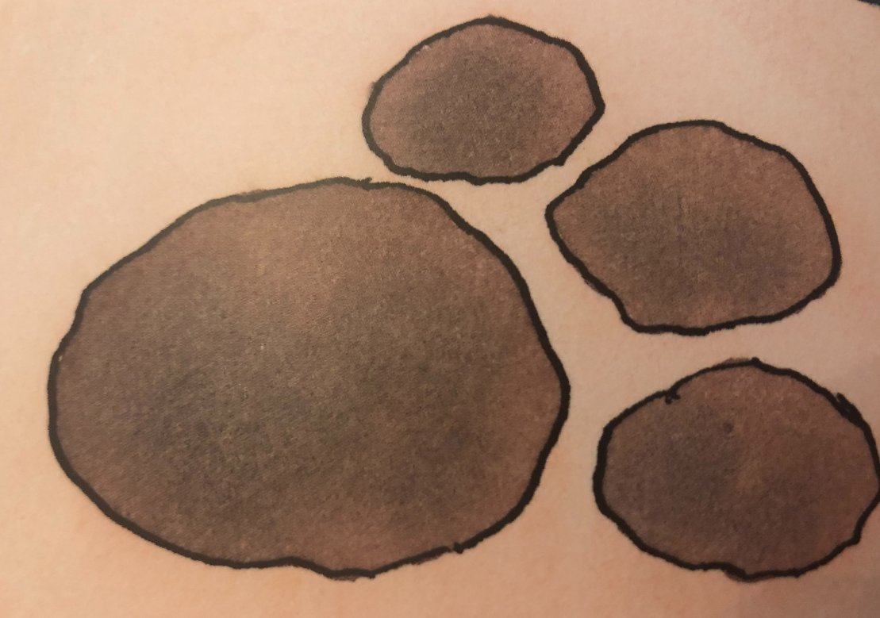
Write a thought or question.
2. ‘He’s called the Hidden Paw’

Slide 5
Write a thought or question.
3. ‘Who can defy the law’

Slide 6
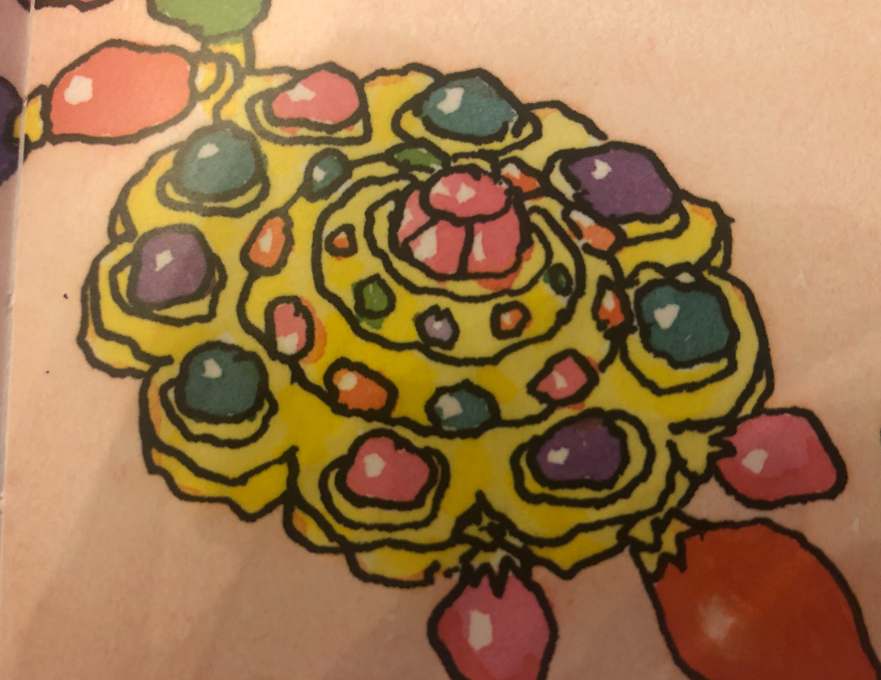
Write a thought or question.
4. ‘The scene of crime’

Slide 7
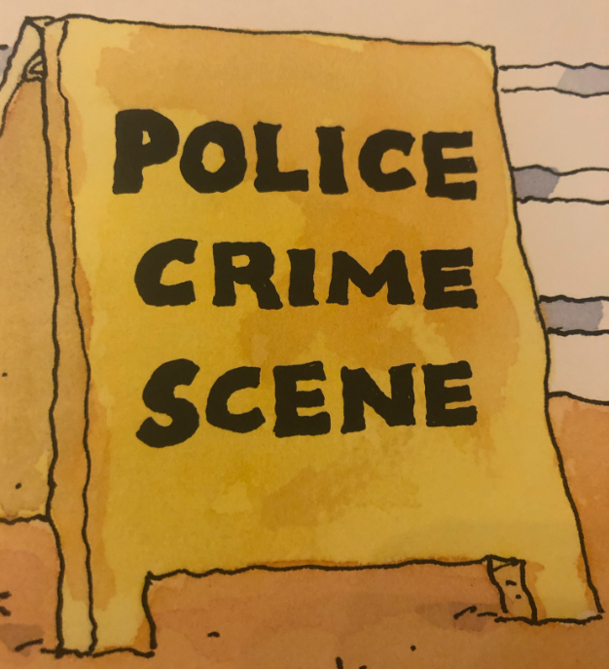
5. ‘He’s broken every human law’
Write a thought or question.

Slide 8
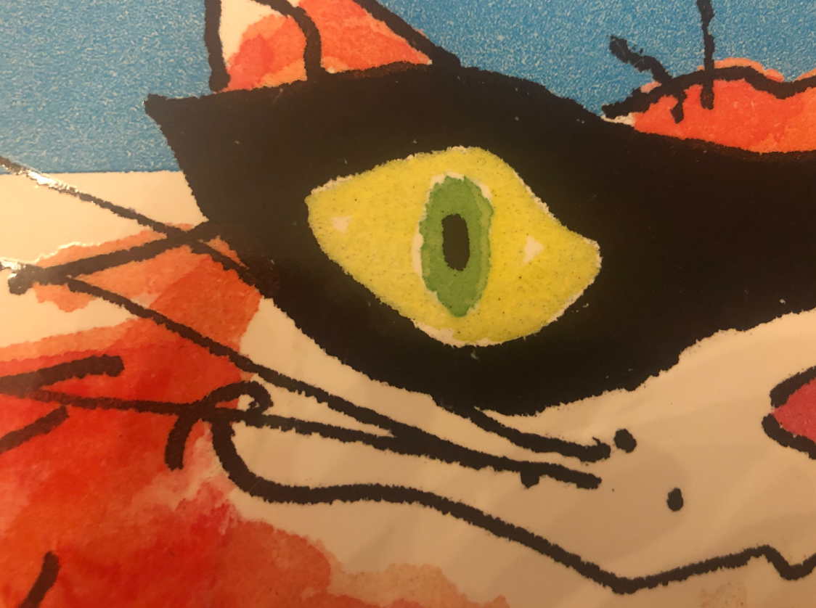
6. ‘His eyes are sunken in’
Write a thought or question.

Slide 9
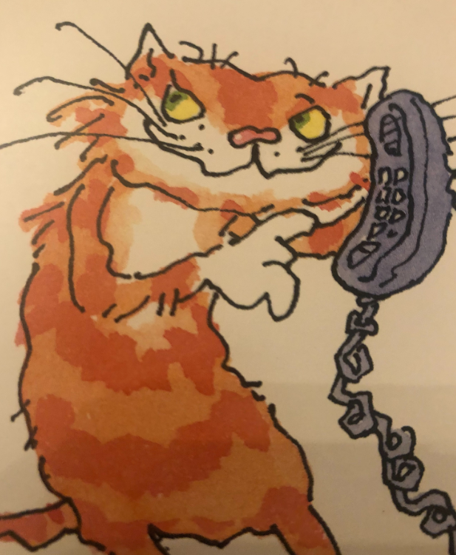
Write a thought or question.
7. ‘He’s very tall and thin’

Slide 10
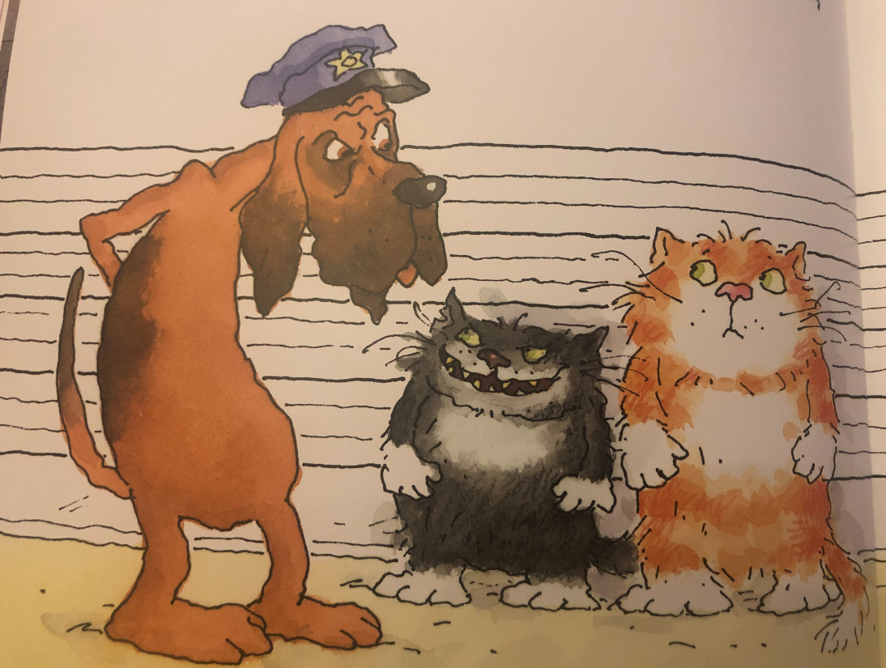
8. ‘He always has an alibi’
Write a thought or question.

Slide 11
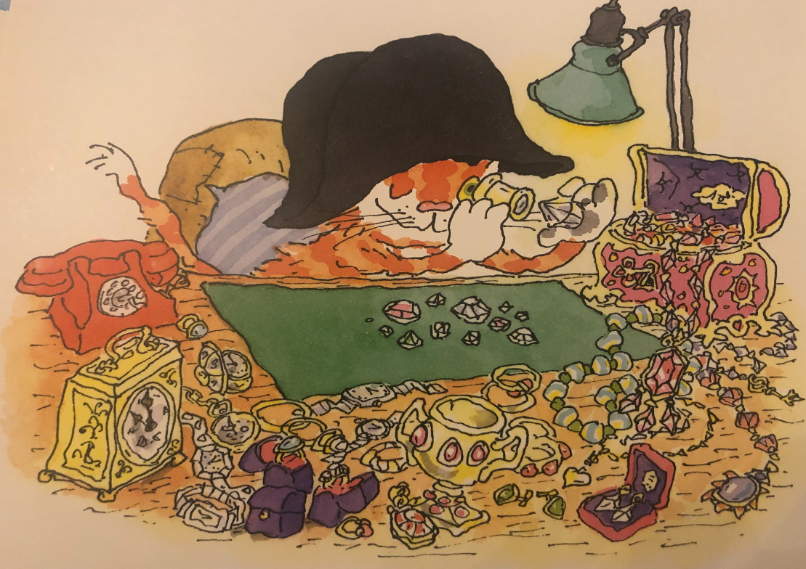
9. ‘When the larder’s looted,
Or the jewel-case is rifled’
Write a thought or question.

Slide 12
Now summarise all your thoughts.
Write a paragraph telling me your predictions about our new text.

Slide 13
Tomorrow you will find out more about me… hehehe…

