Slide 1
Wednesday 20th January Morning SPaG Job
Good Morning Year 4,
Wow your descriptions of the shop were fantastic.
Here are some sentences from your writing:
Early on a winters morning, the shiny, red pan wobbled on the steamy stove while I warmed my frozen hands in front of the fire.
On the bright red, hot stove, the dark pan wobbled like someone carrying jelly who has got the shakes while the copper kettle was whistling.
All of a sudden, the boiling hot pan wobbled on the flaming stove as it overheated.

Slide 2
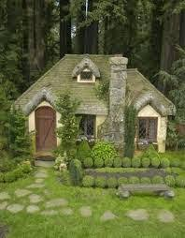
Read this description. Underline or write out the expanded noun phrases and fronted adverbials (use 2 different colours)
Hidden in the enormous forest, there was an old, crumbling cottage. Crooked stones curved around the garden to the wooden front door which creaked open in the cold breeze. Was there someone in there? A tiny, broken window peeped out of the roof and the chimney stood tall with smoke curling to the sky. Even though the cottage was run down, the beautiful garden was cut and trimmed and loved. The perfect, round hedges sat like a row of marbles with a grey, stone bench in front. Behind the hedges, bright flowers and leafy bushes smiled at the sun. Suddenly, the ragged curtain moved. Was there someone in there?
Challenge: can you find a simile?

Slide 3
How did you do? Now mark and correct your work. Yellow= expanded noun phrase. Blue= fronted adverbial.
Hidden in the enormous forest, there was an old, crumbling cottage. Crooked stones curved around the garden to the wooden front door which creaked open in the cold breeze. Was there someone in there? A tiny, broken window peeped out of the roof and the chimney stood tall with smoke curling to the sky. Even though the cottage was run down, the beautiful garden was cut and trimmed and loved. The perfect, round hedges sat like a row of marbles with a grey, stone bench in front. Behind the hedges, bright flowers and leafy bushes smiled at the sun. Suddenly, the ragged curtain moved. Was there someone in there?
Simile: like a row of marbles.

Slide 4
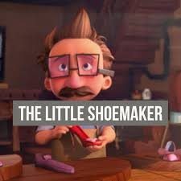
Year 4 English 20.1.21

Slide 5
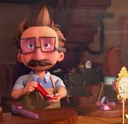
The Little Shoemaker
Yesterday you described the setting.
Today you will describe Mr. Botte and the new shoemaker.
If you want to watch it again, click on the shoemaker to watch the video.

Slide 6
I can collect adjectives to describe a character.
Sort the adjectives on the next slide into these groups:
Mr Botte | The New Shoemaker | Neither of them

Slide 7
Sort these adjectives to describe the characters.
Think about which part of the story shows that they are like this.
clever caring cunning funny grumpy happy hardworking honest rich poor ambitious boastful careless cautious cheerful clumsy confident determined excited friendly gentle imaginative jealous mischievous patient popular proud rude reliable sensitive tricky thoughtful ugly unhappy unlucky

Slide 8
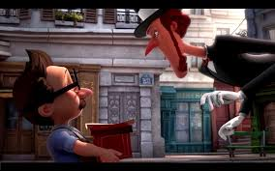
I can write a detailed description of characters.
Now you are going to write 2 paragraphs: one to describe Mr. Botte and one to describe the new shoemaker.
Remember to use the list of adjectives.
Uplevel some of your sentences with:
Expanded noun phrases
Fronted adverbials
Subordinate clauses (not Santa Claus)
Remember to email your work today.

