Slide 1
Good morning Year 6!
Let’s start with a warm-up, and do our Daily Ten mental maths. Level 6-> addition, today. Set the timer at a speed that’s suitable for you.
https://www.topmarks.co.uk/maths-games/daily10
Here are your maths slides for Tuesday 12th January. We will be looking at dividing decimals by integers. (Remember- integer is just another word for a whole number). Before you begin, watch this short tutorial first: https://vimeo.com/490691239
Remember that some of these new objectives are challenging, and we would usually discuss them together as a class. Please email us at year6home@heddon-school.co.uk if you need any help or want to ask any questions.
You are all doing an amazing job. Keep up the super work! ☺

Slide 4
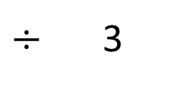
1)
2)
3) 646 $÷$ 5 $=$
$÷$ 3
645
?

Slide 5
1)
2)
3) 646 $÷$ 5 $=$
$÷$ 3
$$=$$
108
3 | 3 | 2 | 4
1
0
8
2
645
129
?
5 | 6 | 4 | 5
1
2
9
1
4
129 r1

Slide 7
Mr Rose is building some garden furniture.
His plank of wood is 3.96 m long.
He needs to cut it into 3 equal pieces.
How long is each piece?

Slide 8
Ones | tenths | hundredths
 | 1
3 | 3 | . | 9 | 6
 | 1 | .
3 | 3 | . | 9 | 6
 | 1 | . | 3
3 | 3 | . | 9 | 6
 | 1 | . | 3 | 2
3 | 3 | . | 9 | 6
3 | 3 | . | 9 | 6
Each piece of wood will be 1.32 m long.

Slide 9
Have a think
Mr Rose has another plank of wood that
is 4.08 m long.
He needs to cut it into four equal pieces.
How long is each piece?

Slide 10
Ones | tenths | hundredths
1.2 m or 1.02 m?
4 | 4 | . | 0 | 8
 | 1
4 | 4 | . | 0 | 8
 | 1 | .
4 | 4 | . | 0 | 8
 | 1 | . | 0
4 | 4 | . | 0 | 8
 | 1 | . | 0 | 2
4 | 4 | . | 0 | 8
Each piece of wood will be 1.02 m long.

Slide 11
Ones | tenths | hundredths
4 | 5 | . | 2 | 8
 | 1
4 | 5 | . | 2 | 8
 | 1 | .
4 | 5 | . | 2 | 8
 | 1 | . | 3
4 | 5 | . | 2 | 8
 | 1 | . | 3 | 2
4 | 5 | . | 2 | 8
1
5.2
5.2
0.2
4
1.2
5

Slide 12
Ones | Tenths
Ones | tenths | hundredths
Have a think
4 | 4 | . | 2
 | 1
4 | 4 | . | 2 | 0
 | 1
4 | 4 | . | 2
 | 1 | .
4 | 4 | . | 2 | 0
 | 1 | . | 0
4 | 4 | . | 2 | 0
 | 1 | . | 0 | 5
4 | 4 | . | 2 | 0
2

Slide 13
Have a go at questions 1 - 4 on the worksheet

Slide 14
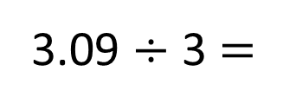
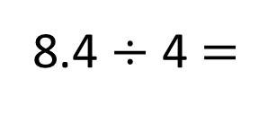
8.4 ÷ 4 $=$
2.1
3.09 ÷ 3 $=$
1.03
8.4
3.09
8
0.4
3
0.09
0.0
÷ 4
÷ 4
÷ 3
÷ 3
÷ 3
2
0.1
1
0.03
0.0

Slide 15
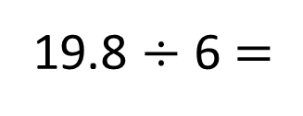
19.8 ÷ 6 $=$
3.3
19.8
19.8
19.8
19.8
6.6
9
19
10
6.6
18
0.8
0.8
1.8
6.6
÷ 6
÷ 6
÷ 6
÷ 6
÷ 6
19.8
3
0.3
1.1
1.1
1.1
10
9.8

Slide 16
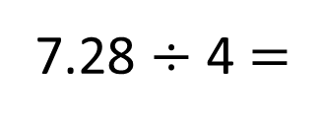
Have a think
7.28 ÷ 4 $=$
1.82
7.82
4
0.08
3.2
÷ 4
÷ 4
÷ 4
1
0.02
0.8

Slide 17

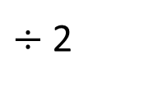
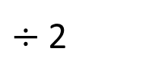
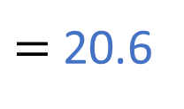
8.24 $÷$ 4 $=$ 2.06
How can I use this to help me solve
$÷$ 2
82.4 $÷$ 4
$=$ 20.6
8.24 $÷$ 4 $=$ 4.12 $÷$ 2
$÷$ 2
Have a think

Slide 18
Have a go at the rest of the questions on the worksheet

