Slide 1
DT
Monday 4th January

Slide 2
Our new unit is....
Pneumatics!

Slide 3
I am successful if...
I can begin to understand how pneumatic systems work.

Slide 4
What is Pneumatics?
Pneumatics is the use of compressed air for mechanical motion.
It is the power that air has when it is trapped.

Slide 5
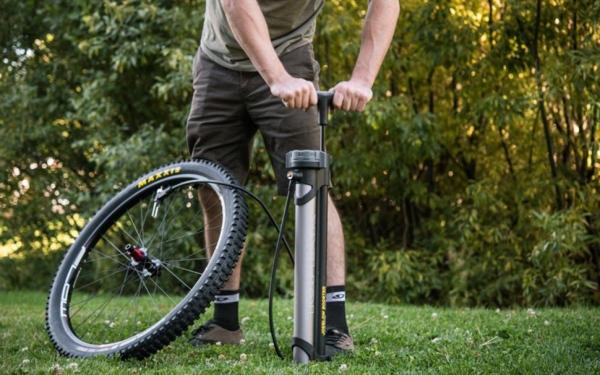
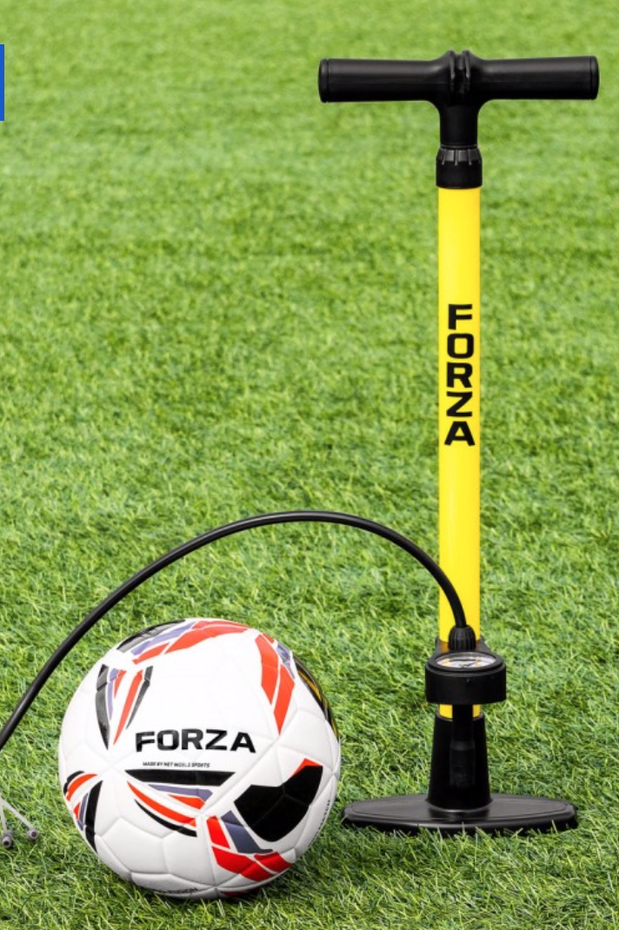
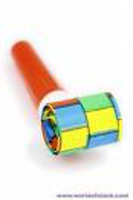
Everyday uses…
What does the air do?
Who might it be for?
What is its purpose?
What do you think will move?
What part moved and how?
What materials have been used?
How effective is it and why?

Slide 6
Your job
Choose an object which requires a pneumatic system to work.
Draw a diagram underneath to show how the air moves it and then write a short explanation.

