Slide 1
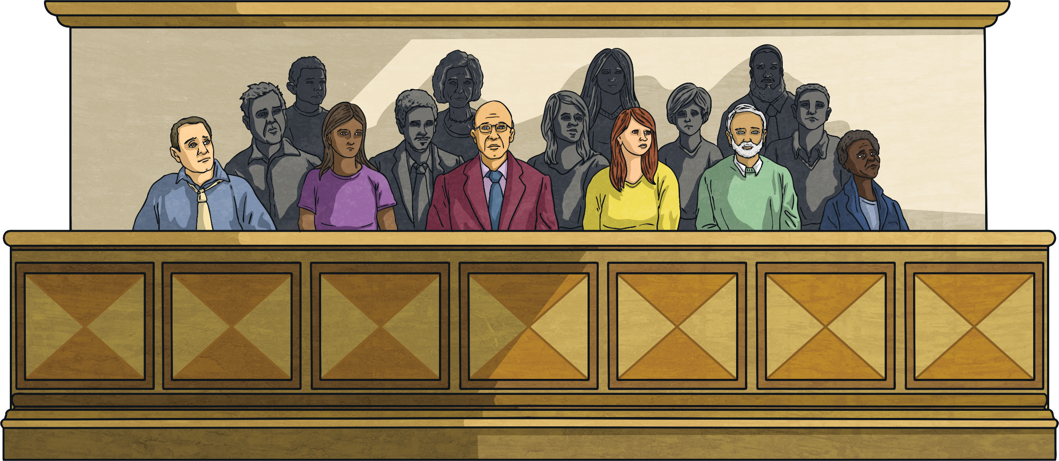
Crime and Punishment
Before we start to learn about crime and punishment in the past, we need to know what it is like in the UK now.
Today we will find out about laws and the justice system. Then we will learn some new vocabulary for our topic.

Slide 2
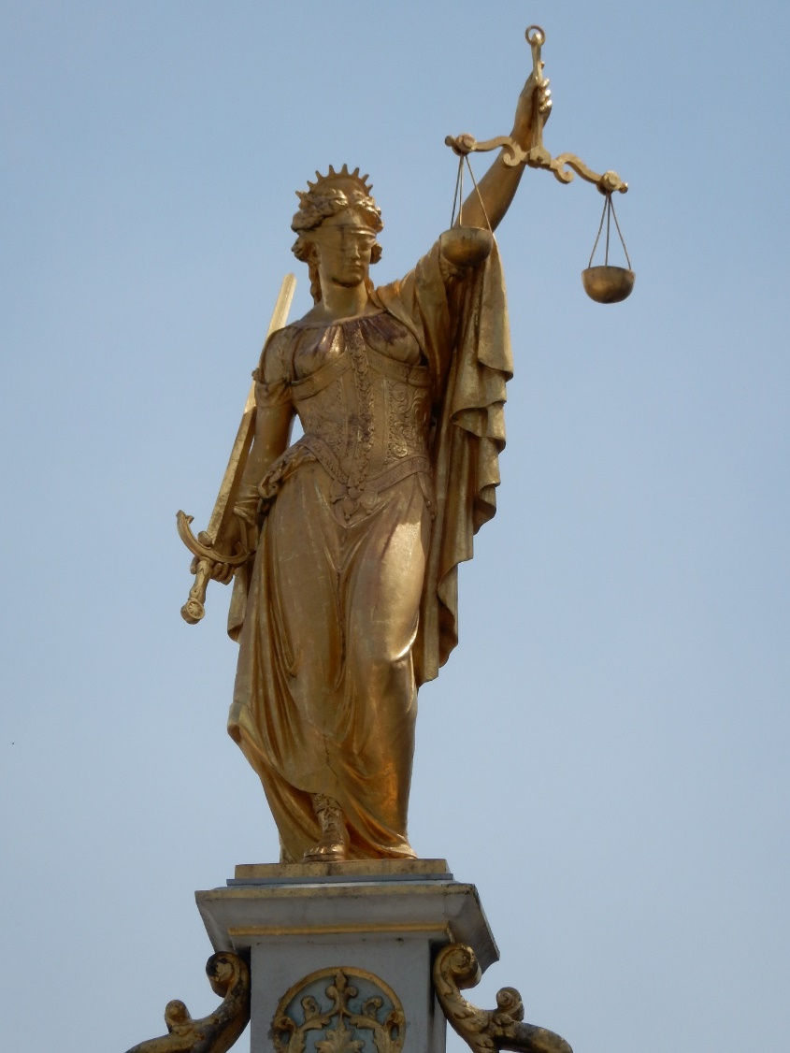
Lady Justice
The Lady Justice is a common sight in legal institutions. Originally known as the goddess Themis, she represents the fairness of the judicial system. In Greek, Themis means 'order'.

Slide 3
Why Do We Have Laws?
Without laws, people would be able to do whatever they wanted to and might harm others. Laws protect our rights and ensure that we carry out our responsibilities.
Most people obey our laws. When people are suspected of breaking the law, they are taken to court. If they are found guilty, they are punished.
Sometimes laws seem unfair and need to be changed. Our governments are constantly changing and making new laws.

Slide 4
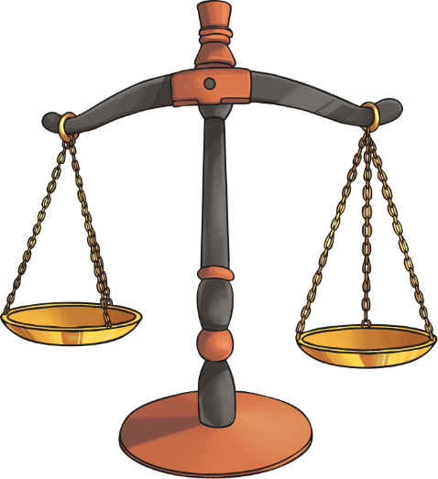
Why does Britain have a legal system?
Think of as many reasons as you can why most countries have laws and a legal system.
Here are just a few:
To prevent anti-social and unacceptable behaviour.
To control business and trade.
To decide who should rightfully own property.
To help family and personal relationships.
To help people to resolve disagreements
with others.

Slide 5
Civil Law and Criminal Law
There are two types of law:
Civil law
Criminal law
The courts of England and Wales are headed by the Senior Courts of England and Wales:
The High Court of Justice (for civil cases)
The Crown Court (for criminal cases).
The Supreme Court is the highest court in the land for both criminal and civil appeal cases

Slide 6
Civil Law
Civil law is concerned with the rights and duties of citizens in dealings with other citizens.
Civil law covers activities such as:
Lending and borrowing money
Entering into contracts
Disputes with neighbours
Getting married
Inheritances and wills
Challenge:
In later lessons, think about these kinds of laws.

Slide 7
Criminal Law
Criminal offences are regarded as offences against society. It includes the punishment of people who break these laws.
It deals with matters such as:
Crimes against people:
E.g. murder, assault
Property crimes:
E.g. theft, burglary, fraud and vandalism
Challenge:
Can you think of any more criminal law activities?

Slide 8
Courts of Law
Courts have a judge or magistrate who is in charge and gives the sentence (punishment) but there is also a jury.
A jury is a group of 12 people who listen to the evidence and decide if the accused if innocent or guilty.
Do you think this sounds like a fair system?

Slide 9
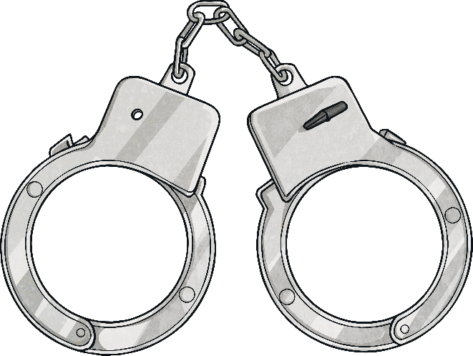
Compensation or Punishment?
In civil law, the courts award compensation when someone can prove the other party is in the wrong.
In criminal courts, the aim is to punish wrongdoers and impose a sentence which prevents them from reoffending.
Compensation
This refers to the act of providing a person with money or other things of value in order to provide for the costs of injuries that they have incurred.
Sentence
This can generally involve imprisonment, a fine and/or other punishments against a defendant convicted of a crime.

Slide 10
Crime and Punishment Vocabulary
We have talked about some new words in the PPT. And there are some more!
See if you can match the vocabulary with the definition on the worksheet.
Use a dictionary to help you.

