Slide 1
Using the Internet

Slide 2
Sending and receiving Emails!
Now we know how to use the Internet safely and we understand how we can search for information to find things out… I thought we could learn about another important use of the Internet.

Slide 3
E mails
E mails (which stands for electronic mail) are used to communicate with other people.
I know that everyone is missing their friends in our class and so sending messages to each other, safely by email, might help.

Slide 4
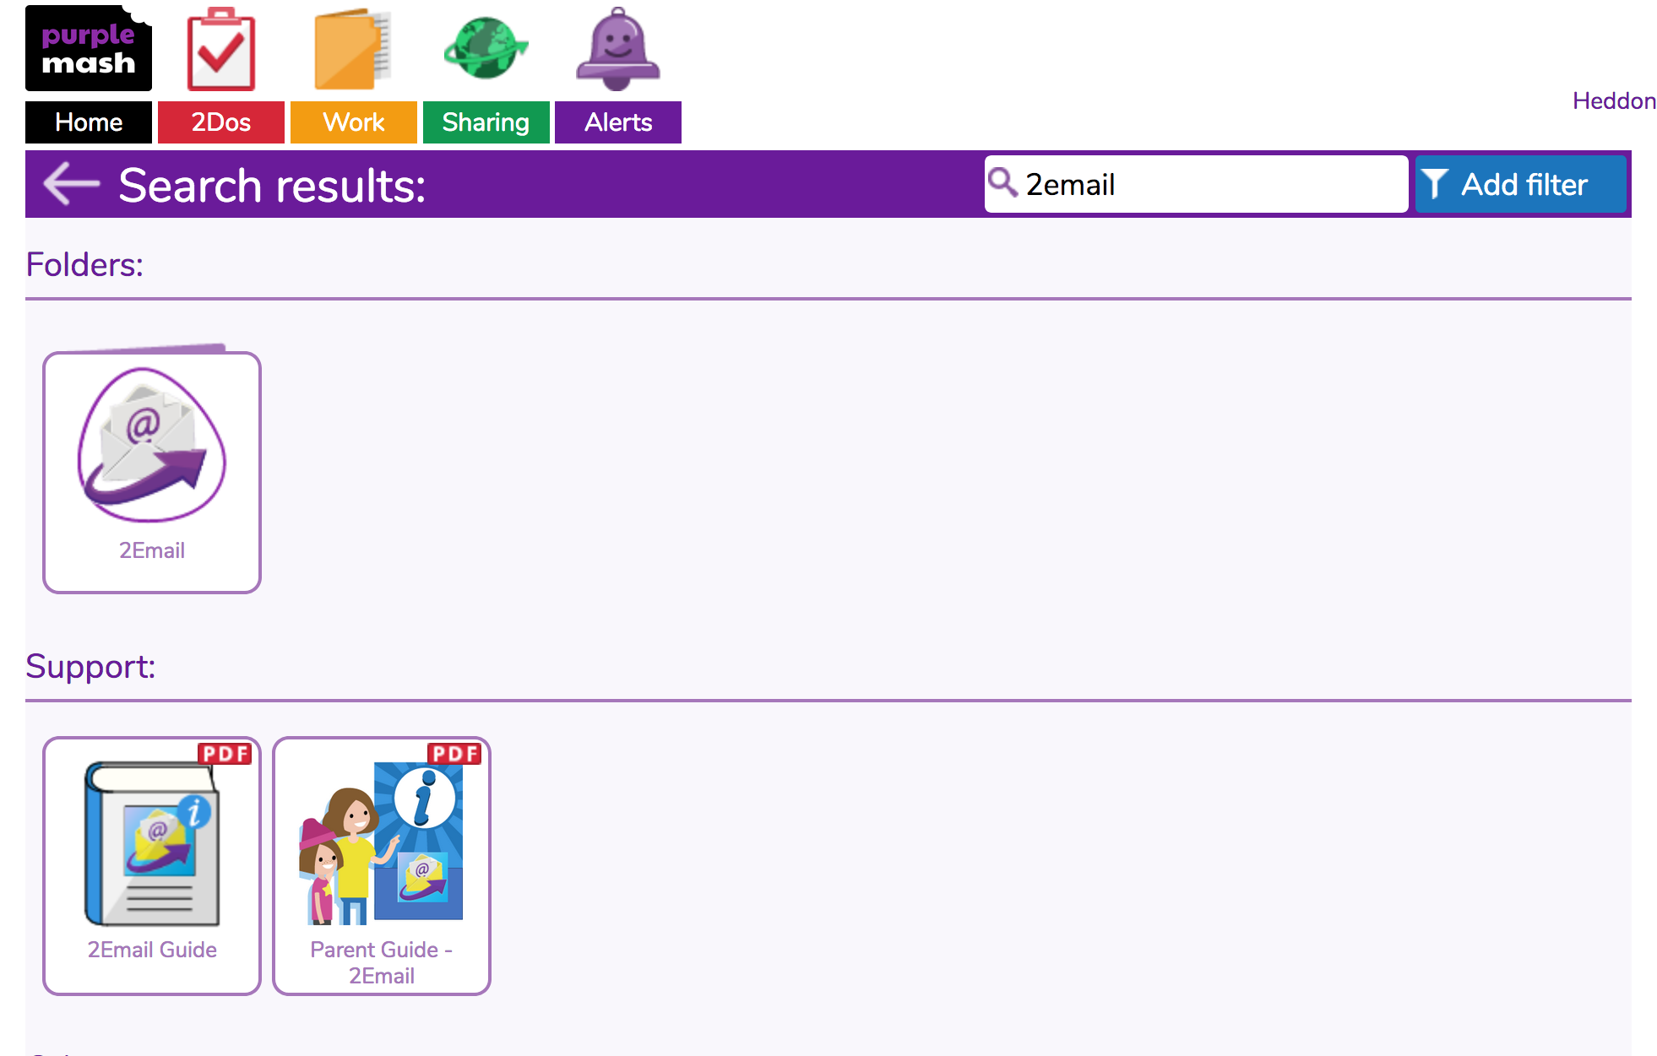
Step 1
Log in to your purple mash account.
Search for 2email

Slide 5
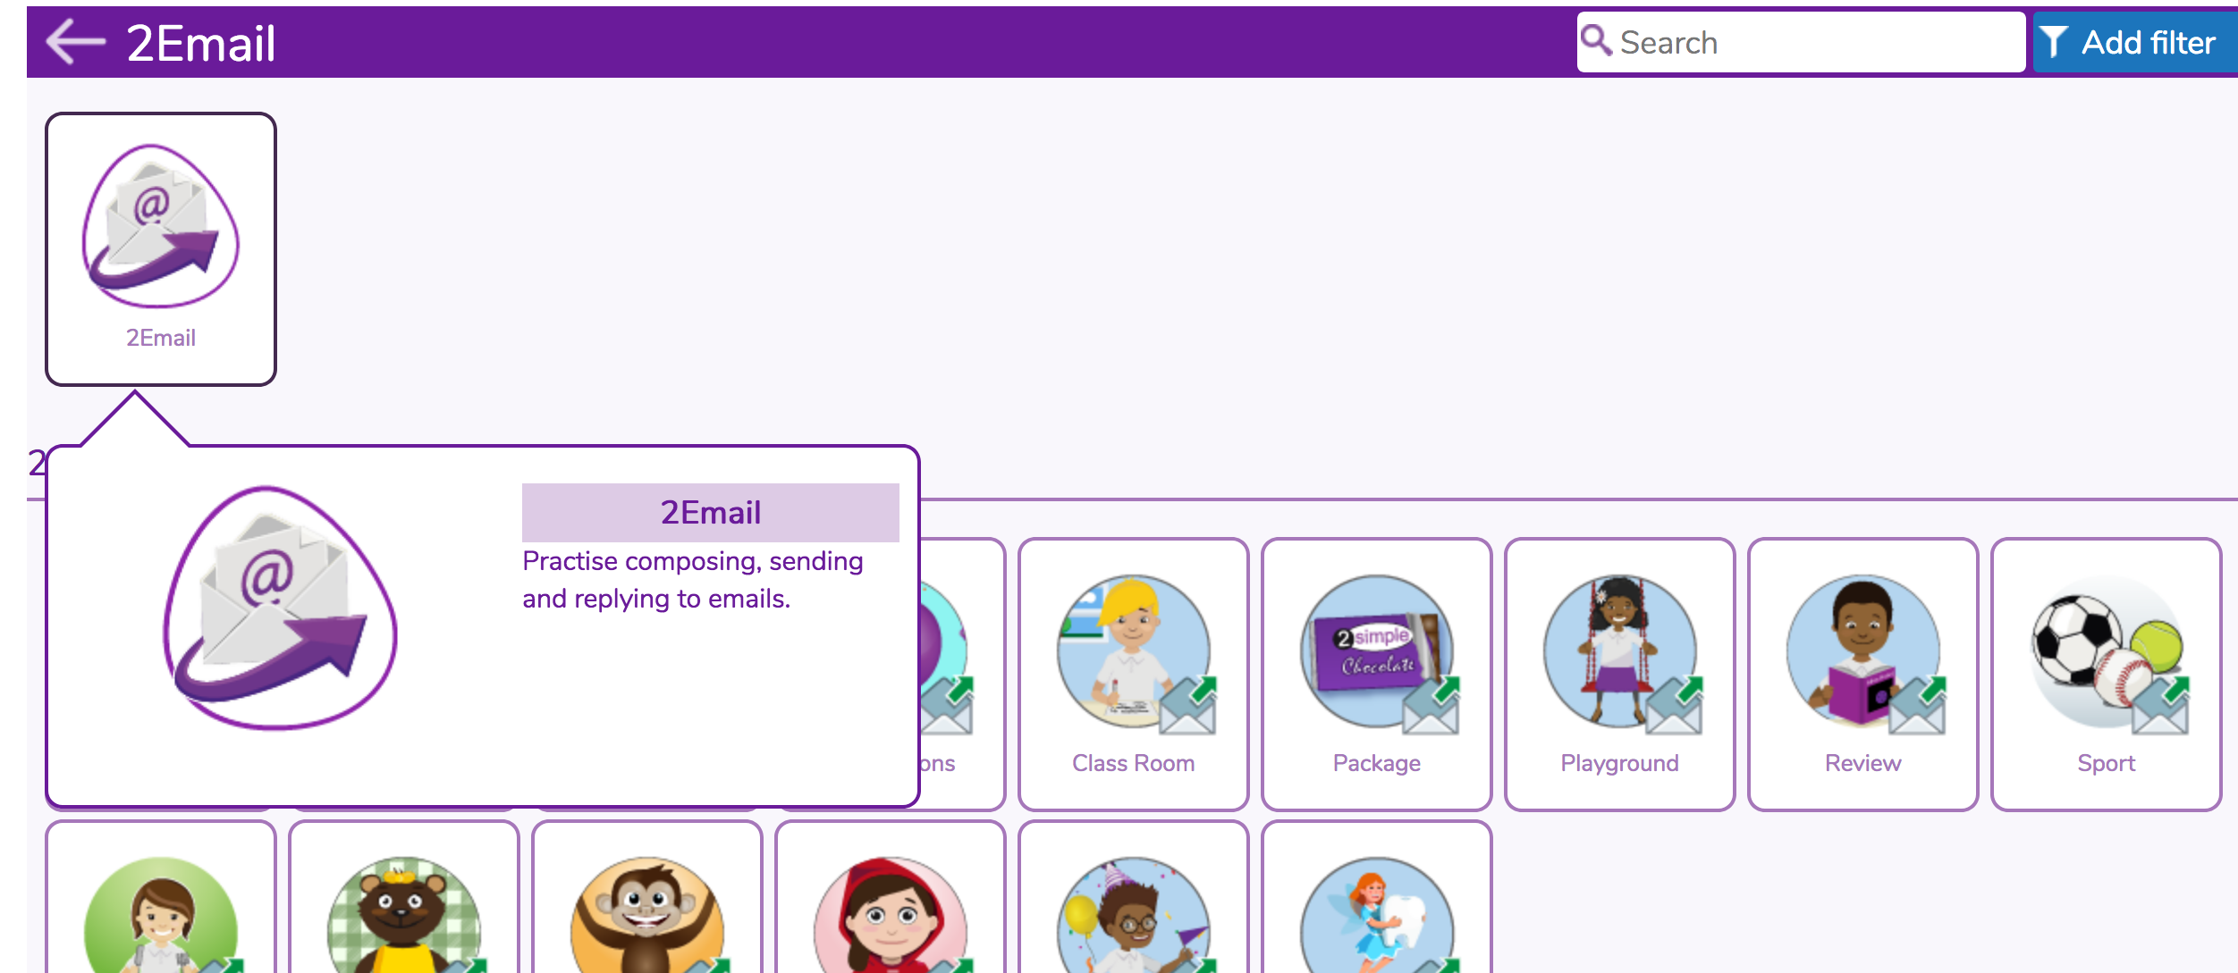
Step 2
Click onto the 2email icon.

Slide 6
Step 3
This is your inbox where you will find any emails which have been sent to you.
Click on the name to read the email.
When you have read the email, you can click ‘reply’ which is a green button and the bottom of the email.

Slide 7
Step 4
You can click ‘Write Email’ if you want to start a new email, to someone new.

Slide 8
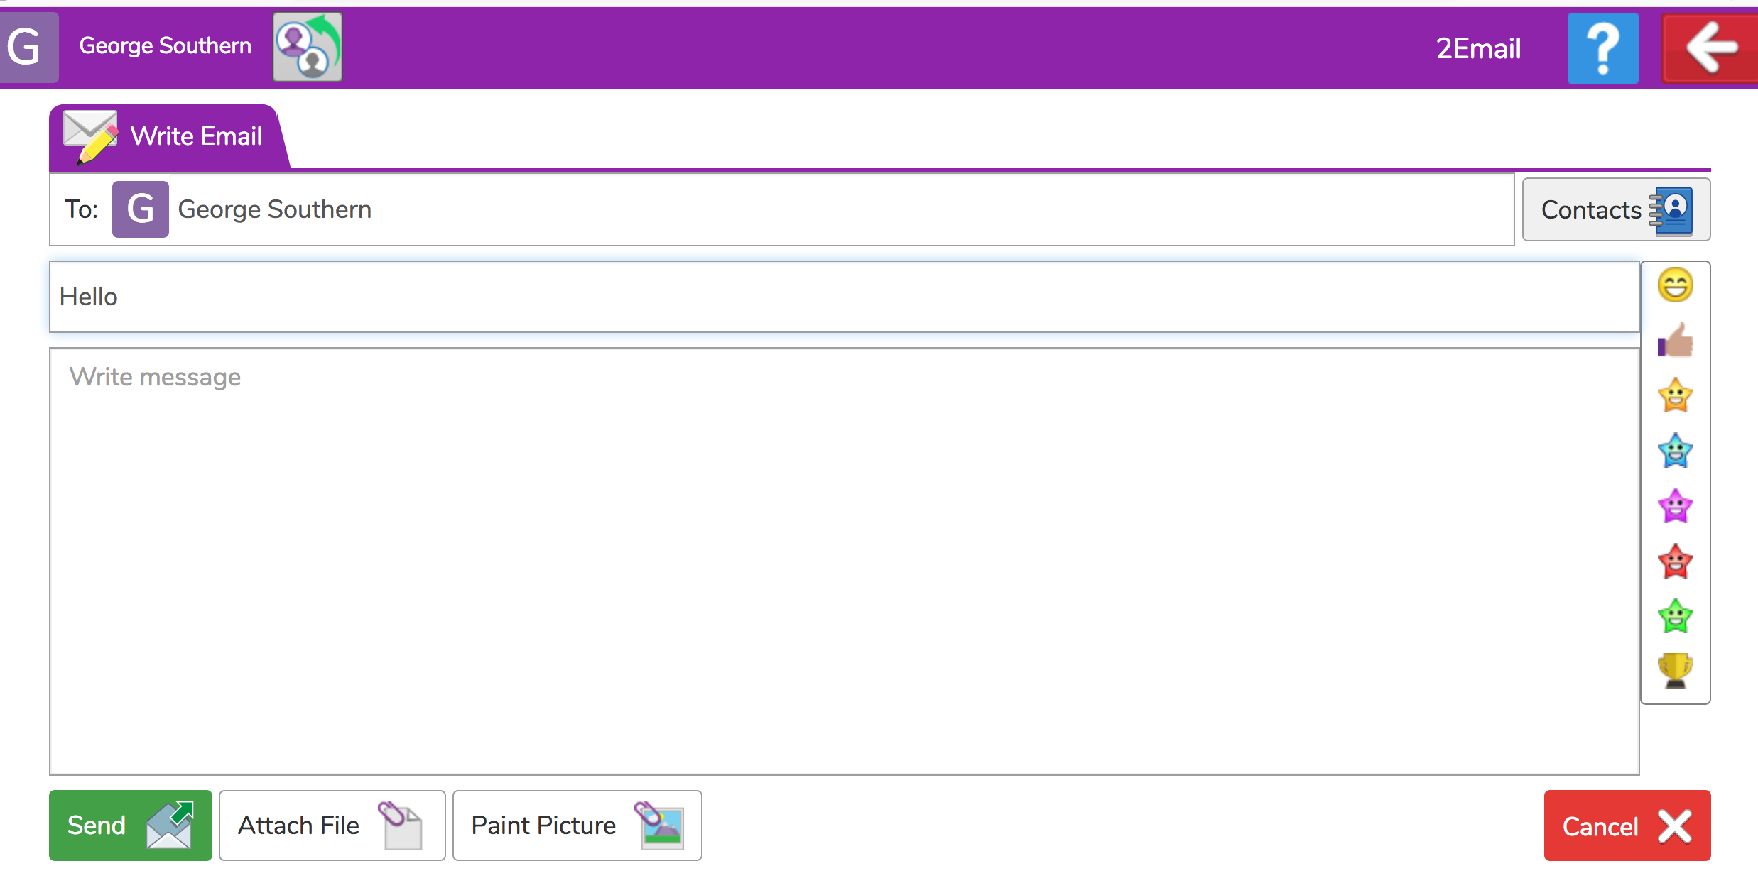
Step 5
Sending a new email
Use the contacts list. You can send the same email to more than 1 person OR you can begin typing a name in the ‘To’ box.
You can paint a picture if you would like to.
SEND
Start typing your email here.

Slide 9
Step 6
Email safety!
Emails sent through Purplemash can ONLY be sent to other children in our class.
ALL emails will come via myself so that I can check what has been said. Please remember to be kind, sending messages to cheer your friends up.
You could tell your friend a joke, ask them how they are, discuss what you both like doing at home or even what you have had for tea!
ENJOY!!!

