Slide 1
LO: natural disasters in art: Hokusai
The Great Wave off Kanagawa

Slide 2
The Great Wave off Kanagawa
The Great Wave off Kanagawa also known as The Great Wave or simply The Wave, is a woodblock print by the Japanese artist Hokusai. It was published sometime between 1830 and 1833. It is Hokusai's most famous work, and one of the best recognized works of Japanese art in the world. It depicts an enormous wave threatening boats off the coast of Kanagawa. While sometimes assumed to be a tsunami, the wave is, as the picture's title suggests, more likely to be a large rogue wave or okinami ("wave of the open sea"). As in all the prints in the series, it depicts the area around Mount Fuji under particular conditions, and the mountain itself appears in the background.

Slide 3
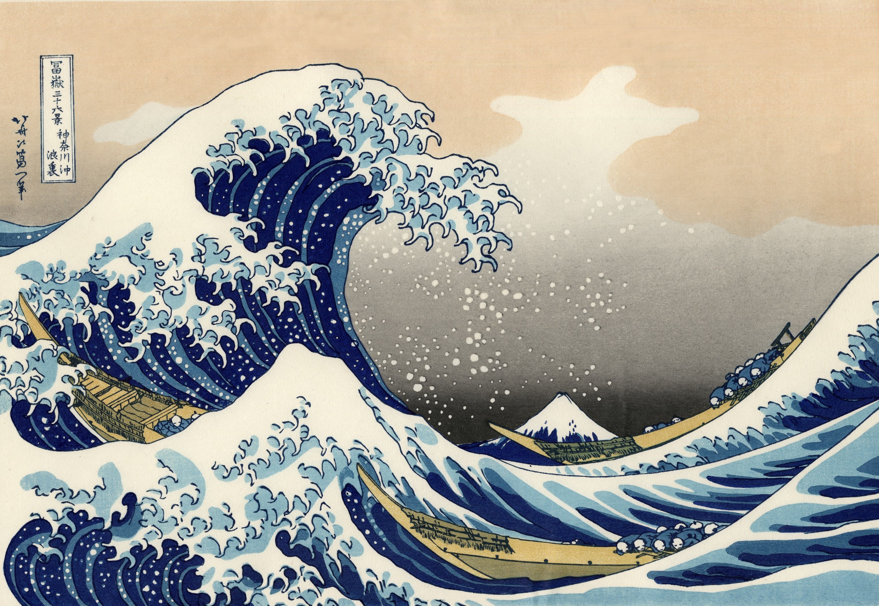
https://www.youtube.com/watch?v=dbPHPfVw6zQ

Slide 4
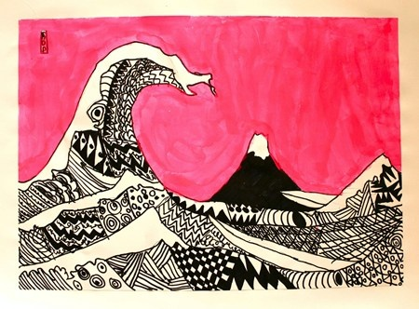
You are aiming to create a finished piece that looks like this!

Slide 5
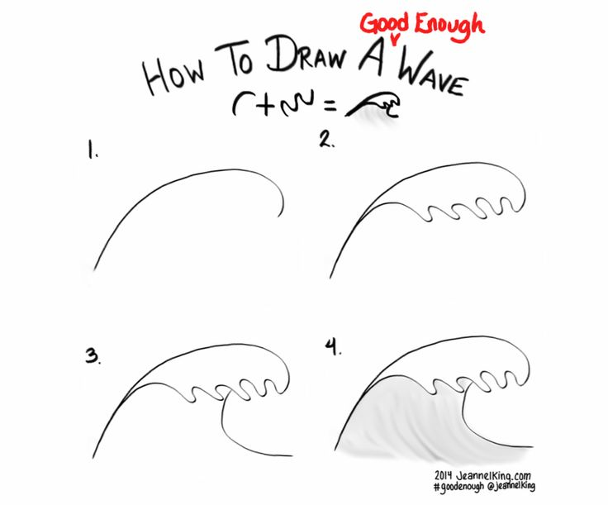
Step one – draw the wave in the foreground. Remember to use the whole page!

Slide 6
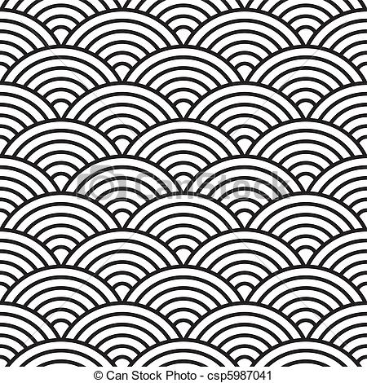
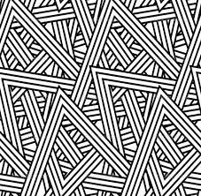
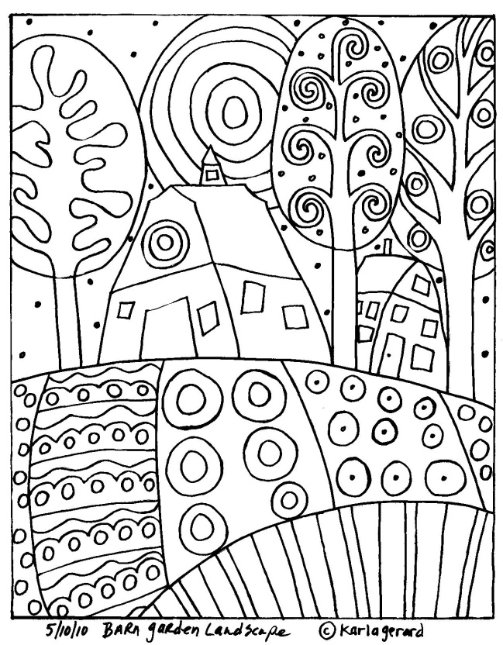
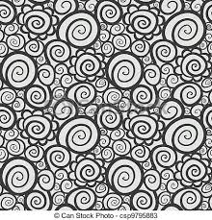
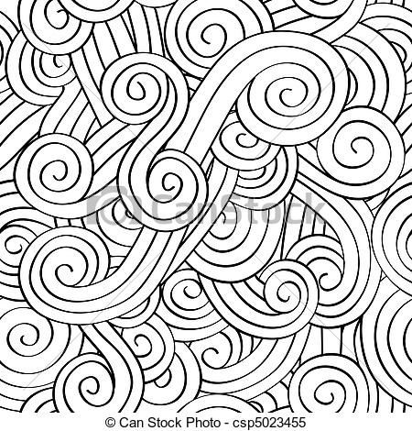
Step two – fill your wave with ‘zentangle’ patterns using a black / dark felt tip pen

Slide 7
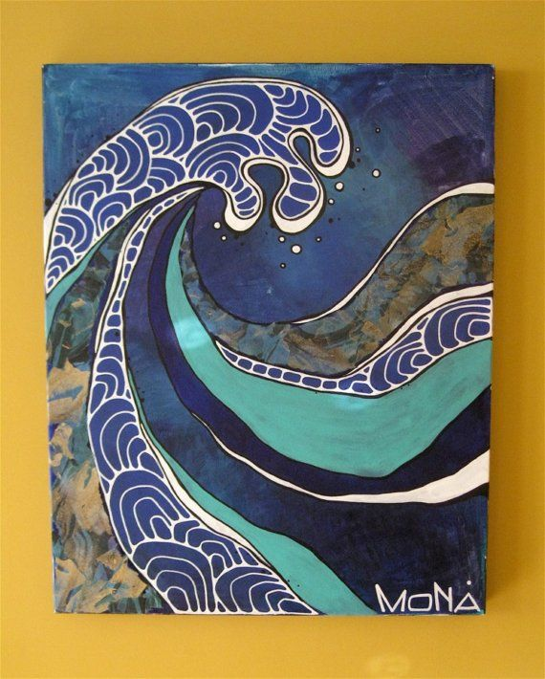
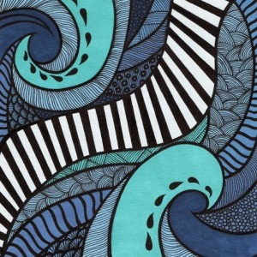
Some more zentangle inspiration…

Slide 8
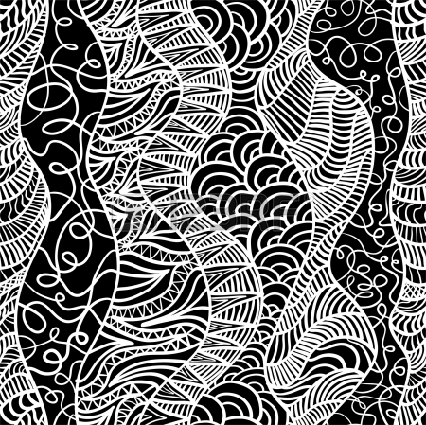
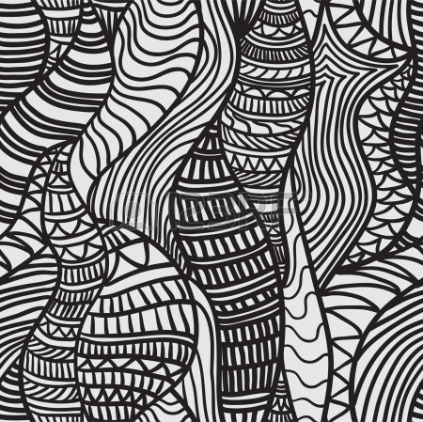
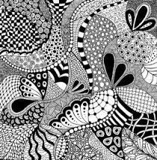

Slide 9
Now draw Mount Fuji in the background…

Slide 10
Now add your name in Japanese and shade or paint the background in a solid block colour.

Slide 11
http://japanesetranslator.co.uk/dictionaries/your-name-in-japanese/

