Slide 1
This half term our music lessons will be on Purple Mash.
I’m excited for this… I hope you are too!!

Slide 2
In today’s lesson you will learn to identify the main elements of music…
Pulse
Rhythm
Tempo
Pitch
Texture

Slide 3
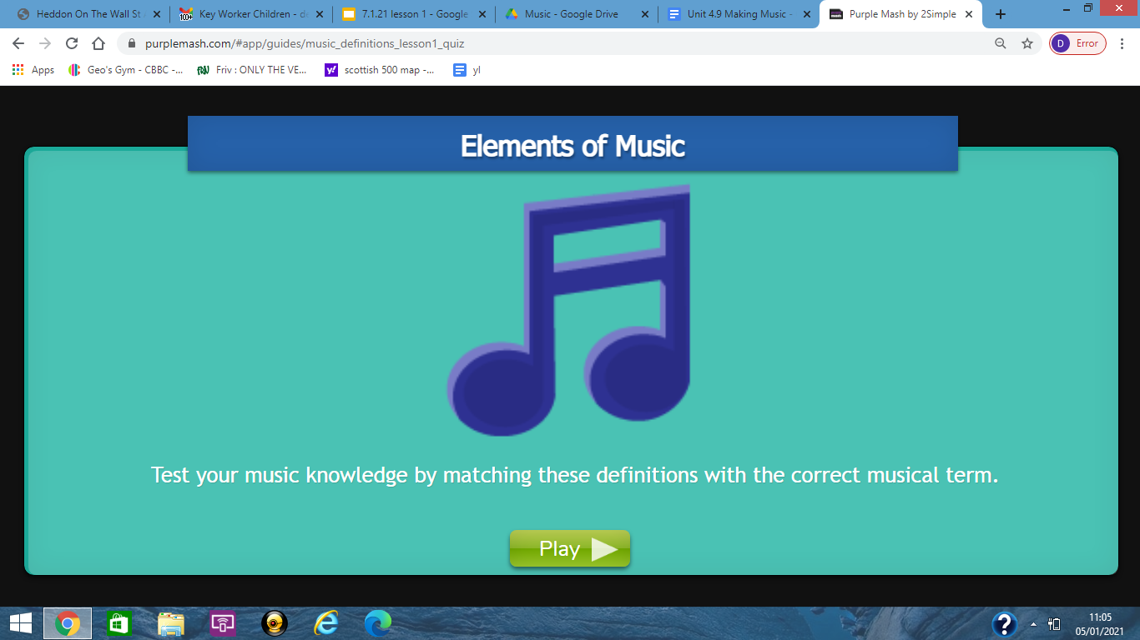
To begin you need to recap some music language.
When you are ready, log-on to your Purple Mash account and complete the to-do Music Element Quiz.
Good Luck!

Slide 4
Well done!! That was quite a tricky quiz.
Use the table below to check you understand the key words…

Slide 5
Next I would like you to complete the to-do Busy-Beats and listen to 3 pieces of music
Dance tune - Chord Sequence -slow groove
For today’s lesson I would just like you to listen to the music - we will do more work using this app in the next few weeks.
Whilst listening consider the following…
Can you clap the pulse of this tune? • What can you say about the tempo of this piece of music? • What can you say about the pitch of the notes? • What sounds / instruments can you hear? • What does this piece of music remind you of? • How does it make you feel?

Slide 6
Your final task today is to complete a Music review sheet. You will find the sheet in your to-do’s and you should complete the boxes and create an artistic image of a piece of music you have chosen from Busy Beats.

