Slide 1
Good morning Year 6!
Let’s start with a warm-up, and do our Daily Ten mental maths. Level 6-> addition, today. Set the timer at a speed that’s suitable for you.
https://www.topmarks.co.uk/maths-games/daily10
Here are your maths slides for Tuesday 26th January. We will be finding percentages of amounts. Before you begin, watch this short tutorial first:
https://vimeo.com/497642809
Remember that some of these new objectives are challenging, and we would usually discuss them together as a class. Please email us at year6home@heddon-school.co.uk if you need any help or want to ask any questions.
You are all doing an amazing job. Keep up the super work! ☺

Slide 4
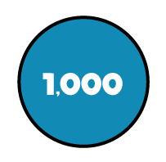
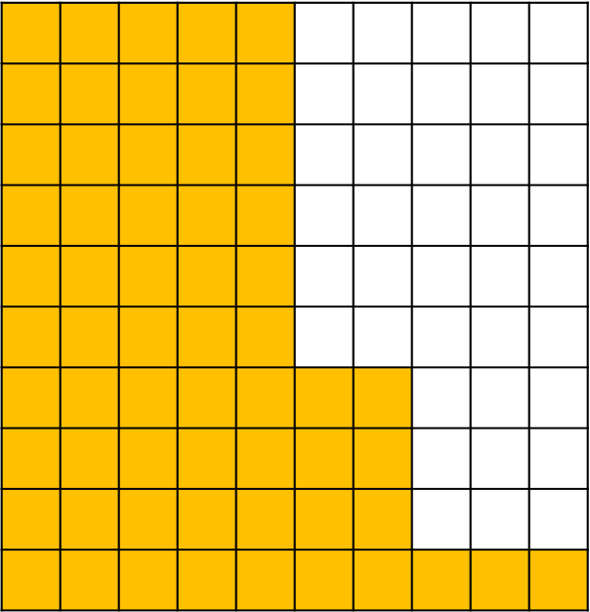

Slide 5
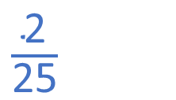
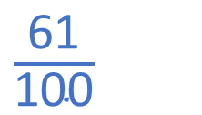
11
425
61%

Slide 7
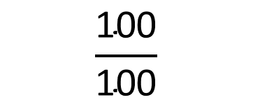
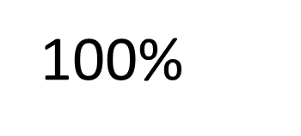
Everything
All
The whole

Slide 8
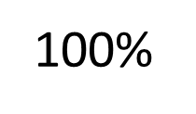
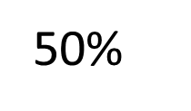
?

Slide 9
Have a think
120
60
60
?
60
60

Slide 10
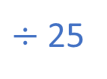
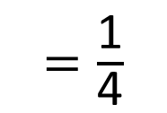
120
30 | 30 | 30 | 30
60

Slide 11
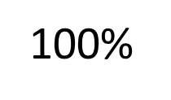
Have a think
What percentage would the shaded part represent?

Slide 12
Have a think
120
12
12
12

Slide 13
Have a go at questions 1 - 3 on the worksheet

Slide 14
Find 1% of 200
The whole is worth 200
2

Slide 15
Find 1% of 4,000
Have a think
The whole is worth 4,000
40

Slide 16
Annie needs to make 1,270 cupcakes for a party.
In the morning she makes 50% of the cupcakes.
In the afternoon Annie makes another 10% of her target amount of cupcakes.
How many more cupcakes does she need to make?
Have a think

Slide 17
Annie needs to make 1,270 cupcakes for a party.
In the morning she makes 50% of the cupcakes.
1,270
635
635
635
?
635

Slide 18
In the afternoon Annie makes another 10% of her target amount of cupcakes.
1,270
127
127

Slide 19
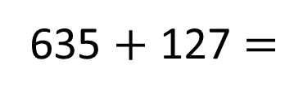
Annie needs to make 1,270 cupcakes for a party.
In the morning she makes 50% of the cupcakes.
635
In the afternoon Annie makes another 10% of her target amount of cupcakes.
127
How many more cupcakes does she need to make?
508
762
508

Slide 20
Have a go at the rest of the questions on the worksheet

