Slide 1
Let’s start with a little experiment...
If you don’t have chocolate you could use ice or butter.

Slide 2
Friday 22nd January
I hope you’ve washed your hands…
Following on from the last 2 science lessons, where you have learned about The States of Matter and the properties of their particles, today you will learn what happens to States of Matter when they are heated and cooled. Think about what just happened to the chocolate in your hand and try and link your learning.
Click the heating and cooling presentation in the today’s home learning

Slide 3
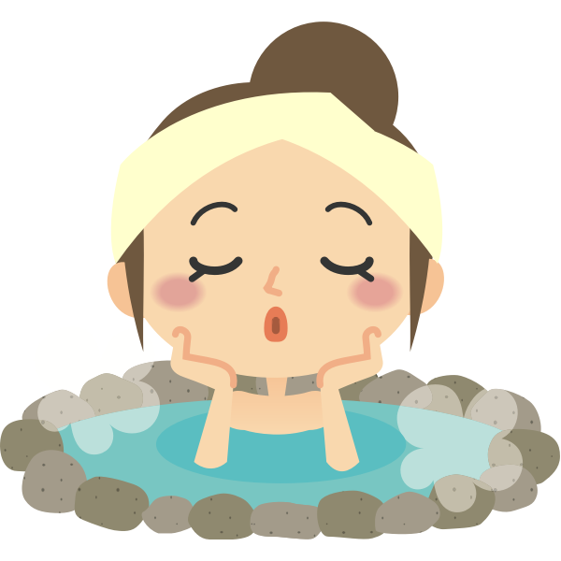
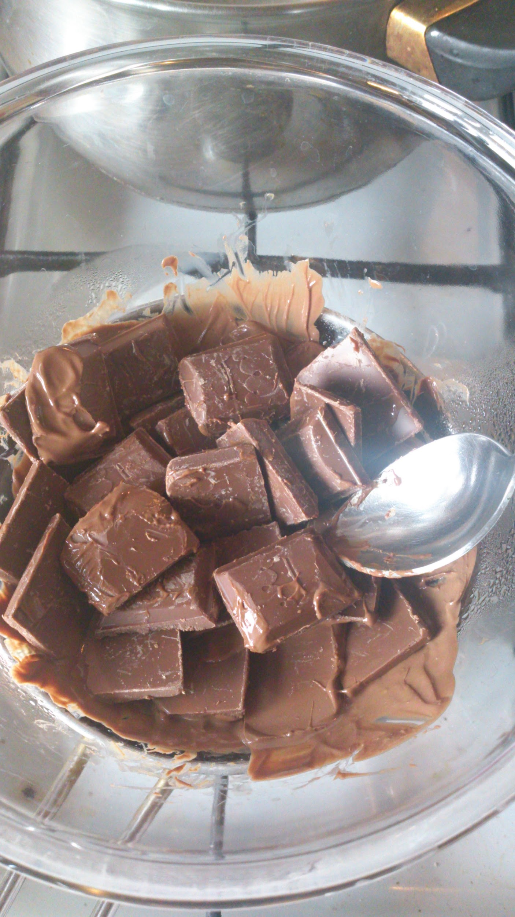
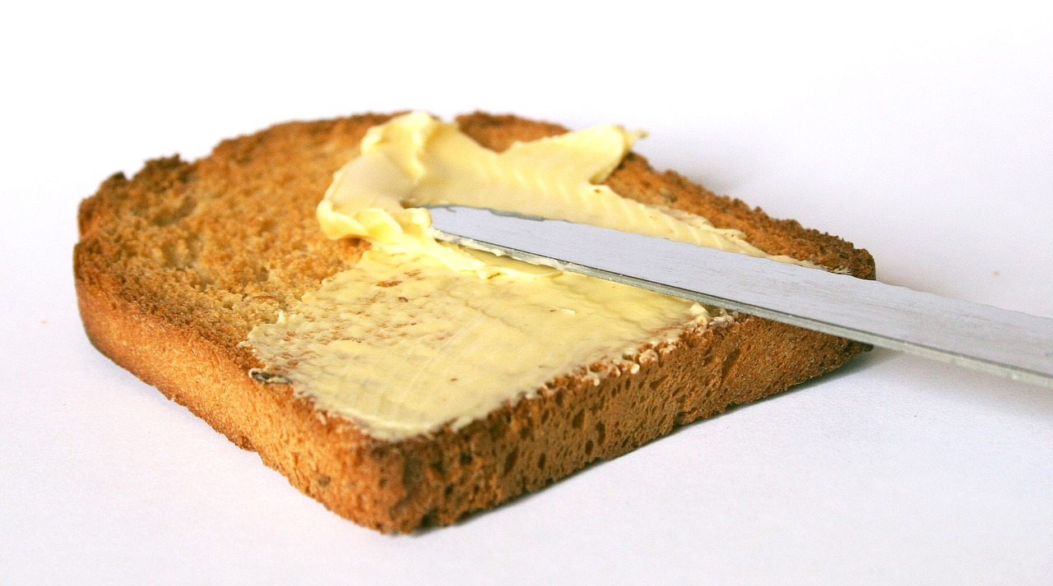
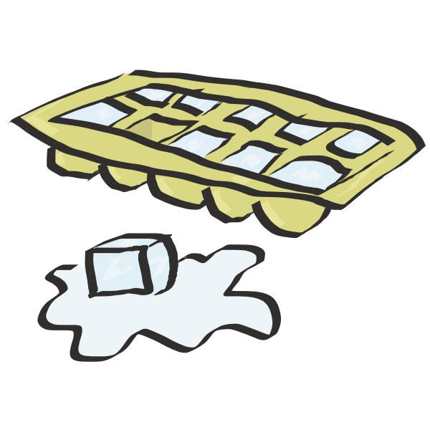
Have a look around your house and see if you can spot where states of matter change their state when they are heated or cooled. Record your answers in a table like this...
l
Matter | Action | Change observed
Water | Heated in the kettle | Water turns to steam (gas)

Slide 4
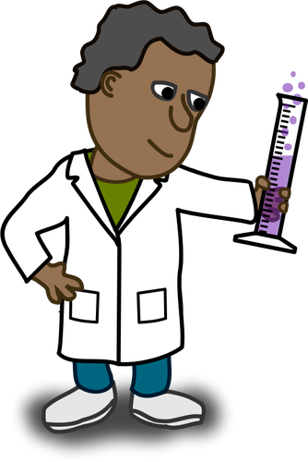
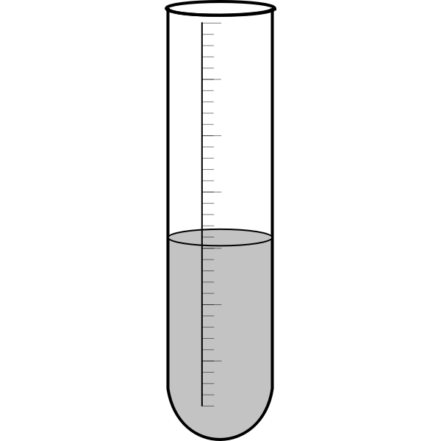
Your final activity in today’s science lesson is to watch the next video and complete the quiz.
Good luck - click the test tube when you are ready.

