Slide 1
I can work with decimals up to 2dp
04.01.21

Slide 2
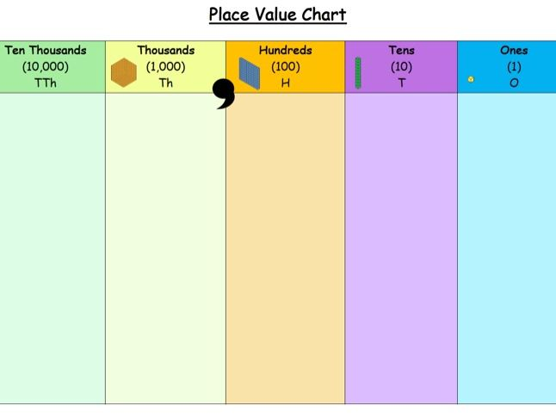
What is Place Value?

Slide 3
https://www.youtube.com/watch?v=KG6ILNOiMgM

Slide 7
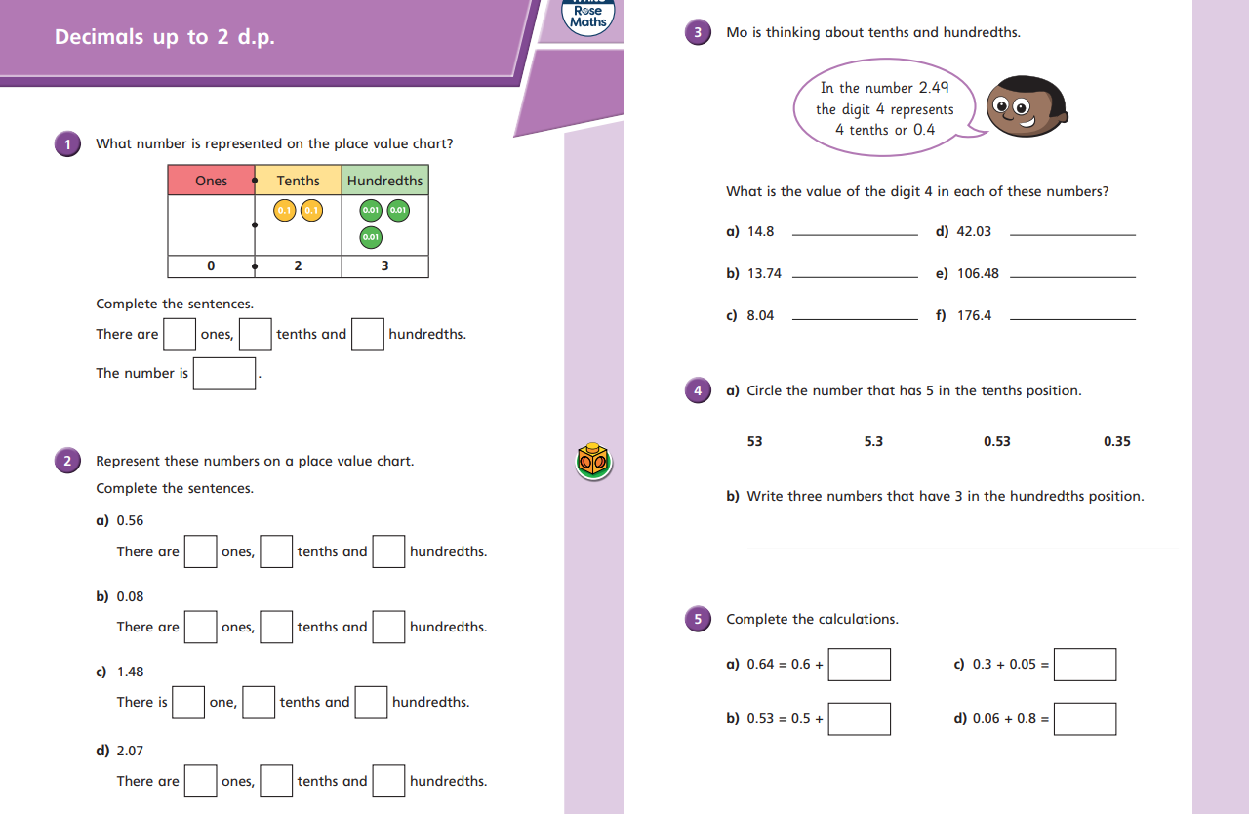

Slide 9
Plenary

