Slide 1
Good Morning Year 2
There are lots of Christmas songs playing on the radio and TV at the moment.
Do you have a favourite Christmas song?

Slide 2
2/12/20
Counting forwards and backwards.
Can you fill in the missing numbers?
36, __, 38, 39, __, 41, 42, __
73, __, __, 70, 69, __, __, 66
61, __, __, 64, 65, 66, __, __
20, __, __, __, __, __, 26, 27
50, __, __, 47, 46, __, __, __

Slide 3
Phonics Spend a little time on each of the activities below.
Lexia – Don’t forget to log on to this regularly, if you have a log-in.
Phonics – Practise the games on phonicsplay website.
Spelling Practise - Look, cover, write, check
HF words –:
https://www.ictgames.com/littleBirdSpelling/
Choose the Year 1 list if Year 2 words are too tricky.

Slide 4
English on Purple Mash
Wow Year 2 you’ve done a great job answering the questions to our Purple Mash story. Well done, I really hope you are enjoying it.
Today, when you are ready log on to Purple Mash and look in your 2dos where you will see Chapter 4 and activities linked to it.
Only 1 more chapter to go, can you predict the ending?
Happy Reading!

Slide 5
Wake up shake up!
Here is a link to our wake-up shake up song on youtube.
https://www.youtube.com/watch?v=KSbwHzlcgs8
Why don’t you do our wakeup-shakeup routine to give yourself some energy and get both sides of your brain working well.

Slide 6
For today’s maths click the worksheet on Wednesday’s home learning page.
It is a recap of the learning you’ve done about money.
Remember to read the questions carefully and try your best.
Maths!

Slide 7
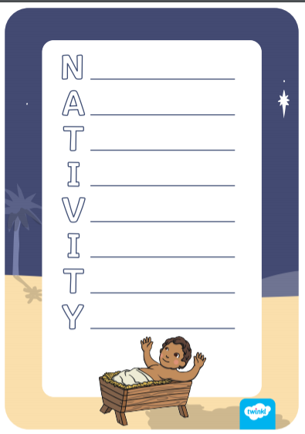
Your Christmas Challenge!
Part three of your Christmas challenge is to write an acrostic poem. This week you have learned about Christmas symbols and even created your own symbol using things from nature.
You could write your poem using the word NATIVITY on the sheet attached, or you could make your own about one of the Christmas symbols, like star, tree or candle.
Your poem might describe the symbol you are writing about or maybe explain what you are thankful for at Christmas time.

