Slide 1

Wednesday 2nd December 2020

Slide 2
Busy Books
199,505
1. Add 95,553
2. Subtract 29,999
3. Is this a multiple of 5? How do you know?
4. What does each number represent?
5. Complete a Part Whole Model for this number.
6. What are the Prime Numbers between 20 and 60?

Slide 3

French 0900 - 0945

Slide 4

English
I can discuss and identify an authors use of figurative and descriptive language.

Slide 5
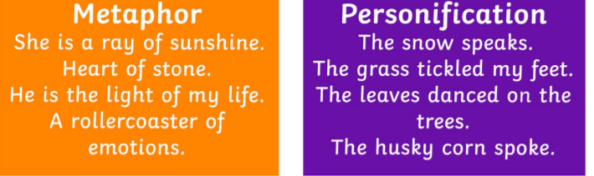
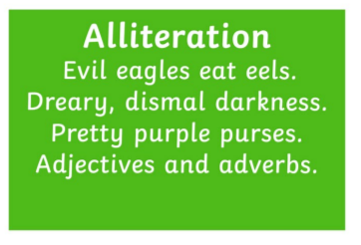
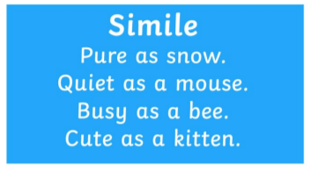
What is figurative language?
Similes
Metaphors
Personification
Alliteration

Slide 6
When an author describes a setting or a character, what do they usually talk about?
Smell
Taste
Touch
See
Hear
Adjectives are key when you are writing a description because it brings the sentence to life!

Slide 7
The Snow Queen – Story 1 and 2
Does Hans Christian Andersen use any figurative language features?
If so what are they?
Where will you find the evidence?
Is it successful? Why do you think it’s used? How does it make you feel?

Slide 8
Let’s share our ideas together!
What have you found?

Slide 9
In your books…
You are going to list the sentences that Hans Christian Andersen has used to describe a setting or a character.
Once you have listed them, you are then going to write beside them if they are a simile, metaphor, alliteration or personification.
Then you are going to write what he was describing and write why it was effective.

Slide 10
Example…
“The loveliest landscapes looked like boiled spinach in it.” (alliteration and simile)
Hans Christian Andersen describes the impact that the mirror has on beautiful settings and the use of “boiled spinach” is effective and helps us understand how disgusting the mirror makes things look.

Slide 11
Break

Slide 12
DMM
Write the prime numbers from 0-40
Solve the following:
A) 5²
B) 6²
C) 9²
D) 10²
E) 0²
Can you solve the following?
A) 8² + 3² B) 4² + 9² = C) 10² - 7² =

Slide 13
Maths
I can solve cubed number problems

Slide 14
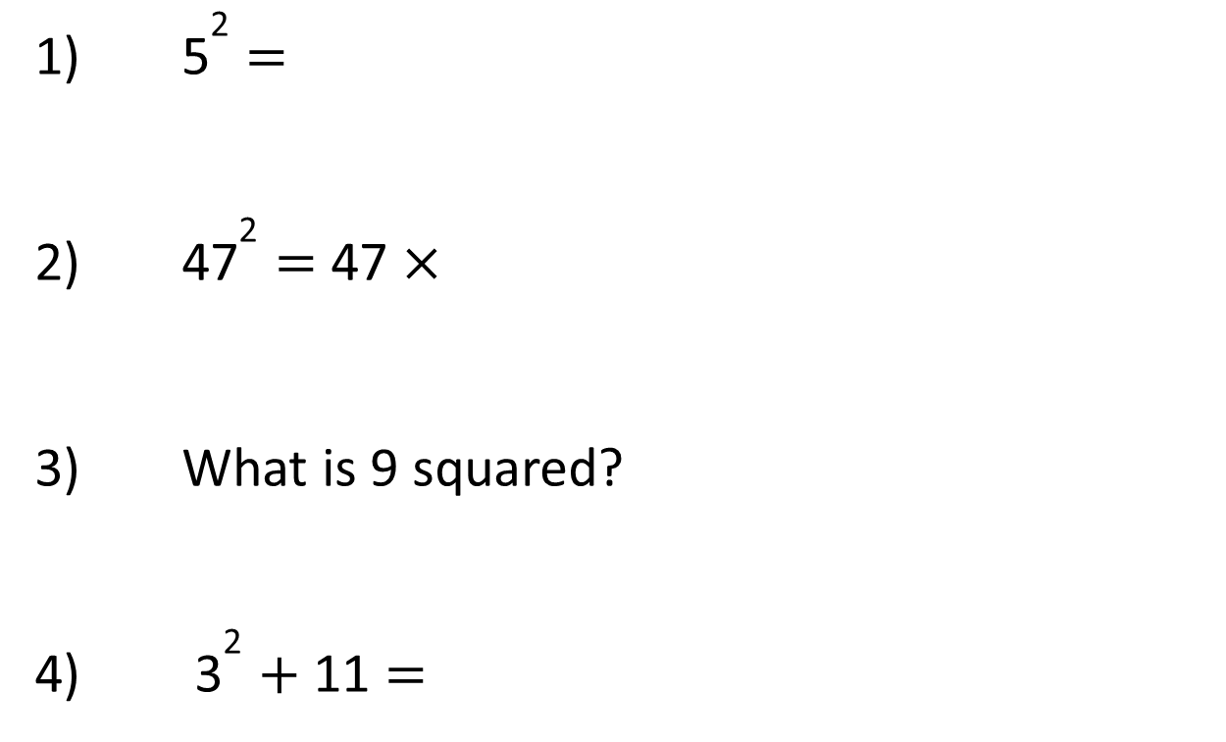
1) ${\text{5}}^{\text{2}}$ =
2) ${\text{47}}^{\text{2}}$ = 47 ×
3) What is 9 squared?
4) ${\text{3}}^{\text{2}}$ + 11 =

Slide 15
1) ${\text{5}}^{\text{2}}$ =
2) ${\text{47}}^{\text{2}}$ = 47 ×
3) What is 9 squared?
4) ${\text{3}}^{\text{2}}$ + 11 =
25
47
81
20

Slide 17

Here are 6 cubes
Have a think
Is it possible to make a cube?

Slide 18
Here are 8 cubes
Is it possible to make a cube?
2
2
2
2 × 2
= 8
× 2
8 is a cube number.

Slide 19
4
4
4
4 × 4
× 4
= 64
16
64 is a cube number.

Slide 20

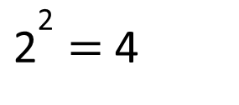
Cube numbers
Square numbers
2 × 2 × 2 = 8
2 × 2 = 4
3
${\text{2}}^{\text{2}}$ = 4
2 = 8
Have a think
4 × 4 × 4 = 64
3
4 = 64
“4 cubed is equal to 64”

Slide 21
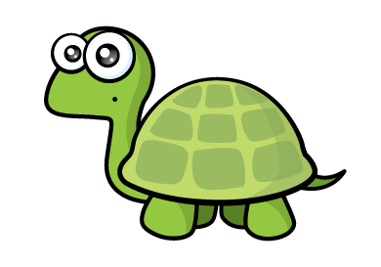

Have a think
5 cubed is equal to 15 because 5 multiplied by 3 is equal to 15
5 × 5 × 5
= 125
25
$${\text{5}}^{\text{3}}$$
= 125

Slide 22
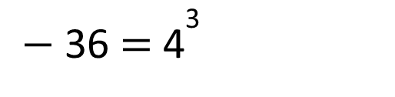


Have a think
Calculate:
$${\text{8}}^{\text{3}} \text{=}$$
512
8 × 8 × 8 =
64 × 8 =
$${\text{3}}^{\text{3}}$$
= 25 +
2
100
$−$ 36 = ${\text{4}}^{\text{3}}$

Slide 23
Have a go at questions
1 - 4 on the worksheet

Slide 24

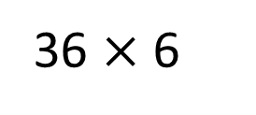


$${\text{1}}^{\text{3}}$$
3
Have a think
$${\text{3}}^{\text{3}}$$
36 $×$ 6
Match the calculation to the number.
3 × 3
27
$${\text{6}}^{\text{3}}$$
1
5 × 2
9
1 + 1 + 1
10

Slide 25
Have a go at questions
5 - 8 on the worksheet

Slide 26
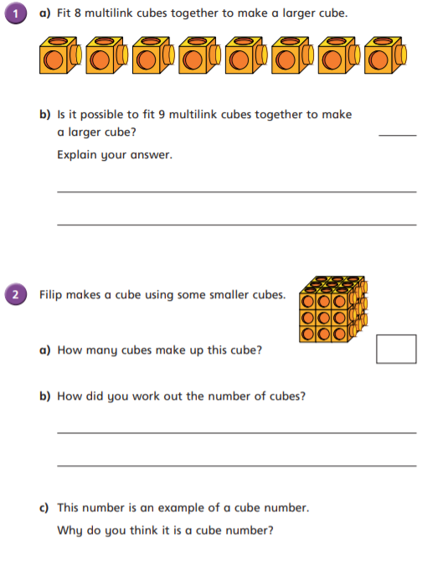
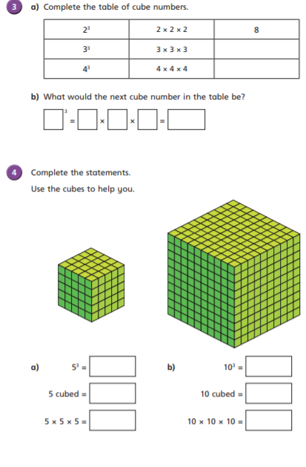

Slide 27
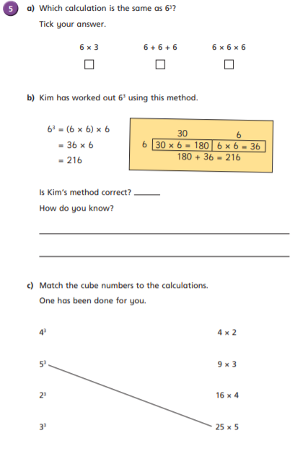
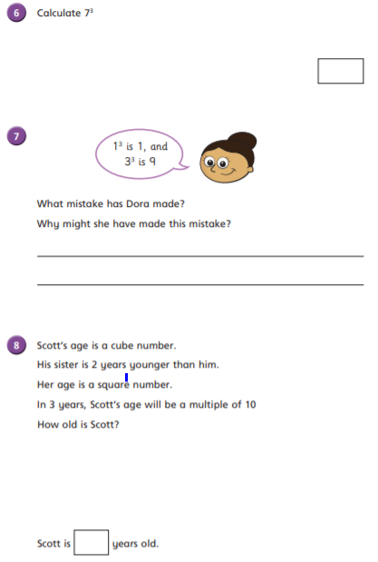

Slide 28
Lunch

Slide 29
Science

