Slide 1
Thursday 3rd December 2020

Slide 2
Squared and Cubed numbers
Squared numbers - E.g. 3² = 3 x 3 = 9
A) 2²
B) 8²
C) 10²
D) 7²
Cubed numbers – E.g. 2³ = 2 x 2 x 2 =8
3³ =
5³ =
7³ =
10³ =
For a challenge: List your prime numbers from 0 to 100.

Slide 3
Commando Joes 0915 - 1030

Slide 4
Break

Slide 5
Rockstars (as we didn’t have time yesterday!)

Slide 6
English
I can summarise a part of the story by identifying the key points from an extract.

Slide 7
What is a summary?
Why do we use it?
Why is it useful?
What do we focus on when we are summarising?
How many steps can you remember from the 6 step rule?

Slide 8
6 step Prep
Step 1 – Who was in that part of the story?
Step 2 – Write what happened.
Step 3 – Write when it happened.
Step 4 – Write where it happened.
Step 5 – Write why it happened.
Step 6 – Write how it happened.
5 words answers for each step!!!
6 Key Steps
Remember you are only allowed 5 words for each step!!!

Slide 9
Once you have answered each step…
You now have the main points to make your summary!
You can use the 6 steps to help you create your work, however, you will need to reword them and make them into longer flowing sentences.
Your summary can be between 5 and 6 lines.
Once you have done written your summary you can rewrite it and make it a maximum 3 sentences long. This is a challenge but it will help you focus on the key points and clearly tell the reader a shorter version of that part of the story.

Slide 10
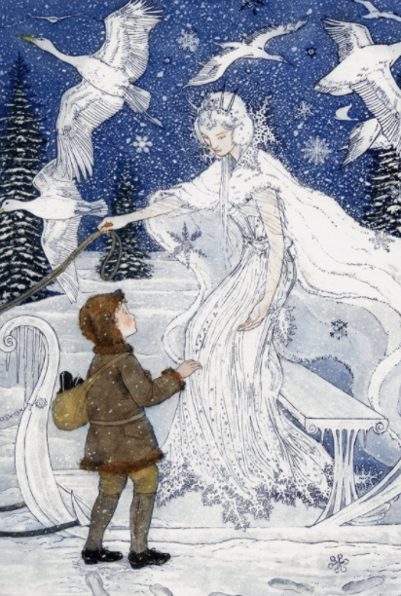
Reading story 3 – “The flower-garden of the woman who knew the art of sorcery.”

Slide 11
What are your thoughts?
Talk with a partner.
Pick a part of the story you are going to summarise. (no longer than a full page)
Discuss the key points.
Then start!!!

Slide 12
6 step Prep (Activity 1)
Step 1 – Who was in that part of the story?
Step 2 – Write what happened.
Step 3 – Write when it happened.
Step 4 – Write where it happened.
Step 5 – Write why it happened.
Step 6 – Write how it happened.
5 words answers for each step!!!
6 Key Steps
Remember you are only allowed 5 words for each step!!!

Slide 13
Once you have answered each step…
ACTIVITY 2
You now have the main points to make your summary!
You can use the 6 steps to help you create your work, however, you will need to reword them and make them into longer flowing sentences.
Your summary can be between 5 and 6 lines.
Once you have done written your summary you can rewrite it and make it a maximum 3 sentences long. This is a challenge but it will help you focus on the key points and clearly tell the reader a shorter version of that part of the story.

Slide 14
Let’s share our summaries

Slide 15
Lunch

