Slide 1
Negative Space https://www.youtube.com/watch?app=desktop&v=ExeekGarOzo

Slide 2
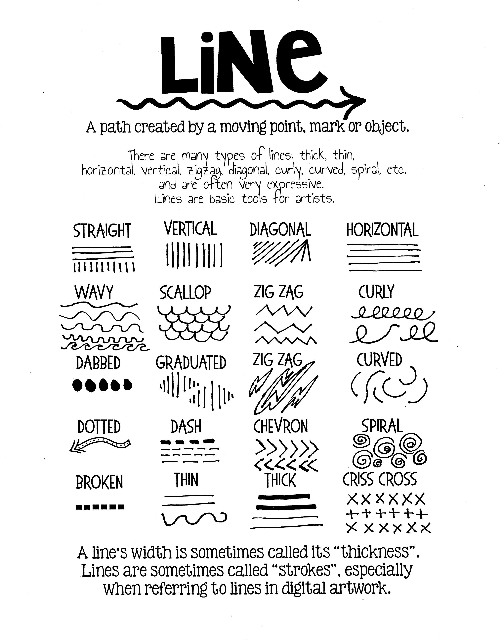
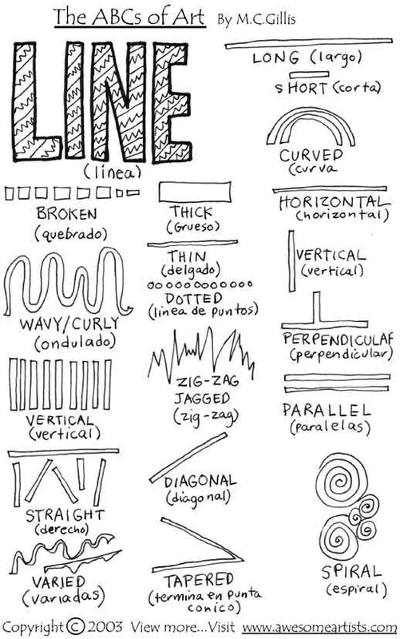

Slide 10
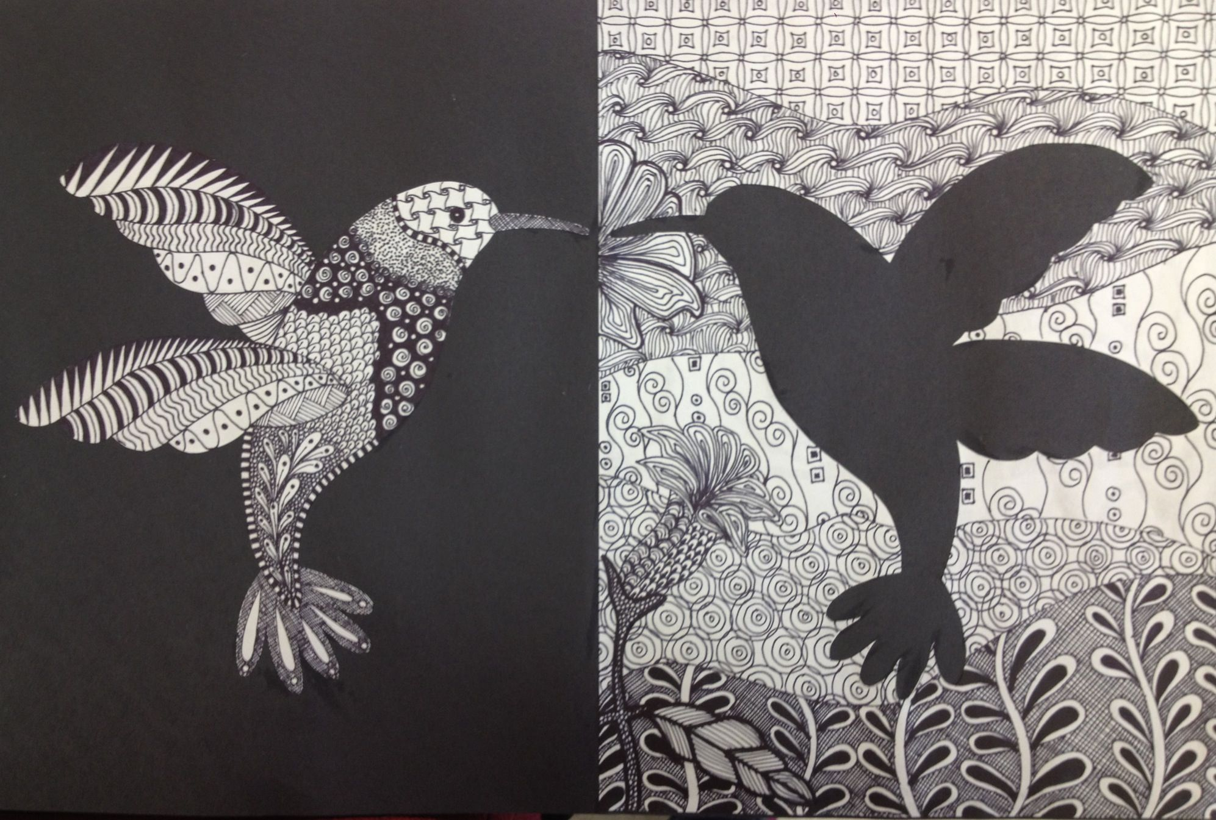

Slide 11
