Slide 1
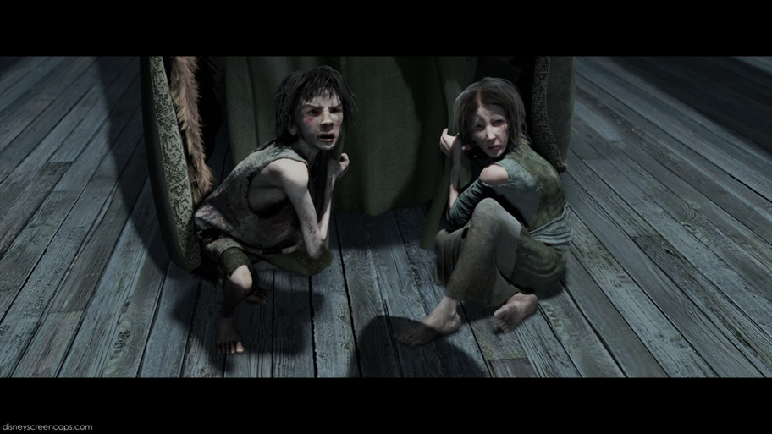
Ignorance & Want

Slide 2
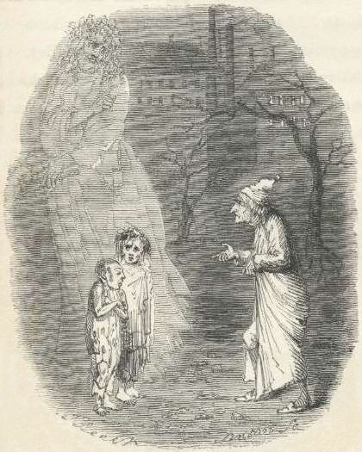
Ignorance and Want
The two children are allegories of two social problems: Ignorance and Want. They represent these problems in human form.
Notice: they have capital letters to show this.

Slide 3
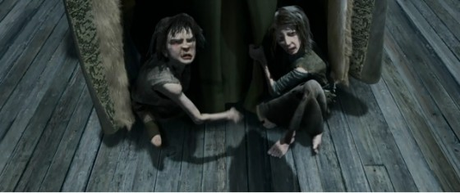
Ignorance: People like Scrooge, who ignore the problems of the poor, create enormous social problems. They create children like this.
Want: because the population has ‘boomed’ in Victorian times, many people ‘want for’ (go without) the basic necessities such as food and shelter. Combined with the ignorance of the rich, this creates massive social problems. It creates children like this.
These children will grow into adults who live a life of crime, causing bigger problems.

