Slide 1

Friday 4th December 2020

Slide 2
Busy Books
287,600
Multiply it by 2
Divide it by 2
Add 4832
Subtract 100,900
What is each digit worth? (2 = 200,000 etc)
Complete the following Prime Number sequence:
2,____, 5,____,11, 13,17_____, 23, 29, ____,____,____.

Slide 3

Marking Homework

Slide 4

Spellings

Slide 5
Rockstars

Slide 6
English
I can use direct speech between characters and accurately punctuate each sentence.

Slide 7

Can you remember the rules for speech?

Slide 8
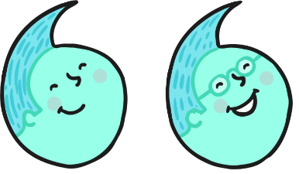

Inverted Commas
The most important rule in punctuating direct speech is that all words spoken must be enclosed by inverted commas.
In British English, a single inverted comma may be used:
‘Get off my bridge.’
However a double inverted comma may also be used:
“Get off my bridge.”
Whichever style you choose, use it consistently across a text.

Slide 9

Punctuation Inside
Inverted Commas
All commas, full stops, question marks and exclamation marks must also be enclosed by inverted commas.
For example:
‘That grass looks delicious,’ said the smallest Billy Goat Gruff.
‘Hey, goat!’ shouted the troll. ‘You are not allowed to cross my bridge.’
‘How can we get to the other side?’ asked the Biggest Goat Gruff.
NOT: ‘Get off my bridge ’ ! shouted the troll.

Slide 10
Commas
Commas are another important tool to help the reader separate direct speech from the rest of the text.
Where direct speech precedes a verb, and does not end in a question mark or exclamation mark, a comma must be used.
For example:
‘We need to get to the other side,’ moaned the goats.
‘Those goats are always disturbing my sleep,’ muttered the troll.

Slide 11
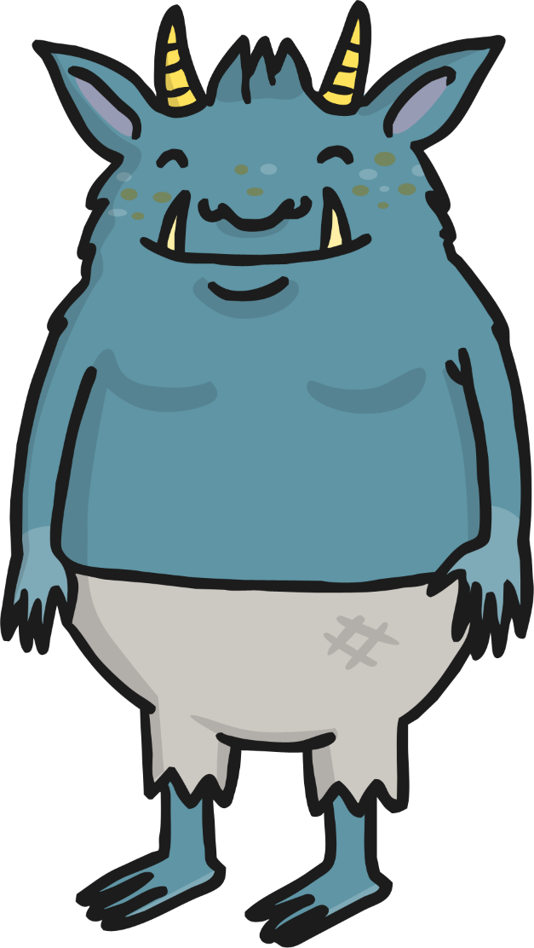
Commas
Where the direct speech before a verb ends in a question mark or exclamation mark however, this punctuation replaces the comma.
For example:
‘Who goes there ?’ shouted the troll.
NOT:
‘Who goes there ?,’ shouted the troll.

Slide 12

Commas
Where the direct speech follows a verb, a comma must be used after the verb to indicate that direct speech is about to begin.
Note: in this context, the direct speech must always begin with a capital letter.
For example:
The smallest Billy Goat Gruff said, ‘I’ll go first.’
The Troll shouted, ‘Who goes there?’
The biggest Billy Goat Gruff shouted, ‘Oh no you won’t!’

Slide 13





Punctuation Inside
Inverted Commas
In addition, where the direct speech follows the verb, a full stop, exclamation mark or question mark must be used inside the inverted commas to signal the end of the speech.
For example:
The smallest Billy Goat Gruff said, ‘I’ll go first.’
The Troll shouted, ‘Who goes there?’
The biggest goat shouted, ‘Oh no you won’t!’

Slide 14
Punctuating ‘Split’
Direct Speech
If the direct speech is one sentence broken up by information about who is speaking, you need a comma (or a question mark or exclamation mark) to end the first piece of speech and another comma before the concluding part of the sentence (before the inverted comma or commas).
For example:
‘I’m light and quiet,’ said the smallest Billy Goat Gruff, ‘so I’ll go first.’
In this context, use a lower case letter to start the second part of the direct speech.

Slide 15


Punctuating ‘Split’
Direct Speech
If the direct speech is two discrete sentences separated by information about who is speaking, you need a comma (or a question mark or exclamation mark) to end the first piece of speech and full stop after the information about the speaker. The second sentence then begins with a capital letter.
For example:
‘You’re right,’ agreed the Biggest Billy Goat Gruff. ‘We can’t let the Troll beat us.’

Slide 16
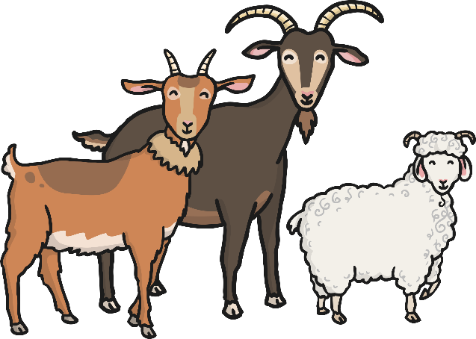
New Speaker, New Line
If the direct speech in a text involves more than one speaker, a new line must be used for each new speaker. This helps the reader to follow what is being said.
For example:
‘We can’t let him win! He’s just a grumpy troll!’ said the smallest Billy Goat Gruff.
‘You’re right,’ agreed the biggest Billy Goat Gruff.
The medium-sized Billy Goat Gruff said, ‘So what shall we do?’

Slide 17

Reporting Clauses
Reporting clauses tell us who is speaking, or who said what. Reporting clauses can be found in both reported speech and direct speech.
For example:
The troll said the goats should get off his bridge. (reported speech)
‘Who goes there?’ shouted the Troll. (direct Speech)
‘That grass looks so green and delicious,’ bleated the Smallest Billy Goat Gruff. (direct speech)

Slide 18
SPaG – Direct Speech you are going to insert the correct punctuation for speech in the sentences below!
I want to go now said Gerda to the old woman.
Ill put on my new red shoes she said one morning.
Perhaps the river will carry me to where little Kay is Gerda thought.
You poor little child! the old woman said; how on earth have you ended up on the swift-flowing river?

Slide 19
Challenge:
You are going to create a dialogue between Gerda and the Old Woman.
It can be when Gerda first met her.
It could be when Gerda first enters the house of the Old woman.
It could be Gerda asking about the flowers in the garden.

Slide 20

Break

Slide 21
DMM
Cubed numbers:
A) 3³ B) 5³ C) 2³
Addition and Subtraction using square and cubed numbers
5² - 2³ =
10² + 5³ =
12² + 4³ =
10³ - 3³ =
Multiply the following numbers by 10:
A) 22 B) 0 C) 4004 D) 5³

Slide 22

Maths
I can solve number problems by multiplying a number by 10.

Slide 23
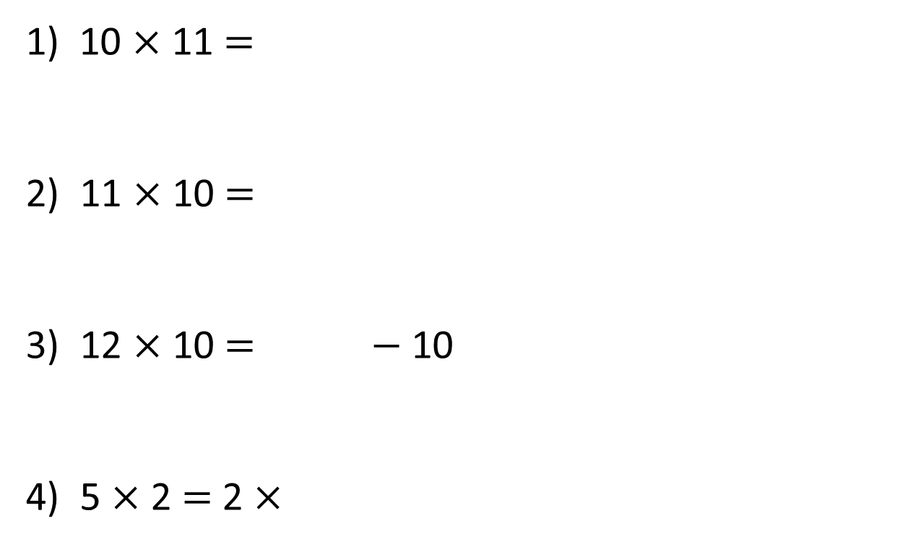
1) 10 × 11 =
2) 11 × 10 =
3) 12 × 10 = $−$ 10
4) 5 × 2 = 2 ×

Slide 24
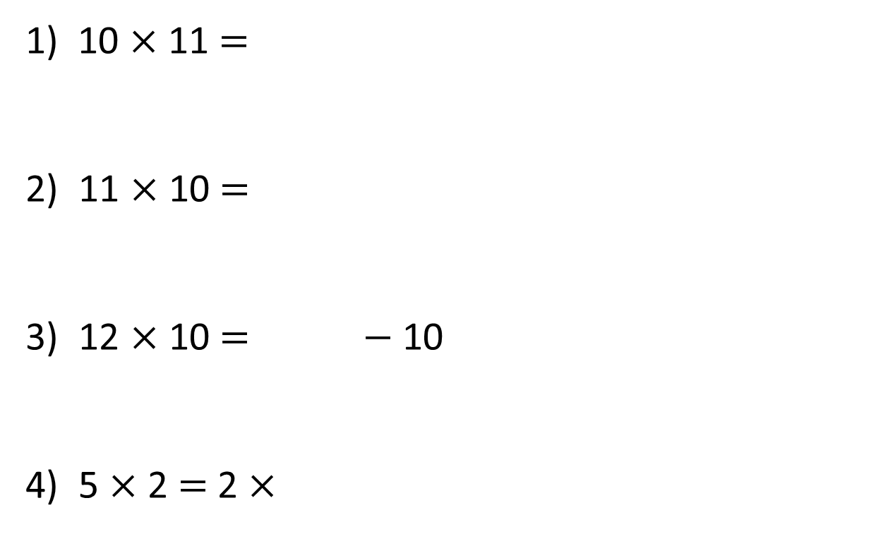
110
1) 10 × 11 =
2) 11 × 10 =
3) 12 × 10 = $−$ 10
4) 5 × 2 = 2 ×
110
130
5

Slide 26

1 ten
4 times
4 × 1 ten =
4 tens
40
4 × 10 =

Slide 27
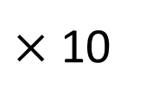
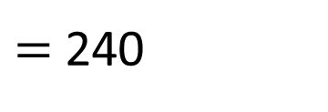
$×$ 10
24
$=$ 240
H | T | O

Slide 28

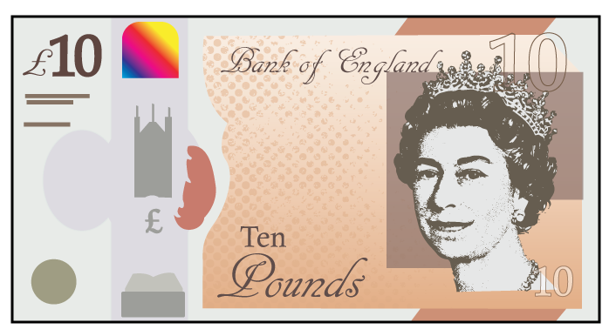
Have a think
Jack has 7 £10 notes.
How much money does Jack have?
7 × £10 =
£70

Slide 29



H | T | O
Each row has 2 tens and 1 one.
Each row has 21
There are 10 rows.
The calculation is
21 × 10 =
210

Slide 30
H | T | O
Have a think
Each row has hundreds.
2
Each row has tens.
0
Each row has ones.
3
There are rows.
10
The calculation is
× =
203
10
2,030

Slide 31
Have a go at questions
1 - 7 on the worksheet

Slide 32
Have a think
× 77 =
770
2 × 5
10
Have a think
270
360
_____ = 5 × 27 × 2
_____ = 36 × 2 × 5
_____ = 5 × 24 × 2
5 × 2 × 190 =
1,900
240
_____ = × 24
5 × 2
10

Slide 33

Whitney has 81 points.
Alex has 10 times as many points as Whitney.
810
How many points does Alex have?
Alex has 91 points because 81 add 10 is equal to 91
Have a think
81 × 10 =
810

Slide 34
Have a go at questions
8 - 11 on the worksheet

Slide 35

Lunch

Slide 36

Designing our Calendar’s

Slide 37
In your Art and DT books…
You are going to create a spider diagram to record your ideas.
The spider diagram that you produce will based upon the 4 seasons of the year.
What do you think about when you hear Summer, Autumn, Winter and Spring.
Discuss your ideas with your partner.

Slide 38
Summer
Spring
Calendar Ideas
(Seasons)
Autumn
Winter

Slide 39
You are now going to split your page into 4 equal sections.
Spring
Summer
Autumn
Winter

Slide 40
When you have completed that, you are going to pick 1 idea from each season and draw it in the correct place.
Eg – Summer - Holidays, beaches, aeroplanes. (whatever summer means to you)

Slide 41
Once you have had a practice drawing, you are going to create the real thing!!!
Each person will get a card that has already been split into 4. You are going to draw in your ideas, slowly and neatly into the spaces.
You need to take your time and you can use colouring pencils when you have finished drawing the outline of your sketch.

