Slide 1
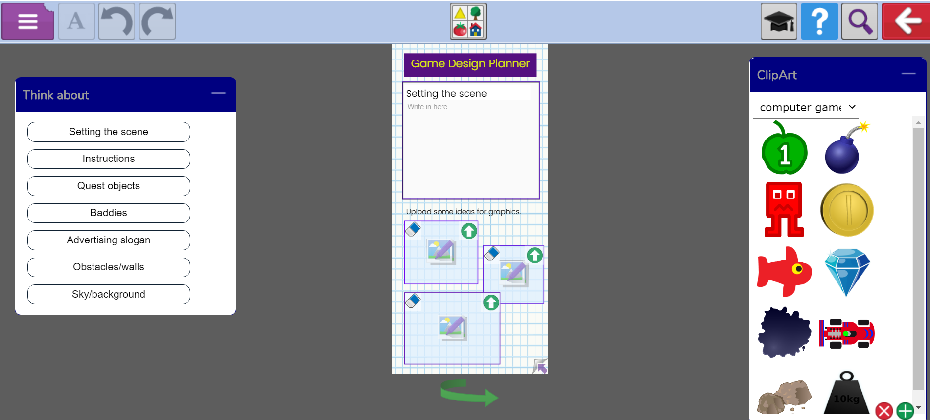
Design your own game...
Remember to use your planning sheet to help you!

Slide 2
Creating a virtual game...
Watch this video first because it will help you create a simple game.
Watch these videos to help you create your own game!

Slide 3
Creating a virtual game...
Your task is to create
a simple game.

Slide 4
Creating a virtual game...
Once you are familiar
with the features you are
to follow your design plan
and create your own game.
Remember to save and share with me.

