Slide 1
I can apply the four rules with fractions
02.12.20

Slide 3
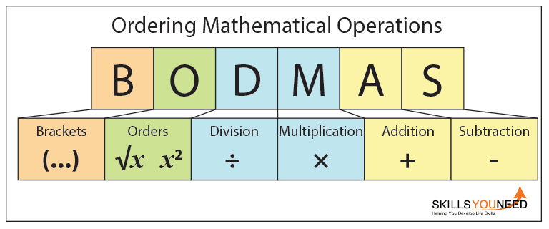
Can you remember the BODMAS rules?

