Slide 1
I can divide fractions by integers
01.12.20

Slide 3
Use a bar model to help you

Slide 4
8 = 8 because 8 ÷ 1 = 8 1
Did you know that you can change ANY whole number (integer) into a fraction simply by putting it over a denominator of 1? This is because what a fraction really means is numerator divided by denominator.
Any integer divided by one won’t change!

Slide 5
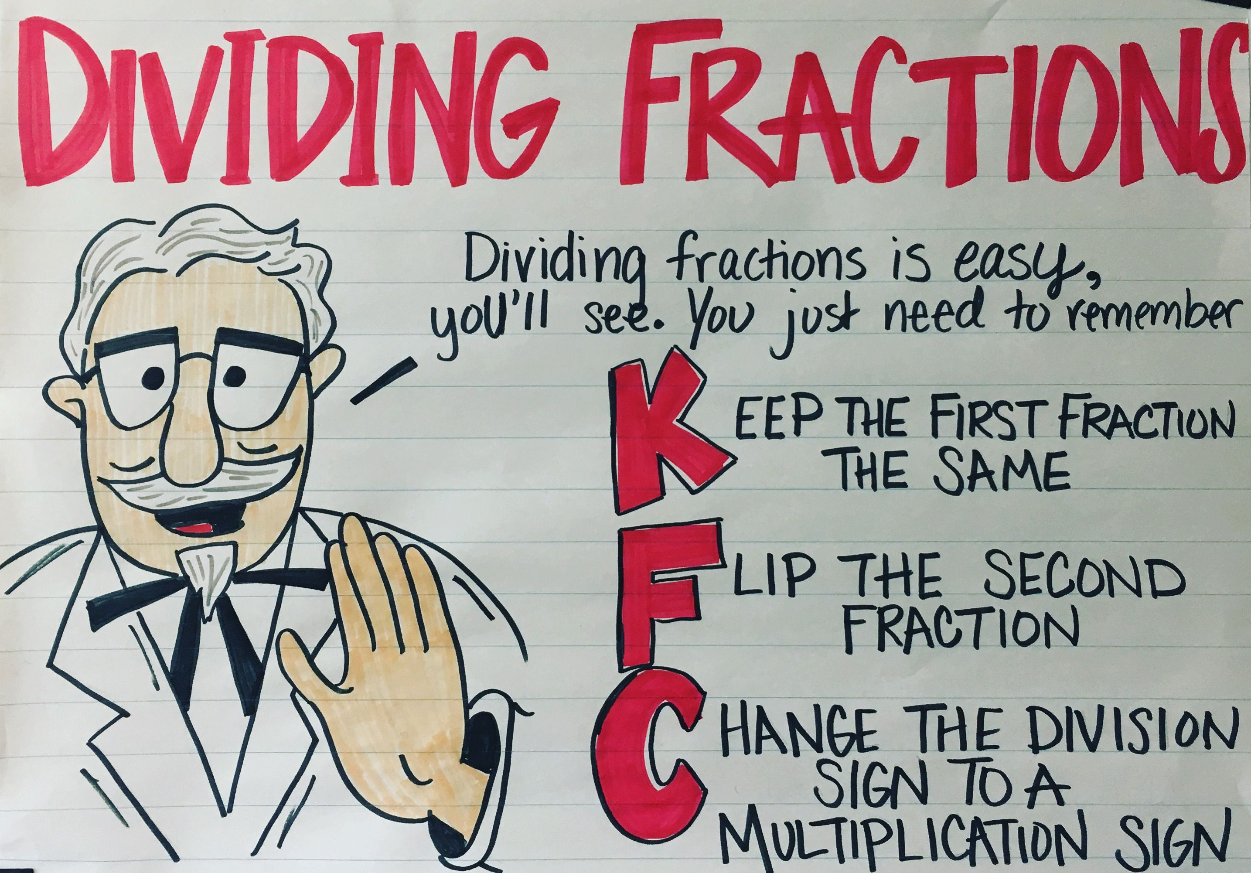
Today’s success checklist:
Turn the integer into a fraction.
K F C!

Slide 6
Try these…
Then these…

Slide 7
3, 5, 5, 4

Slide 8
A reminder of the methods we’ve learnt so far when calculating with fractions.

