Slide 1
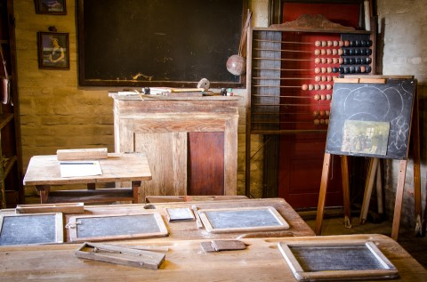
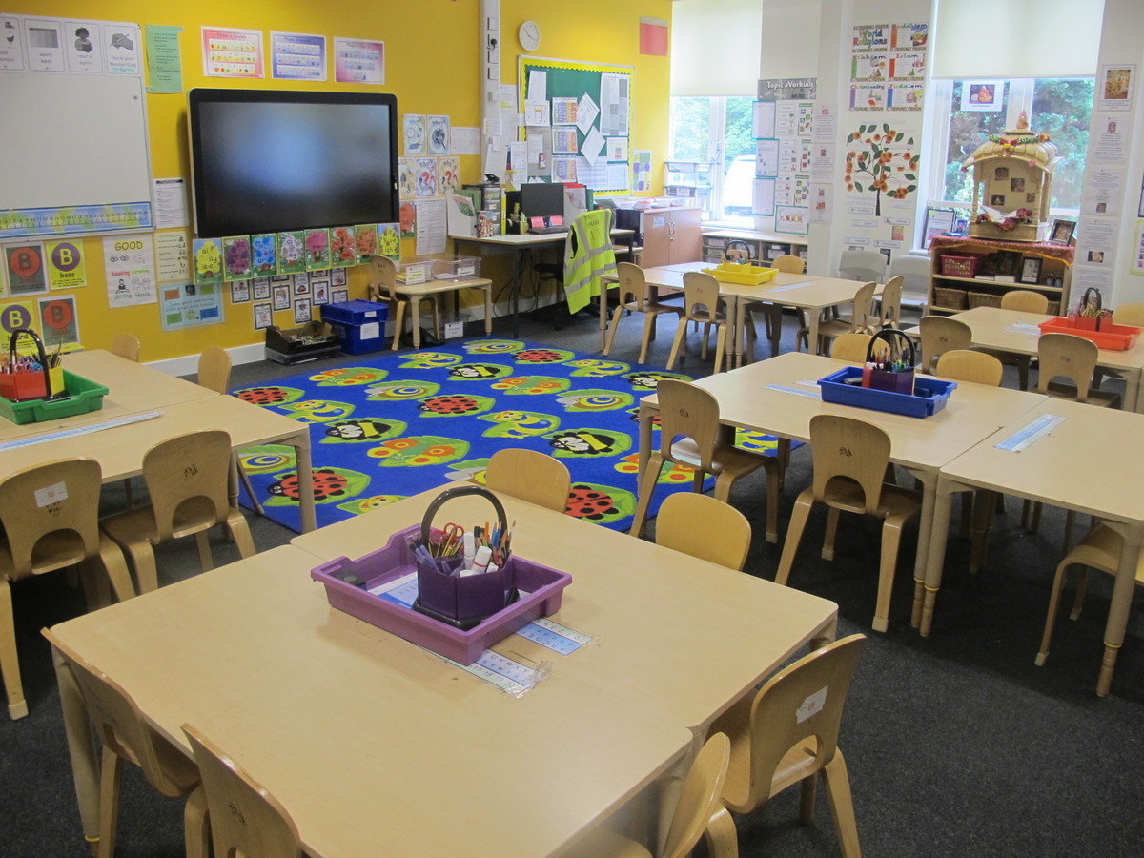
Eye Spy – can you find any differences/ similarities between primary classrooms then and now
100 years ago
Now

Slide 2
Task: Look at the playground games from the past. What is similar? What is different?

Slide 3
Watch video showing what childhood was like in the past.
https://www.bbc.co.uk/bitesize/topics/zc9s6g8/articles/zdwxjsg

Slide 4
Children then
Children now
Now you know a bit more about school and childhood in the past, can you guess what they might be thinking and feeling.
Task: draw a school child from the past and yourself. Then can you write about what they would be thinking and feeling and also complete the task for yourself.
See example on the next slide

Slide 5
Example
I go to school and we sit on the carpet and our chairs for lessons. We have some of our lessons on the smart board and we write our work in books. We wear a uniform to school. In my free time I play with my favourite toy which is a robot dog and games on my iPad. My favourite game is playing teachers and football. In the evening I sometimes watch Tv which is in colour. We only listen to the radio in the car.
My favourite show is Peppa pig and Paw patrol.
Compare

Slide 6
Task: have a think/answer the questions below
Why do you think they are different?
Why do you think so much has changed?
Would you rather go to school then or now?

