Slide 1
Friday 20th November
Maths

Slide 2
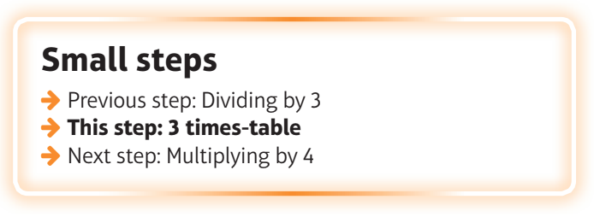
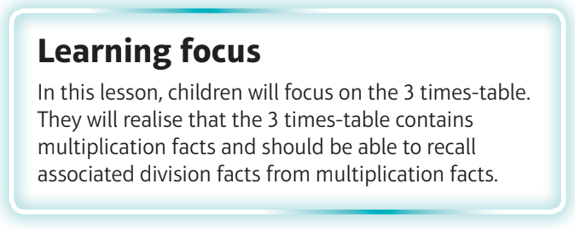
What are we learning?
I can recall facts from the 3 times tables.

Slide 3
Watch the video
https://vimeo.com/476319270

Slide 4
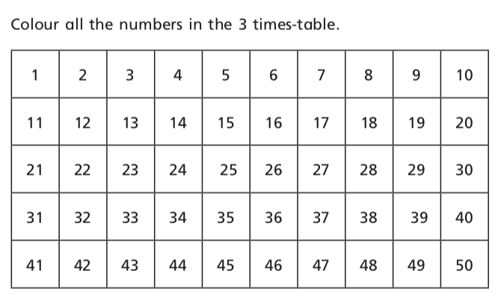

Slide 5
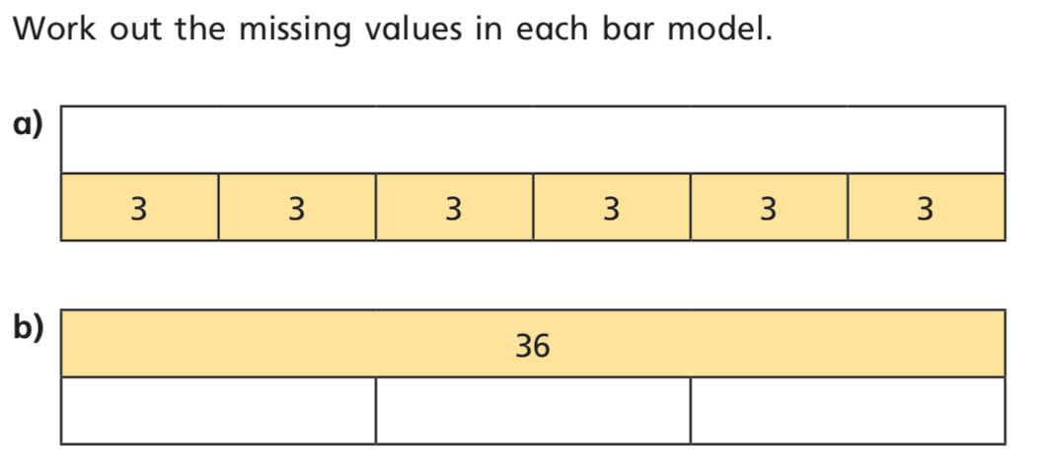

Slide 7
